Slide 1
Distributed Object and Components
Spring Components and dependency injection
Notes:
Objectif : présenter un exemple d’architecture à base de composants distribués (point de vue développeur)
Petit retour sur les motivations
Petite introduction à J2EE

Slide 2
Objectives
Understand the development of distributed system
Present middleware solutions for
Distributed object
Component based application
Spring Framework
Dependency Injection

Slide 3
Engineering problem
How to build distributed applications
Safe
Secure
Scalable
Available
Extensible
Cost effective
It is very difficult

Slide 4
Fault tolerant systems
The basic characteristics of fault tolerance require:
No single point of failure
Fault isolation to the failing component
Fault containment to prevent propagation of the failure
Availability of reversion modes
Many kind of faults
Power
Network
Server
Disk
Virus or Attack
Requires replication and redundancy

Slide 5
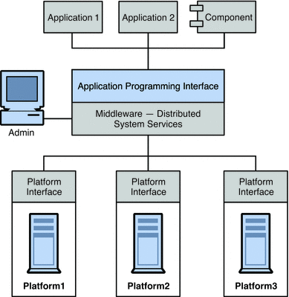
Middleware
Software between the operating system and the application
https://docs.oracle.com/cd/E19575-01/821-0028/aeraq/index.html

Slide 6
Middleware
Hide distribution complexity
Help to make distribution transparent
Transparency of heterogeneity
Transparency of location
Transparency of invocation
Transparency of transaction management
Transparency of security management
Transparency of service replication

Slide 7
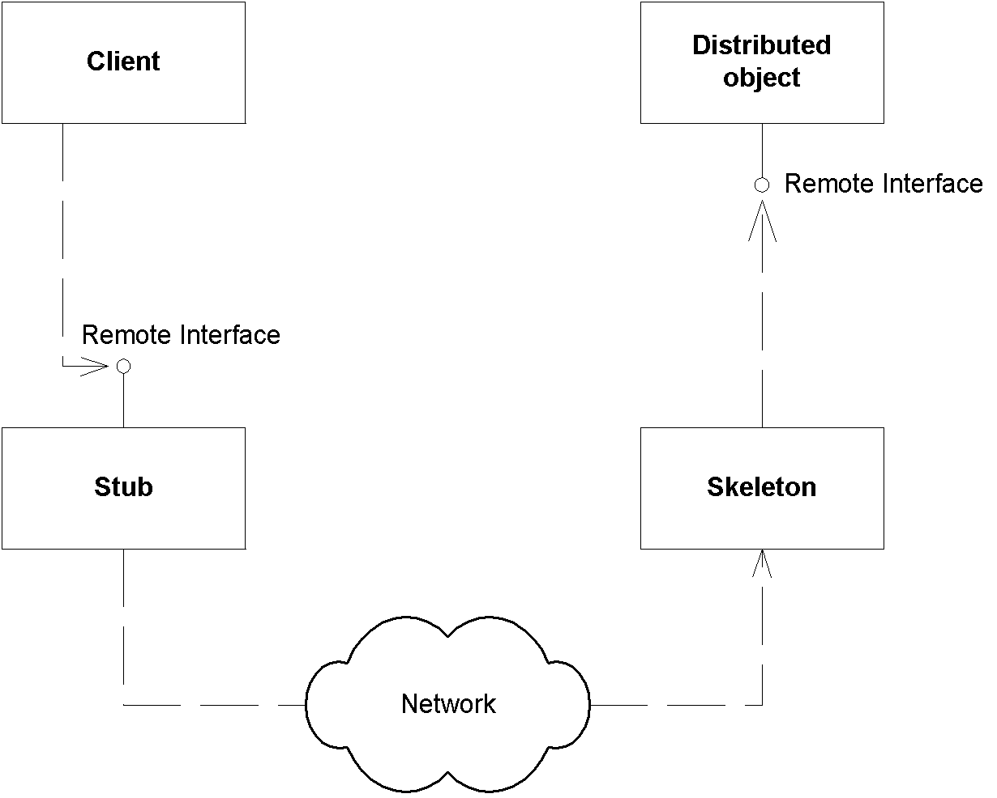
Distributed Object
A distributed object is made available to a distant client
Executing in another process,
From another place of the network

Slide 8
Developing a distributed object
Take into account the execution context
Explicit middleware
The developer is in charge
The environment manage the execution context
Implicit middleware
The container is in charge

Slide 9
Software Code/Middleware code
Software Code, related to the business
Management of a bank account
Middleware code, not directly related to the business
Security management
Audit
Persistence management
Goal : separate the application code from the middleware code

Slide 10
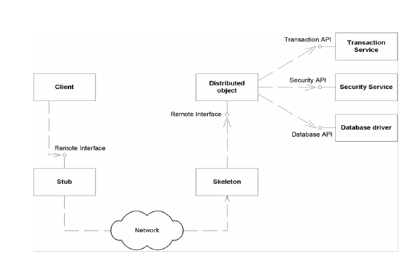
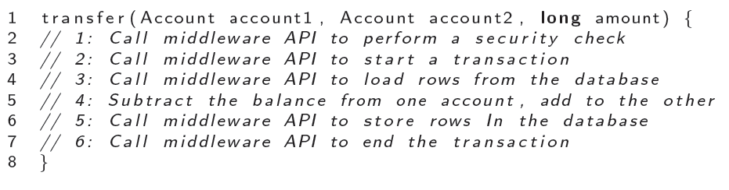
Explicit Middleware

Slide 11
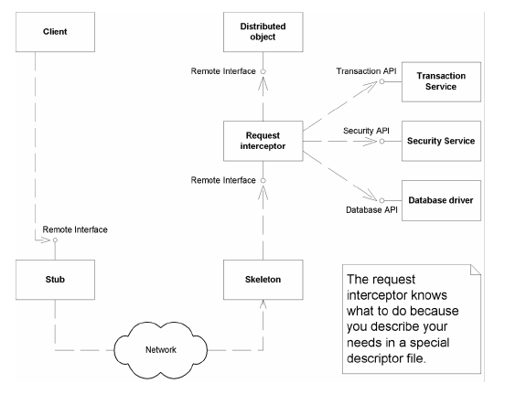
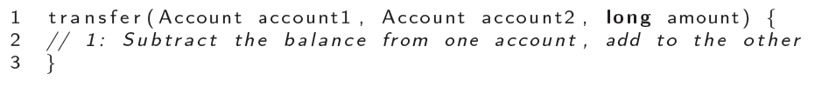
Implicit Middleware

Slide 12
Middleware code
Access as services
Persistence
Logging, audit
Transation
Defined by API and policies
Start/commit transaction, store/load data...
Question : how to manage both the middleware code and the application code

Slide 13
CORBA and object brokers
Common Object Request Broker Architecture
www.corba.org
Distributed Object Model
Standardized by the OMG since 1990
Objectives
Transparency of distribution
Interoperability

Slide 14
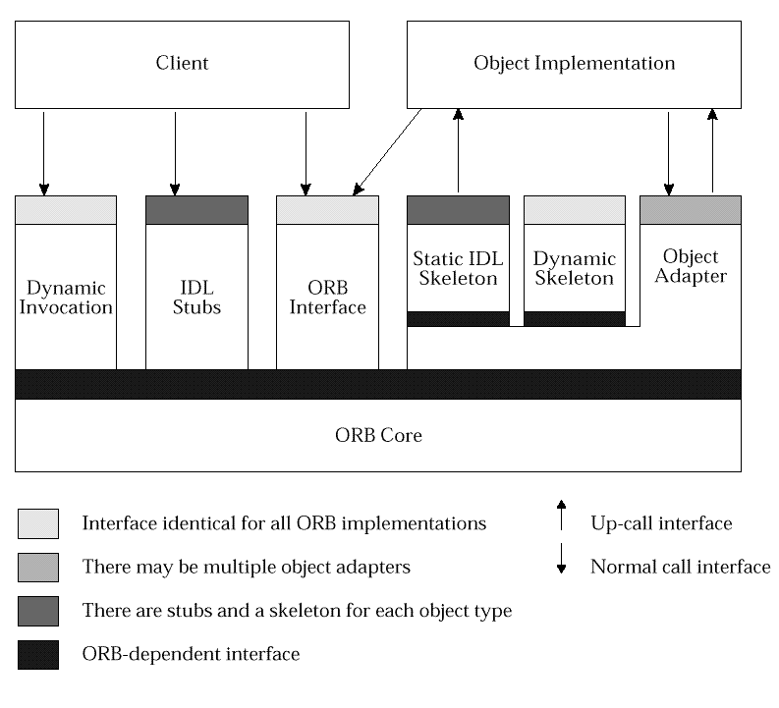
Object Request Broker
Software bus to route request
Services
Locate objects on the network
Call operation on the network
Internet InterORB Protocol

Slide 15
Common Object Services
Naming
Event
Notification
Transaction
Security
Concurrency control

Slide 16
CORBA and interoperability
Agnostic language to define interface
IDL = Interface Définition Language
IDL Translation from and to C++, Java, Python,C,…
Allows to call a Java service from a C++ applications
No interoperability between ORB from different vendors

Slide 17
Problems with Distributed Objects
Implicit dependencies
Interaction with the middleware
Lack of separation of distribution concern
No support for deployment

Slide 18
Component
A component complies to a contract to execute itself in a container
Includes
A set of provided interfaces
A set of required interfaces

Slide 19
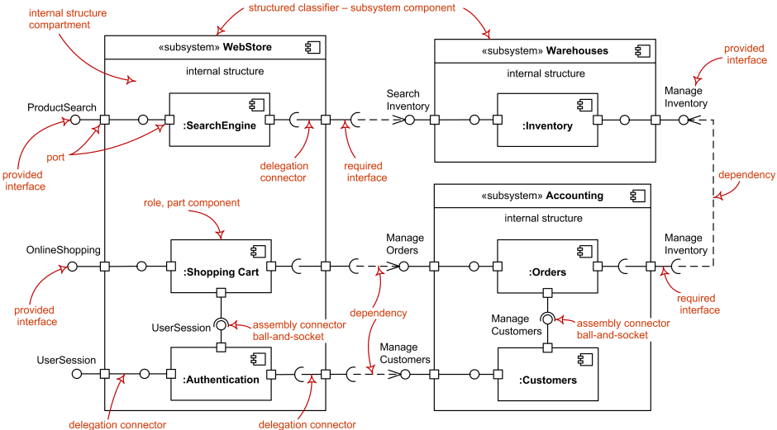
Component diagram

Slide 20
Definitions
Council et Heinmann
A software component is a software element that conforms to a component model and can be independently deployed and composed without modification according to a composition standard
Szyperski
A software component is a unit of composition with contractually specified interfaces and explicit context dependencies only. A software component can be deployed independently and is subject to composition by third-parties.

Slide 21
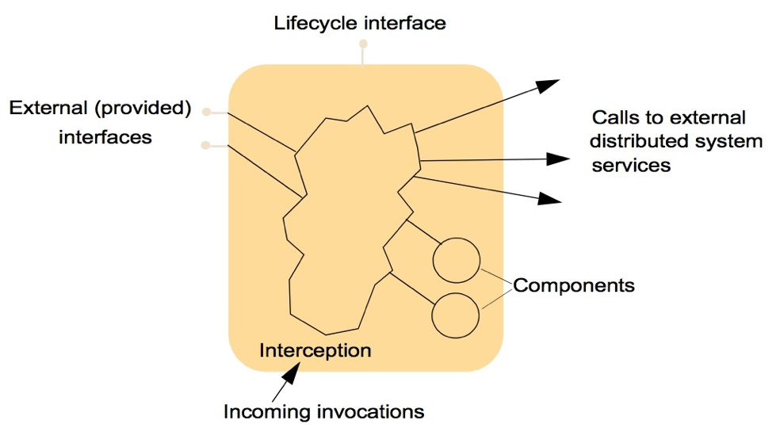
Container
Provide an execution environment for component
Manage the component life cycle
Manage the relation with other services

Slide 22
Components as service provider
Component are independant executable entities
All interactions with a component take place through an interface
The state of a component is never exposed

Slide 23
Interfaces
Provides interfaces
Define the services provided by the component
API of the component
Used by the component client
Required interfaces
Services needed by the component for its execution
No reference to how the service have to be provided

Slide 24
Component models
Definition of standards for the development, deploiement and documentation of components
Examples
Spring Component
EJB
COM (.Net)
Corba Component Model
SCA

Slide 25
Component vs Objects
Component can be deployed
Component do not define type
Component implementation is hidden
Components are language neutral
Components are standardized

Slide 26
Middleware support
Component models are the basis for middleware that provides support for executing components.
Component model implementations provide:
Platform services that allow components written according to the model to communicate;
Horizontal services that are application-independent services used by different components.
To use services provided by a model, components are deployed in a container. This is a set of interfaces used to access the service implementations.

Slide 27
Spring Framework
Started in 2003
Java Framework for Java Applications
Separation of concerns
Dependency injection and Inversion of control
Choice at every level
Reaction to Java EE and other application servers

Slide 28
Core and modules
Used to build
Factory pattern, MVC, Decorator
Complementary to Java EE
Different modules
Core Container
Data Access/Integration
Web
AOP & Intrumentation
Test

Slide 29
Framework

Slide 30
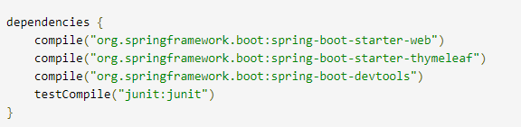
Example : a Web application with Spring MVC
https://spring.io/guides/gs/serving-web-content/

Slide 31
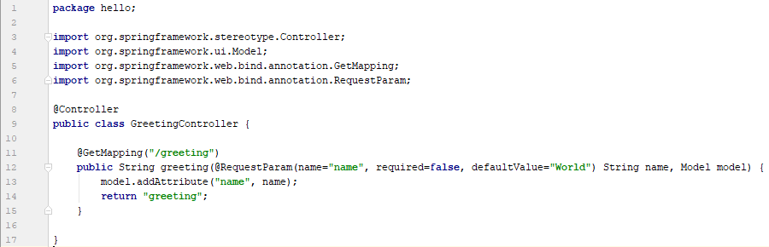
Web controller

Slide 32
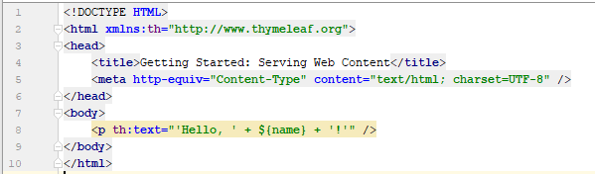
Web page template

Slide 33
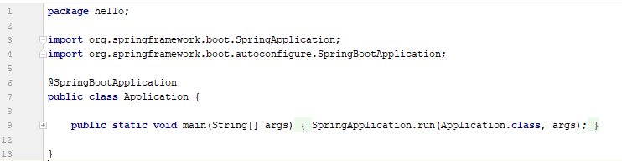
Make executable

Slide 34
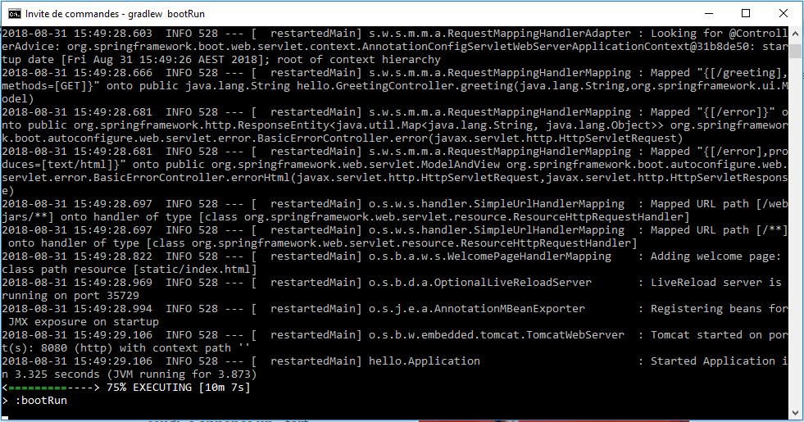
Start the server

Slide 35
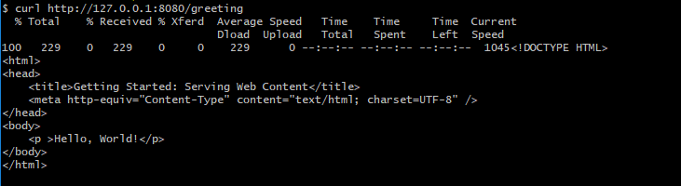
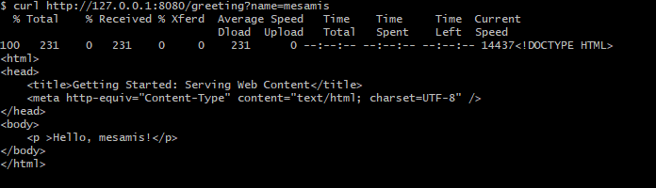
Test

Slide 36
Spring dependency injection
Or inversion of control
Allows to inject dependencies at object creation time
Hollywood principle
Don’t call us, we call you

Slide 37


The DiceTweet app
Roll a dice, tweet the result

Slide 38
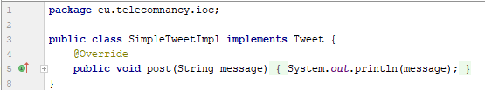
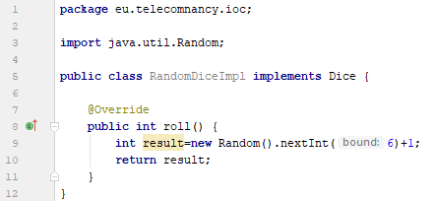
Crappy DiceTweet

Slide 39
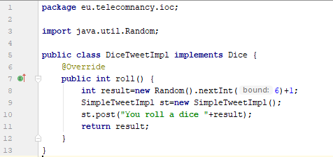
The Student Way

Slide 40
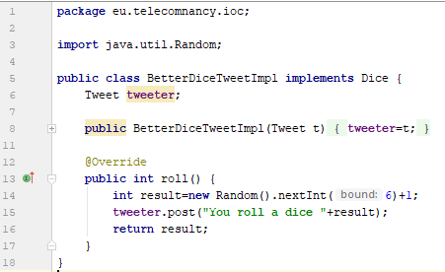
A Better Way

Slide 41
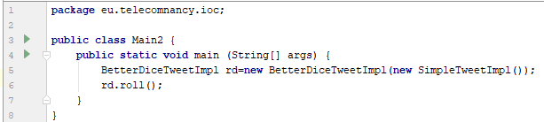
Injection principle

Slide 42
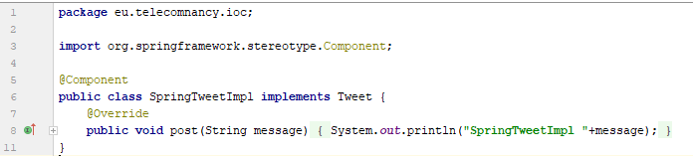
Spring Component

Slide 43
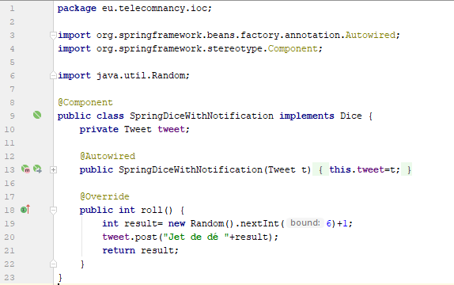
Wiring Spring Component

Slide 44
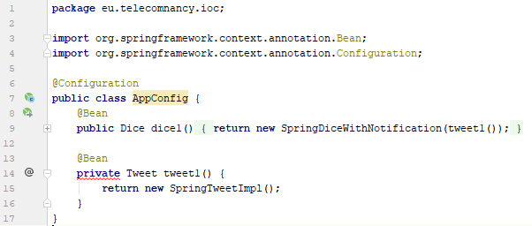
Configuration and Bean declaration

Slide 45
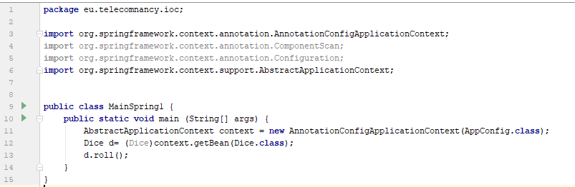
ApplicationContext
Les composants sont des singletons

Slide 46
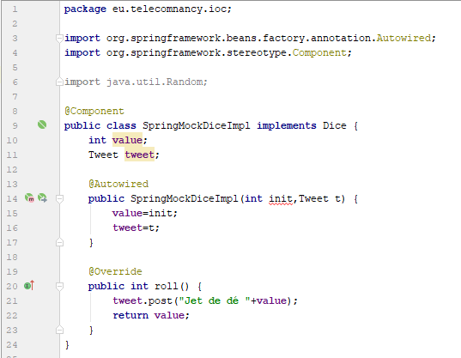
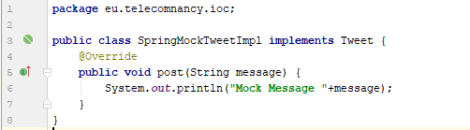
Other implementation

Slide 47
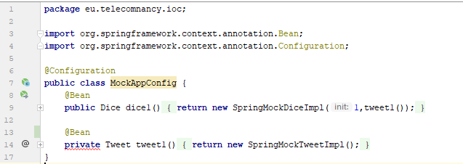
Other Config

Slide 48
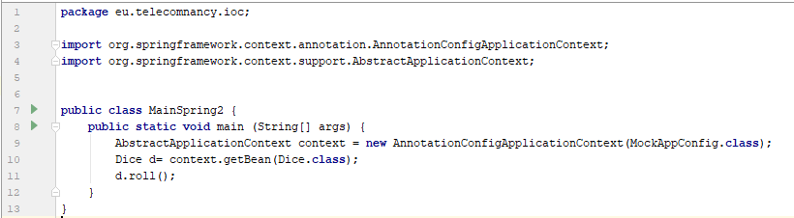
Other Application

Slide 49
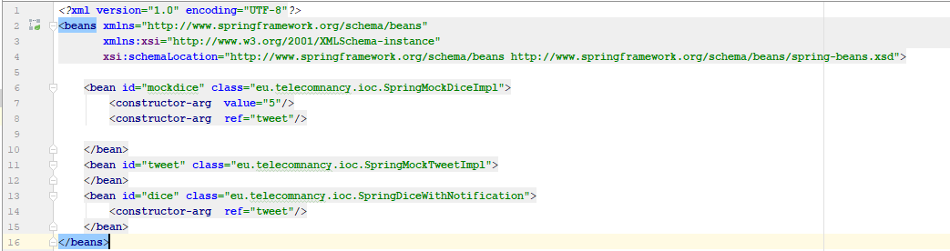
XML Configuration

Slide 50
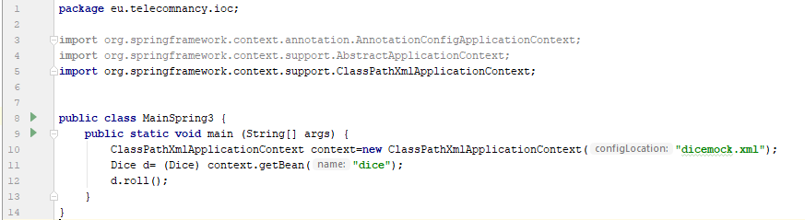
Last Application

Slide 51
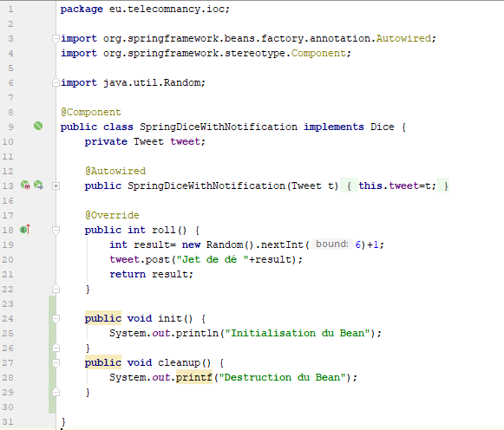
Lifecycle Callbacks

Slide 52
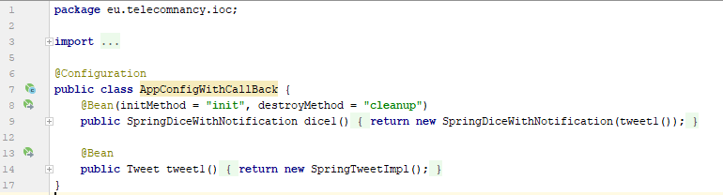
Callback Declaration

Slide 53
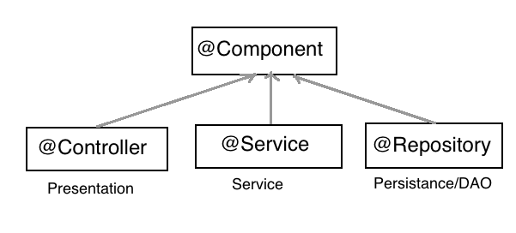
Conclusion on component and injection
Explicit dependencies
Creation responsibility delegated to the framework

