Slide 1
Persisting objects in Java
A Short introduction

Slide 2
Storage solutions
Problem
How to store object in a persistent way (and find them back)
Solutions
Use a RDBMS
Use an Object Oriented Database
Use Object Relational Mapping
Or a Key-Value Store, or a No-SQL Database

Slide 3
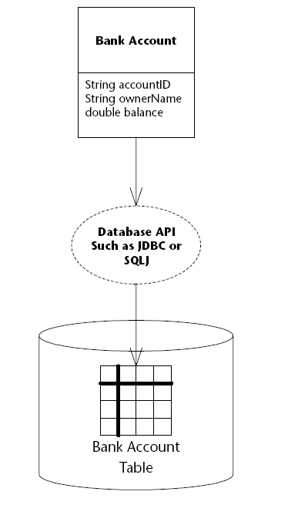
Use a RDBMS
Most used solution
Through an API
JDBC
Problems ?

Slide 4
Problems
Errors in requests
Management of persistance by hand
Type matching
Change management
Transactions management

Slide 5
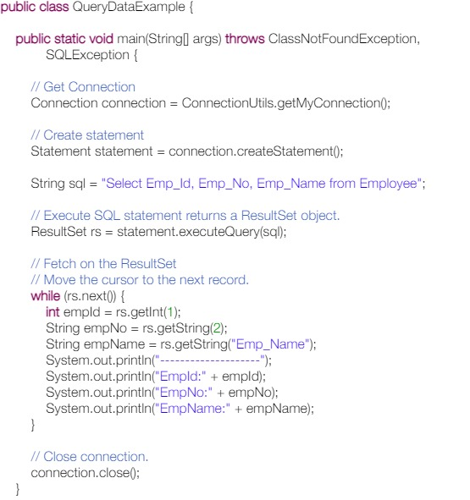
Data Access Object
Let’s automate that
RDBMS
Business Component
Data Component
Hide the plumbing
This is a lot of code

Slide 6

The plumbing
Type translation
Schema translation
Request
Static vs dynamic

Slide 7
Object Oriented Database
Database with an OO model
Persisting objects is easier
Translation is straightforward
Only one model
Navigational (avoid joins)

Slide 8
OODBS
Appear in the 80’s
Remplacement for RDBMS
Standardization
ODMG (2001)
Object Query Language
Lack of success
Partially integrated in SQL 99 (Object Relational Databases)
Some NoSQL initiative with graph databases

Slide 9
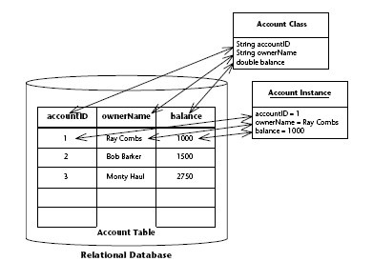
Object/Relational Mapping
Automate the Object/Relational Mapping
Solutions
EJB 2.0 CMP
Hibernate
JDO (JSR 12)
JPA Java Persistence Specification

Slide 10
Entity
Persisting objet
Part of the application model
Person, Bank Account
Implemented as a POJO (plain old java object)
Unique and visible identity
Visible persistent state
Not distributed

Slide 11

Persistence manager
Manage the communication with the DBMS
Storage
Loading
Update
Manage the synchonisation between memory and the database

Slide 12
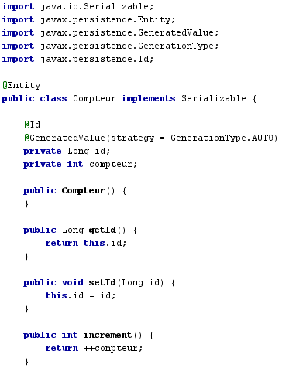
Entity Class
Object that can be made persistant

Slide 13
The plumbing
Persistence is managed by an “Entity manager”
Created by
A PersistenceManagerFactory
With a configuration file : persistence.xml

Slide 14
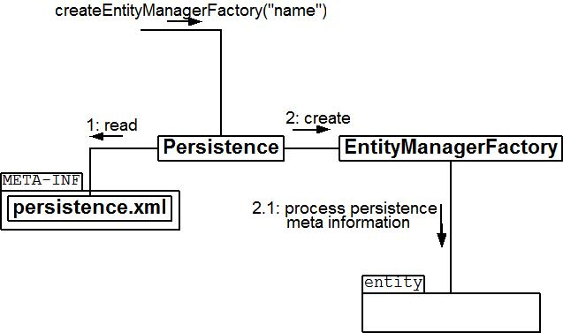
Persistence Factory

Slide 15
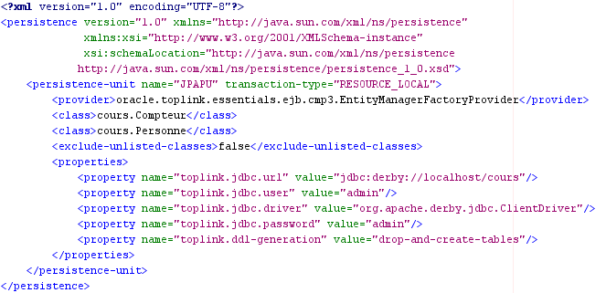
persistence.xml
Definition of a persistence unit

Slide 16
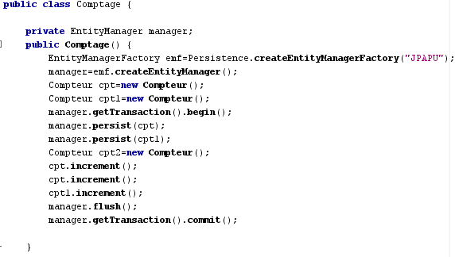
Using the class

Slide 17
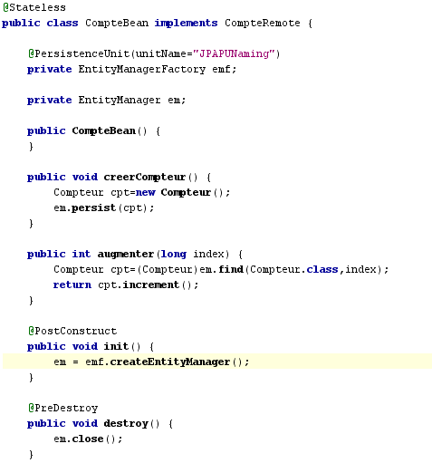
From a Component

Slide 18
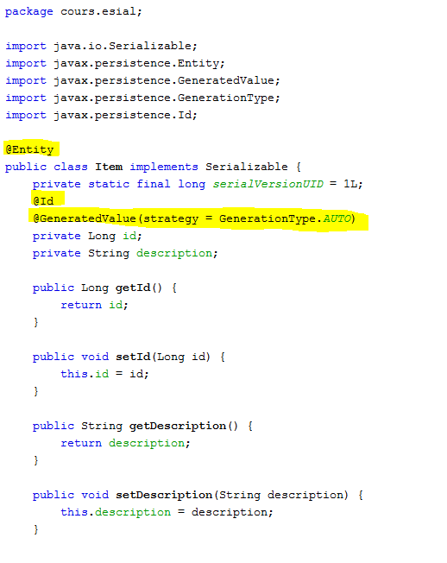
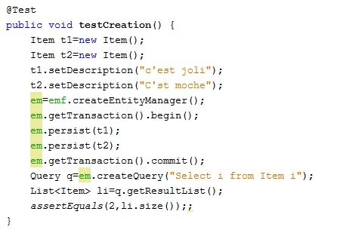
Another example

Slide 19
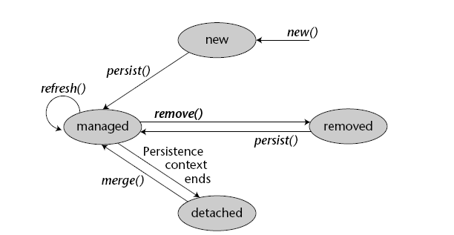
Life Cycle of an entity

Slide 20
Entity Manager
Manage the synchronisation between the state of the database and the state of memory
Manage instances under its control
Persist -> add an object to the persistent context
Find -> get the object and put it in the persistent context

Slide 21
Persistence context
Transaction-scoped persistence
Exist for the duration of the transaction
Entities are no more managed at the end of the transaction
Extended persistence
Life longer than the transaction

Slide 22
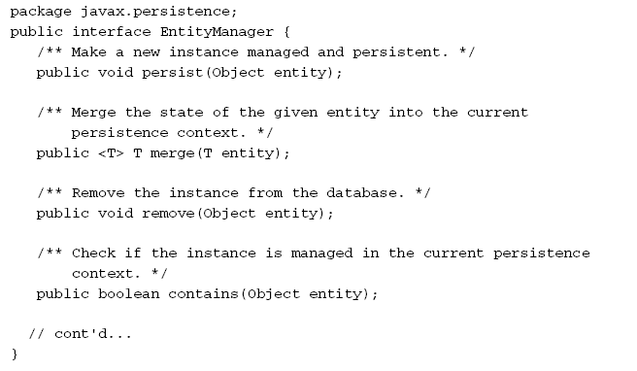
EntityManager API

Slide 23
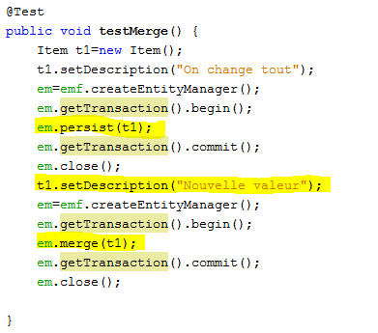
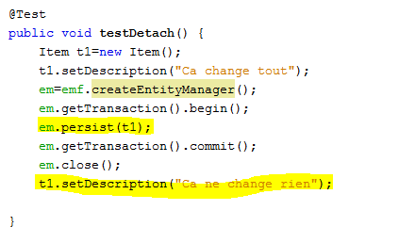
Merge

Slide 24

Les CallBacks
PrePersist
PostPersist
PreRemove
PostRemove
PreUpdate
PostUpdate
PostLoad

Slide 25
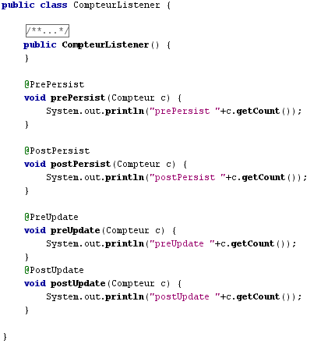
Callback Listener

Slide 26
Synchronisation with the base
Data are written at commit time
Problem : a request on the base might be inconsistant.
Require to force writing in the database
Flush
Or setFlushMode – AUTO ou COMMIT

Slide 27
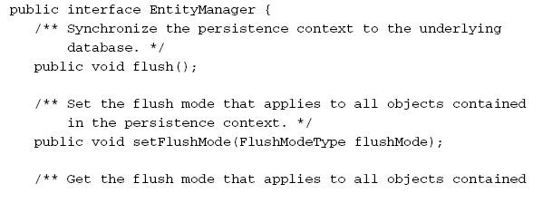
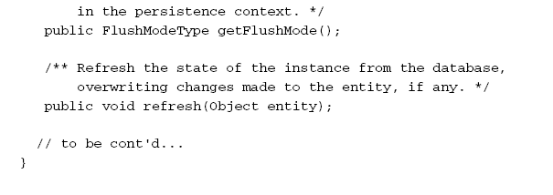
Synchronisation
refresh

Slide 28
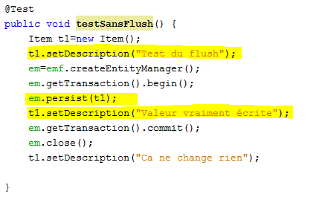
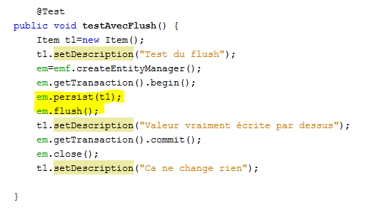
Synchronisation with the database

Slide 29
Concurrent access and locking
How to control access to data
Isolation level
SERIALIZABLE
READ UNCOMMITED
READ COMMITED (default)
Optimistic control (avoid lost update)
@Version
Posibility to use explicit locks (READ/WRITE)

Slide 30


Requests
Find
Find an object from its primary key

Slide 31
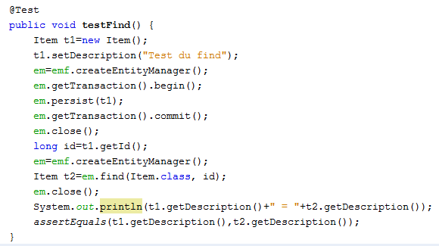
Find
Find an entity from its key

Slide 32
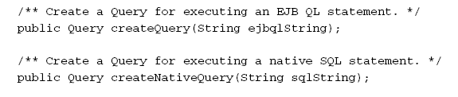

Request
EJB-QL
Object request language
Portable betwen databases
SQL
Entity Manager methods

Slide 33
Advanced O/R Mapping
Inheritance
Polymorphisme
Relationships
Object Requests

Slide 34
Inheritance
Participant
Three mapping strategy
One table per hierarchy
One table for each subclass
One table for each concrete class
Member
Speaker
SeniorMember

Slide 35
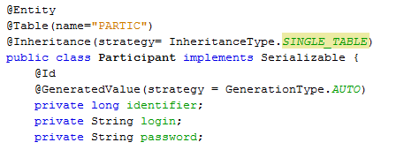
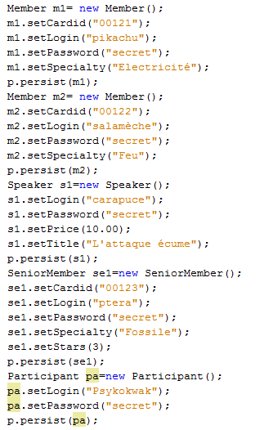



Example

Slide 36
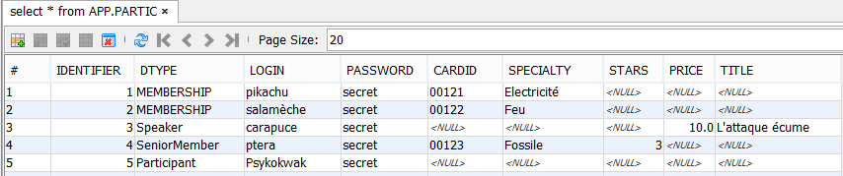
Default
One table for the hierarchy

Slide 37

The good/The bad
Supports polymorphism
Very large table
No constraints on subclass fields

Slide 38

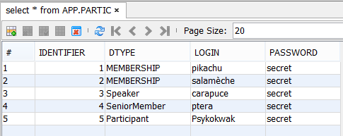
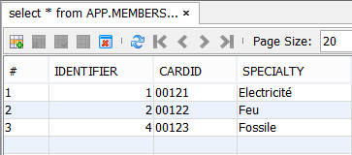
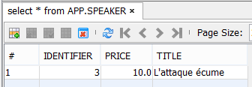
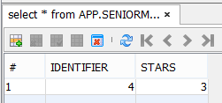
A table by subclass

Slide 39
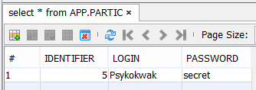
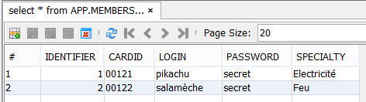
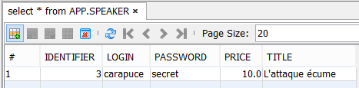
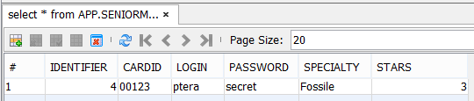
TABLE_PER_CLASS
One table for each class
Some request are complex

Slide 40


Polymorphisme
Works as usual
The persistence engine translate the queries

Slide 41
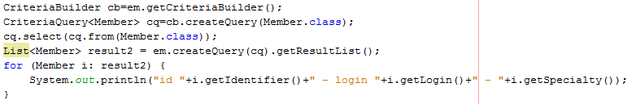

Polymorphism

Slide 42
Relations
Translate relations between classes to relational tables
Relation 1-1
Foreign Key
Relation 1-n
Foreign Key
Relation n-m
New table with foreign keys

Slide 43
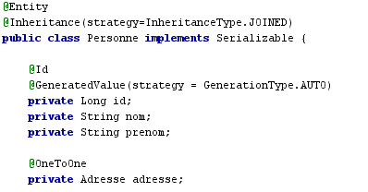

One-to-One

Slide 44
Cascading
Indique comment gérer la persistence avec des relations
Faut-il rendre persistant / supprimer / rafraichir / fusionner un objet en relation avec un autre
PERSIST
REMOVE
REFRESH
MERGE
A
B

Slide 45
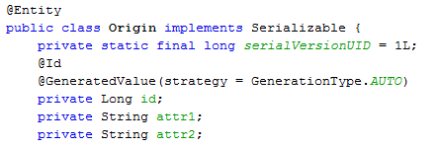
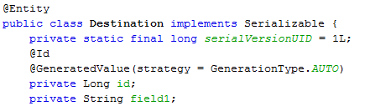
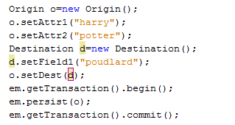
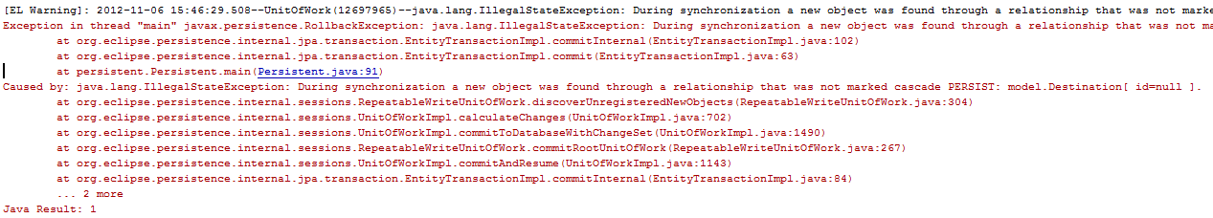
PERSIST

Slide 46

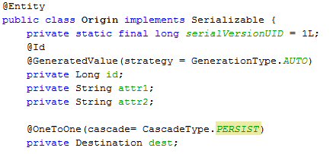
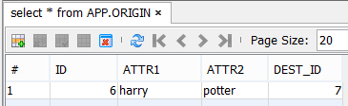
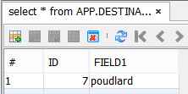
Persist

Slide 47
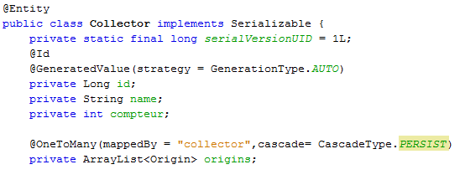
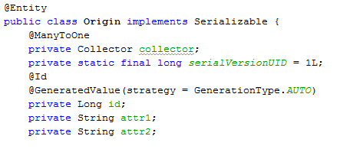
One-to-Many

Slide 48
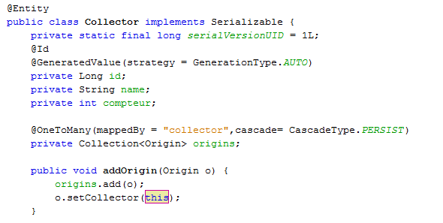
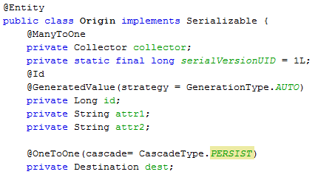
One-to-Many

Slide 49
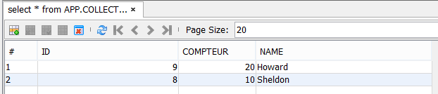
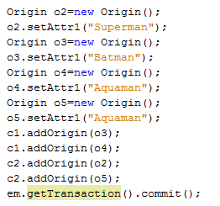
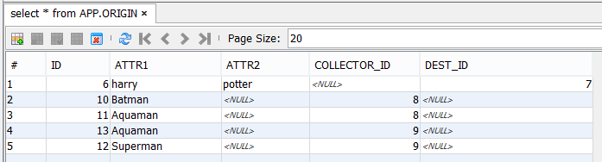
One-To-Many

Slide 50
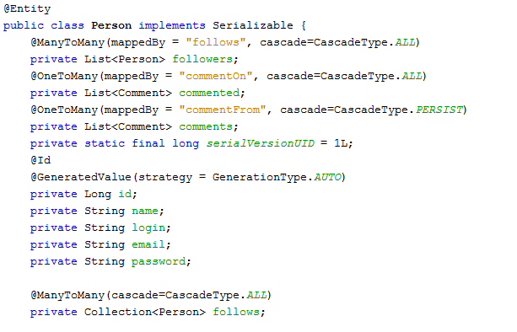
Entity Class Person

Slide 51
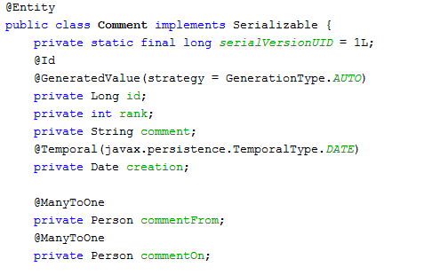
Entity Class Comment

Slide 52


Autre exemple

Slide 53





Many-to-Many

Slide 54



Many-to-Many

Slide 55
Fetch
Loading of relation
LAZY : on demand
EAGER : on load
Depend on use cases
Avoid using Eager all the time

Slide 56


Collections and persistence
Collections may persist (multi-valued attributes)

Slide 57
EJB-QL
Advanced version (2.1)
Group update and delete
JOIN
GROUP BY
HAVING
Projection
Sous requêtes
Requêtes dynamiques
Paramètres nommés
Construction de nouveaux objets

Slide 58


Mise à jour et suppression en masse
L 'opération s'applique à toutes les sous-classes
Pas de cascade
Application directez dans la base de données
Pas de synchronisation avec le contexte de persistence
N'affiche pas platrier

Slide 59



JOIN
Equivalent au inner JOIN – retourne les objets pour lesquels la jointure est possible

Slide 60


OUTER JOIN + FETCH
Fetch précharge les
éléments de la
relation
(Les étudiants)

Slide 61

GROUP BY/HAVING
Comme en SQL

Slide 62

Projection
Returns a Vector of Array of Object

Slide 63

Dynamic Queries/Named Parameters

Slide 64

Subqueries

Slide 65

Construction d'objet dans les requêtes

Slide 66
Sur EJB-QL
Standard pour des requêtes objets
Il est toujours possible de faire des requêtes SQL
Non portable
Dépendance sur le schéma relationnel
Il y a encore des progrès à faire...

Slide 67

Utilisation avec des Session Beans
Injection du persistence manager dans l'application
Méthodes métiers pour modifier les objets du modèle
Attention à la gestion des Stateful

Slide 68

Conclusion sur la persistence
Progrès par rapport aux anciennes versions
Plus simple
Plus lèger
Moins puissant que Hibernate
Mais portable (standard)

