Slide 1
RPC/Remote Invocation

Slide 2
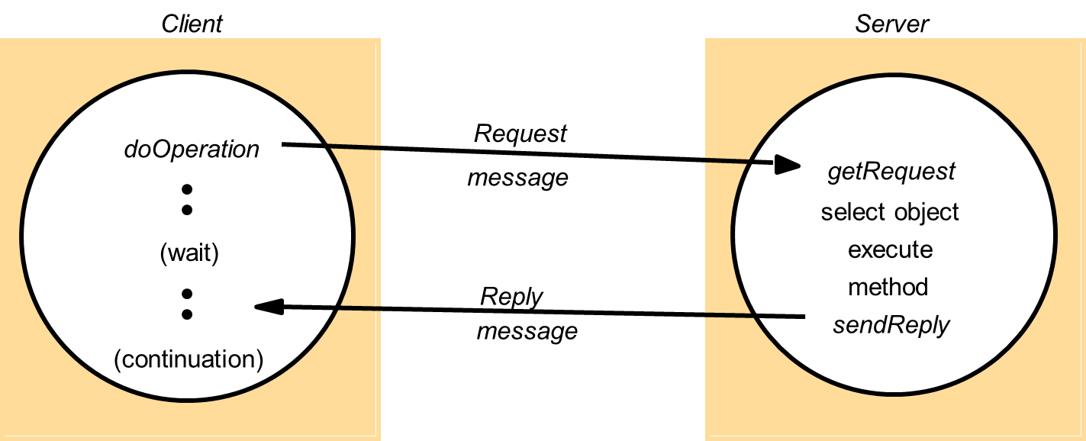
Remote Invocation
How process communicate in a distributed system
Request-reply protocols
What are the problems and the solutions ?

Slide 3
Call Semantics
Fault tolerance measures
Call
semantics
Retransmit request
Duplicate
Re-execute procedure
message
filtering
or retransmit reply
No
Not applicable
Not applicable
Maybe
Yes
No
Re-execute procedure
At-least-once
Yes
Yes
Retransmit reply
At-most-once

Slide 4
Transparency
Goal : remote calls as similar as local calls as possible
Location and access transparency
New kind of failures (network)
Latency
Parameter passing

Slide 5
RPC – Remote Procedure Call
History
Invented in 1976 (RFC 707)
Implemented by SUN in 1988
Used in NFS
Design issues
Programming with interfaces
Call semantics
Transparency

Slide 6
Three key issues
Programming with interfaces
Hide the implementation details
Hide programming language
Easier evolution
Call Semantics
Sun RPC provides « at-least-once » semantics
Transparency
Location and access transparency
No call by reference

Slide 7
SUN RPC (1988)
Generation of code common to all calls
https://www.slideshare.net/PeterREgli/sun-rpc

Slide 9
SUN RPC
The Client Stub
Receive the local call
Wrap the parameters (marshalling)
Generate an identifier
Send the client call
Waits for the result
Receive and unwrap the result (unmarshalling)
Send the result to the caller (return)
The Server Skeleton
Receive the call
Unwrap the parameters
Execute the local call
Wrap and return the result

Slide 10
Naming and binding
Naming : name given by an entity to another
Binding : setting in relation entities
Naming: what procedure is called on which computer
Naming should not depend on localisation

Slide 11
Registry : from name to address
1: Binding
2: Lookup
Criteria
Name (service, computer, node)
Properties
Client
Server
2
1
Stub
Registry
Skeleton

Slide 12
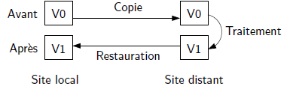
Parameter passing
By value: foo(43)
No problem
By reference : foo(&x)
Impossible – not the same address space
By copy/restore
Potential problem

Slide 13
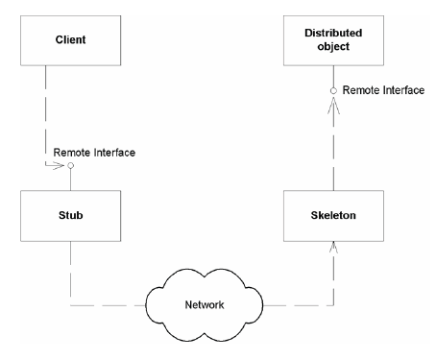
Distributed Objects
RPC but with objects
The remote object can be called as a local object

Slide 14
RPC vs RMI (Remote Method Invocation)
Commonalities
Programming with interfaces
Request reply protocol
Similar level of transparency
Differences
RMI : object oriented programming
Object have an identity and can be passed as parameters

Slide 15
Java RMI
Object model
Object references
Interfaces
Actions
Exceptions
Garbage Collection
Distributed object model
Remote object reference
Remote interfaces
Actions
Exceptions & Remote Exceptions
Distributed Garbage Collection

Slide 16
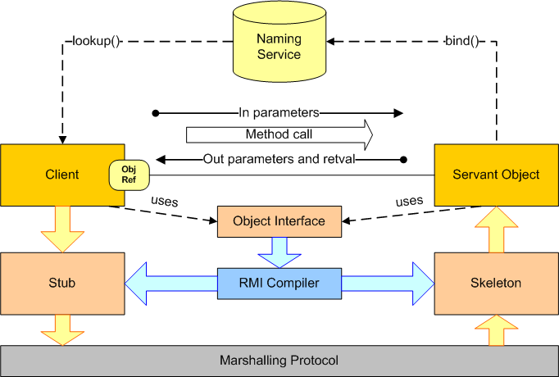
Implementation of RMI

Slide 17
Implementing a distributed object
Big picture
Define the interface
Implement it (servant)
Implement the server (instantiate the servant and bind it)
Implement the client
The interface contract
Must be public
Must extends java.rmi.Remote
Each method must throw java.rmi.RemoteException

Slide 18
Programming principles (Contract)
Servant
Must implement the remote interface (Remote)
May implement local methods
Server
Instantiate and install a security manager
Instantiate the servant class
Bind the instant in the name registry
Registry
Maintain a reference between the name and the reference
Implement java.rmi.registry.Registry
Provide the bind and lookup service

Slide 19
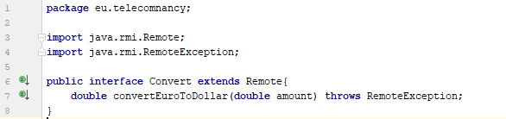
Example

Slide 20
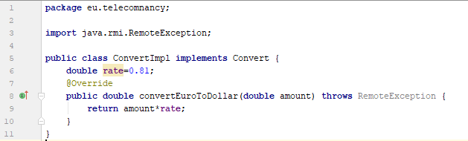
Example

Slide 21
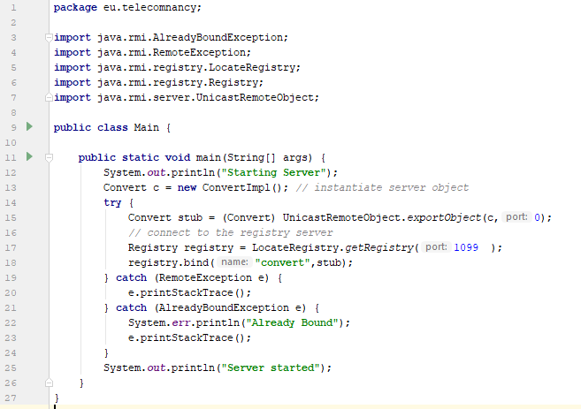
Example

Slide 22
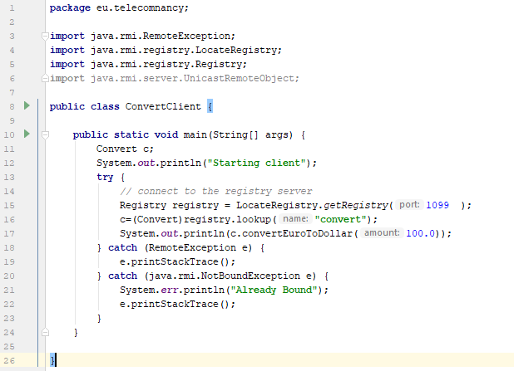
Example

Slide 23
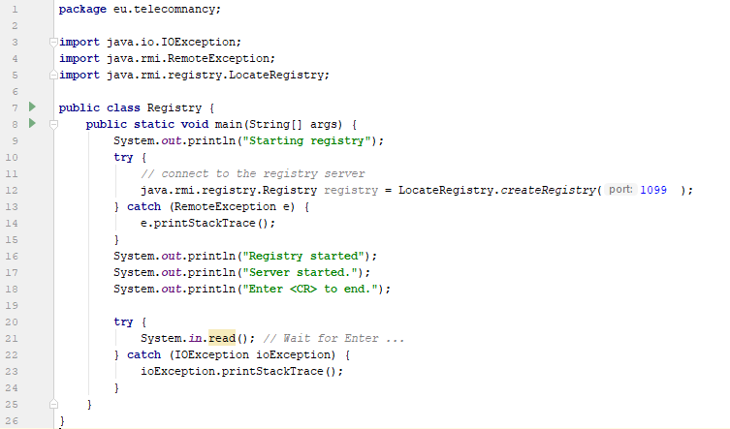
Example

Slide 24
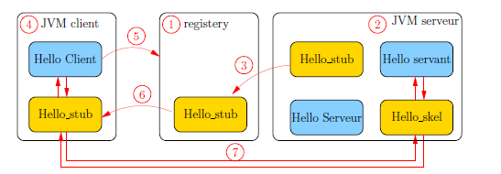
RMI execution in Java
Exercice : Faire le diagramme de séquence d’un appel RMI

Slide 25
Conclusion RPC/RMI
Basic distributed systems
Call and location transparency
No other services
Everything has to be coded

