Slide 1
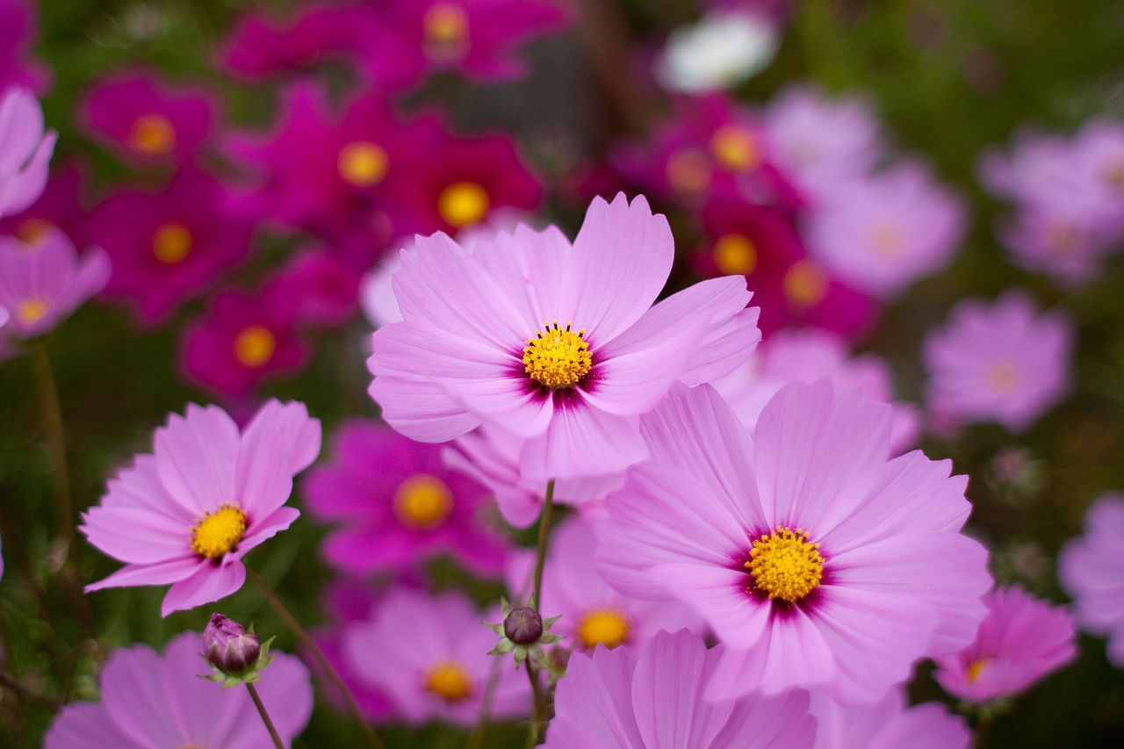




Quit to desktop
FlowerOS public_beta2
7:45 PM
App Store
Quiz Game
Preview
Rating

