Slide 1

Brake System CDR
Brakes Team:
Nick and Lucas
Made Feb 8th 2025

Slide 2
HIGH LEVEL DESIGN
REQUIREMENTS
DESIGN OVERVIEW
SIMULATIONS
RISK ANALYSIS
MANUFACTURING
TESTING
Index
01
02
03
04
05
06
07

Slide 3
CDR GOALS
Confirm Design Finalization
Validate Calculations
Validate Risk Analysis
Confirm Manufacturing Readiness

Slide 4
PROJECT PROGRESS
INTRO
REVIEW
SEP-OCT
NOV-FEB
MAR-APR
MAY-JUN
PREVIOUS PHASE
CURRENT PHASE
APPROACH
AESTHETICS
RESEARCH
DESIGN
MANUFACTURING
TESTING
COLOR
DESIGN
Gather information about the engineering process, FSAE Rules, and Component Designs
Design around requirements and optimize weight and reliability
Fabricate all components and mounting tabs.
Test and optimize all brake systems
NEXT

Slide 5
HIGH LEVEL DESIGN
Make a reliable way of stopping vehicle
Design optimal control brake and accelerator pedal for driver
Withstand 2000N of force on system
Decelerate car from max speed comfortably

Slide 6
HIGH LEVEL DESIGN
Work the intended way
How often can we stress test this
How many cycles before it gives?
Aiming for 1,000 cycles
2 hours runtime
How do you measure work iterations?
1 forward and back cycle.

Slide 7
REQUIREMENTS
FSAE 2025 Rules encompassing brakes:
T.3.2.2- Must withstand a force of 2000N without failure of system
IN.12.3.1- Brake Test: All 4 wheels must lock while tractive system is shut down
T.3.1.3- Must have two independent hydraulic circuits

Slide 8
REQUIREMENTS
Main Takeaways
Withstand 2000N force
BOTS to turn off system

Slide 9
REQUIREMENTS
Success of the brake system is defined by:
RELIABILITY- Probability part will perform successfully over time

Slide 10
REQUIREMENTS
Measures of Reliability that we can obtain in this phase is:
Factor of Safety- Yield Strength of part
—---------------------- Max stress

Slide 11
REQUIREMENTS
Simulations will show that Pedal Box components will be able to withstand 2000N
Heat is displaced into calipers with 0.8 ratio of efficiency. The rest is displaced from air cooling or other suquencial metals on the car. The pressure to lock 4 wheels will be less than the max pressure the brake lines can hold.

Slide 12
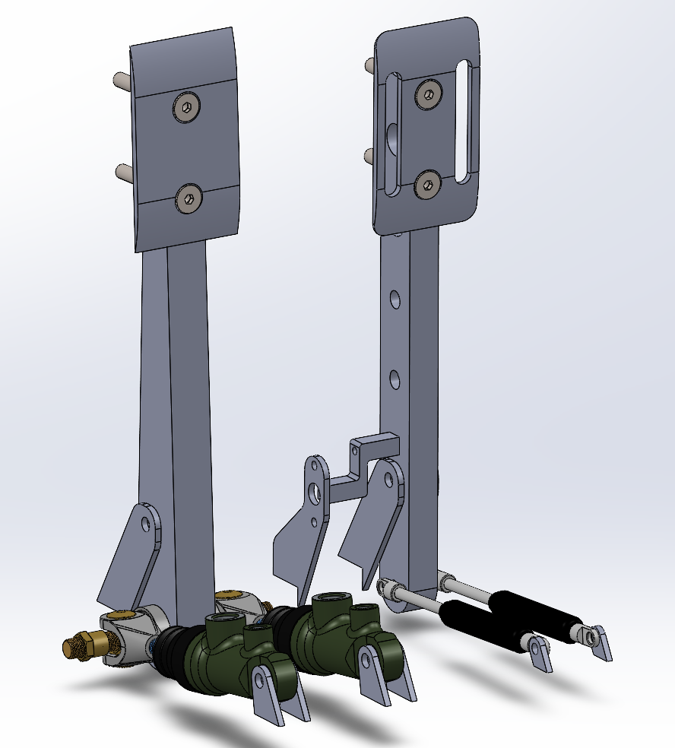
DESIGN OVERVIEW
Brake Calipers
Rotors
Pedal Box
Tabs

Slide 13
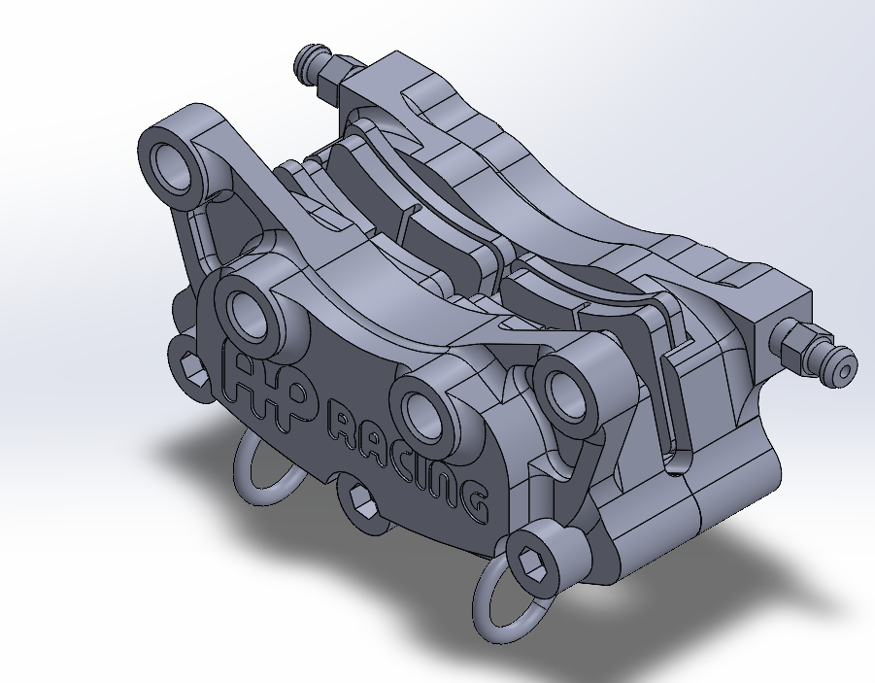
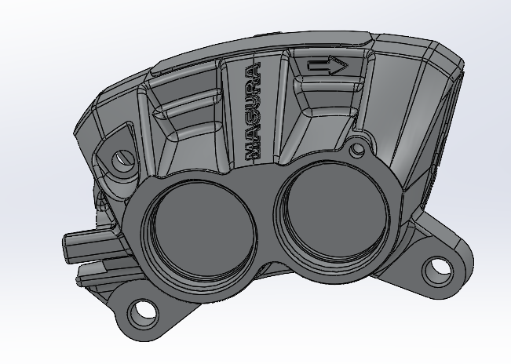
DESIGN OVERVIEW
Front: AP racing 4227
Cost $742 for 1
4 Piston caliper
Will provide the most stopping force since it is the front caliper
We have repair kits if needed
We have 2 so we are reusing from last year
Rear: Magura
Not manufactured anymore
Eventually team will have to phase this out of design
For now it fits knuckles so we are keeping it
$500 used on Ebay
4 Piston caliper

Slide 14

DESIGN OVERVIEW
Rotors
Material: G2 cast iron
Rotors have been made in house
They use a floating bearing design
We are using these for economic efficiency. Since they are already made, we will not have to spend time and money making new ones.

Slide 15
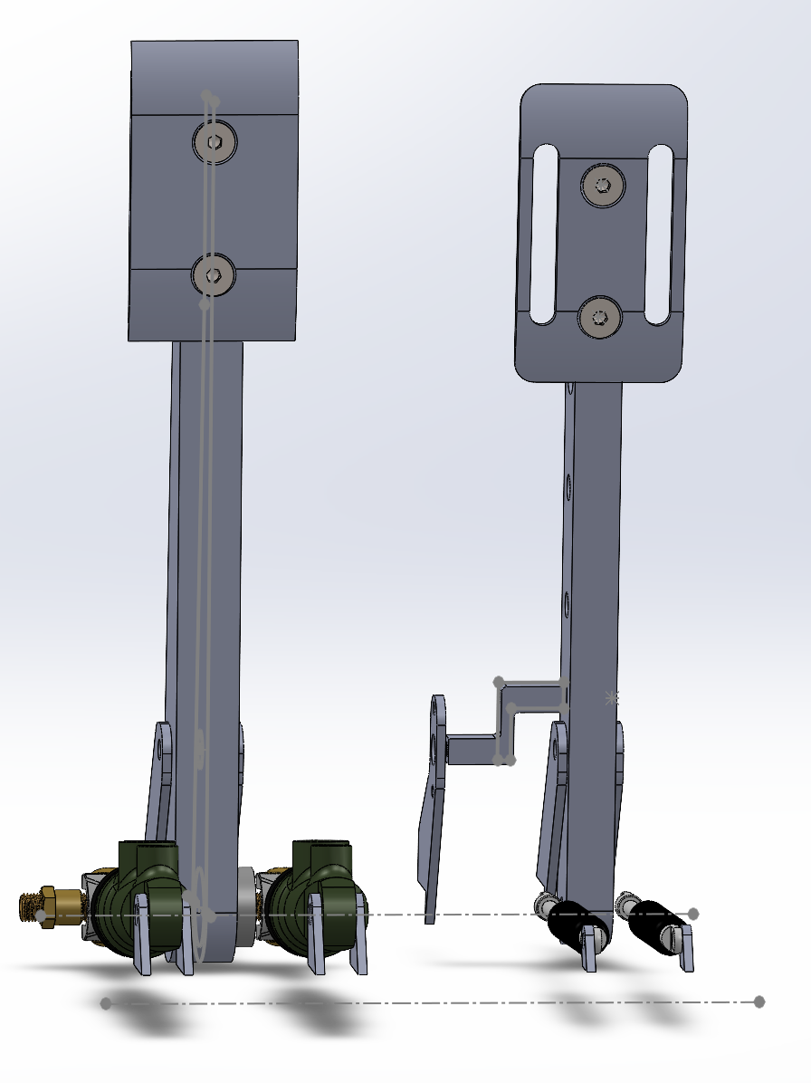
DESIGN OVERVIEW
Pedal Box
Pedals will be mounted to steel tube.
Flipped cylinders to get foot room
Welded to chassis to save on materials needed to make a pedal box

Slide 16
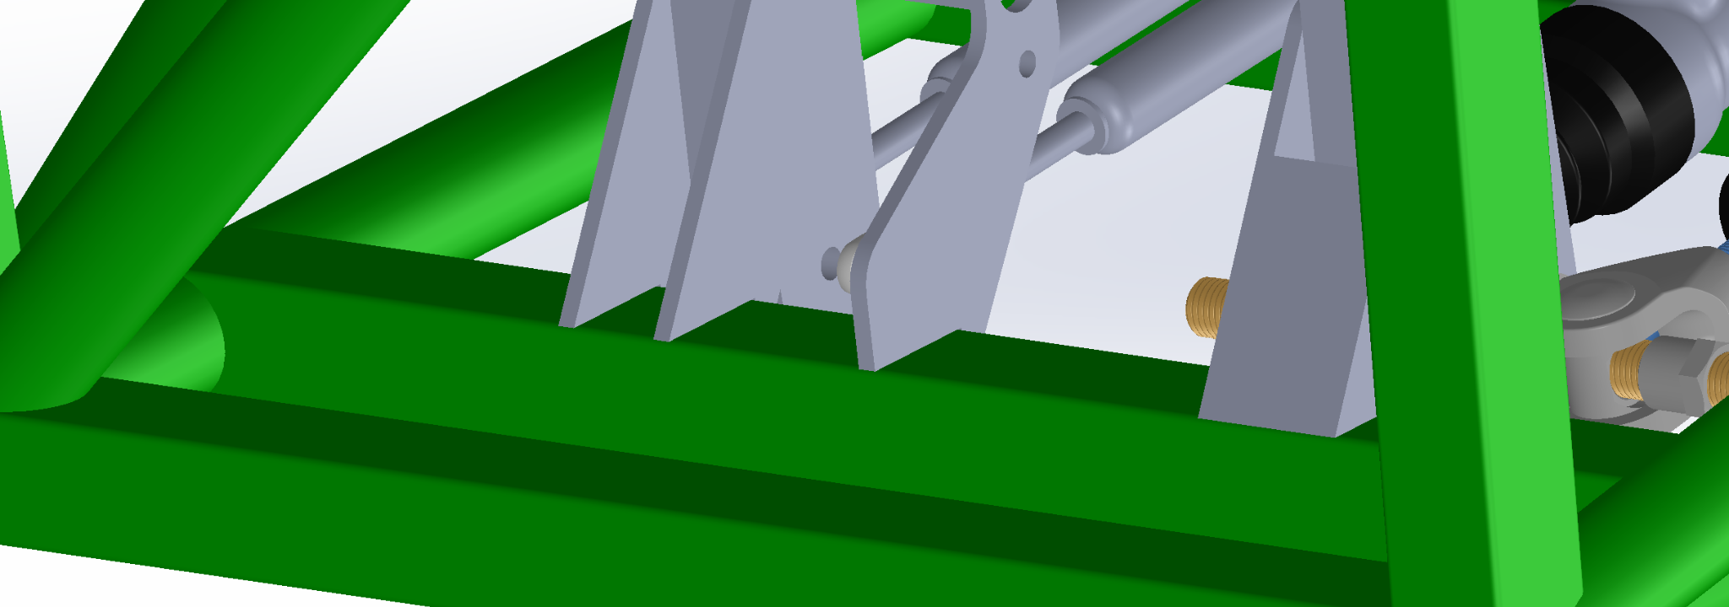
DESIGN OVERVIEW
Pedal Box Tabs
All tabs will mount to 1”x 1” square bars welded to the chassis
Provides before resistance to torque
All made in house from scrap steel
All will be welded on chassis

Slide 17
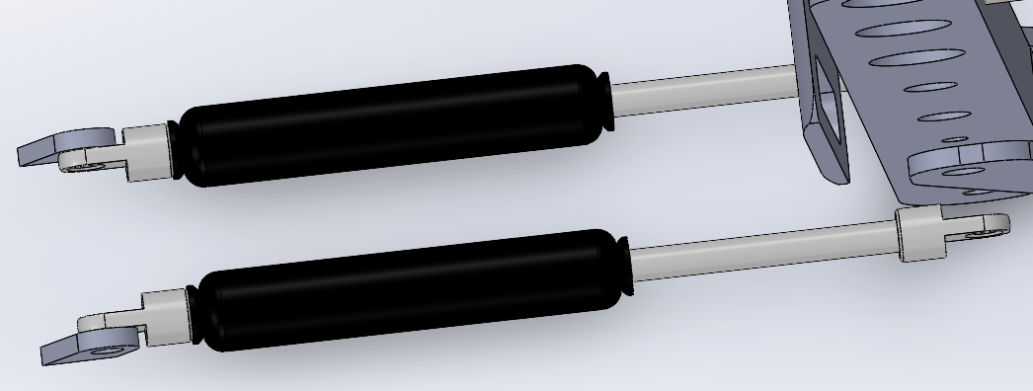
DESIGN OVERVIEW
Accelerator pedal return method
Using gas springs to return the accelerator pedal to zero position.
Provides both a zero position and a 100% position, since the spring can only travel so far.
Used to align better mirror the brake pedal assembly.

Slide 18

DESIGN OVERVIEW
APPS Tab
Connects the accelerator pedal to the pivot of the APPS (Accelerator Pedal Position Sensor)
Currently Undergoing a rework will be done before March
Will be made out of most durable three printable material
Will bring 2 spare to comp due to easy manufacturability

Slide 19
SIMULATIONS
3 Important Sims:
Accelerator Pedal
Brake Pedal
Tabs

Slide 20
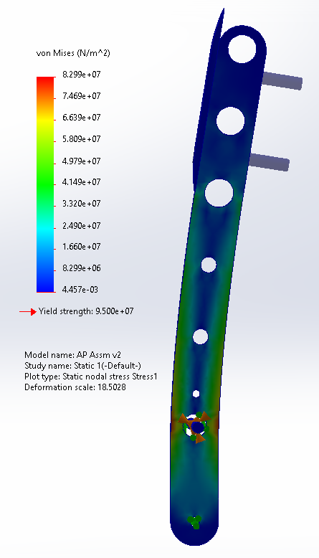
SIMULATIONS
Accelerator Pedal
Material: 7075 Aluminum
Force applied: 2000N
Max stress: 8.29E7 N
FoS: 1.14
Max stress < yield strength, so this will remain intact
Sim done without bolts added. Bolts will distribute load, so the real FoS will be higher.

Slide 21
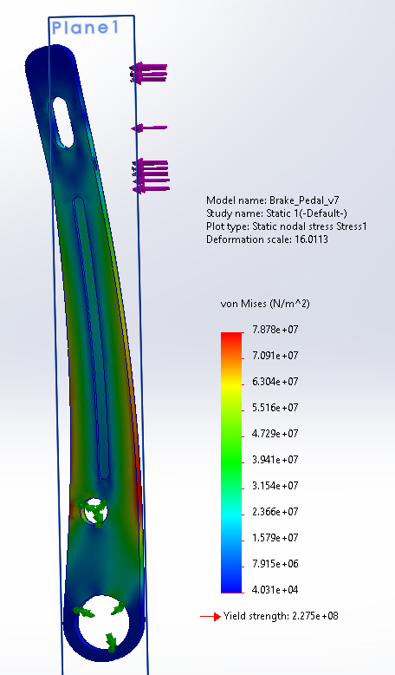
SIMULATIONS
Brake Pedal
Material: 7075 Aluminum
Force applied: 2000N
FoS: 2.89
Max stress < yield strength, so this will remain intact

Slide 22
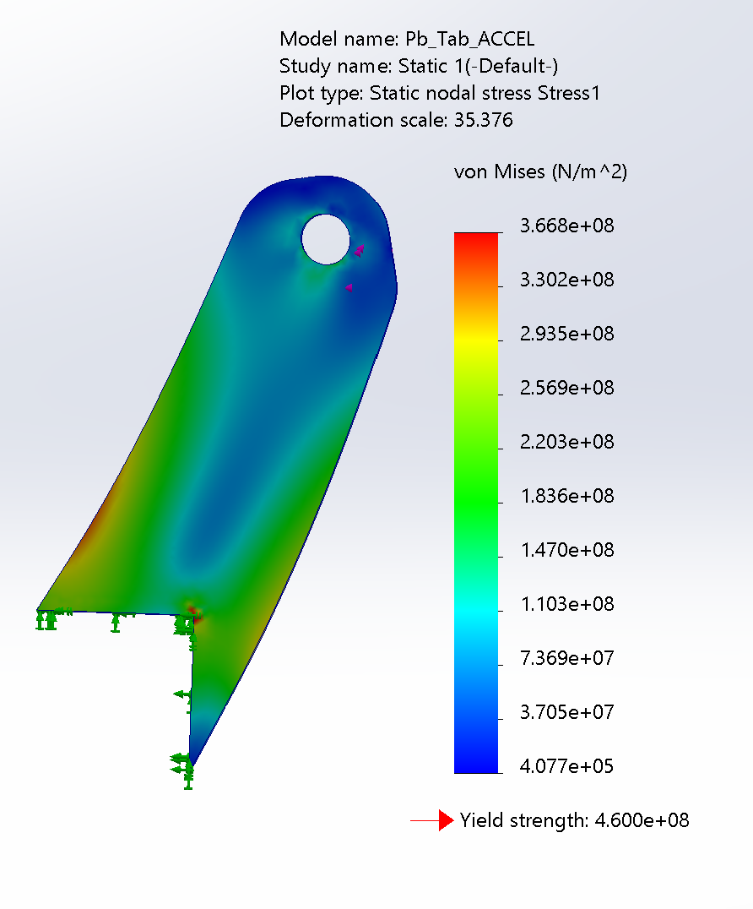
SIMULATIONS
Brake Pedal Tabs
Material: 4130 Steel
Force applied: 5000N
Max stress: 4.700*10^8 von Mises
FoS: 1.25

Slide 23
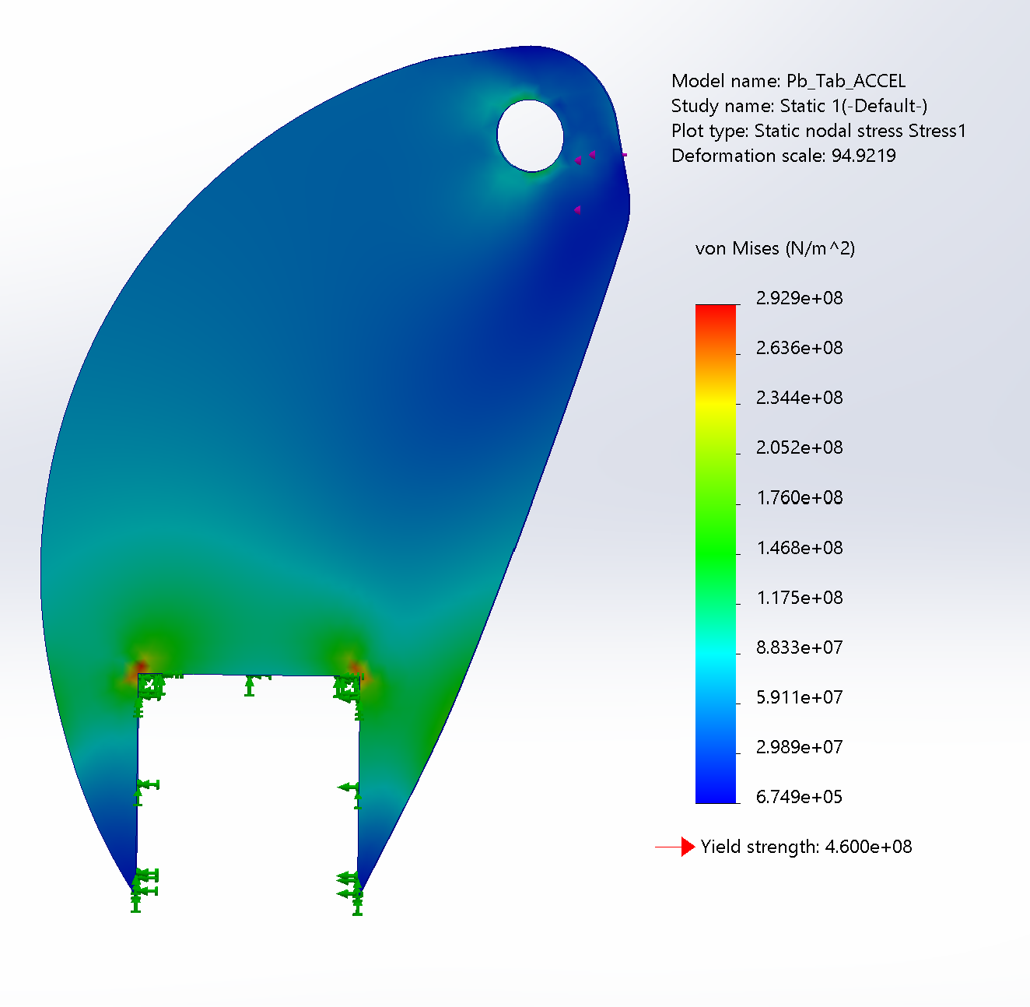
SIMULATIONS
FoS: 1.25
FoS:
1.57

Slide 24
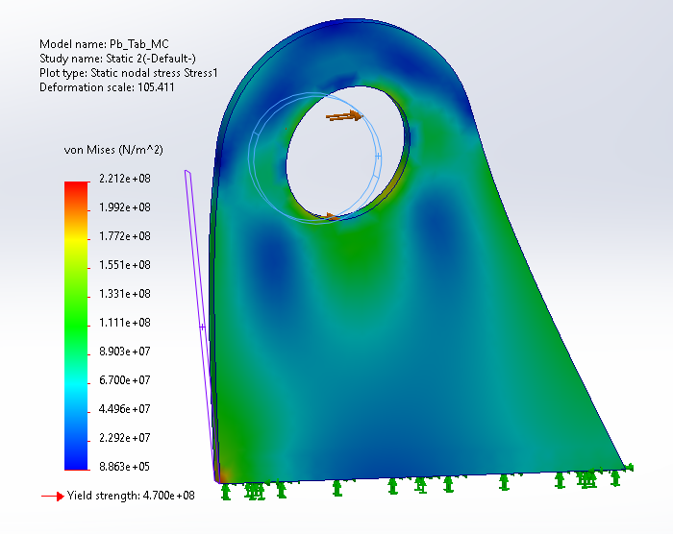
SIMULATIONS
Master Cylinder Tabs
Material: 4130 Steel
Force applied: 2000N
Factor of Safety: 2.1
Max stress < yield strength, so this will remain intact

Slide 25
RISK ANALYSIS
Factors of Safety from Sims
Reliability Factors for System

Slide 26
RISK ANALYSIS
Reliability Factor:
-Probability that a component or system will not fail during a specific amount of time
How many times can we use brakes before they break or don't work?
Should be at least 10,000

Slide 27
MANUFACTURING
Parts made by team In-House | Outsourced (MSEL) Parts | Already Made
Accelerator Pedal All pedal tabs (minus APPS) APPS “Fork” | Brake Pedal APPS tab | Pedal Faces Rotors

Slide 28
MANUFACTURING
Brake Pedal:
Who- Haydn,
What- Aluminum Scrap
Where- MSEL
How- In house
Why- It will be cheaper with us working through MSEL.
When- March 15th

Slide 29
MANUFACTURING
Accelerator Pedal:
Who- Nick
What- Aluminum Scrap
Where- MSEL
How- In house
Why- It will be cheaper with us working through MSEL.
When- March 30

Slide 30
MANUFACTURING
Tabs
Who- Lucas and Nick
What- Steel Scrap
Where- MSEL
How- In house
Why- It will be cheaper with us working through MSEL.
March 20th

Slide 31
SENSORS
APPS
BPSD
Brake Pressure
BOTS

Slide 32
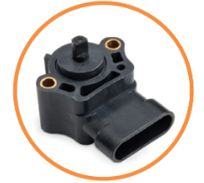
SENSORS
APPS (Accelerator Pedal Position Sensor)
Used to send signal to motor to accelerate
Will be mounted with tab aligned with accel pedal.

Slide 33
SENSORS
BSPD (Brake System Plausibility Device)
Sensor that prevents the driver from accelerating and braking at the same time
Will be attached to chassis with a small tab

Slide 34
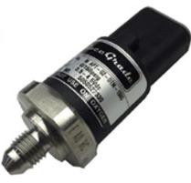
SENSORS
Brake Pressure Sensor
Produces a DC voltage proportional to the pressure reading
Will be integrated into the brake lines
Uses a T-joint to separate it from the brake line circuit.

Slide 35
SENSORS
BOTS (Brake Over Travel Switch)
Safety sensor to shut off power to vehicle if brake pedal goes past a certain threshold
Will be mounted to brake pedal tab
Need to build physical system to fully design
Design in March during manufacturing

Slide 36
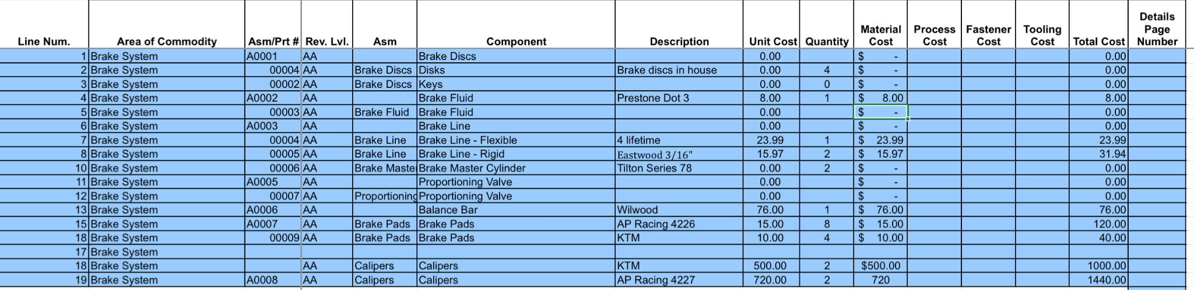
BILL OF MATERIALS

Slide 37
TESTING
Most important is honing in on Brake Bias
Once we get better weight data we can adjusted the bias on the front brakes
After testing we can fine adjust APPS (Accelerator Pedal Position Sensor) for driver comfortability
After braking test we can get accurate data on the amount of brake pressure required to lock wheels

Slide 38
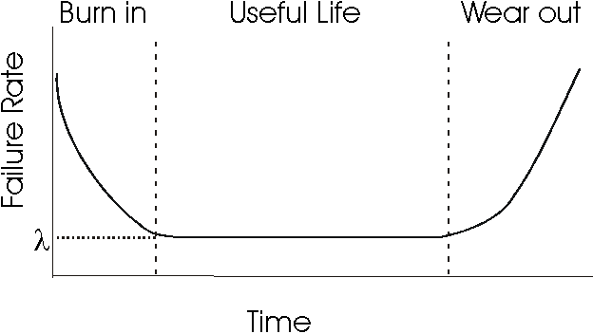
TESTING
How can we measure/test/proof reliability?
R(t): Reliability(R ), a function of time
R(t)=e^(-λ*t)

Slide 39
Goals for Spring Term
Manufacturing done before end of March
Testing phase in April

