Slide 1


Slide 2
Ontology smart contract development
公有链新架构 & 分布式信任生态
Zhou Peiwen
Senior System Engineer

Slide 3
Content
Ontology Overview
Ontology Smart Contract introduction
Environment Setting
Toolkits
How to develop smart contract
Practice

Slide 4
Ontology Overview
Consensus:
VBFT (POS + VRF + BFT)
TPS:
10,000+
VM:
NeoVM, WasmVM

Slide 5
Ontology network architecture

Slide 6
Token
ONT:
Governance token
Decimal : 0
ONG:
Utility token
Decimal : 9
Gas limit: max steps consume count of the operation
Gas price: price for each steps
0.01 ong <= Actual cost <= gas limit * gas price

Slide 7
Ontology Smart Contract
What is smart contract
A smart contract is "a computerized transaction protocol that executes the terms of a contract".

Slide 8
Ontology Smart Contract
Native contract
ONT , ONG, OntID, Governance
NeoVM contract
For Application
Supports Python, C#, Golang, (Java, TS is in developing)
WasmVM contract
For subchain(in developing)
C, C++, Rust

Slide 9
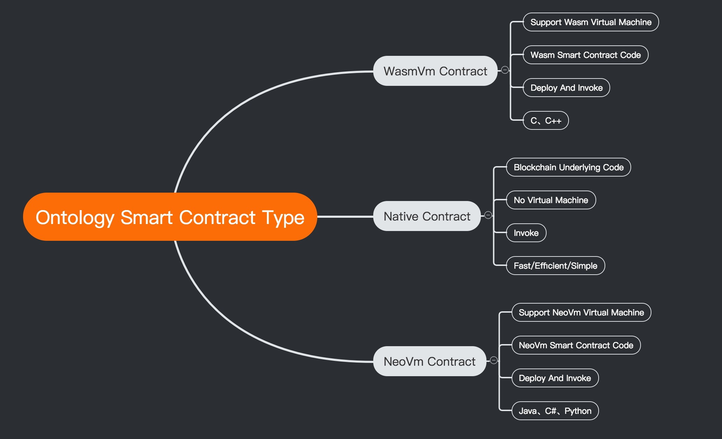

Slide 10
Environment Setting
Setup an ontology node in local.
Build from source code
git clone https://github.com/ontio/ontology.git
glide install
make
Use the release
https://github.com/ontio/ontology/releases

Slide 11
Environment Setting
Start test mode
Create wallet:
./ontology account add –d
Startup node:
./ontology –-testmode
More startup arguments:
./ontology --help

Slide 12
Toolkits
Smart contract compiler
SDK
Test Framework
SmartX
dAPI

Slide 13
Smart contract compilers
C# :
http://docs.neo.org/en-us/sc/quickstart/getting-started-csharp.html
Golang:
https://github.com/ontio/neo-go-compiler
Python:
https://github.com/ontio/neo-boa

Slide 14
Ontology SDK
Golang SDK:
https://github.com/ontio/ontology-go-sdk
Java SDK:
https://github.com/ontio/ontology-java-sdk
Python SDK:
https://github.com/ontio/ontology-python-sdk
TS SDK:
https://github.com/ontio/ontology-ts-sdk

Slide 15
Ontology SDK
Wallet file management
Digital identity and verifiable claim management
Digital assets
Smart contract deployment and invocation
Basic interactions with blockchain nodes

Slide 16
Test Framework
Ontology-test:
https://github.com/ontio/ontology-test
Smart contract Test Framework
https://github.com/ontio-community/ontology-sctf

Slide 17
SmartX
https://smartx.ont.io/#/

Slide 18
Cyano wallet
Cyano wallet plugin
You can use Cyano wallet to transfer ont/ong
Deploy & invoke smart contract
You can config the connection of mainnet / testnet /private net

Slide 19
How to develop smart contract
A smart contract is essentially a binary script that runs on a blockchain, and in theory it can implement arbitrary business logic. Generally there are two steps for a smart contract: Deploy and Invoke.

Slide 20
A simple smart contract
from boa.interop.System.Runtime import Notify
def Main(operation, args):
if operation == 'Hello':
msg = args[0]
return Hello(msg)
return False
def Hello(msg):
Notify(msg)
return msg

Slide 21
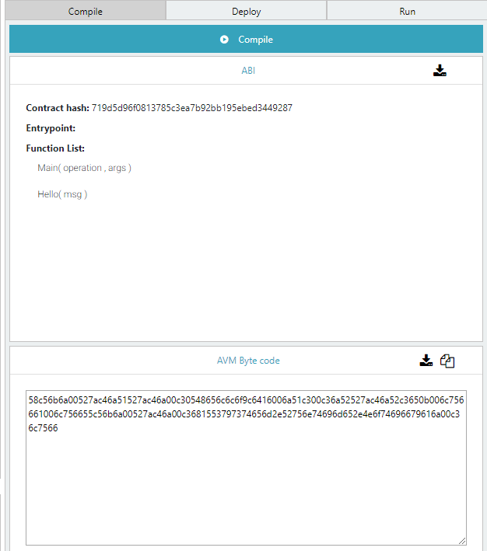
Compile smart contract

Slide 22
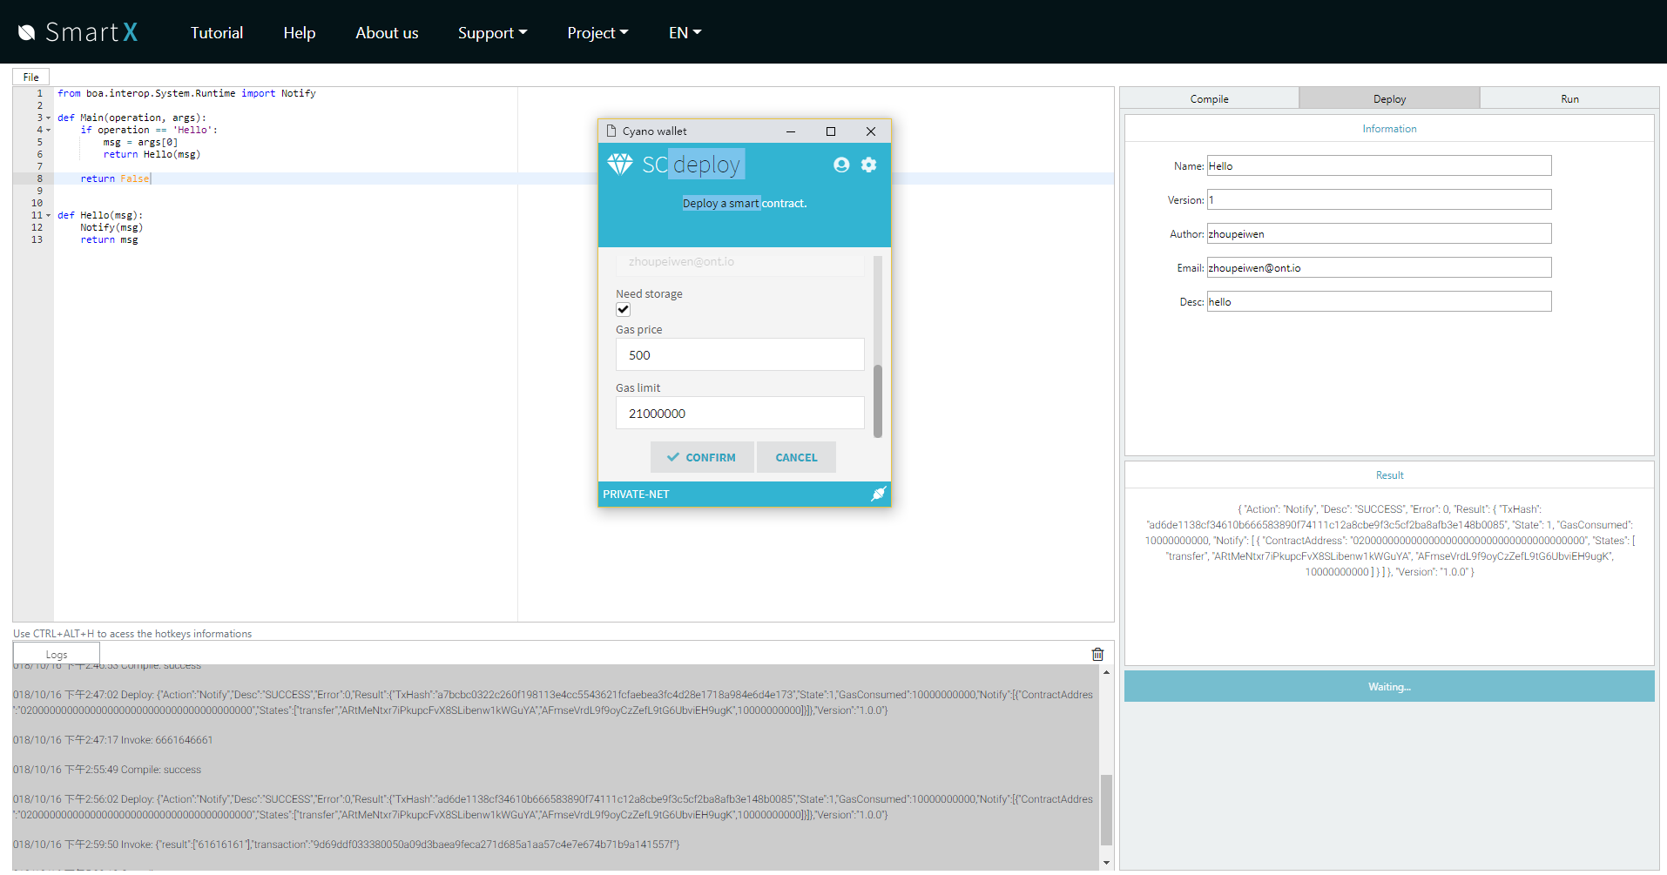
Deploy smart contract

Slide 23
Invoke smart contract
Pre-execute(pre-Run)
Node will invoke the contract but never commit the storage change, and also costs no ONG .
Execute (Run)
Node will commit the storage change, and costs ONG based on steps , storage and other calls

Slide 24
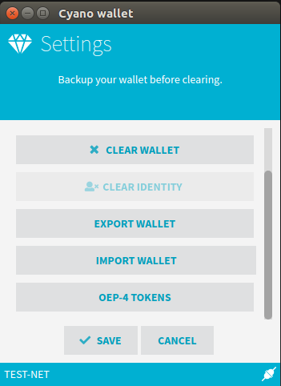
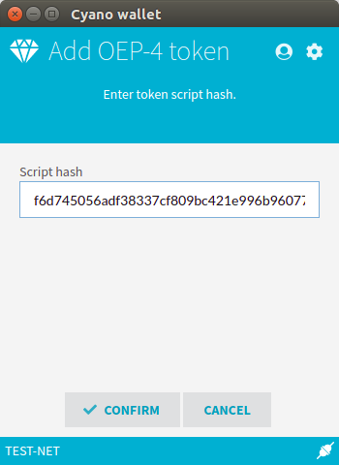
Check your token in Cyano

Slide 25
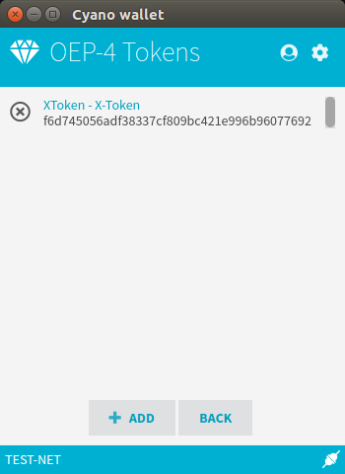
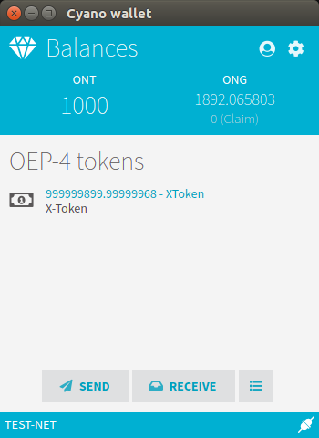

Slide 26
Python APIs
API document
https://github.com/ontio/neo-boa/blob/master/Ontology%20smart%20contract%20API%20for%20Python.md

Slide 27
Practice
An OEP-4 Sample
The OEP-4 Proposal is a standard interface for tokens, this standard allows for the implementation of a standard API for tokens within smart contracts.
https://github.com/ontio/OEPs/blob/master/OEP-4/OEP-Token-Standard.mediawiki

Slide 28
Practice
Get the template contract code:
https://github.com/ONT-Avocados/python-template/blob/master/OEP4Sample_raise_Exception/OEP4Sample_raiseException.py
Create a new python project in SmartX and paste the code.
Deploy and invoke the smart contract

Slide 29
dAPI
dAPI is a lightweight JS library for developers to interact with Ontology blockchian easily, which supports message signature, wallet management, smart contracts interaction and more.
https://github.com/ontio/ontology-dapi

Slide 30
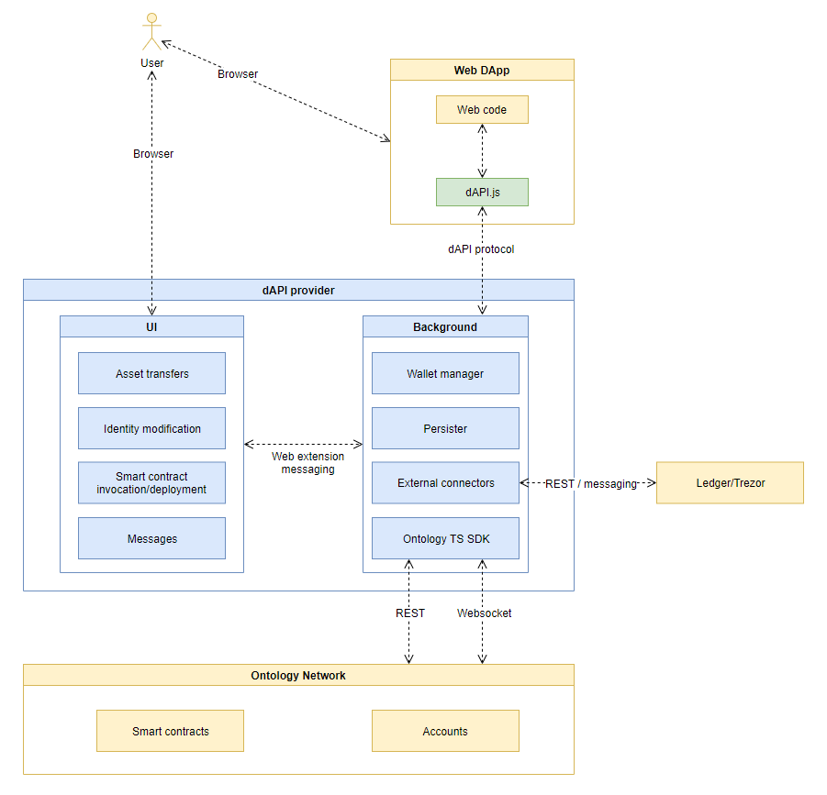
dAPI

Slide 31
Wallet sample using dApi
Claim test net ONT and ONG
http://13.78.112.191:8080/tokenapply/<your address>
Deploy the OEP4 contract to test net
Create a wallet using dAPI
Display the name, symbol, balance
Transfer token
https://github.com/punica-box/oep4-box

Slide 32
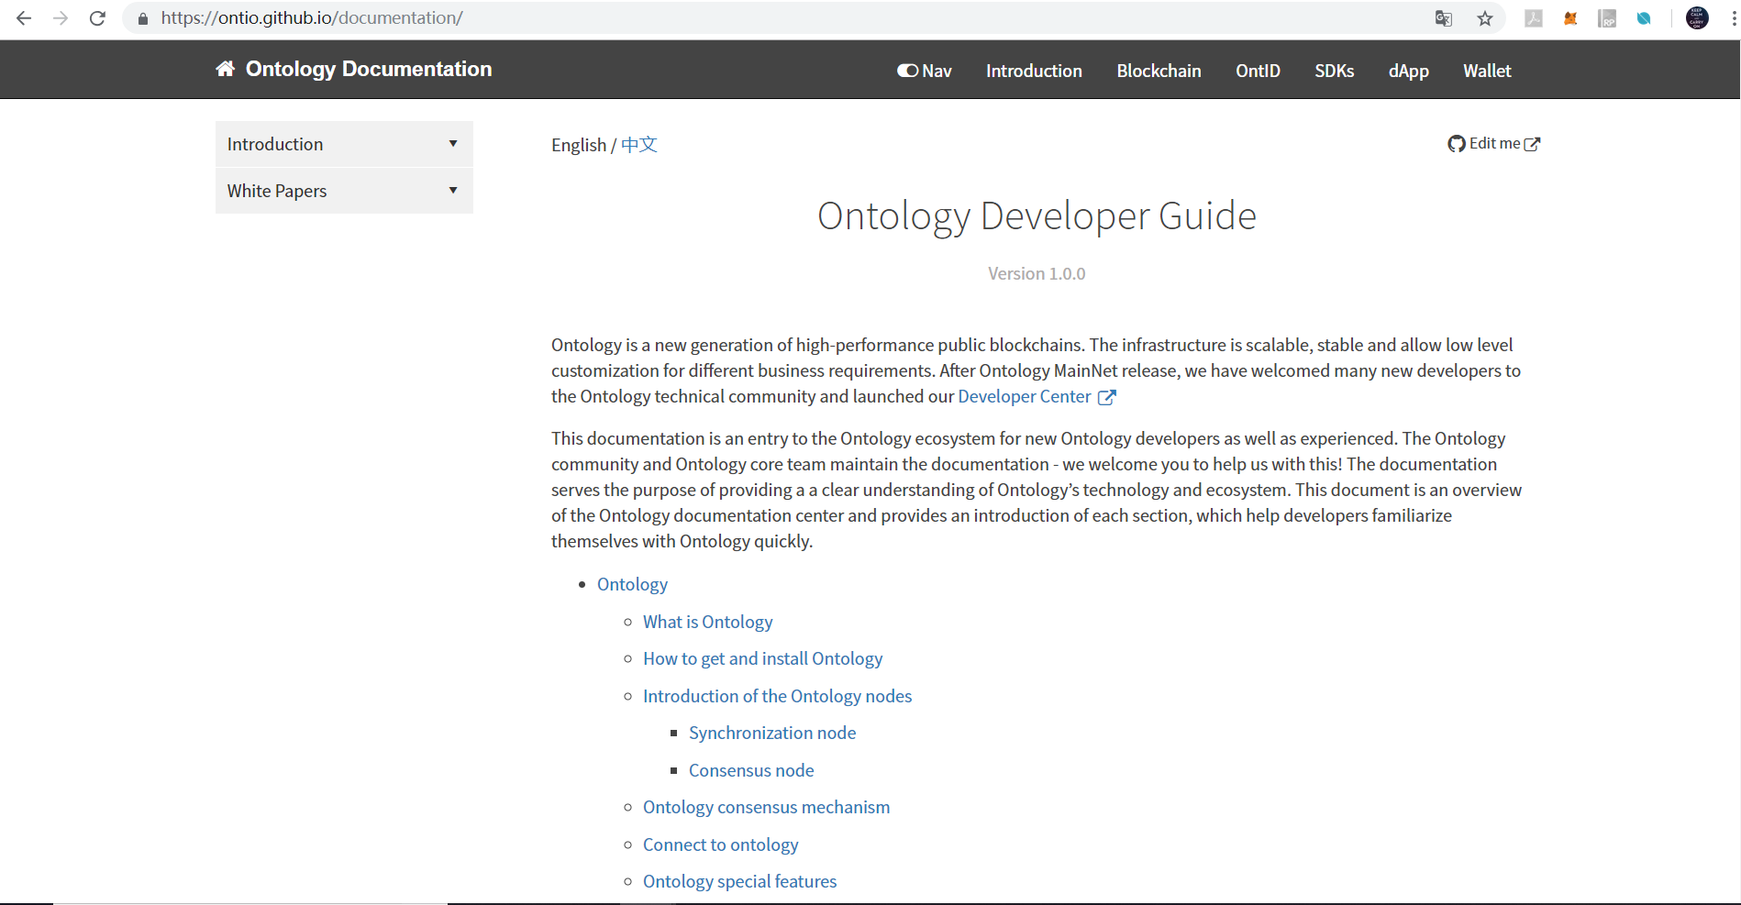
Document center
https://ontio.github.io/documentation/

Slide 33
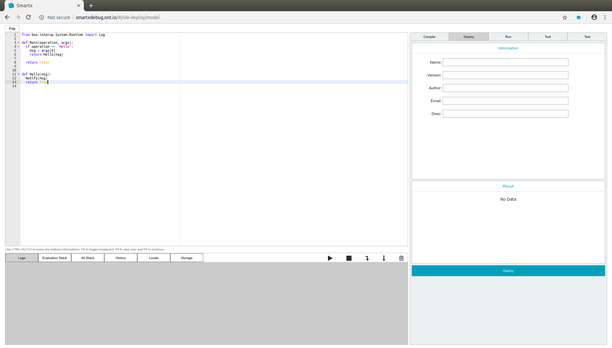
SmartX debug

Slide 34

Punica Suite
The Ontology blockchain dApp development framework.
https://github.com/punicasuite
Punica
Punica-python
Punica-ts
Punica box
Solo chain
Smart contract package manager

Slide 35
Community
Developer center
https://developer.ont.io/
Bounty
https://bounty.ont.io/index.php/index/index

Slide 36
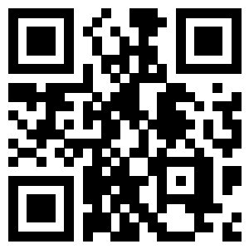
Telegram
https://t.me/OntologyJpn

Slide 37
Q & A

Slide 38
Thank you very much

