Slide 1
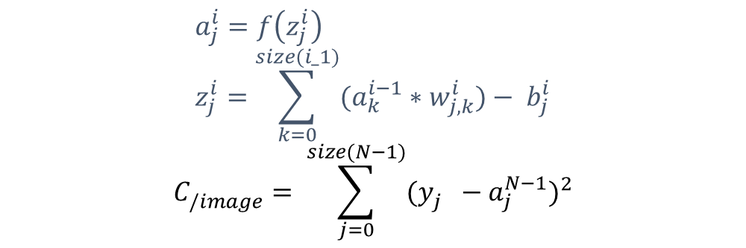




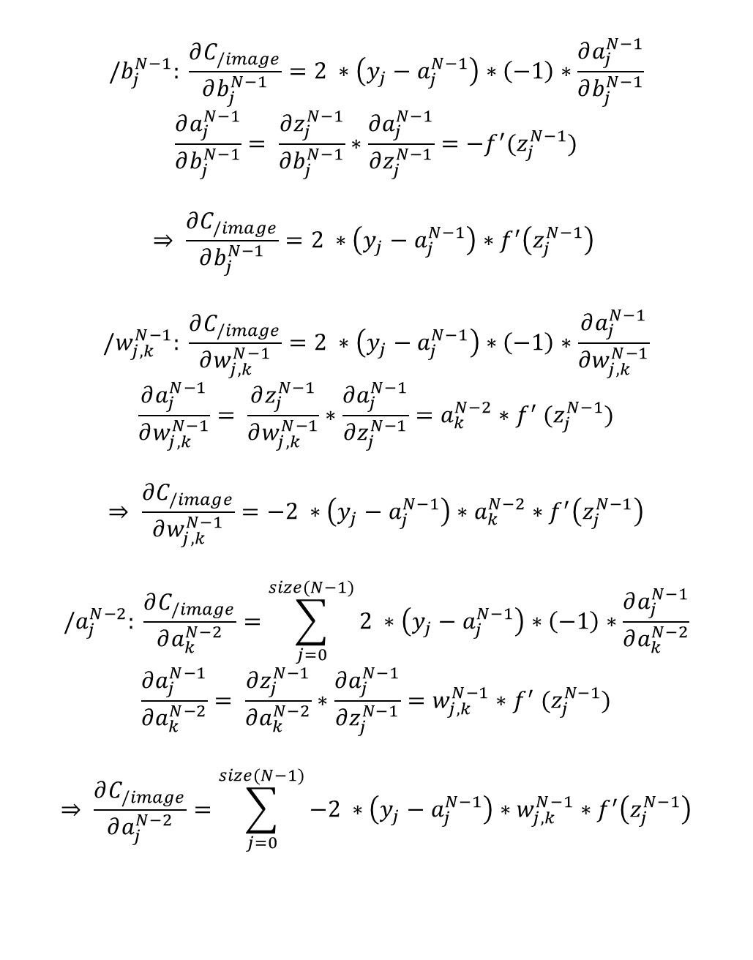










$$/b_{j}^{N−1}: \frac{∂C_{/image}}{∂b_{j}^{N−1}}=2 ∗\left(y_{j}−a_{j}^{N−1}\right)∗\left(−1\right)∗\frac{∂a_{j}^{N−1}}{∂b_{j}^{N−1}}$$
$$\frac{∂a_{j}^{N−1}}{∂b_{j}^{N−1}}= \frac{∂z_{j}^{N−1}}{∂b_{j}^{N−1}}∗\frac{∂a_{j}^{N−1}}{∂z_{j}^{N−1}}=−f^{′}(z_{j}^{N−1})$$
$$⇒ \frac{∂C_{/image}}{∂b_{j}^{N−1}}=2 ∗\left(y_{j}−a_{j}^{N−1}\right)∗f^{′}\left(z_{j}^{N−1}\right)$$
$$/w_{j,k}^{N−1}: \frac{∂C_{/image}}{∂w_{j,k}^{N−1}}=2 ∗\left(y_{j}−a_{j}^{N−1}\right)∗\left(−1\right)∗\frac{∂a_{j}^{N−1}}{∂w_{j,k}^{N−1}}$$
$$\frac{∂a_{j}^{N−1}}{∂w_{j,k}^{N−1}}= \frac{∂z_{j}^{N−1}}{∂w_{j,k}^{N−1}}∗\frac{∂a_{j}^{N−1}}{∂z_{j}^{N−1}}=a_{k}^{N−2}{∗f}^{′}(z_{j}^{N−1})$$
$$⇒ \frac{∂C_{/image}}{∂w_{j,k}^{N−1}}=−2 ∗\left(y_{j}−a_{j}^{N−1}\right)∗a_{k}^{N−2}∗f^{′}\left(z_{j}^{N−1}\right)$$
$$/a_{j}^{N−2}: \frac{∂C_{/image}}{∂a_{k}^{N−2}}=\sum_{j=0}^{size(N−1)}{2 ∗\left(y_{j}−a_{j}^{N−1}\right)∗\left(−1\right)∗\frac{∂a_{j}^{N−1}}{∂a_{k}^{N−2}}}$$
$$\frac{∂a_{j}^{N−1}}{∂a_{k}^{N−2}}= \frac{∂z_{j}^{N−1}}{∂a_{k}^{N−2}}∗\frac{∂a_{j}^{N−1}}{∂z_{j}^{N−1}}=w_{j,k}^{N−1}{∗f}^{′}(z_{j}^{N−1})$$
$$⇒ \frac{∂C_{/image}}{∂a_{j}^{N−2}}=\sum_{j=0}^{size(N−1)}{−2 ∗\left(y_{j}−a_{j}^{N−1}\right)∗w_{j,k}^{N−1}∗f^{′}\left(z_{j}^{N−1}\right)}$$
couche N-2
y
$$b_{0}^{N−2}$$
nœud j (y-axis)
$$a_{0}^{N−2}$$
$$w_{j,0}^{N−1}$$
x
$$b_{1}^{N−2}$$
couche N-1 (dernière couche)
$$a_{1}^{N−2}$$
$$w_{j,1}^{N−1}$$
$$b_{0}^{N−1}$$
$$a_{0}^{N−1}$$
$$b_{1}^{N−1}$$
$$a_{1}^{N−1}$$
$$b_{j}^{N−2}$$
$$a_{j}^{N−2}$$
$$b_{j}^{N−1}$$
$$a_{j}^{N−1}$$
$$a_{j}^{i}=f\left(z_{j}^{i}\right) \\ z_{j}^{i}=\sum_{k=0}^{size(i_1)}{(a_{k}^{i−1}∗w_{j,k}^{i})}− b_{j}^{i}$$
$$C_{/image}^{}= \sum_{j=0}^{size(N−1)}{{(y_{j}^{}−a_{j}^{N−1})}^{2}}$$

Slide 2



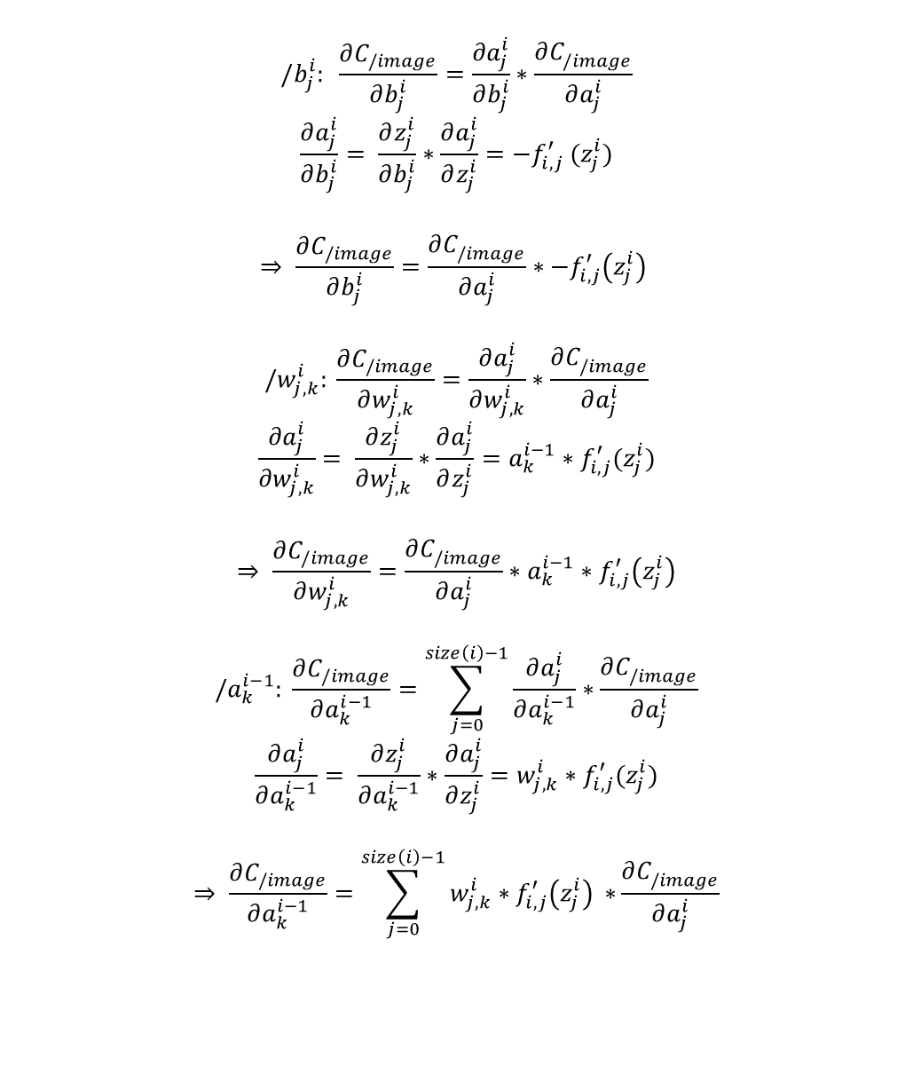






$$/b_{j}^{i}: \frac{∂C_{/image}}{∂b_{j}^{i}}=\frac{∂a_{j}^{i}}{∂b_{j}^{i}}∗\frac{∂C_{/image}^{}}{∂a_{j}^{i}}$$
$$\frac{∂a_{j}^{i}}{∂b_{j}^{i}}= \frac{∂z_{j}^{i}}{∂b_{j}^{i}}∗\frac{∂a_{j}^{i}}{∂z_{j}^{i}}=−f_{i,j}^{′} (z_{j}^{i})$$
$$⇒ \frac{∂C_{/image}}{∂b_{j}^{i}}=\frac{∂C_{/image}^{}}{∂a_{j}^{i}}∗−f_{i,j}^{′}\left(z_{j}^{i}\right)$$
$$/w_{j,k}^{i}: \frac{∂C_{/image}}{∂w_{j,k}^{i}}=\frac{∂a_{j}^{i}}{∂w_{j,k}^{i}}∗\frac{∂C_{/image}^{}}{∂a_{j}^{i}}$$
$$\frac{∂a_{j}^{i}}{∂w_{j,k}^{i}}= \frac{∂z_{j}^{i}}{∂w_{j,k}^{i}}∗\frac{∂a_{j}^{i}}{∂z_{j}^{i}}=a_{k}^{i−1}∗f_{i,j}^{′}(z_{j}^{i})$$
$$⇒ \frac{∂C_{/image}}{∂w_{j,k}^{i}}=\frac{∂C_{/image}^{}}{∂a_{j}^{i}}∗a_{k}^{i−1}∗f_{i,j}^{′}\left(z_{j}^{i}\right)$$
$$/a_{k}^{i−1}: \frac{∂C_{/image}}{∂a_{k}^{i−1}}=\sum_{j=0}^{size\left(i\right)−1}{\frac{∂a_{j}^{i}}{∂a_{k}^{i−1}}∗\frac{∂C_{/image}^{}}{∂a_{j}^{i}}}$$
$$\frac{∂a_{j}^{i}}{∂a_{k}^{i−1}}= \frac{∂z_{j}^{i}}{∂a_{k}^{i−1}}∗\frac{∂a_{j}^{i}}{∂z_{j}^{i}}=w_{j,k}^{i}∗f_{i,j}^{′}(z_{j}^{i})$$
$$⇒ \frac{∂C_{/image}}{∂a_{k}^{i−1}}=\sum_{j=0}^{size\left(i\right)−1}{w_{j,k}^{i}∗f_{i,j}^{′}\left(z_{j}^{i}\right) ∗}\frac{∂C_{/image}^{}}{∂a_{j}^{i}}$$
$$b_{0}^{i}$$
$$w_{j,0}^{i}$$
$$a_{0}^{i}$$
$$w_{j,1}^{i}$$
$$b_{1}^{i}$$
$$a_{1}^{i}$$
$$b_{j}^{i}$$
$$a_{j}^{i}$$
$$a_{j}^{i}=f\left(z_{j}^{i}\right) \\ z_{j}^{i}=\sum_{k=0}^{size(i_1)}{(a_{k}^{i−1}∗w_{j,k}^{i})}− b_{j}^{i}$$
$$C_{/image}^{}= \sum_{j=0}^{size(N−1)}{{(y_{j}^{}−a_{j}^{N−1})}^{2}}$$

Slide 3

les formules de la diapo 2 marchent même pour la 1ère (dans l’ordre de calcul) couche. Il faut juste avoir rentré les dérivées partielles du coût par rapport aux valeurs de la dernière couche :
$$\frac{∂C_{/image}}{∂a_{j}^{N−1}}=−2 ∗\left(y_{j}−a_{j}^{N−1}\right)$$
$\frac{∂C_{/image}}{∂A^{N−1}}=−2 ∗\left(y−A^{N−1}\right) (l)$
$\frac{∂C_{/image}}{∂A^{N−1}}=−2 ∗\left(y−A^{N−1}\right) (l)$
$$\boxed{\frac{∂C_{/image}}{∂A^{N−1}}=−2 ∗\left(y−A^{N−1}\right) }$$

Slide 4
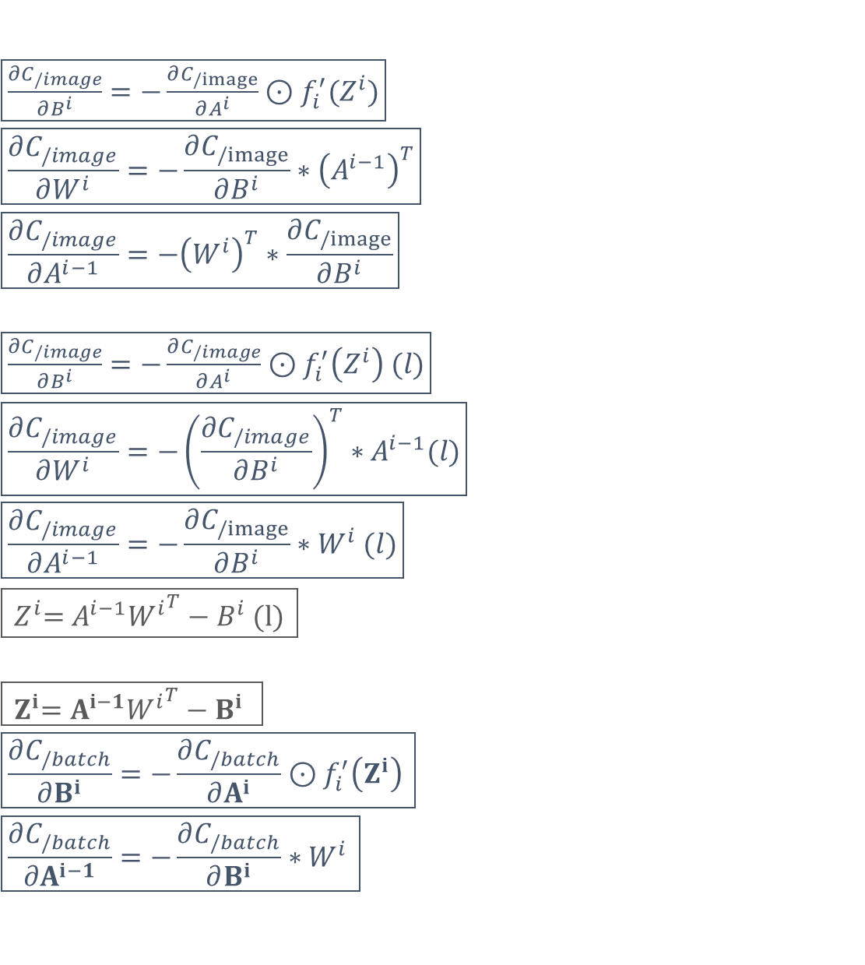
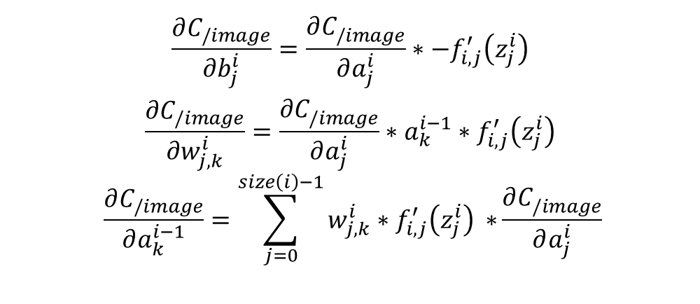
$\boxed{\frac{∂C_{/image}}{∂B^{i}}=−\frac{∂C_{/image}}{∂A^{i}}⊙f_{i}^{′}(Z^{i})}$
$$\boxed{\frac{∂C_{/image}}{∂W^{i}}=−\frac{∂C_{/image}}{∂B^{i}}∗{\left(A^{i−1}\right)}^{T}}$$
$$\boxed{\frac{∂C_{/image}}{∂A^{i−1}}={−\left(W^{i}\right)}^{T}∗\frac{∂C_{/image}}{∂B^{i}}}$$
$\boxed{\frac{∂C_{/image}}{∂B^{i}}=−\frac{∂C_{/image}}{∂A^{i}}⊙f_{i}^{′}\left(Z^{i}\right) (l)}$
$$\boxed{\frac{∂C_{/image}}{∂W^{i}}=−{\left(\frac{∂C_{/image}}{∂B^{i}}\right)}^{T}∗A^{i−1}(l)}$$
$$\boxed{\frac{∂C_{/image}}{∂A^{i−1}}=−\frac{∂C_{/image}}{∂B^{i}}∗W^{i} (l)}$$
$$\boxed{{ Z}^{i}=A^{i−1}{W^{i}}^{T}−B^{i}\text{ (}\text{l}\text{)} }$$
$$\boxed{{ Z}^{i}=A^{i−1}{W^{i}}^{T}−B^{i} }$$
$$\boxed{\frac{∂C_{/batch}}{∂B^{i}}=−\frac{∂C_{/batch}}{∂A^{i}}⊙f_{i}^{′}\left(Z^{i}\right) }$$
$$\boxed{\frac{∂C_{/batch}}{∂A^{i−1}}=−\frac{∂C_{/batch}}{∂B^{i}}∗W^{i} }$$
Vectorisation des opérations
$$\frac{∂C_{/image}}{∂b_{j}^{i}}=\frac{∂C_{/image}^{}}{∂a_{j}^{i}}∗−f_{i,j}^{′}\left(z_{j}^{i}\right)$$
$$\frac{∂C_{/image}}{∂w_{j,k}^{i}}=\frac{∂C_{/image}^{}}{∂a_{j}^{i}}∗a_{k}^{i−1}∗f_{i,j}^{′}\left(z_{j}^{i}\right)$$
$$\frac{∂C_{/image}}{∂a_{k}^{i−1}}=\sum_{j=0}^{size\left(i\right)−1}{w_{j,k}^{i}∗f_{i,j}^{′}\left(z_{j}^{i}\right) ∗}\frac{∂C_{/image}^{}}{∂a_{j}^{i}}$$
rq : toutes les variables sont à b (batch) fixé.

Slide 5
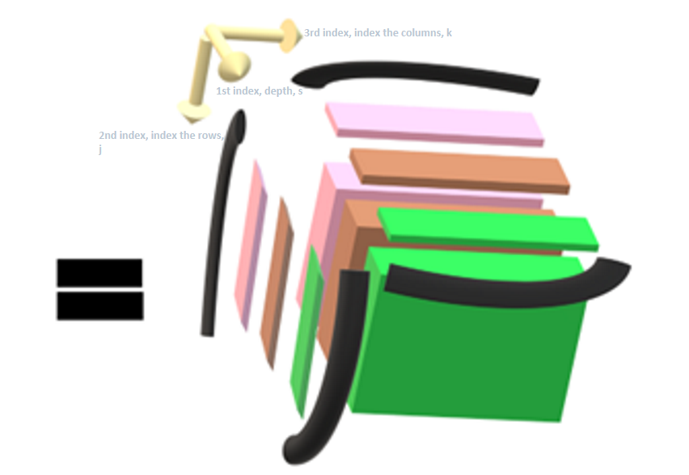
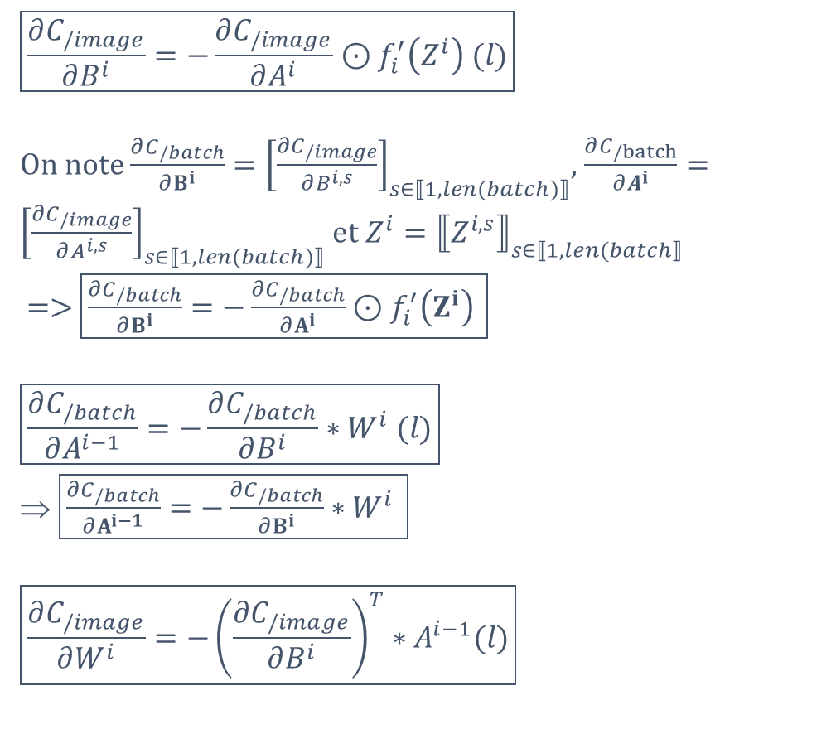
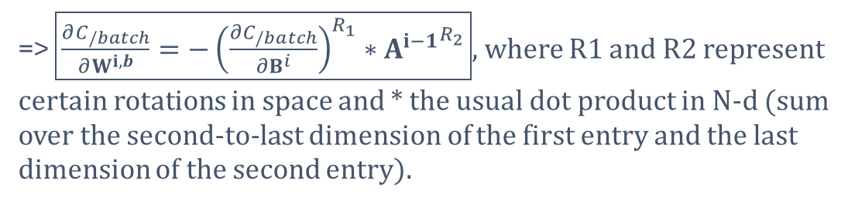
$$\boxed{\frac{∂C_{/image}}{∂B^{i}}=−\frac{∂C_{/image}}{∂A^{i}}⊙f_{i}^{′}\left(Z^{i}\right) (l)}$$
On note $\frac{∂C_{/batch}}{∂B^{i}}={\left[\frac{∂C_{/image}}{∂B^{i,s}}\right]}_{s∈⟦1, len(batch)⟧}$, $\frac{∂C_{/batch}}{∂A^{i}}={\left[\frac{∂C_{/image}}{∂A^{i,s}}\right]}_{s∈⟦1, len(batch)⟧}$ et $Z^{i}={⟦Z^{i,s}⟧}_{s∈⟦1, len(batch⟧}$
=> $\boxed{\frac{∂C_{/batch}}{∂B^{i}}=−\frac{∂C_{/batch}}{∂A^{i}}⊙f_{i}^{′}\left(Z^{i}\right) }$
$$\boxed{\frac{∂C_{/batch}}{∂A^{i−1}}=−\frac{∂C_{/batch}}{∂B^{i}}∗W^{i} (l)}$$
$\boxed{\frac{∂C_{/batch}}{∂A^{i−1}}=−\frac{∂C_{/batch}}{∂B^{i}}∗W^{i} }$
$$\boxed{\frac{∂C_{/image}}{∂W^{i}}=−{\left(\frac{∂C_{/image}}{∂B^{i}}\right)}^{T}∗A^{i−1}(l)}$$
=> $\boxed{\frac{∂C_{/batch}}{∂W^{i,b}}=−{\left(\frac{∂C_{/batch}}{∂B^{i}}\right)}^{R_{1}}∗{A^{i−1}}^{R_{2}}}$, where R1 and R2 represent certain rotations in space and * the usual dot product in N-d (sum over the second-to-last dimension of the first entry and the last dimension of the second entry).

Slide 6
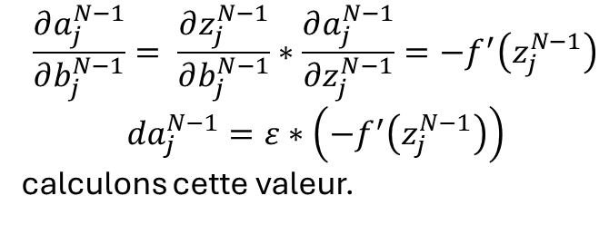
$$\frac{∂a_{j}^{N−1}}{∂b_{j}^{N−1}}= \frac{∂z_{j}^{N−1}}{∂b_{j}^{N−1}}∗\frac{∂a_{j}^{N−1}}{∂z_{j}^{N−1}}=−f^{′}\left(z_{j}^{N−1}\right)$$
$${da}_{j}^{N−1}=ε∗\left(−f^{′}\left(z_{j}^{N−1}\right)\right)$$
calculons cette valeur.

