Slide 1







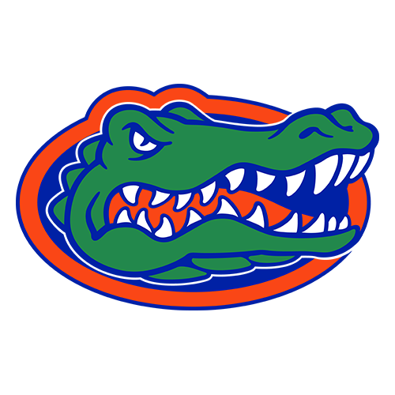


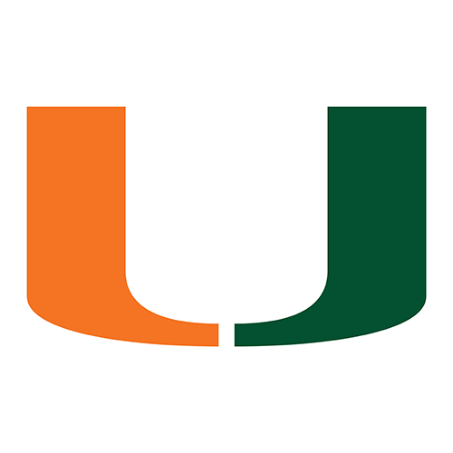





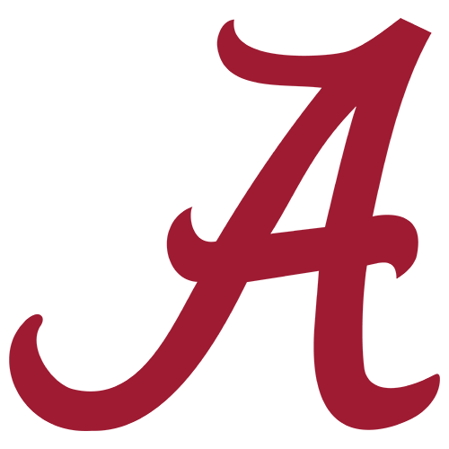





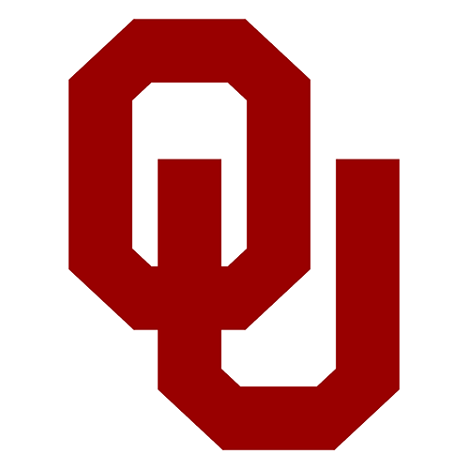


EPISODE 3 · WEEK 2 · THE MACHINE'S TOP 25
Our Top 25
Machine rating · Δ vs preseason · AP week 2 poll
RATING
Δ PRE
VOTERS
RATING
Δ PRE
VOTERS
1
Notre Dame
27.3
+1.4
AP 3
14
USC
15.2
-1.8
AP 14
2
Texas
25.8
-1.1
AP 4
15
Tennessee
15.1
0.0
AP 18
3
Georgia
24.8
0.0
AP 2
16
Penn State
14.3
+0.6
AP 16
4
Ohio State
24.6
-4.1
AP 1
17
Florida
13.7
+0.1
NR
5
LSU
23.8
+3.8
AP 8
18
BYU
13.1
0.0
AP 15
6
Miami
23.2
+1.4
AP 7
19
Missouri
12.2
0.0
AP 23
7
Indiana
22.3
-0.8
AP 5
20
Virginia
11.8
+3.9
AP 25
8
Oregon
21.9
-3.4
AP 6
21
Michigan
11.6
-4.3
NR
9
Alabama
21.1
+1.0
AP 12
22
SMU
11.4
+0.3
AP 17
10
Texas Tech
20.0
0.0
AP 13
23
Auburn
11.1
-0.9
NR
11
Texas A&M
19.0
-1.0
AP 10
24
South Carolina
10.9
-0.8
NR
12
Oklahoma
16.0
-1.8
AP 11
25
Iowa
10.7
+0.1
AP 21
13
Ole Miss
15.3
-0.7
AP 9
Biggest splits: Virginia #20 vs AP #25 · SMU #22 vs AP #17 · Ole Miss #13 vs AP #9
Ours, not theirs: Florida, Michigan, Auburn, South Carolina · Theirs, not ours: Washington, Utah, Houston, Louisville

Slide 2









EPISODE 3 · WEEK 2 · THE SEAT BOARD
Hot Seat Top 10
60% CBS rating + 40% machine odds of missing the bar
COACH · SCHOOL
TENURE
CBS
NEEDS
P(GETS IT)
MACHINE WINS
Δ
SCORE
LAST RESULT
1
Mike Norvell · Florida State
38-34, yr 7
5.0
8 W
20%
6.2 (4–8)
-2.4
92
L 24-27 vs SMU
2
Mike Locksley · Maryland
37-49, yr 8
4.9
6 W
50%
5.5 (4–7)
0.0
79
W 62-0 vs Hampton
3
Dave Aranda · Baylor
36-37, yr 7
5.0
7 W
63%
7.0 (5–9)
+0.9
75
L 16-17 at Auburn
4
Greg Schiano · Rutgers
31-41 2nd stint, yr 7
3.0*
6 W
5%
3.6 (2–5)
-7.4
74
L 21-37 vs Massachusetts
5
Luke Fickell · Wisconsin
17-21, yr 4
5.0
6 W
67%
6.2 (4–8)
-1.4
73
L 13-41 at Notre Dame
6
Shane Beamer · South Carolina
33-30, yr 6
4.3
7 W
47%
6.4 (5–8)
-0.8
73
W 57-0 vs Kent State
7
Derek Mason · Middle Tennessee
3-9 in 2024, yr 3
3.6
6 W
30%
4.7 (3–7)
0.0
71
W 38-14 vs Murray State
8
Bill O'Brien · Boston College
9-16, yr 3
3.5
5 W
28%
3.8 (2–5)
-1.9
71
L 15-34 at Cincinnati
9
Dabo Swinney · Clemson
186-53, yr 18
3.1
9 W
22%
7.3 (5–9)
-3.8
68
L 10-51 at LSU
10
Bill Belichick · North Carolina
4-8, yr 2
4.1
6 W
63%
6.0 (4–8)
+1.3
64
W 15-10 at TCU
Next three: Kalen DeBoer 64 · Dave Doeren 64 · Bryant Vincent 63
NEEDS = wins that keep the job · P(GETS IT) = the machine's odds · MACHINE WINS = projected (10th–90th)

Slide 3
EPISODE 3 · WEEK 2 · OUR HEISMAN BOARD
Our Heisman Favorite
Team factor × QB efficiency (PPA per play) · market = DraftKings
QUARTERBACK · TEAM
2026 PPA (PLAYS)
2025 PRIOR
BLEND
TEAM P(10+)
INDEX
MARKET
MKT RANK
MAN VS MACHINE
1
Julian Sayin · Ohio State
0.934 (28)
0.545
0.606
47%
44.7
+1400
#8
market too low
Best returning efficiency in the sport · market has him 8th
2
Darian Mensah · Miami
1.107 (31)
0.371
0.497
74%
43.2
+600
#1
agree
One huge game vs Stanford · Duke prior · best team factor
3
C.J. Carr · Notre Dame
0.398 (31)
0.433
0.427
91%
40.9
+1100
#4
agree
Carried by Notre Dame's 91% · average line so far
4
Josh Hoover · Indiana
1.639 (15)
0.353
0.470
73%
40.6
+1900
#11
market too low
1.639 on 15 plays · Indiana's offense
5
Will Hammond · Texas Tech
0.420 (35)
0.376
0.384
80%
34.5
off board
—
unpriced
Situation, not tape · Texas Tech's 80%
Next up: Dante Moore 31.3 (market #6) · Jayden Maiava 30.9 (market #10) · Arch Manning 30.6 (market #2) · Sam Leavitt 25.9 (market #9)
★ OUR FAVORITE
Julian Sayin, Ohio State · index 44.7 · market +1400
Non-QB watch: Jeremiah Smith (+1000) · Malachi Toney (+1250) · Ryan Wingo · Trent Mosley
PPA = predicted points added per play · re-computes every rebuild

Slide 4


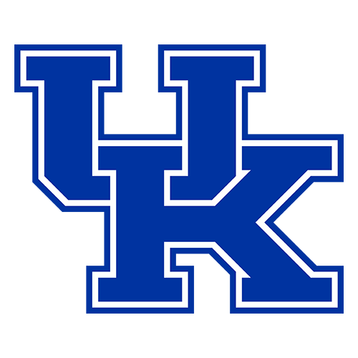
EPISODE 3 · WEEK 2 · SEP 12, 2026
Five Games, One Card
Oklahoma at Michigan
Oklahoma –2 · +5.5 / +5.5
Ann Arbor · Michigan Stadium
machine · market
Arizona State at Texas A&M
Texas A&M –16.5 · –14.5 / –14
College Station · Kyle Field
machine · market
Arizona at BYU
BYU –8.5 · –7.5 / –7.5
Provo · LaVell Edwards Stadium
machine · market
Alabama at Kentucky
Alabama –13 · +10.5 / +10.5
Lexington · Kroger Field
machine · market
Ohio State at Texas
Texas –3.5 · –1.5 / –2
Austin · DKR–Texas Memorial Stadium
machine · market
Machine = our in-season rating + 2.5 home field · lines as of Sep 9

Slide 5

Week 1 — the receipts
Calls frozen at recording · closing line = last pre-kick pull · off by = miss vs the final margin
Baylor vs Auburn
our line Auburn –5.5 · closing Auburn –7.5
we called Auburn 33–27 · FINAL Auburn 17–16
machine off by 4.5 · market off by 6.5 — machine closer
Clemson at LSU
our line LSU –9 · closing LSU –10
we called LSU 30–21 · FINAL LSU 51–10
machine off by 32 · market off by 31 — market closer
Louisville vs Ole Miss
our line Ole Miss –6.5 · closing Ole Miss –6.5
we called Ole Miss 31–25 · FINAL Ole Miss 41–38
machine off by 3.5 · market off by 3.5 — dead tie
Wisconsin vs Notre Dame
our line Notre Dame –21 · closing Notre Dame –20.5
we called ND 34–13 · FINAL Notre Dame 41–13
machine off by 7 · market off by 7.5 — machine closer
SMU at Florida State
our line Florida State –0.5 · closing SMU –2.5
we called FSU 27–26 · FINAL SMU 27–24
machine off by 3.5 · market off by 0.5 — market closer
Machine 50.5 · market 49.0 · machine closer in 2, market 2, 1 tie
Season: machine 120.5 vs market 119.0 · stated leans 3–2 · Monster Under cashed

Slide 6
at
Oklahoma at Michigan
Sat Sep 12 · 12:00 ET · Ann Arbor
WHY IT MATTERS
THE NUMBER
An eight-point line swing
Oklahoma –2
Michigan +118 · Oklahoma –118
Whittingham's first Big House test
machine line · fair odds, no vig · raw margin Oklahoma +1.9
+5.5 / +5.5
Underwood vs Mateer
market (DK / Bovada) · DK Michigan +190 / Oklahoma -230 · Bov Michigan +175 / Oklahoma -210
Payback for 24–13
Oklahoma 23 – Michigan 21
score prediction
MICH 46%
54% OU
Lean Michigan +5.5 — research, not a position
win probability (machine)
LINE MOVE –2.5 → +5.5 · CLV +8
Line movement: first-seen –2.5 (Aug 18) → now +5.5 · opened –1.5 · CLV +8

Slide 7
Oklahoma
What it takes to win · Oklahoma at Michigan
COACH
QB
ROSTER
Venables, year 5
Mateer returns, senior
63% back · 16 portal adds
Mateer's legs vs Hill's pressure
The portal line has to prove it
Erase Underwood's bad day
Win the hidden yards
EP 3 · WEEK 2 · Oklahoma at Michigan

Slide 8
Michigan
What it takes to win · Oklahoma at Michigan
COACH
QB
ROSTER
NEW — Whittingham (Utah)
Underwood, year two
69% back · the Utah pipeline
Own the ball
Run Underwood like Dampier
Find receiver No. 2
Pressure without the busts
EP 3 · WEEK 2 · Oklahoma at Michigan

Slide 9
at
Arizona State at Texas A&M
Sat Sep 12 · 12:00 ET · College Station
WHY IT MATTERS
THE NUMBER
Dillingham's reboot vs an 11-win roster
Texas A&M –16.5
Texas A&M –560 · Arizona State +560
Boley's second start
machine line · fair odds, no vig · raw margin Texas A&M +16.7
–14.5 / –14
A&M's portal-built lines
market (DK / Bovada) · DK Texas A&M -650 / Arizona State +470 · Bov Texas A&M -650 / Arizona State +450
No 2026 snaps in the number
Texas A&M 34 – Arizona State 17
score prediction
TAMU 85%
15% ASU
Agreement — no play
win probability (machine)
LINE MOVE –14.5 → –14.5
Line movement: first-seen –14.5 (Aug 23) → now –14.5 · CLV +0

Slide 10
Arizona State
What it takes to win · Arizona State at Texas A&M
COACH
QB
ROSTER
Dillingham, year 4
NEW — Cutter Boley
16% back · 24 portal adds
Tempo the transfer front
Boley vs real disguise
Contain before you gamble
Fix special teams
EP 3 · WEEK 2 · Arizona State at Texas A&M

Slide 11
Texas A&M
What it takes to win · Arizona State at Texas A&M
COACH
QB
ROSTER
Elko, year 3 · two new coordinators
Reed returns
73% back · both lines rebuilt
Reed's ball security
Prove the portal line
Havoc from the new front
Finish drives, cut the flags
EP 3 · WEEK 2 · Arizona State at Texas A&M

Slide 12
at
Arizona at BYU
Sat Sep 12 · 3:30 ET · Provo · Big 12 opener
WHY IT MATTERS
THE NUMBER
The Big 12's continuity kings
BYU –8.5
BYU –239 · Arizona +239
Provo's biggest game until Notre Dame
machine line · fair odds, no vig · raw margin BYU +8.4
–7.5 / –7.5
Poppinga replaces Hill
market (DK / Bovada) · DK BYU -290 / Arizona +235 · Bov BYU -310 / Arizona +255
BYU took four, Arizona gave three
BYU 28 – Arizona 20
score prediction
BYU 70%
30% ARIZ
Machine = market — no play
win probability (machine)
LINE MOVE –7 → –7.5 · CLV +0.5
Line movement: first-seen –7 (Sep 4) → now –7.5 · opened –6.5 · CLV +0.5

Slide 13
Arizona
What it takes to win · Arizona at BYU
COACH
QB
ROSTER
Brennan, year 3
Fifita returns, year four
65% back · 22 portal adds
Attack Poppinga early
Hold the line vs Martin
Ball security
Win field position
EP 3 · WEEK 2 · Arizona at BYU

Slide 14
BYU
What it takes to win · Arizona at BYU
COACH
QB
ROSTER
Sitake, year 11 · new DC Poppinga
Bachmeier, year two
79% back · most on the card
Run first, then punish
Martin and Eka behind the veterans
Prove the new receivers
Win the hidden margin
EP 3 · WEEK 2 · Arizona at BYU

Slide 15
at
Alabama at Kentucky
Sat Sep 12 · 3:30 ET · Lexington · SEC opener
WHY IT MATTERS
THE NUMBER
DeBoer's referendum, on the road
Alabama –13
Kentucky +380 · Alabama –380
Stein's anti-Stoops
machine line · fair odds, no vig · raw margin Alabama +13.2
+10.5 / +10.5
Lowest continuity on the card
market (DK / Bovada) · DK Kentucky +330 / Alabama -425 · Bov Kentucky +320 / Alabama -430
The early landmine
Alabama 31 – Kentucky 18
score prediction
UK 21%
79% BAMA
Quibble, not a position
win probability (machine)
LINE MOVE +10.5 → +10.5
Line movement: first-seen +10.5 (Sep 4) → now +10.5 · CLV +0

Slide 16
Alabama
What it takes to win · Alabama at Kentucky
COACH
QB
ROSTER
DeBoer, year 3 · the referendum
NEW — Keelon Russell, RS freshman
26% back · 17 portal adds
Russell's first road start
Run it 49 times again
Wommack's secondary vs the void
Special teams can't leak
EP 3 · WEEK 2 · Alabama at Kentucky

Slide 17
Kentucky
What it takes to win · Alabama at Kentucky
COACH
QB
ROSTER
NEW — Will Stein (Oregon OC)
NEW — Kenny Minchey
19% back · 31 portal adds
The mauling line
Minchey keeps it clean
The defense is the strength
Fix third down and the flags
EP 3 · WEEK 2 · Alabama at Kentucky

Slide 18
at
Ohio State at Texas
Sat Sep 12 · 7:30 ET · Austin · No. 1 at No. 4
WHY IT MATTERS
THE NUMBER
The rematch
Texas –3.5
Texas –150 · Ohio State +150
One coordinator gamble each
machine line · fair odds, no vig · raw margin Texas +3.7
–1.5 / –2
Texas has the continuity edge
market (DK / Bovada) · DK Texas -122 / Ohio State +102 · Bov Texas -110 / Ohio State -110
Week 1 proved nothing yet
Texas 27 – Ohio State 23
score prediction
TEX 60%
40% OSU
Pick'em plus home field — no position
win probability (machine)
LINE MOVE –1.5 → –1.5
Line movement: first-seen –1.5 (Aug 18) → now –1.5 · opened –2.5 · CLV +0

Slide 19
Ohio State
What it takes to win · Ohio State at Texas
COACH
QB
ROSTER
Day, year 8 · new OC Arthur Smith
Sayin returns, year two
68% back · 2 of 9 D starters
Make the run game real
Sayin-to-Smith vs the back end
Prove the eight-transfer defense
Play with pace, cut the flags
EP 3 · WEEK 2 · Ohio State at Texas

Slide 20
Texas
What it takes to win · Ohio State at Texas
COACH
QB
ROSTER
Sarkisian, year 6 · new DC Muschamp
Arch returns, final season
72% back · 22 portal adds
Arch on the move
Protect the interior
Explosives over efficiency
Muschamp's first real test
EP 3 · WEEK 2 · Ohio State at Texas

Slide 21
EPISODE 3 · THE CARD
Our predictions
Oklahoma at Michigan
Oklahoma 23 – Michigan 21
market +5.5
Arizona State at Texas A&M
Texas A&M 34 – Arizona State 17
market –14.5
Arizona at BYU
BYU 28 – Arizona 20
market –7.5
Alabama at Kentucky
Alabama 31 – Kentucky 18
market +10.5
Ohio State at Texas
Texas 27 – Ohio State 23
market –1.5
★ SUPERDOG
Buffalo +10.5 at Florida International · ML +340
★ GIANT KILLER
Arkansas +12.5 at #20 Utah · ML +390
Superdogs pay only on the win · research, not picks

