Slide 1
MapReduce
Some slides have been adapted from those of Jeff Dean’s

Slide 2
Why distributed computations?
How long to sort 1 TB on one computer?
  One computer can read ~60MB from disk
  Takes ~1 days!!
Google indexes 100 billion+ web pages
  100 * 10^9 pages * 20KB/page = 2 PB
Large Hadron Collider is expected to produce 15 PB every year!

Slide 3
Solution: use many nodes!
Data Centers at Amazon/Facebook/Google
  Hundreds of thousands of PCs connected by high speed LANs
Cloud computing
  Any programmer can rent nodes in Data Centers for cheap
The promise:
  1000 nodes ➔ 1000X speedup

Slide 4
Distributed computations are difficult to program
Sending data to/from nodes
Coordinating among nodes
Recovering from node failure
Optimizing for locality
Debugging
Same for
all problems

Slide 5
The world before MapReduce comes along
Dominant philosophy in systems research
  programming many machines should be “the same” that of a single multi-core machine
  distributed shared memory
  automatic parallelization of existing programs
MPI for high performance computing
  a collection of communication/synchronization primitives to simplify message passing
No systems handle failures

Slide 6
MapReduce
A programming model for large-scale computations
  Process large amounts of input, produce output
  No side-effects or persistent state (unlike file system)
MapReduce is implemented as a runtime library:
  automatic parallelization
  load balancing
  locality optimization
  handling of machine failures

Slide 7
MapReduce design
Input data is partitioned into M splits
Map: extract information on each split
  Each Map produces R partitions
Shuffle and sort
  Bring M partitions to the same reducer
Reduce: aggregate, summarize, filter or transform
Output is in R result files

Slide 8
More specifically…
Programmer specifies two methods:
  map(k, v) → <k', v'>*
  reduce(k', <v'>*) → <k', v'>*
All v' with same k' are reduced together
Usually also specify:
  partition(k’, total partitions) -> partition for k’
    often a simple hash of the key
    allows reduce operations for different k’ to be parallelized

Slide 9
Example: Count word frequencies in web pages
Input is files with one doc per record
Map parses documents into words
  key = document URL
  value = document contents
Output of map:
“to”, “1”
“be”, “1”
“or”, “1”
…
“doc1”, “to be or not to be”

Slide 10
Example: word frequencies
Reduce: computes sum for a key
Output of reduce saved
key = “be”
values = “1”, “1”
key = “not”
values = “1”
key = “or”
values = “1”
key = “to”
values = “1”, “1”
“2”
“1”
“1”
“2”
“be”, “2”
“not”, “1”
“or”, “1”
“to”, “2”

Slide 11
Example: Pseudo-code
Map(String input_key, String input_value):
//input_key: document name
//input_value: document contents
for each word w in input_values:
EmitIntermediate(w, "1");
Reduce(String key, Iterator intermediate_values):
//key: a word, same for input and output
//intermediate_values: a list of counts
int result = 0;
for each v in intermediate_values:
result += ParseInt(v);
Emit(AsString(result));

Slide 12
MapReduce is widely applicable
Distributed grep
Document clustering
Web link graph reversal
Detecting duplicate web pages
…

Slide 13
MapReduce implementation
Input data is partitioned into M splits
Map: extract information on each split
  Each Map produces R partitions
Shuffle and sort
  Bring M partitions to the same reducer
Reduce: aggregate, summarize, filter or transform
Output is in R result files, stored in a replicated, distributed file system (GFS).

Slide 14
MapReduce scheduling
One master, many workers
  Input data split into M map tasks
  R reduce tasks
  Tasks are assigned to workers dynamically

Slide 15
MapReduce scheduling
Master assigns a map task to a free worker
  Prefers “close-by” workers when assigning task
  Worker reads task input (often from local disk!)
  Worker produces R local files containing intermediate k/v pairs
Master assigns a reduce task to a free worker
  Worker reads intermediate k/v pairs from map workers
  Worker sorts & applies user’s Reduce op to produce the output

Slide 16
Parallel MapReduce
Input
data
Map
Map
Map
Map
Master
Shuffle
Shuffle
Shuffle
Reduce
Reduce
Reduce
Partitioned output

Slide 17
WordCount Internals
Input data is split into M map jobs
Each map job generates in R local partitions
“to”, “1”
“be”, “1”
“or”, “1”
“not”, “1
“to”, “1”
“to”,“1”,”1”
Hash(“to”) % R
“doc1”,
“to be or not to be”
“be”,“1”
R local
partitions
“not”,“1”
“or”, “1”
“do”, “1”
“not”, “1”
“be”, “1”
“silly”, “1
“do”,“1”
“doc234”,
“do not be silly”
“not”,“1”
R local
partitions
“be”,“1”

Slide 18
WordCount Internals
Shuffle brings same partitions to same reducer
“to”,“1”,”1”
“do”,“1”
“to”,“1”,”1”
“be”,“1”
R local
partitions
“not”,“1”
“or”, “1”
“be”,“1”,”1”
“do”,“1”
“not”,“1”,”1”
“be”,“1”
R local
partitions
“or”, “1”
“not”,“1”

Slide 19
WordCount Internals
Reduce aggregates sorted key values pairs
“do”,“1”
“do”,“1”
“to”, “2”
“to”,“1”,”1”
“be”,“1”,”1”
“be”,“2”
“not”,“1”,”1”
“not”,“2”
“or”, “1”
“or”, “1”

Slide 20
The importance of partition function
partition(k’, total partitions) -> partition for k’
  e.g. hash(k’) % R
What is the partition function for sort?

Slide 21
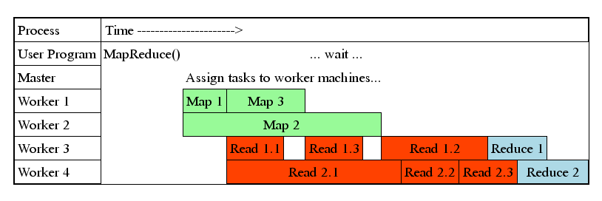
Load Balance and Pipelining
Fine granularity tasks: many more map tasks than machines
  Minimizes time for fault recovery
  Can pipeline shuffling with map execution
  Better dynamic load balancing
Often use 200,000 map/5000 reduce tasks w/ 2000 machines

Slide 22
Fault tolerance
What are the potential failure cases?
  Lost packets
  Temporary network disconnect
  Servers crash and rebooted
  Servers fail permanently (disk wipe)

Slide 23
Fault tolerance via re-execution
On master failure:
Lab1 assumes the master does not fail
On worker failure:
Re-execute in-progress map tasks
Re-execute in-progress reduce tasks
Task completion committed through master
Is it possible a task is executed twice?

Slide 24
Avoid straggler using backup tasks
Slow workers drastically increase completion time
  Other jobs consuming resources on machine
  Bad disks with soft errors transfer data very slowly
  Weird things: processor caches disabled (!!)
  An unusually large reduce partition
Solution: Near end of phase, spawn backup copies of tasks
  Whichever one finishes first "wins"
Effect: Dramatically shortens job completion time

Slide 25
Performance
Ideal speedup on N Machines?
Why no ideal speedup in practice?
Straggler: Slow workers drastically increase completion time
  Other jobs consuming resources on machine
  Bad disks with soft errors transfer data very slowly
  Weird things: processor caches disabled (!!)
  An unusually large reduce partition
Solution: Near end of phase, spawn backup copies of tasks
  Whichever one finishes first "wins"
Effect: Dramatically shortens job completion time

Slide 26
MapReduce Sort Performance
1TB (100-byte record) data to be sorted
1700 machines
M=15000 R=4000

Slide 27
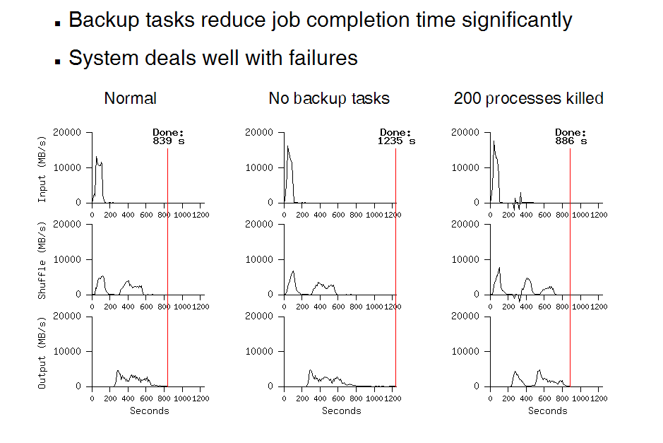
MapReduce Sort Performance
When can shuffle start?
When can reduce start?

Slide 28
The world after MapReduce
Ushered the era of “Big Data”
Inspired many distributed programming frameworks
  Dryad
  Spark
  GraphLab
  Many others....

