Slide 1
An introduction to GEMSEO
January 13, 2022
Luca Sartori, PhD

Slide 2
Session program
Tour de table/personal presentations
GEMSEO Introduction and theory
Presentation
Key concepts
GEMSEO basic grammar
Break (10 mins)
Tutorials
GEMSEO Installation and setup
Test case 1: The Sellar Problem
Test case 2: Optimal Resource Allocation
Test case 3: Airfoil optimization
Break(10 mins)
Miscellanea & Questions

Slide 3
Agenda
GEMSEO
01
Presentation
GEMSEO Key Concepts
GEMSEO Grammar
Tutorials
02
GEMSEO Installation and setup
The sellar problem
Optimal resource allocation
Aerodynamic optimization of airfoils
Miscellanea
03
Post-processing
Observables
Default inputs

Slide 4
01. Presentation

Slide 5
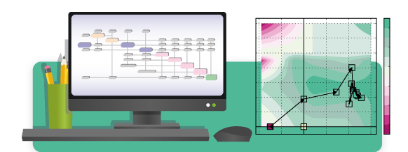
01. GEMSEO: Definition
GEMSEO: Generic Engine for Multidisciplinary Scenarios, Exploration and Optimisation developed in Python. It is the result of the collaboration between academic and industrial partners within the IRT Saint Exupéry MDA-MDO project (AIRBUS, ALTRAN, CERFACS, ISAE Supaero, ONERA, Capgemini)
Features:
Automation of MDO processes based on MDO formulations
Features: coupling, optimization, design of experiments, visualization, surrogate modeling, machine learning, uncertainty quantification, ...
Easy to embed in simulation platforms or to use as a standalone software
Can use tools in Python, Matlab, Excel, Scilab, executables, ...
Built on NumPy, SciPy and Matplotlib
Open source (GNU LGPL v3.0), commercially usable - see licenses
Source code is available on gitlab

Slide 6
01. GEMSEO: Key Concepts & Features
v3.1.0
Main Concepts
Main Features
Discipline
Define input/output to interface a model
Interfaces: analytic expression, executable, surrogate model, etc.
Design Space
Define a set of parameters, such as design variables, constraints, obj. function
Types: deterministic or uncertain
Scenario
Define an evaluation process over a design space, for a set of disciplines and a given objective
Types: DOE scenario, MDO scenario
Saving & Storing Data
Store disciplinary evaluations in a cache, either in memory or saved in a file.
Study Prototyping
MDO without writing any code (Excel)
DOE & Trade-off
Define, solve and post-process
MDA
Gauss-Seidel, Jacobi, MDA chain, etc
Surrogate Models
Based on scikit-learn and OpenTURNS
Machine Learning
Clustering, classification & regression
Optimisation
Based on openopt, nlopt, scipy, snopt
MDO Formulations
Bi-level, IDF, MDF, std. optimisation
Visualisation
Of optimisation histories
Scalable Models
Scalability study, scalable problem…
Uncertainty
Definition, propagation and analysis
Documentation: https://gemseo.readthedocs.io/en/latest/index.html

Slide 7
01. GEMSEO Key concepts

Slide 8
GEMSEO: key concepts
Multidisciplinary optimization (MDO)
Discipline
Coupling variables
Discipline wrapper
Global and local variables
Design space
Merit function
Constraints
Scenario

Slide 9
Key concepts: multidisciplinary optimization (MDO)
Definition:
“MDO is a field of engineering that uses numerical optimization to perform the design of systems involving a number of disciplines or subsystems”
(Martins & Lambe, 2013)

Slide 10
Key concepts: multidisciplinary optimization (MDO)
Peculiarities:
The optimum of a system can only be found when the interactions between its disciplines are fully considered
The overall optimum is usually different form that obtained by optimizing each discipline individually
Adopting MDO in the early stage of the design can help exploring the domain of feasibility, conducting trade-off studies etc.

Slide 11
Key concepts: discipline
A discipline is a computational block that produces a set of outputs from a set of inputs
Outputs are computed from inputs according to a certain model (analytic relations, simulations, optimization loops..)
We often use a functional representation of disciplines:
Input 1
Discipline
Output 1
Input 2
Input 3
Output 2
Analytical model
Simulation software
Optimization loop

Slide 12








Key concepts: coupling variables
A coupling variable is a variable linking different disciplines
If the coupling is mono-directional, we have a loose coupling and disciplines can be solved directly
[Example]:
Discipline A requires two inputs $\left[x_{A}^{1} , x_{A}^{2}\right]$ and produces two outputs $\left[y_{A}^{1} , y_{A}^{2}\right]$
Discipline B requires two inputs $\left[x_{B}^{1} ,y_{A}^{2}\right]$ and produces one output $y_{B}^{1}$
$y_{A}^{2}$ is a (loose) coupling
$$x_{A}^{1}$$
A
$$y_{A}^{1}$$
$$x_{B}^{1}$$
B
$$y_{B}^{1}$$
$$x_{A}^{2}$$
$$y_{A}^{2}$$
$$y_{A}^{2}$$
Loose coupling

Slide 13










Key concepts: coupling variables
If the coupling is multi-directional, we have a strong coupling and disciplines must be solved iteratively (MDA analysis)
[Example]:
Discipline A requires three inputs $\left[x_{A}^{1} , x_{A}^{2},y_{B}^{2}\right]$ and produces two outputs $\left[y_{A}^{1} , y_{A}^{2}\right]$
Discipline B requires two inputs $\left[x_{B}^{1} ,y_{A}^{2}\right]$ and produces two outputs $\left[y_{B}^{1} , y_{B}^{2}\right]$
The pair $\left\{y_{B}^{2} ,y_{A}^{2}\right\}$ forms a strong coupling
$$x_{A}^{1}$$
A
$$y_{A}^{1}$$
$$x_{B}^{1}$$
B
$$y_{B}^{1}$$
$$x_{A}^{2}$$
$$y_{B}^{2}$$
$$y_{A}^{2}$$
$$y_{A}^{2}$$
$$y_{B}^{2}$$
Strong coupling

Slide 14
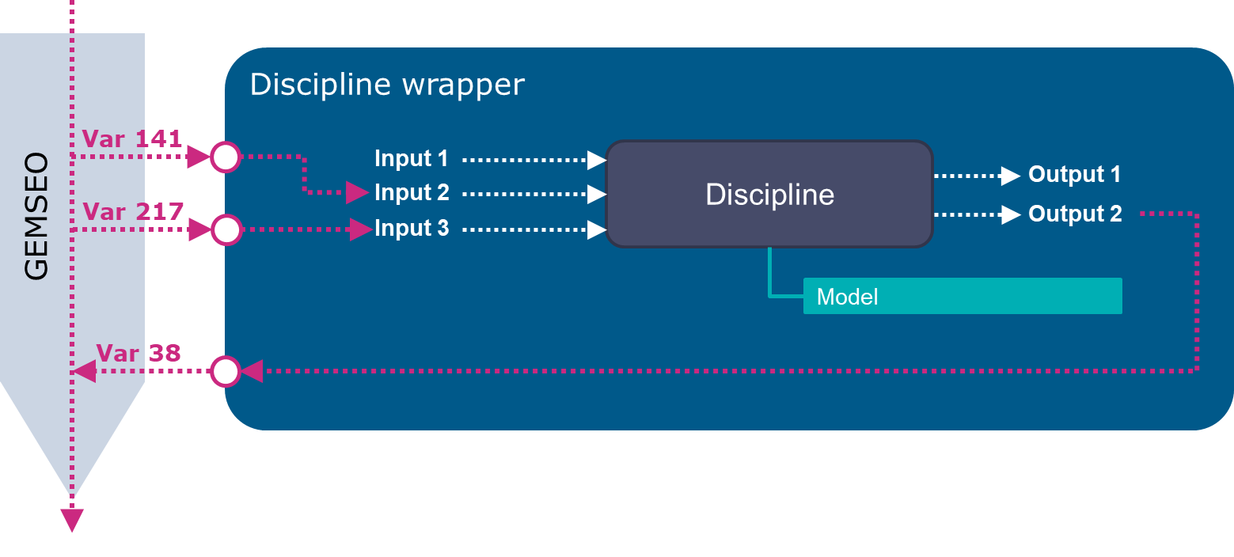
Key concepts: discipline wrapper
A wrapper is piece of code that acts as an interface between GEMSEO and the discipline
It makes sure they exchange informations properly
[Example]:
Generic discipline wrapper

Slide 15
Discipline wrapper
Var 141
Discipline
Input 1
Output 1
GEMSEO
Input 2
Var 217
Input 3
Output 2
Model
Var 38

Slide 16
Key concepts: global and local variables
Variables defined at GEMSEO level are global variables. They must have a unique name
Variables defined at DISCIPLINE level are called local variables
The scope of a wrapper is to provide a mapping between global and local variables
[Example]: Variables mapping form previous slide
Global (GEMSEO) Variable | Local variable (INPUTS) | Local variable (OUTPUTS)
- | Input 1
Var 141 | Input 2
Var 217 | Input 3
- |  | Output 1
Var 38 |  | Output 2

Slide 17
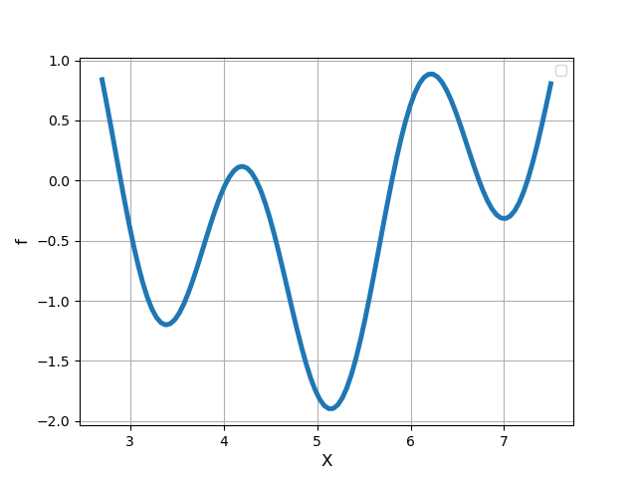
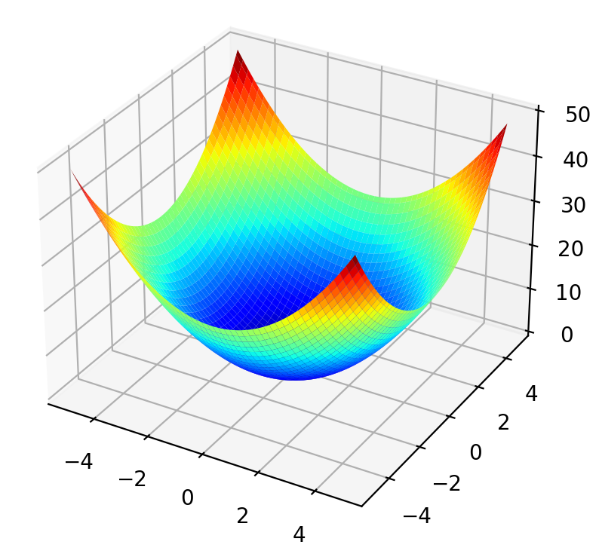


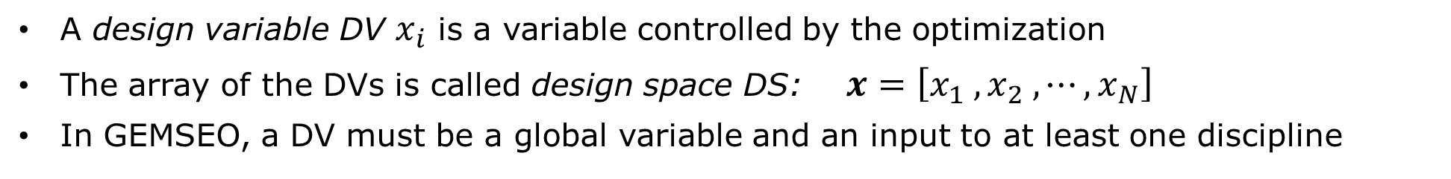



Key concepts: design space
A design variable DV $x_{i}$ is a variable controlled by the optimization
The array of the DVs is called design space DS: $x=\left[x_{1} , x_{2} , ⋯, x_{N}\right]$
In GEMSEO, a DV must be a global variable and an input to at least one discipline
${f(x}_{1}, x_{2})$
${f(x}_{1})$
$x_{2}$
$x_{1}$
$x_{1}$

Slide 18
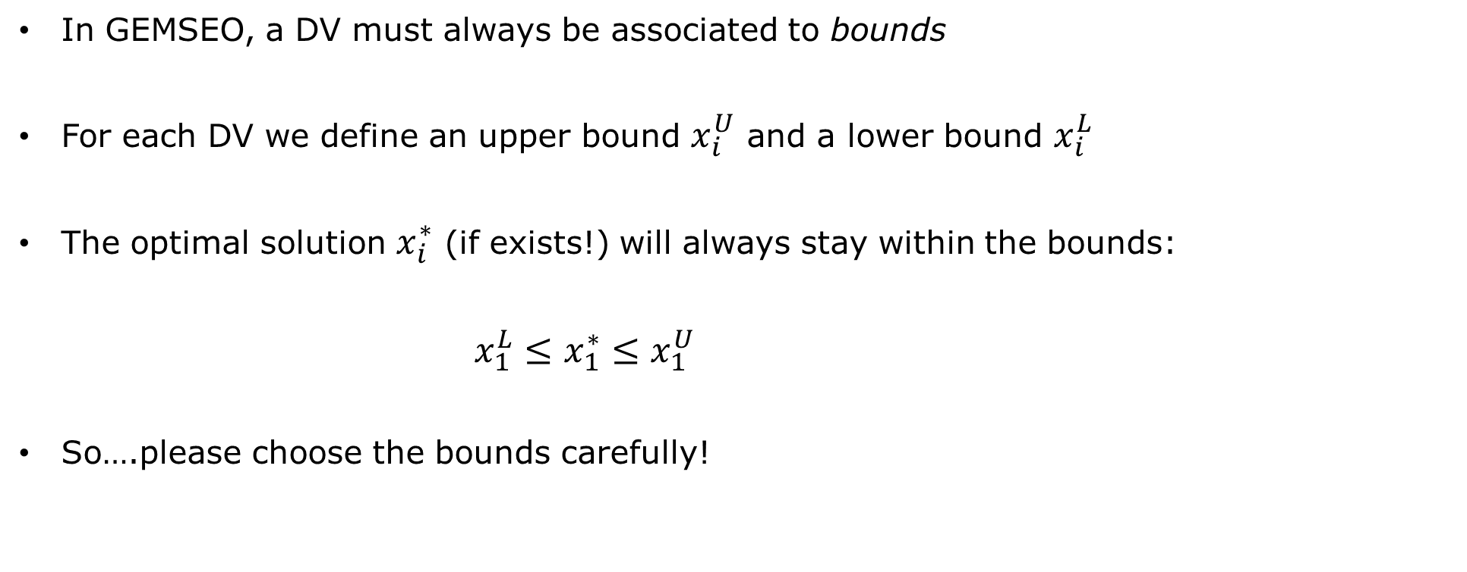
Key concepts: design space
In GEMSEO, a DV must always be associated to bounds
For each DV we define an upper bound $x_{i}^{U}$ and a lower bound $x_{i}^{L}$
The optimal solution $x_{i}^{∗}$ (if exists!) will always stay within the bounds:
$x_{1}^{L}≤x_{1}^{∗}≤x_{1}^{U}$
So….please choose the bounds carefully!

Slide 19








Key concepts: design space
Proper definition of bounds
Poor definition of bounds
${f(x}_{1})$
${f(x}_{1})$
$$x_{1}^{L}$$
$x_{1}$
$$x_{1}^{U}$$
$$x_{1}^{L}$$
$x_{1}$
$$x_{1}^{U}$$

Slide 20

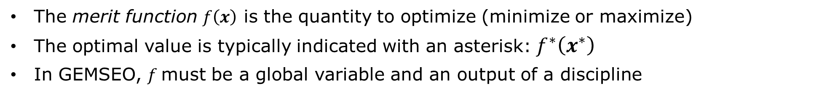

Key concepts: merit function
The merit function $f\left(x\right)$ is the quantity to optimize (minimize or maximize)
The optimal value is typically indicated with an asterisk: $f^{∗}\left(x^{∗}\right)$
In GEMSEO, $f$must be a global variable and an output of a discipline
$f^{∗}\left(x_{1}^{∗}\right)$
$$x_{1}^{∗}$$

Slide 21
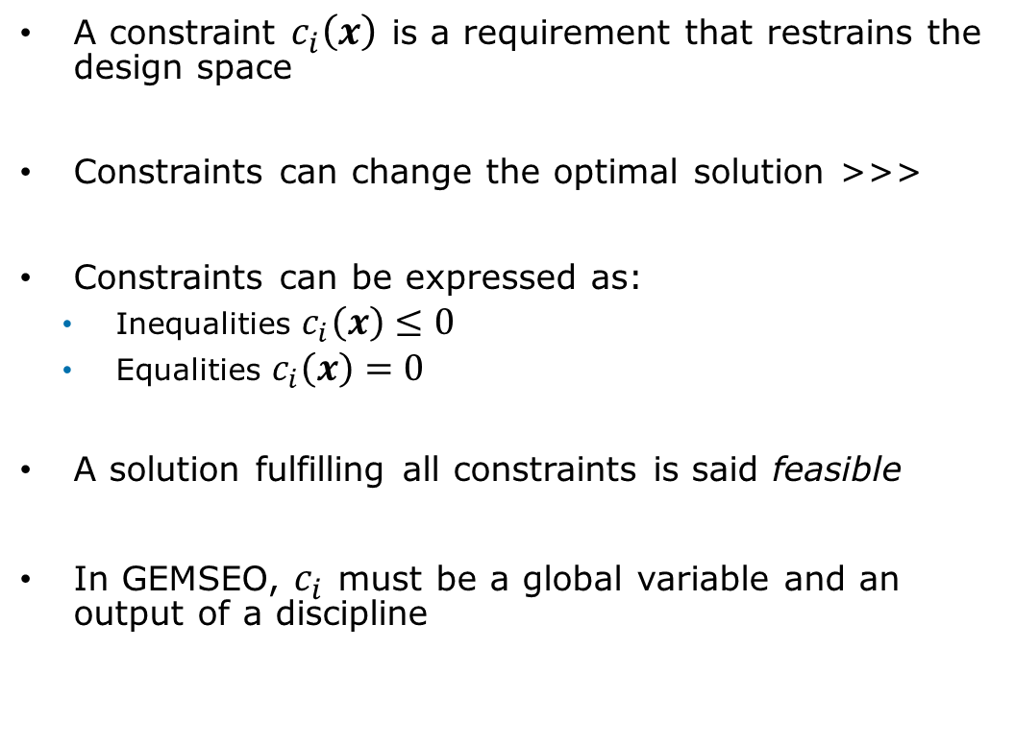

Key concepts: constraint
Feasible (multiple solutions)
A constraint $c_{i}\left(x\right)$ is a requirement that restrains the design space
Constraints can change the optimal solution >>>
Constraints can be expressed as:
Inequalities $c_{i}\left(x\right)≤0$
Equalities $c_{i}\left(x\right)=0$
A solution fulfilling all constraints is said feasible
In GEMSEO, $c_{i}$ must be a global variable and an output of a discipline
$$c_{1}=f\left(x_{1}\right)≥−0.25$$
Unfeasible

Slide 22
Key concepts: scenario
A scenario is a workflow manager that puts evrything together:
Creates and optimization problem
Builds an MDO workflow from a set of disciplines and a design space
Add the necessary constraints
Runs the problem according to the chosen algorithm (i.e. gradient-based, search methods..)
Disciplines
MDO
Design space
Discipline 1
Discipline 2
Constraints
Discipline 3
Merit function

Slide 23
01. GEMSEO basic grammar

Slide 24
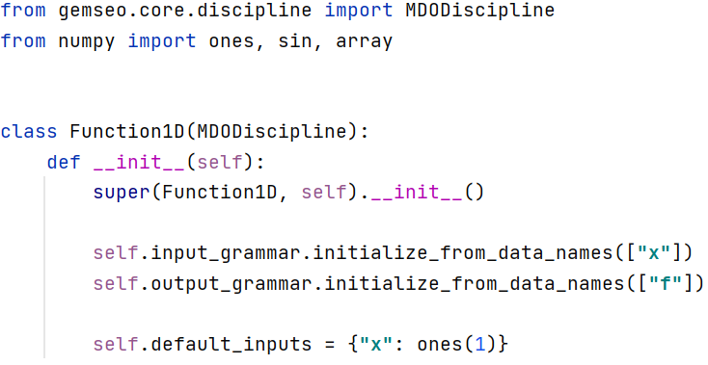
GEMSEO basic grammar: disciplines
From TestCase0_Function1D/discipline.py
A discipline must be a subclass of the GEMSEO MDODiscipline class
A discipline must have a method __init__() where inputs and outputs are initialized
Inputs and outputs can be defined in different ways. The simplest way is to just declare their names
Each input must have a default value specified

Slide 25
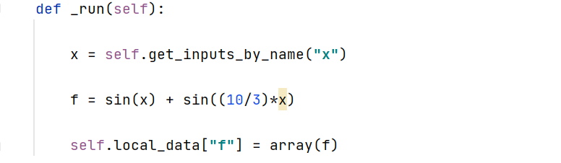
GEMSEO basic grammar: disciplines
From TestCase0_Function1D/discipline.py
A discipline must have a method _run() which is called by GEMSEO each time a discipline evaluation is necessary
First, we recover the actual values of inputs (controlled by GEMSEO)
Then, we compute outputs from inputs
Finally, we send back outputs to GEMSEO by storing them in the self.local_data attribute
That’s it! No more steps required! (Although doing all this stuff can be kinda complicated if the problem is complex….)

Slide 26
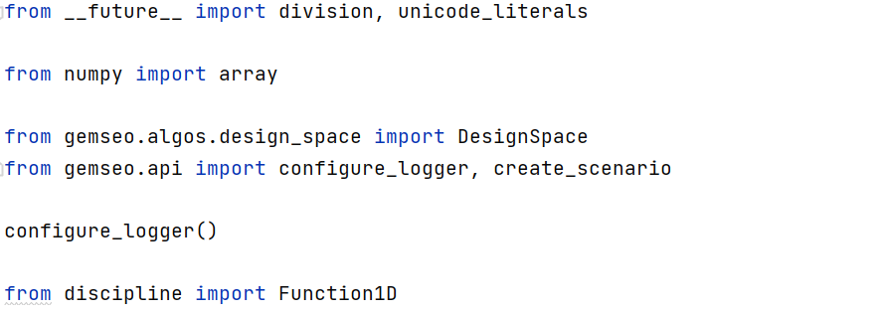
GEMSEO basic grammar: scenario
From TestCase0_Function1D/scenario.py
In the header, we import the necessary GEMSEO methods and classes, as well as the necessary standard python libraries (i.e. numpy)
Here we initialize the logger, which provides useful runtime information while the optimization is running
We also need to import all our disciplines

Slide 27
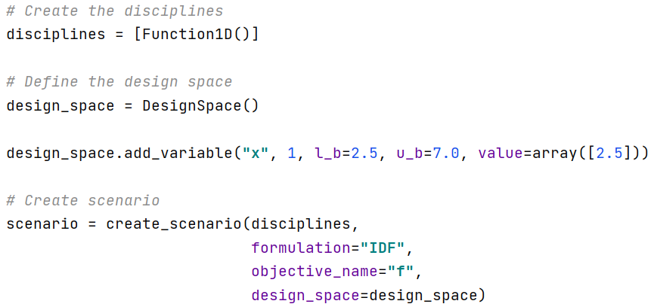
GEMSEO basic grammar: scenario
From TestCase0_Function1D/scenario.py
We define the list of the disciplines used in the optimization
Then we cretae the DS and define all the design variables. For each, we specify lower and upper bounds, as well as the initial value
Finally we create the scenario. To do so, we need to associate it to a DS and to a merit function

Slide 28
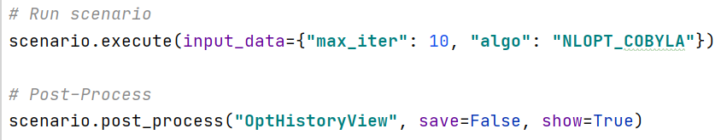
GEMSEO basic grammar: scenario
From TestCase0_Function1D/scenario.py
From here, we run the optimization according to a selected optimization algorithm
This line allows to post-process and visualize some important info

Slide 29
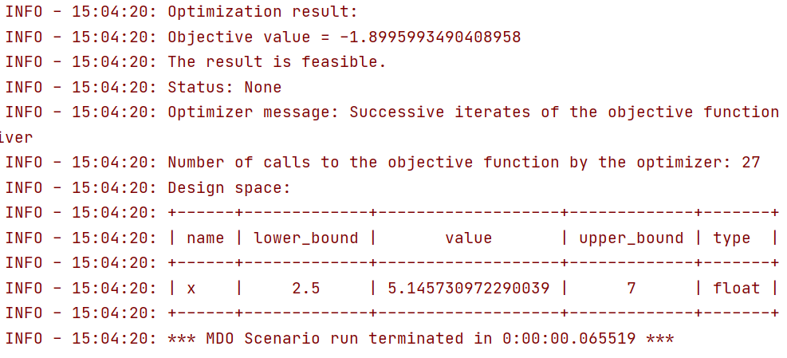
GEMSEO basic grammar: scenario
As expected, GEMSEO computes the actual optimum of our test 1D function

Slide 30
02. Tutorials: GEMSEO Installation

Slide 31
02. Tutorials: The Sellar Problem

Slide 32
02. Tutorials: Optimal Resource Allocation

Slide 33



Optimal Resources Allocation: Formulation
Goal: Manufacture a certain number of products per day minimizing the production cost
Variables: Allocation/charge of 3 resources
Resource 1
Salary:
$c_{1}$ = USD 25/h
Max production:
$$N_{0_{1}}=8 prod/h$$
Impact of fatigue:
$γ_{1}=0.5$ (severe)
Resource 2
Salary:
$c_{2}$= USD 18/h
Max production:
$$N_{0_{2}}=6 prod/h$$
Impact of fatigue:
$γ_{2}=0.2$ (average)
Resource 3
Salary:
$c_{3}$= USD 12/h
Max production:
$$N_{0_{3}}=4 prod/h$$
Impact of fatigue:
$γ_{3}=0.1$ (low)

Slide 34
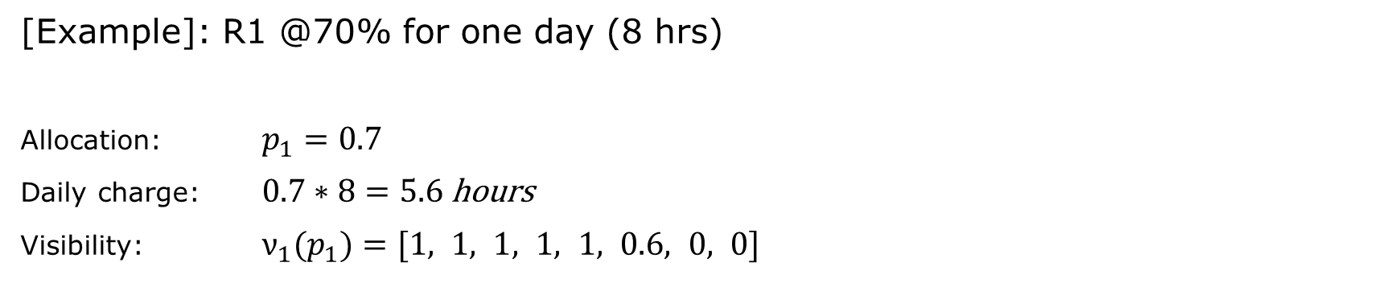




Optimal Resources Allocation: Formulation
Allocation $p$: an array containing the daily charge of work for each Resource
$$p=[{ p}_{1},p_{2},p_{3} ]$$
$$R_{1}$$
$$R_{2}$$
$$R_{3}$$
Visibility $ν(p)$: an array containing the hour-by-hour charge of work for each Resource
[Example]: R1 @70% for one day (8 hrs)
Allocation: $p_{1}=0.7$
Daily charge: $0.7∗8=5.6$ hours
Visibility: $ν_{1}(p_{1})=[1, 1, 1, 1, 1, 0.6, 0, 0]$

Slide 35
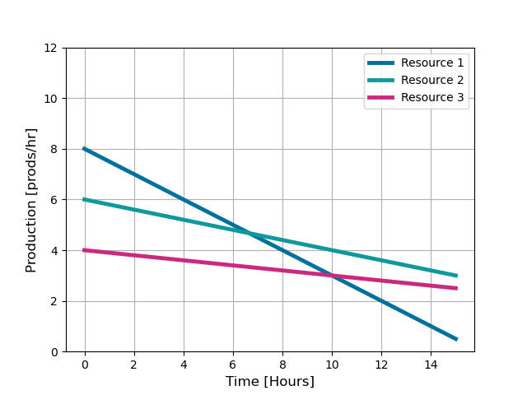
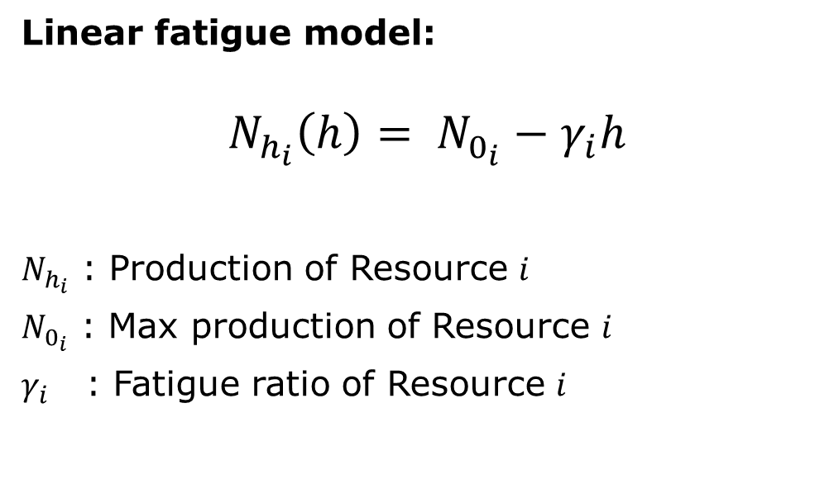


Optimal Resources Allocation: Formulation
Fatigue: it is assumed that the hourly production of a Resource decreases with time
Linear fatigue model:
$$N_{h_{i}}\left(h\right)= N_{0_{i}}−γ_{i}h$$
$N_{h_{i}}$ : Production of Resource $i$
$N_{0_{i}}$ : Max production of Resource $i$
$γ_{i}$ : Fatigue ratio of Resource $i$
$$N_{0_{i}}$$
$$γ_{i}$$

Slide 36
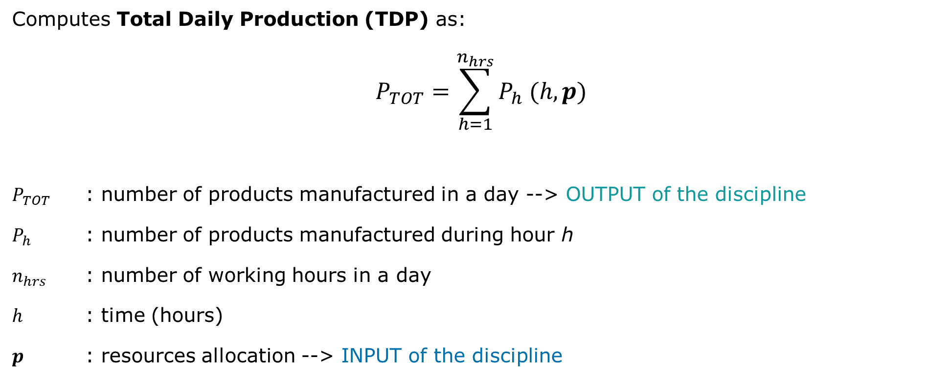
Optimal Resources Allocation: Disciplines (TDP)
Computes Total Daily Production (TDP) as:
$$P_{TOT}=\sum_{h=1}^{n_{hrs}}{P_{h} (h, p)}$$
$P_{TOT}$ : number of products manufactured in a day --> OUTPUT of the discipline
$P_{h}$ : number of products manufactured during hour h
$n_{hrs}$ : number of working hours in a day
$h$ : time (hours)
$p$ : resources allocation --> INPUT of the discipline

Slide 37
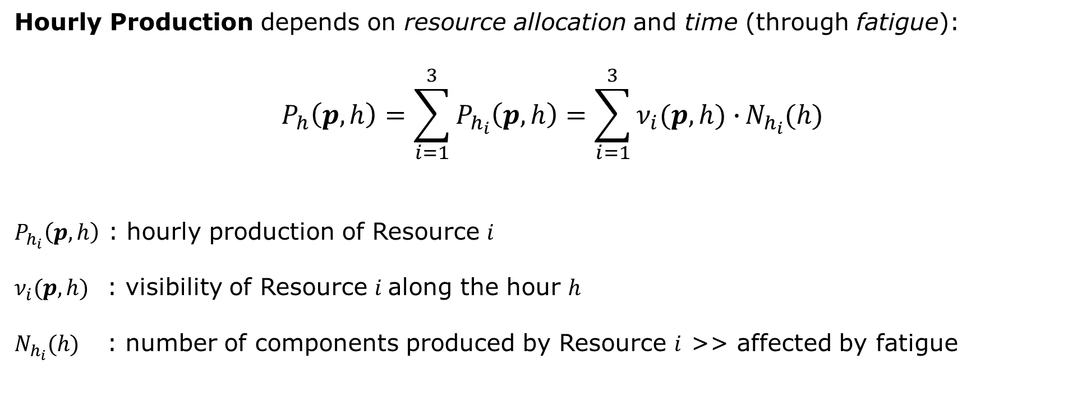
Optimal Resources Allocation: Disciplines (TDP)
Hourly Production depends on resource allocation and time (through fatigue):
$$P_{h}\left(p, h\right)=\sum_{i=1}^{3}{P_{h_{i}}\left(p, h\right)}=\sum_{i=1}^{3}{ν_{i}(p, h)∙}N_{h_{i}}(h)$$
$P_{h_{i}}\left(p, h\right)$ : hourly production of Resource $i$
$ν_{i}(p, h)$ : visibility of Resource $i$along the hour $h$
$N_{h_{i}}(h)$ : number of components produced by Resource $i$ >> affected by fatigue

Slide 38
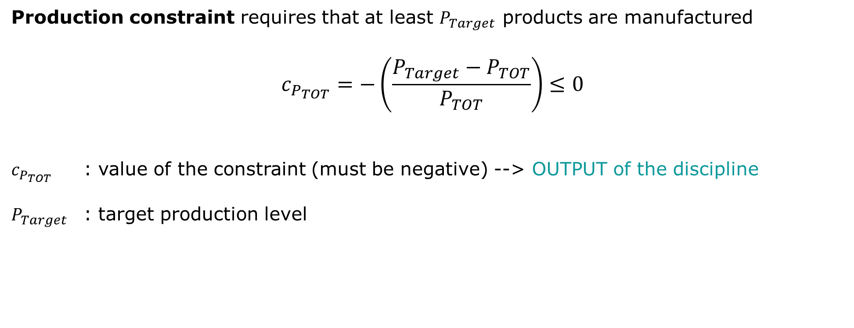
Optimal Resources Allocation: Disciplines (TDP)
Production constraint requires that at least $P_{Target}$ products are manufactured
$$c_{P_{TOT}}=−\left(\frac{P_{Target}−P_{TOT}}{P_{TOT}}\right)≤0$$
$c_{P_{TOT}}$ : value of the constraint (must be negative) --> OUTPUT of the discipline
$P_{Target}$ : target production level

Slide 39
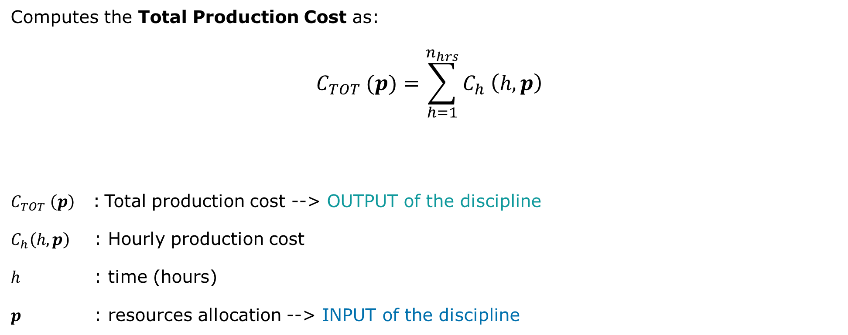
Optimal Resources Allocation: Disciplines (TPC)
Computes the Total Production Cost as:
$$C_{TOT} (p)=\sum_{h=1}^{n_{hrs}}{C_{h} \left(h, p\right)}$$
$C_{TOT} \left(p\right)$ : Total production cost --> OUTPUT of the discipline
$C_{h}\left(h, p\right)$ : Hourly production cost
$h$ : time (hours)
$p$ : resources allocation --> INPUT of the discipline

Slide 40

Optimal Resources Allocation: Disciplines (TPC)
Hourly production cost depends on resource allocation and time:
$$C_{h} \left(h, p\right)=\sum_{i=1}^{3}{ν_{i}(p,h)∙}c_{i}$$
$c_{i}$ : hourly cost of the Resource $i$
$ν_{i}(p, h)$ : visibility of Resource $i$along the hour $h$

Slide 41





Optimal Resources Allocation: Disciplines
Functional representation of the disciplines (uncoupled):
TDP
Total daily production $P_{TOT}$
Resource allocation $p$
Production constraint $c_{P_{TOT}}$
Algebraic production model
TPC
Resource allocation $p$
Total production cost $C_{TOT}$
Algebraic cost model

Slide 42


Optimal Resources Allocation: code structure
TestCase_2_Resource_Allocation
disciplines
Contains discipline wrappers for GEMSEO and the associated functions
TDP
TPC
Contains common scripts and data used across the code (i.e. post-processor)
global
Contains scenario scritps for GEMSEO to run optimization
runs

Slide 43



Optimal Resources Allocation: code structure
TestCase_2_Resource_Allocation
disciplines
d_total_production.py
Discipline wrapper
TDP
f_total_production.py
Discipline functions
TPC
global
runs

Slide 44

Optimal Resources Allocation: code structure
TestCase_2_Resource_Allocation
disciplines
TDP
d_total_cost.py
Discipline wrapper
TPC
f_total_cost.py
Discipline functions
global
runs

Slide 45


Optimal Resources Allocation: code structure
TestCase_2_Resource_Allocation
disciplines
TDP
postprocessor.py
GEMSEO Post-Pro
TPC
utilities.py
Shared functions
global
resources.txt
Resources data (salary, production etc..)
runs

Slide 46

Optimal Resources Allocation: code structure
TestCase_2_Resource_Allocation
disciplines
GEMSEO scenario file >> runs the optimization problem
TDP
Resources_Allocation_MDO.py
TPC
global
history_resource_allocation_MDO.h5
runs
Optimization results >> for post-processor

Slide 47
Optimal Resources Allocation: code structure

