Slide 1

SkillBridge
Prove what you can do, and exactly what you did, in an afternoon
Group Project I · Group G2 · Rapid Prototyping with AI · IE University · 13 October 2026
Notes:
Open with the customer outcome, not project history. SkillBridge: tech students solve short, real challenges set by companies; each result becomes a company-calibrated score with a verified record of what each student contributed.

Slide 2




Today: the four things Group Project I asks for
01
02
03
04
Press release + Venture Skeleton v0.1
Market evidence + value curve
ERRC + value innovation hypothesis
Real-user feedback on the riskiest hypothesis
Customer outcome first, then the whole venture logic on one page
Four-category alternatives, Fermi estimate, a clear so what
Four moves that change cost and buyer value; how it can fail
Students, recruiters and an engineer; what changed because of them
And the two questions we must answer: What did real evidence change? · What could still make us narrow, pivot or stop?
Notes:
Map the talk to the course's 'What to bring to Group Project I' slide. Every item lives in the repo; the README has a table pointing to each file.

Slide 3
Start from the customer outcome
01 · WORKING BACKWARDS
The press release we want to be true in September 2027, and the evidence status of every claim in it

Slide 4
Press release: proof of what each student did
Evidence status of each claim
MADRID, September 2027
SkillBridge lets tech students prove what they can do, and exactly what they did, in an afternoon
Students can't show work beyond coursework or their own part
Evidence
2–7 hours fits their week
Evidence
Real company challenges, scored against the company's own bar, with every team member's contribution on the record.
AI cheating makes employers wary
Desk research
2–7 hours on a real brief from a SaaS, engineering or data company
Score calibrated to that company's rubric, plus written feedback from its engineer
A verified record of your own contribution, shareable to CV and LinkedIn
Companies will post briefs
Hypothesis
Recruiters trust it; students pay
Riskiest hypothesis
Source: evidence-log/press-release.md. Quotes in the full release are illustrative.
Notes:
Read the headline and the subhead. Then point at the right column: the problem and time-fit claims have real evidence; companies posting briefs, recruiters trusting the score and students paying are still hypotheses. That's what the pilot tests.

Slide 5
From paid projects to company challenges
02 · THE PIVOT
What v1 was, why the evidence pushed us off it, and what stayed the same
Notes:
Be explicit: the pivot was a team decision on existing evidence, not a validated result.

Slide 6

v1: student teams doing paid projects for small businesses
Planned test
The v1 idea
Pitch 10 small businesses. Pass if at least 2 sign a charter and pay a 10% deposit.
An open platform where teams of tech students take on small, real, paid "campaigns" for small businesses, and leave with a verified record of shipped client work plus some cash.
What happened
Riskiest assumption: a small business will trust an inexperienced student team with a real, paid project.
No business reached a formal pitch. No charter, no deposit. Closed as not run, not scored as a failure.
Source: evidence-log/archive/v1-paid-projects/README.md and experiment-card.md
Notes:
v1's riskiest assumption sat with the business: would a small business hand a real, paid project to an inexperienced student team? The planned test never reached a qualifying pitch, so we closed it honestly as not run.

Slide 7
The evidence pushed us off v1
0
3/17
12/17
14/17
businesses reached a formal pitch
students say payment motivates them (vs 11/17 for clear scope)
can give 4 hours a week or less; none can give 8+
struggle to explain their personal contribution
v1 recruitment
Survey Q5
Survey Q6
Survey Q2
Nolita's manager (UV-B02): no current project, and even cheap student work costs time to brief and review.
Sources: survey-summary-2026-10-12.md (n = 17, unscreened); interviews-2026-09-22.md
Notes:
Four signals: business pull was weak (Nolita had no current project and said even cheap work costs time to brief and review); students aren't motivated by payment; they have little time; and the real pain is explaining their own contribution. Survey is n = 17, unscreened.

Slide 8

Same student, same job; new customer and new product
v1 · paid projects
v2 · company challenges
Who sets the work
Small businesses with a paid project
Companies that already hire juniors set a short challenge
Size of the work
Multi-week client project
2–7 hour challenge (pilot: 4 h)
What the student gets
Cash plus experience
Company-calibrated result + verified contribution record
Riskiest assumption
Will a business trust students?
Will recruiters trust the credential, and will students pay?
Kept: the same target student and the same Job to Be Done. v1 is archived, not deleted.
Notes:
The Job to Be Done is solution-neutral, so it survived the pivot. What changed: who sets the work, how long it takes, what the student gets, and where the risk sits.

Slide 9
A student who can't show what they personally did
03 · USER AND PROBLEM
Target user, Job to Be Done, the evidence for the problem, and the three critical personas

Slide 10

Our user: a tech student with mostly coursework
“
Target user
In the first call he asked 'so which parts did you write?' and I kind of froze… I had nothing to show him that proved it was me.
A 2nd–4th-year software, web or data student whose experience is mainly coursework.
Job to Be Done
When applying for internships and asked for project examples, have practical work I can demonstrate and explain to an employer.
V2-S01, IE CSAI student, interviewed 5 Oct 2026
Notes:
Target user and Job come straight from opportunity.md and jtbd.md. V2-S01's story is the Job in action: they froze when the recruiter asked which parts of the group project they wrote.

Slide 11
The pain is proving contribution, not finding paid work
So what
Build the product around a verified individual-contribution record
Drop paid client work: the reward is proof of skill
Keep challenges short: 12/17 have 4 h a week or less
Source: validation/survey-summary-2026-10-12.md. Unscreened sample; overlap with the pilot (n = 11) unknown, so samples are never added.
Notes:
Student survey, n = 17, unscreened. The top two difficulties are explaining personal contribution and showing work beyond coursework. Payment is at the bottom. This is why v2 centres on a verified contribution record.

Slide 12



Three critical personas, and why each one matters
The Tinkerer
The Late Sprinter
The Skeptical Verifier
Core student user: builds side projects nobody outside reviews.
Most likely payer: a deadline makes a fast, credible signal worth money.
The recruiter who decides whether the certificate is worth anything.
Tests whether a student finishes a 2–7 h challenge without a prize.
Counter-case: may churn after one certificate.
Replaced the Once-Bitten Owner: small businesses are no longer the customer.
A1.2 completion · A1.3 paying
A1.3 paying · A3.1 trust
A3.1 trust · A3.3 replaces take-home
Source: evidence-log/personas/README.md
Notes:
Answering the Challenge II personas feedback: the personas README now names the three critical personas and why. The Skeptical Verifier replaced the Once-Bitten Owner because after the pivot the riskiest assumption sits with the recruiter.

Slide 13
Has this been done already?
04 · MARKET EVIDENCE
The professor's Challenge I question. What students use instead, where we differ, and how big the market is

Slide 14



Alternatives are free, but none proves who did what
Direct competitors
Indirect substitutes
NUWE, Forage, Riipen
HackerRank, Kaggle, Devpost, Coursera certificates
All free to students; none records individual contribution in a team
Free scores and badges exist; ours must be worth more to a recruiter
Manual workarounds
Doing nothing
Coursework, personal GitHub, portfolio
Apply with a CV only
Most common today; 9/17 latest project reviewed only in class
6/17 applied and got no interview; pain peaks in application season
Our axis: a scored, company-calibrated result on a real brief, with each member's contribution verified. Not found for Forage, HackerRank, Devpost or Kaggle; NUWE unverified.
Notes:
Four-category map from the course template. Strongest alternatives: Forage (free, short, employer-branded) and HackerRank (a standardised score employers already use). Nobody in the published materials we checked records individual contribution in a team. NUWE in Barcelona is closest and its model is not published, so we say 'not found', not 'nobody does it'.

Slide 15
Value curve: we diverge where every alternative is weak
Reading it
Eliminated: prizes and events
Created: contribution proof (5) and employer calibration (4)
Weak spot: price. Everyone else is free
Source: market-research/value-curve.md. Kaggle and NUWE discussed in the file, left off the chart for readability.
Notes:
Scores are team judgement from published offers, not measurements. SkillBridge drops prizes and stays low on time, then rises on contribution proof, integrity, feedback and employer calibration. Where we lose: price. Every alternative is free to the student.

Slide 16
≈ 2,000 Madrid students a year would finish one
260,000 Madrid undergraduates (known, 2024/25)
If only students pay €15
26,000 in tech studies (assume 10%)
5% pay
€1,462 / yr
10% pay
€2,925 / yr
19,500 in years 2–4 (assume 75%)
30% pay (our threshold)
€8,775 / yr
9,750 with an experience gap (assume 50%)
So what: student fees alone can't fund engineer time or a platform. Companies must pay, which makes "which side pays first" the key open question.
≈ 2,000 complete a challenge this year (assume 20%)
Source: market-research/README.md, v2 Fermi estimate. Range on the last step alone: 975–2,925.
Notes:
Fermi estimate: one known anchor, four assumptions. The so what matters more than the number: even at our 30% payment threshold, student fees alone in Madrid are under €9,000 a year. That can't fund engineers' time or a platform, so companies have to pay. This is why 'which side pays first' is our most decision-relevant open question.

Slide 17
Lower cost, higher value per result
05 · STRATEGY AND BUSINESS MODEL
The ERRC grid, the value innovation hypothesis, how the product works and who pays

Slide 18


ERRC: four moves that change cost and value
Eliminate
Reduce
Raise
Create
Prize pools and weekend-long hackathons
Time to 2–7 h; AI rubric + tests score every entry; engineer scores a sample
Verifiability: commits + peer ratings, 10-min debrief, feedback on every certified result
Company-calibrated score with a verified individual-contribution record
Cost: No prize budget or event logistics
Cost: Fewer engineer hours per challenge
Cost: More engineer time per certified result
Cost: Low marginal cost once the rubric exists
Value: Students keep evenings and weekends
Value: Fits 12/17 students' ≤4 h a week
Value: Answers "what did you do?" and the AI-cheating worry
Value: A signal the market lacks
Source: evidence-log/ERRC.md
Notes:
Each move has a cost effect and a buyer-value effect. Eliminate and Reduce cut cost for companies and time for students; Raise and Create add the value nobody else offers. The Reduce row was updated after the interviews: the engineer scores a sample including two lower-half entries and writes feedback on every certified result.

Slide 19

Value innovation hypothesis, and exactly how it fails
By dropping prizes and long events and letting automated tests and AI do first-pass scoring, SkillBridge cuts the cost of a challenge for companies and the time cost for students, while raising what the result is worth: a score calibrated to a real company's bar, with each student's contribution and an integrity check on record.
It is falsified if…
Fewer than 30% of submitting students pay €15 for the certified result (with at least 10 submissions; fewer is inconclusive)
Fewer than 3 of 5 recruiters say it would change or support a shortlisting decision
A hypothesis, not a validated blue ocean or business model. Source: ERRC.md, experiment-card.md
Notes:
Read the hypothesis, then the two falsifiers. Stress that this is a hypothesis, not a validated blue ocean. Thresholds were fixed before the test and won't be adjusted after.

Slide 20

How it works: four steps from brief to certified result
1 Company brief
2 Students submit
3 Score + feedback
4 Certify for €15
A real 4-hour task; 4–6 rubric criteria signed off by the company's engineer
Solo or teams of up to 3; commits, task log and peer ratings record who did what
AI rubric and tests score every entry; engineer scores a sample incl. 2 from the lower half
Engineer-written feedback; private by default; the true score always shows
Entry is free and students see their score for free. They pay only to certify, and a certified result can't be bought: you can fail it.
Notes:
This is the flow in prototype v1. Point out what changed after the interviews: engineer feedback for every paying student; the engineer checks two lower-half entries; results are private by default; the certificate always shows the true score and you can fail.

Slide 21
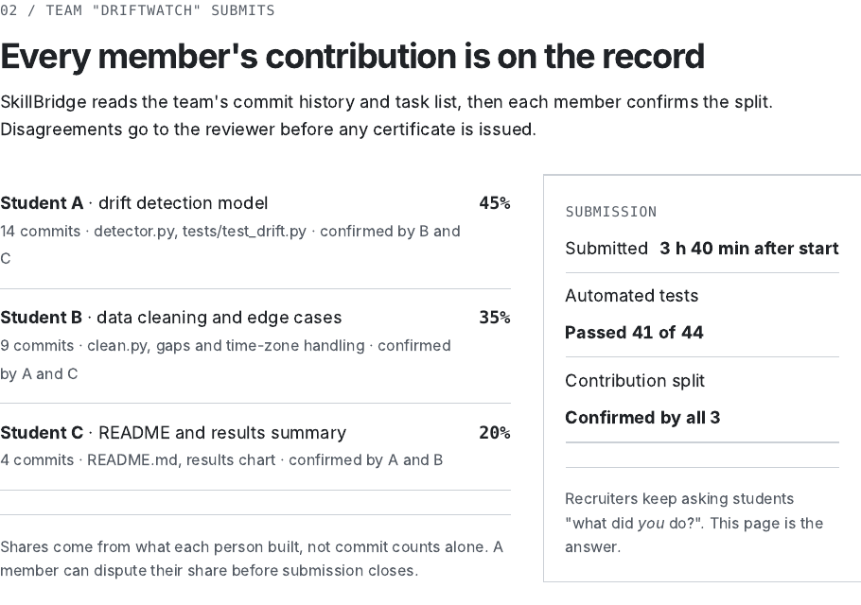
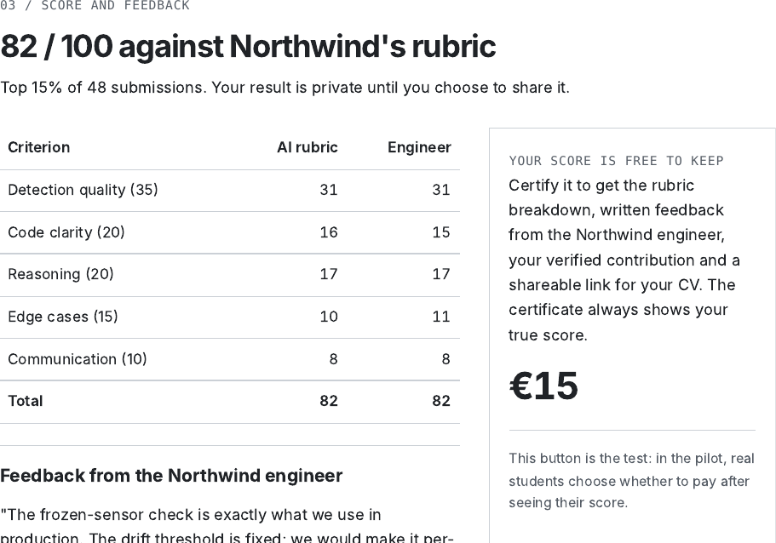
Rough test: prototype v1 shows the full flow
Step 2: every member's contribution is on the record
Step 3: AI and engineer scores side by side, then certify
prototype/prototype-v1.html (offline), PDF and PNG backups. All companies, students and scores shown are invented.
Notes:
Open prototype-v1.html live if there's time; it works offline. Everything shown is invented for the walkthrough. It demonstrates the flow and is not evidence. The 12 Oct version is backed up in prototype/backups.

Slide 22

Business model: three ways money can come in
Hypothesis 1
Hypothesis 2
Hypothesis 3
Students pay to certify
Companies pay per challenge
Companies sponsor challenges
€15 per certified result. Score is free.
A cheaper first screen than reviewing every take-home.
From the employer-branding budget instead of a hackathon.
Our first test. But every alternative is free, and fees alone stay under €9k a year in Madrid.
HackerRank from $79/month. DF-R01: "per hire or per challenge", compared with job boards.
V2-R01: a hackathon of about 8,000 (currency not recorded) from the talent-brand budget. DF-R01: ~€5k datathon, no hires.
Sources: assumptions.md (revenue hypotheses), stakeholder-map.md, v2-interviews (V2-R01 Q10), company-interview-deem-finance.md (Q8, Q15–16)
Notes:
The team ranked students paying first; every company-side person we spoke to points at companies. We keep the ranking until the pilot decides, but we draft the company price now so the 'students fail, recruiters pass' branch can start immediately.

Slide 23

Each player gets and pays something different
Gets
Pays
Student
Proof of what they personally did, plus specific feedback
2–7 h; €15 if they certify
Company engineer
A cheaper first screen than reviewing every take-home
One brief, one rubric, ~20 min per review
Recruiter
A shortlist signal they can inspect: work, rubric, note, contribution
Learning a new signal
Budget owner (HR / talent)
Less engineer time on take-homes; employer branding
Per-challenge or sponsorship fee
University careers office
Better student outcomes; a ready-made partner programme
Promotion, maybe a licence
Source: evidence-log/stakeholder-map.md (also lists hurdles: no signed brief, free alternatives, engineer time, AI-only scores, payments licence, IP, NUWE)
Notes:
Answers the Challenge II defense feedback on dynamics and value per player. The company is the scarce side: credibility is borrowed from its name and rubric, so we secure a company first.

Slide 24
Options, prioritised: do the cheap, high-value moves first
Now
Next
Later
Not now
One company, one signed brief
IE Talent & Careers for recruiters and students
Student tech clubs for Arm A
Draft the company-pays offer
University plan: the university pays or co-issues
Employer-branding sponsorship instead of a hackathon
Test the company price
EU micro-credential format (Europass, LinkedIn)
Public funding via a university consortium
Pro-bono briefs as fallback only
Kit Digital / Kit Consulting (funds SMEs, not us)
Enterprise clients (GDPR and legal review first)
Notes:
From the stakeholder map. 'Now' is during the 16–30 Oct pilot; 'Next' is Phase 2. Everything else waits for the pilot's decision rule.

Slide 25
What real people told us
06 · REAL-USER VALIDATION
Who we talked to, what students, recruiters and an engineer said, and which claims changed
Notes:
This is the most important rubric line (13%): verifiable feedback from real people on the highest-risk hypothesis, and results that changed a decision.

Slide 26
We talked to students, recruiters and an engineer
Round | Who | n | Strength
Sep interviews | 2 IE students, 2 small-business owners | 4 | Medium
Student survey | Students, unscreened | 17 | Medium
Pilot (1 Oct) | 3rd-year software students, Madrid | 11 | Medium
V2 interviews | 1 IE CSAI student, 1 tech recruiter, 1 company engineer | 3 | Medium
One-on-ones | 1 graduate (outside target), 1 IE student, 1 recruiter | 3 | Low–medium
Company interview | 1 fintech recruiter, Deem Finance (DF-R01) | 1 | Low–medium
Honest limits
All stated, none observed
Samples never added: participants may overlap
Some interviews undated; past samples unscreened
Pilot recruits screened students and recruiters
Source: validation/claims-changed.md; recruitment.md (participant fit)
Notes:
Six rounds. Strength is labelled honestly: everything is stated, not observed. Samples are never added together because participants may overlap. Answering the Challenge I traceability feedback, recruitment.md now has a participant-fit table against the target user.

Slide 27
Students: "It has to be possible to fail it"
Would pay, on conditions
"Fifteen euros is two coffees. If I'd already done the work and the feedback was real — an actual engineer wrote it, not generated — I'd pay that."
Also heard
Fear of a public bad score
Forage: "it felt fake. Nobody checked anything I did"
4 hours clashes with deadlines
One-on-ones: 3–5 and 4–6 h a week
"If a bad score is attached to my name somewhere public, that's worse for me than not doing it at all."
Scarcity protects value
"The second it's on fifty profiles it's noise… if the money is what gets you the certificate rather than the work, then it's worthless."
V2-S01 (5 Oct), v2-interviews-2026-10-12.md; OO-S02, one-on-one-interviews-2026-10-12.md
Notes:
V2-S01 is a current IE CSAI student. They had done two Forage simulations ('it felt fake, nobody checked anything I did'), paid for LeetCode Premium before an interview, and would pay €15 under conditions. Their conditions became product decisions: engineer-written feedback, private by default, true score always shown.

Slide 28
Recruiters: trust the evidence, ignore a bare number
V2-R01
OO-R01
DF-R01
Tech recruiter, 6 Oct
Recruiter, one-on-one
Fintech recruiter, Deem Finance
"82 out of 100 means nothing to me on its own… If it's the hiring company's rubric and their engineer signed it, that's the part with weight."
Needs "a clear scoring rubric, review by the company that set the challenge, the actual work sample, and consistency across candidates."
Picked the certified profile. Wants their own rubric, an engineer's note, the code and the rank: "a bare number would be ignored".
Decision: the certified result is an evidence bundle (work, company-named rubric, contribution record, engineer's note), never a bare score. Recruiters also want a live check: 10–15 min (V2-R01, DF-R01).
Notes:
Three recruiters, same message: they picked or trusted the certified profile only when they could see the work, whose rubric it was and an engineer's note. None would act on a bare score. These are preliminary stated judgements and do not count toward Arm B's 3 of 5, which is measured in the pilot.

Slide 29


Engineer: a real company task is on the table
“
Five criteria, in order
Runs on an unseen file · handles broken rows · readable · has tests · has a README
We've got a CSV import thing — customers send us messy spreadsheets and someone cleans them by hand every time… it's been in the backlog about a year.
Review time
~20 minutes each; "send me three zips and a deadline"
Trusting the AI
"I'd spot-check one from the bottom" → engineer samples 2 lower-half entries
IP
V2-E01, company engineer, 10 Oct
Students keep their code; assessment use only
Notes:
V2-E01 offered a real backlog task and five criteria in order. Note the limits: no written brief or rubric sign-off yet, and the PDF's closing request has no recorded answer. The written brief is due 20 Oct (owner: Lucas Avila).

Slide 30
What real evidence changed
We believed
Now
Because of
The score is the product ("82/100")
Certified result = evidence bundle, never a bare score
V2-R01, OO-R01, DF-R01
Engineer reviews only the top entries
Every paying student gets engineer-written feedback
V2-S01
Results go on a public profile
Private by default; true score always shows; you can fail
V2-S01
AI ranks; engineer checks the top
Engineer scores 5 incl. 2 from the lower half
V2-E01
Students can do a multi-week project
Challenges sized to 2–7 h; pilot uses 4 h
Survey, one-on-ones
Small-business owner is a critical persona
Skeptical Verifier (recruiter) replaces them
Pivot
Source: validation/claims-changed.md (11 claims, with links to where each change now lives)
Notes:
Answers the Challenge II defense: the link between what we learned and what we changed. Full table with 11 rows is in validation/claims-changed.md. Each row: what we believed, what people said, what we changed.

Slide 31
Skills or payment? Skills. And companies should pay
3/3
2
< €9k
one-on-one interviewees: companies should pay most or all
recruiters named a company budget it could come from (V2-R01, DF-R01)
a year from student fees in Madrid, even at 30% paying
What we decided
What we're doing about it now
We're after proof of skill, not paid work: payment motivates only 3/17 students. The ranking (students pay first) stays until the pilot decides.
Draft a per-challenge company price alongside the pilot, so the "students fail, recruiters pass" branch can start at once.
Notes:
The professor asked in Challenge I: are you after skills or payment? Skills (proof). And on who pays: every outside voice points at companies. We have not reversed the team's ranking yet, because these are stated preferences; the pilot decides. But the company price is drafted now so we can switch at once.

Slide 32
Test both halves of the riskiest assumption
07 · DECISION AND NEXT TEST
The two-arm pilot, the decision rule, owners and the stop condition

Slide 33
The pilot tests both halves at once, 16–30 October
Arm A · Students
Arm B · Recruiters
One 4-hour challenge from a real company brief
Free entry; score shown free
Certified result for €15 (Bizum or card link)
Metric: students who pay ÷ students who submit
5+ recruiters who screened interns in the last 12 months
Same CV, with and without the certified bundle
Ask: shortlist? replace take-home? distrust?
Metric: share who say it changes or supports a shortlist
Threshold: ≥ 30% pay, with at least 10 submissions
Threshold: ≥ 3 of 5 recruiters
Secondary: AI vs engineer score gap; completion rate (submit ÷ start). Thresholds fixed before the test. Source: experiment-card.md
Notes:
Riskiest assumption: students will pay for a certified challenge score, because employers treat that score as credible. Arm A is high-strength evidence (real money, real submissions). Arm B is medium (stated intent from real recruiters).

Slide 34



Decision rule: what we do with each result
Both pass
Students fail · recruiters pass
Continue
Change revenue
Build the working skeleton in Phase 2; recruit a second company
Students free; companies pay for the screen (hypothesis 2)
Students pass · recruiters fail
Both fail
Narrow
Stop
Sell practice and feedback; drop the hiring-credential claim
Stop the v2 credential model; return to the evidence and archived v1 options
Notes:
Precommitted branches. This answers 'what could still make you narrow, pivot or stop?': students fail → companies pay; recruiters fail → narrow to practice and feedback; both fail → stop the credential model.

Slide 35

Owners, dates and the stop condition
16 Oct
16–30 Oct
20 Oct
30 Oct
Company brief confirmed, or switch to an illustrative brief on a public dataset
Two-arm pilot runs: students take the challenge; 5+ recruiters compare profiles
Written brief + engineer's rubric sign-off (owner: Lucas Avila)
Results against the fixed thresholds → decision rule
Stop condition: no engineer sign-off of a brief and rubric by 20 Oct → run Arm B alone and record Arm A as not run.
Notes:
Lucas Avila coordinates and owns the written brief; arm owners are assigned at Session 14. If no engineer signs off a brief and rubric by 20 Oct, we run Arm B alone and record Arm A as not run.

Slide 36
How we answered your feedback
"Has this been done already?"
"Skills or payment?"
Competitor check: no individual-contribution certification found in four platforms; NUWE unverified
Skills. Payment motivates 3/17; v2 drops paid client work
Traceability: show participant fit
Real-user validation (Rework)
Participant-fit table in recruitment.md; screening questions for the next round
Six rounds incl. students, three recruiters, an engineer; claims-changed table
Link between learning and change
Dynamics, hurdles, options
Claims changed: before → what people said → what changed
Stakeholder map: value per player, hurdles, 11 ranked options
Still open: the v2 test hasn't run yet. That is the same weakness Challenge I flagged; the pilot starts 16 Oct.
Source: evidence-log/feedback-response.md
Notes:
Challenge I: 7.3 / 8. Challenge II: 6.5 / 8. Real-user validation was 'Rework' in Challenge II; since then we have six rounds of evidence and a claims-changed table. Be honest that 'test not run yet' is the same weakness as in Challenge I.

Slide 37

Honest status check
We know
Only stated so far
Still unknown
Students struggle to show their own contribution (14/17)
Short challenges fit their time (12/17 ≤ 4 h)
Recruiters want inspectable evidence, not a number
Students would pay €15, on conditions
Recruiters would shortlist on the bundle
Companies would pay per challenge or sponsor
Real payment and real completion
A signed company brief and rubric
AI–engineer score agreement
Any hiring decision made on a certified result
Notes:
Self-reflective, critical status check is part of the Explanation grade. Problem: real evidence. Payment and recruiter trust: stated and conditional. Unknown: everything that requires behaviour, which the pilot starts to measure.

Slide 38
Questions
What did real evidence change? · What could make us narrow, pivot or stop?
Everything lives in the repo. Start at evidence-log/venture-skeleton.md: the whole venture on one page.
Notes:
Ready answers: (1) Evidence changed the product: evidence bundle, feedback for every payer, private by default, engineer samples the lower half, recruiter persona. (2) Narrow/pivot/stop: the decision rule; and if no company signs a brief by 20 Oct, Arm A doesn't run.

