Slide 1



The Cyprus Economy
Two years after the financial crisis
Nicos S. Kyriakides Partner - Head of Financial Advisory Services
Deloitte Cyprus
Limassol, 20 March 2015

Slide 2
Contents
Cyprus at a Glance
The Crisis of March 2013 and the Road to Recovery
Current Macroeconomic Outlook.
Competitive Advantages & Tax Framework
Investment Opportunities

Slide 3

Cyprus at a Glance

Slide 4
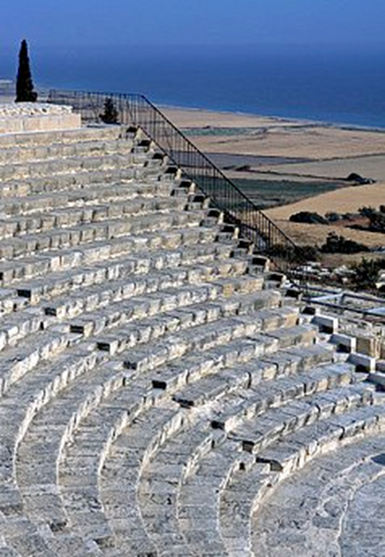
Cyprus at a Glance
Republic of Cyprus – Basic Data
Cyprus is the south eastern outpost of the EU, located in the east Mediterranean at the crossroads of three continents; Europe Asia and Africa.
It is the third largest and third most populous island in the Mediterranean.
It covers an area of 9,251 Km² and its total population was 866,000 as per the last census in 2012. (1.100.000 including the occupied areas).
The Republic of Cyprus is an independent state with a presidential system, and a member state of the EU since 2004.
Cyprus has joined the Eurozone since 1 January 2008 and as a result its official currency is the Euro (€).

Slide 5
The Crisis of March 2013 and Road to Recovery

Slide 6
The Crisis of March 2013 and Road to Recovery
The events of March 2013
The banking crisis caused by the large size of the sector.
Main contributors leading to the Eurogroup Decision of March 2013:
Accumulated imbalances from large deposit inflows to the two major Cypriot Banks (BOCY and CPB);
The banks’ exposure to the Greek economy (loan operations and investments in Greek Government Bonds) and the haircut of the Greek public debt;
The excessive credit expansion abroad and domestically deteriorating loan quality in Cyprus (especially for real estate projects), eroding depositor confidence;
Rapid fiscal deterioration and reduced economic activity due to international financial crisis and bursting of the housing bubble; and
Weak prudential supervision.

Slide 7
The Crisis of March 2013 and Road to Recovery
The events of March 2013
The Eurogroup decision led to:
The Greek operations of the two main banks and HB were sold out to Bank of Piraeus, thus ring fencing Cyprus banking sector from Greece.
Subsequently, the two main banks were subject to a restructuring by means of resolution, which involved the immediate bail-in of subordinated debt.
Uninsured deposits were subject to a bail-in, implying a deposit-to-share swap, which at Bank of Cyprus eventually reached 47,5%.
The capital required for CPB and of BOCY to be adequately capitalised exceeded 50% of Cypriot GDP and was covered exclusively through the contributions of uninsured depositors with full contribution of equity shareholders and bond holders.
The third largest bank was bailed out from funds borrowed from Troika

Slide 8
The Crisis of March 2013 and Road to Recovery
Restrictions in place
After the announcement of the banks’ resolution on 25 March 2013, in order to prevent massive liquidity outflows and a collapse of the banking system, Cypriot authorities imposed capital controls of a temporary nature, on funds held in the system at the time.
New funds injected into the Cypriot economy after March 2013 are not subject to any restrictions
The capital controls imposed started gradually to be relaxed.
In June 2014, all domestic capital controls were lifted.
Foreign banks are allowed to continue serving their international clients without any significant restrictions.
All remaining restrictive measures for funds that were present in the Cypriot banking system before March 2013, are expected to be lifted shortly after 31 March 2015.

Slide 9
The Crisis of March 2013 and Road to Recovery
The Economic Adjustment Programme
Following the events described earlier, an economic adjustment was needed to recapitalise banks and provide financing for the government.
The program which was agreed with our lenders; IMF, EC, ECB and is monitored by them, addresses short-term and medium-term financial, fiscal and structural challenges with measures under 3 pillars:
Banking sector: Enhanced supervision, greater liquidity and recapitalisation of banks to rebuild confidence in the banks by depositors and the market.
Public finances: Fiscal consolidation for correcting the excessive general government deficit by year 2016 and achieving surpluses thereafter.
Structural measures: Aimed at enhancing competitiveness and returning to a sustainable and balanced growth path. Such measures include the enhancement of the Budgetary Framework to safeguard fiscal discipline, labour market reforms to contain wage costs, pension reforms to ensure long-term sustainability, health care sector reform and reform of the public sector to improve service to businesses and citizens.
Also, the privatisation of state owned monopolies is expected to enhance competitiveness in key sectors and raise a significant amount for the repayment of government debt. A total revenue target of the Privatisations Programme is €1,4bln.

Slide 10
The Crisis of March 2013 and Road to Recovery
Review Missions and Disbursements
We have had 5 positive review missions confirming that the programme is “on track”. As a result, by early October 2014, Cyprus had received 5 bail-out tranches, amounting to €5,77bn of the €10bn EUIMF funds.
The 6th bail-out tranche (€436m) remains incomplete at €350mln due to Cyprus not implementing the foreclosures legislation.
As per the Economic Adjustment Programme, real GDP was initially projected to contract by 12,5% cumulatively in the period from 2013 to 2014, with growth expected to rebound in 2015 and remain close to 2% over the long run.
However, the Cypriot Economy performed better than expected during 2013-2014 and hopefully might exit the programme earlier than expected which is in year 2016.
It is important to note that Standard & Poor’s has upgraded the long term credit rating of Cyprus from B to B+ and confirmed its short term to B, citing the country’s strong budgetary performance (October 2014).
Also, Moody`s Investors Service and Fitch Rating Agency have also upgraded Cyprus revising the outlook on the government bond rating from stable to positive (October 2014).

Slide 11
The Crisis of March 2013 and Road to Recovery
Financial Sector: Stabilisation process - Single Supervisory Mechanism (SSM)
The size of the sector has been reduced and the deposit base has been broadly stabilised.
Four systemic financial institutions in Cyprus, namely Bank of Cyprus, Hellenic Bank, the Cooperatives and RCB Bank, representing about 80% of asset base, are directly supervised by the European Central Bank under SSM as of November 2014.
The 4 banks had participated in the comprehensive assessment (Asset Quality Reviews and Stress testing) conducted by the ECB in October 2014.
The results of the comprehensive assessment were satisfactory, having only one of the Cypriot systemic banks needing additional capital, which was successfully raised in excess of the stress test capital needs.
The Capital Adequacy ratios currently remain at high levels.

Slide 12
The Crisis of March 2013 and Road to Recovery
Total deposits outstanding
The outflow of deposits from the Cyprus banking system has slowed down significantly after the sudden drop of March 2013. More stability is observed in recent months.

Slide 13
The Crisis of March 2013 and Road to Recovery
Road to Recovery
Focus on resilient sectors of the economy: tourism, business services, shipping – sectors that do not heavily depend on credit in the short-term but more on cash flow.
Restore investor confidence via structural reforms in fiscal governance and banking sector.
Promote Investment opportunities from privatization projects.
Tourism: expand tourist season to reduce seasonality, diversify markets and products, focus on markets with high return, increase competitiveness by providing more value-added services.
Business services: diversify source and nature of professional services providers (financial services), promote the new AIFs regime and expand double tax treaties network.

Slide 14
Current Macroeconomic Outlook

Slide 15
Current Macroeconomic Outlook
Macroeconomic Indicators
Real GDP declined by 5,4% in 2013 compared with an anticipated decline of 8,7% included in the economic adjustment programme.
Further contraction is estimated for 2014 due to a fall in wages, high unemployment and the banks being forced to tackle nonperforming loans.
The unemployment rate peaked at 15,9% in 2013 and now appears to trend lower, expected to reach approx. 15% by 2016.

Slide 16
Current Macroeconomic Outlook
Macroeconomic Indicators
Over 2015-16, it is expected that the economy will return to a growth trajectory, although this is likely to take some time, since banks will be extremely careful to whom they lend and on which projects. They will avoid highly leveraged corporations and households and the deleveraging process in all sectors is expected to continue.

Slide 17
Current Macroeconomic Outlook
Macroeconomic Indicators
Consumer prices decreased by 2,3% in 2013. Deflationary pressures were estimated to continue in 2014 with deflation expected to be -1,4%. For years 2015 and 2016, it is expected to have positive inflation rates, which will gradually increase.
In 2013, the general government budget deficit decreased to -4,9% of GDP, from -5,8% in 2012. It is expected that in 2015 the deficit will narrow to -3,6% of GDP. After 2016, a further reduction in the deficit is expected to be achieved.
According to the Public Debt Management Office newsletter for February 2015, the overall fiscal deficit for 2014 has already been effectively eliminated at -€7mln (i.e. 0% of GDP).
The government debt/GDP ratio was 102,2% in 2013. It is estimated that the debt/GDP ratio will peak in 2014, at 108,6% of GDP and it will drop further in 2016 onwards.

Slide 18
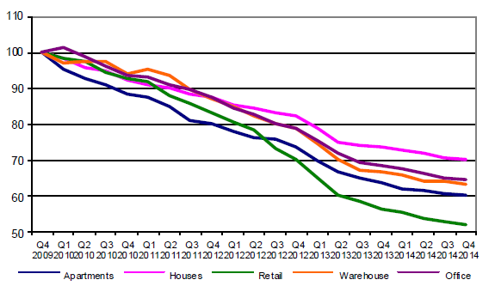
Current Macroeconomic Outlook
Real Estate Price Index (RICS Cyprus)
Source: RICS Cyprus Property Price Index, 4Q2014
The Property Price Index has recorded falls in almost all cities and asset classes, with houses and offices having more resistance to the drop.

Slide 19
Current Macroeconomic Outlook
2013 Nominal GVA, by sector
89,7%
7,8%
Source: Cyprus Statistical Service, National Accounts 2013
The Real estate activities and Tourism (Accommodation and food service activities) sectors form 11,7% and 6,7% of 2013 Nominal GVA, respectively.

Slide 20
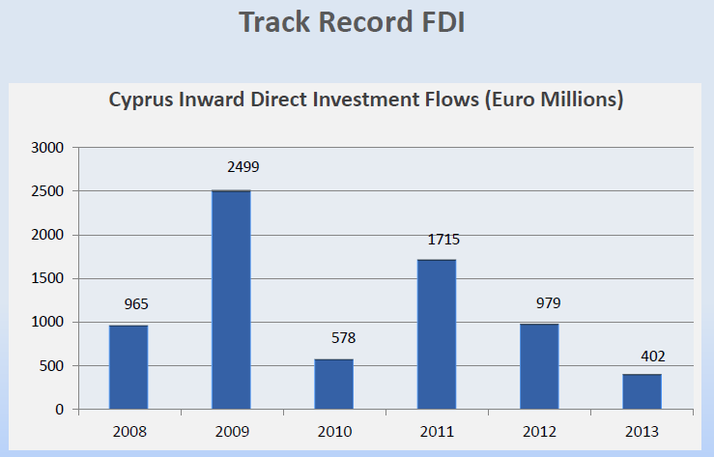
Current Macroeconomic Outlook
Foreign Direct Investment
Source: Central Bank of Cyprus Statistics
The Foreign Direct Investment in Cyprus suffered a significant drawback in the years 2012 and 2013 due to the crisis.

Slide 21
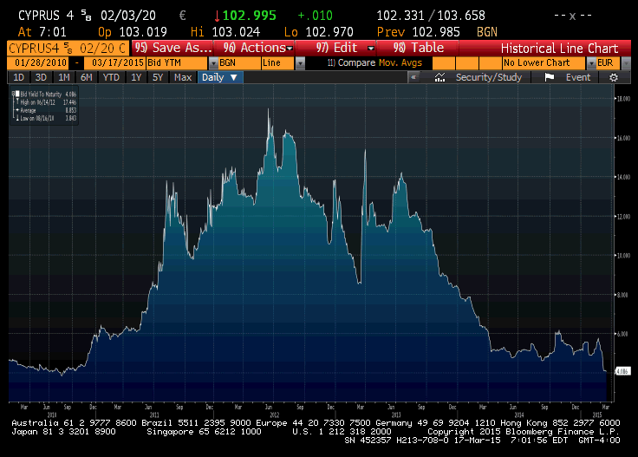
Current Macroeconomic Outlook
Cyprus 10-year Government Bond Yield
Source: Bloomberg
The yield on the 10-year Government Bond suffered a significant increase in 2012 and for most of 2013 reflecting the uncertainty, and started dropping since the end of last year. It currently stands at approximately 4,1%.

Slide 22
Competitive Advantages &
Tax Framework

Slide 23
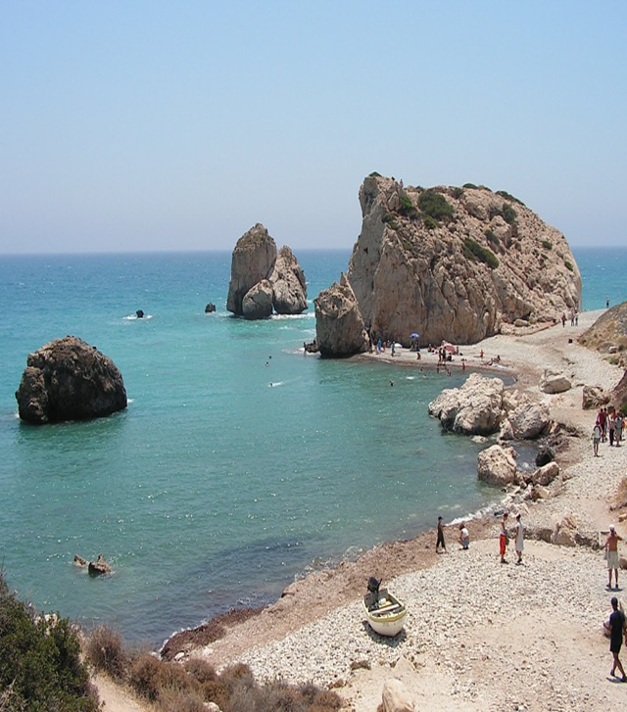
Competitive Advantages & Tax Framework
Republic of Cyprus – Ideal Jurisdiction
Strategic Location and time zone
Political stability and well developed ties with ME, Central & Eastern Europe
Advanced infrastructure – reliable telecommunication system, two international airports (Larnaca & Paphos) and two ports (Limassol & Larnaca).
Robust Legal and Regulatory Framework with a well developed financial services sector – banking, investment and fund management
Highly educated and multilingual human talent with tertiary education – (39,2% in age group 25 – 64) being higher than EU28 average and one of the highest in the world.

Slide 24

Competitive Advantages & Tax Framework
Republic of Cyprus – Ideal Jurisdiction
High quality of professional services: Top quality accounting, auditing, tax, business administration, legal,.
Good quality of life – A safe country to live and work – A Mediterranean country with an international business environment
Investment Incentives in a number of sectors, with huge potential for growth e.g. tourism, natural gas, infrastructure, privatisations, etc.

Slide 25
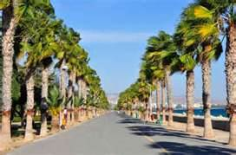
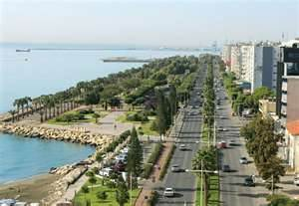
Competitive Advantages & Tax Framework
Republic of Cyprus – Tax Framework
Well developed and attractive tax system, one of the most favourable in the EU
Simplified, effective, transparent and fully compliant with EU laws and regulations.
Corporate tax rate at 12,5%
Dividend income, overseas PE profits and profits or gains from the disposal of securities are exempt from taxation.
Favourable IP, Royalty & financing structures regime
Extensive network of double tax treaties (currently 54)
Ability to use the EU Directives
Unilateral credit relief
Low or zero withholding taxes.

Slide 26
Investment Opportunities

Slide 27

Investment Opportunities
Reasons to invest in Cyprus
Investment Incentives: A number of measures has been put in place by the Government to stimulate foreign direct investment and economic growth. These measures include:
Reduced the time required to issue planning permission to a maximum of one month for small projects and three months for large projects.
Increased building coefficients by 30% in residential areas for large commercial developments. Coefficient will be increased by 25% on the outskirts of residential areas for large commercial or office developments. It will increase by 20% in certain tourist zones for large-scale property and from 10% to 15% for areas available for golf courses.
Permits for joint tourist developments such as condo hotels.
Foreign nationals encouraged to invest in Cyprus by being given permanent residency status (€300k) and citizenship by exception if they invest in real estate, financial assets or companies operating in Cyprus (€5m in total reduced to €3m if through a collective scheme).

Slide 28
Investment Opportunities
Reasons to invest in Cyprus
Vote of confidence by international investors:
Wilbur Ross with a group of investors have recently invested over €400 million in Bank of Cyprus resulting in the acquisition of 19% of the institution’s equity capital, showing confidence in the Cypriot Economy’s potential for growth.
EBRD invested also in the share capital of Bank of Cyprus during the recapitalisation exercise in late 2014.
International investors, Wargaming.net and North American hedge fund Third Point LLC, acquired a 30% stake each in the share capital of Hellenic Bank. They have also fully supported the Rights Issue for meeting the EBA stress test capital needs.

Slide 29
Investment Opportunities
Investment Sectors
Hotel & Tourism: A number of opportunities exist for investing in large scale development projects related to the Hotel & Tourism sectors. These large scale developments aim to develop further the current infrastructure, add value and reduce seasonality for the Cypriot touristic product. Examples of such projects include:
Golf courses;
Marinas;
Hotels and Condominiums;
Theme Parks; and
A world-class integrated casino resort.
Medical and Wellness Centres; and
Education
According to the Cyprus Statistical Service, tourist arrivals in the period January – December 2014 increased by 1,5% to 2.441.239 compared to 2.405.390 in the corresponding period for 2013.

Slide 30

Investment Opportunities
Investment Sectors
Renewable Energy: The National Action Plan issued by the MECIT, has set a target to reach RES energy production of 657GWh by 2020, which will be equal to 16% of the total electricity production in Cyprus (3% higher than EU target).
As a result, significant opportunities exist for investment in large scale solar thermal and photovoltaic projects.
Already have installed capacity:
Wind - 147 MW
PVs - 41,1 MW
Biomass - 9,7 MW
1st in the world for solar energy use for water heating in households

Slide 31
Investment Opportunities
Investment Sectors
Oil & Gas: Deep-water natural gas reserves in Cyprus Exclusive Economic Zone bring investment opportunities across the oil & gas supply chain for domestic consumption but mainly in export and related infrastructure.
At present, six offshore exploration licences and Production Sharing Contracts have been granted. The first was for Block 12, issued to Noble Energy in October 2008. In January 2012 Noble Energy announced a natural gas field discovery in “Aphrodite” with a current estimated resource at 4,5 tcf. Drilling in the “Onasagoras” area of Block 9 by ENI Kogas resulted in no exploitable quantities of hydrocarbons and they will move drilling to the “Amathousa” area of Block 9.
Also, the construction of a €300m storage and distribution terminal of a total capacity of 848k m³ in Cyprus by VTTI, connecting Europe and the Black Sea with markets in the Middle East, Asia and and North Africa, is expected to transform Cyprus into a regional energy hub.
The first license (Block 12) was issued to Noble Energy in Oct 2008.
In Jan 2013, an ENI-KOGAS consortium was issued with licences for Blocks 2, 3 and 9.
TOTAL E&P was issued with licences
for Blocks 10 and 11 in February 2013.

Slide 32
The Cyprus Economy Outlook
Source: Eurostat
The Economic Sentiment Indicator shows a steadily rising index for Cyprus converging with both the EU-28 and the Euro-19 member states average.

Slide 33
Concluding Remarks
We should not let the economy to derail again, but keep the measures and the discipline, even after exiting from the Programme.
Keep interest rates low and even lower to finance growth
Adopt a One stop shop approach for large scale projects, reduce bureaucratic procedures and introduce more coordination between the government departments involved.
Promote Cyprus to the markets abroad and restore confidence of international investors.
We rely to a great extent on our Russian friends who already know the Cyprus market and they will certainly have an advantage in the process.
You are all very welcome and warmly invited to do business in Cyprus or through Cyprus!!
Thank you for your attention!!

Slide 34

Thank you for your attention!
Contact Details
Nicos S. Kyriakides
Deloitte Limited
Partner in charge of Limassol Office
Head of Financial Advisory Services
Maximos Plaza, Tower 1, 5th Floor,
213 Arch. Makariou III Avenue, CY-3030
Limassol, Cyprus
Main: + 357 25 868686 | Fax: +357 25 868600 | Mob: +357 99 611827
nkyriakides@deloitte.com | www.deloitte.com/cy

Slide 35
Deloitte refers to one or more Deloitte Touche Tohmatsu Limited, a UK private company limited by guarantee, and its network of member firms, each of which is a legally separate and independent entity. Please see www.deloitte/com/about for a detailed description of the legal structure of Deloitte Tohmatsu Limited and its member firms.
Deloitte provides audit, tax, consulting, and financial advisory services to public and private clients spanning multiple industries, with a globally connected network of member firms in more than 150 countries. Deloitte brings world-class capabilities and high-quality service to clients, delivering the insights they need to address their most complex business challenges. Deloitte has in the region of 200,000 professionals, all committed to becoming the standard of excellence.
Deloitte Limited is the Cyprus member firm DTTL. Deloitte Cyprus is among the nation's leading professional services firms, with more than 500 professionals, operating out of offices in all major cities. For more information, please visit the Cyprus firm's website at www.deloitte.com/cy.
Deloitte Limited is a private company, registered in Cyprus (Reg. No. 162812). Offices: Nicosia, Limassol, Larnaca.
This communications contains general information only, and none of Deloitte Touche Tohmatsu Limited, its member firms, or their related entities
(collectively, the “Deloitte network”) is, by means of this communication, rendering professional advice or services. No entity in the Deloitte network
shall be responsible for any loss whatsoever sustained by any person who relies on this communication.
© 2015 Deloitte Limited

