Slide 1
SOLID

Slide 2
What is SOLID?
SOLID is an acronym for five design principles to make software design more understandable, flexible and maintainable.
SOLID stands for:
(S)ingle Responsibility Principle (SRP – Princípio da Responsabilidade Única)
(O)pen/Closed Principle (OCP – Princípio do Aberto/Fechado)
(L)iskov Substitution Principle (LSP – Princípio da Substituição de Liskov)
(I)nterface Segregation Principle (ISP – Princípio da Segregação de Interfaces)
(D)ependency Inversion Principle (DIP – Princípio da Inversão de Dependências)

Slide 3
SOLID principles must be Applied in software development to have the following characteristics
Easy to maintain, adapt and adjust to constant changes;
Easy to understand and test;
Be constructed so that it is prepared to be easily changed with as little effort as possible;
Reusage must be possible;
Meets the needs of the customers it was created for.

Slide 4
SOLID use has the objective to avoid
Errors and Faults;
Bad code structure;
Unmaintainable code;
Bad performance;
Difficult code to understand.

Slide 5
The Single-Responsability Principle - SRP Princípio da responsabilidade única
There should never be more than one reason for a class to change;
Every class should have only one responsability;
Methods should only do one thing;

Slide 6
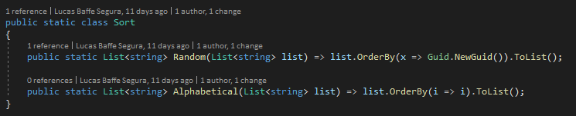
The Single-Responsability Principle - SRP Princípio da responsabilidade única

Slide 7
The Open-Closed Principle - OCP Princípio do Aberto/Fechado
Software Entities (classes, modules, functions, etc) should be open for extension, but closed for modification;
Extensibility: When a new behavior or functionality needs to be added, the existing ones should be extended and not modified
Abstraction: Abstraction is what allows this concept of extensibility to work. If the software has well defined abstractions, it will be open to extension.

Slide 8
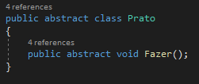
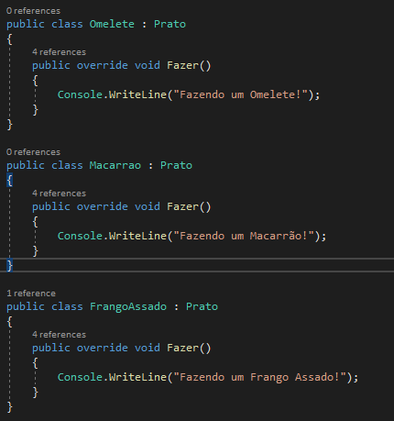
The Open-Closed Principle - OCP Princípio do Aberto/Fechado

Slide 9
The Liskov substitution principle - LSP Princípio da substituição de Liskov
Note: This principle was first introduced by Barbara Liskov, who is a mathematician and talks about the power of abstractions.
The Liskov Substitution principle was introduced by Barbara Liskov in her conference keynote “Data abstraction” in 1987
Functions that use pointers or references to base classes must be able to use objects of derived classes without knowing it.

Slide 10
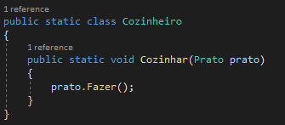
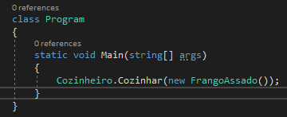
The Liskov substitution principle - LSP Princípio da substituição de Liskov

Slide 11
Interface Segregation Principle Princípio da Segregação de Interface
Many client-specific interfaces are better than one general-purpose interface;
We should never have contracts that are not going implemented;
Keep your interfaces simple and objective.

Slide 12
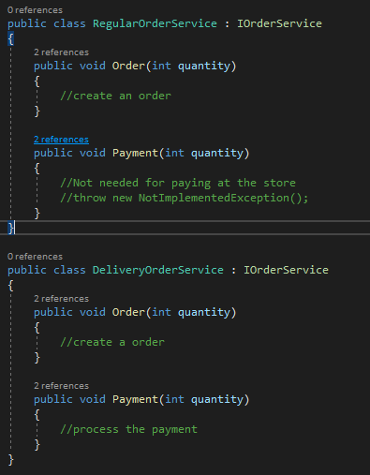
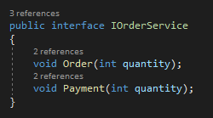
Interface Segregation Principle Princípio da Segregação de Interface

Slide 13
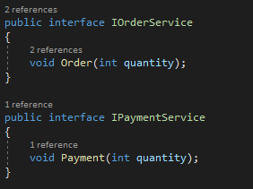
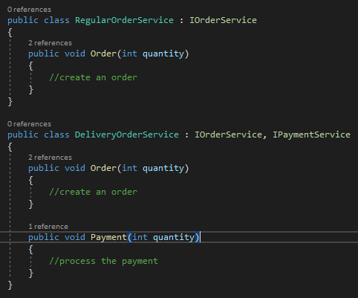
Interface Segregation Principle Princípio da Segregação de Interface

Slide 14
The Dependency Inversion Principle Princípio da inversão de dependência
Dependency inversion is depending on abstractions (interfaces or abstract classes) instead of depending on an implementation.
Every software should depend on abstraction, not concretions/implementations;
High level modules should not depend on low level modules. Both must depend on abstractions;
Abstractions should not depend on details, details must depend on abstractions.
These three definitions mean the same, that is:
Program for an abstract interface/class and not a concrete class.

Slide 15
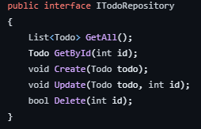
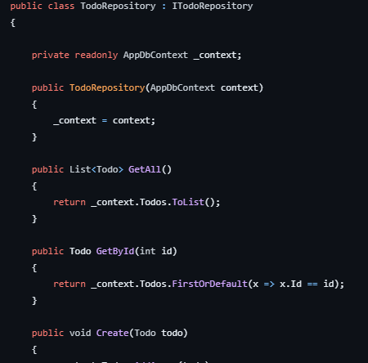
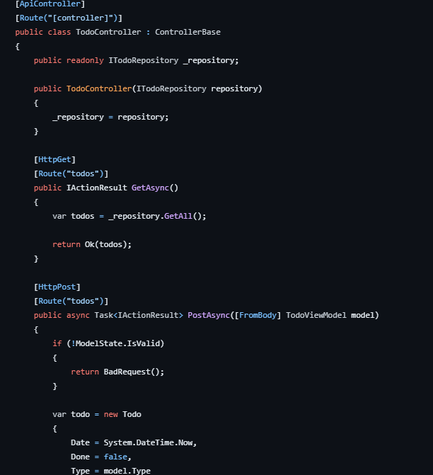
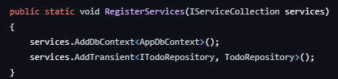
The Dependency Inversion Principle Princípio da inversão de dependência

Slide 16
Takeaway
The SOLID principles apply to any object-oriented design, but they can also form a core philosophy for methodologies such as agile development or adaptive software development.
Need more takeaways

Slide 17
Thank you!
lucasbsegura@gmail.com

