Slide 1


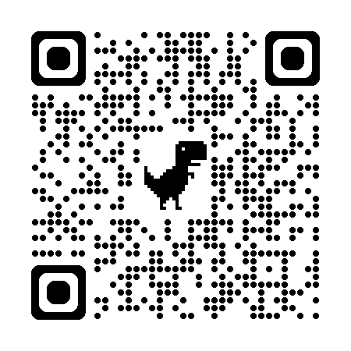

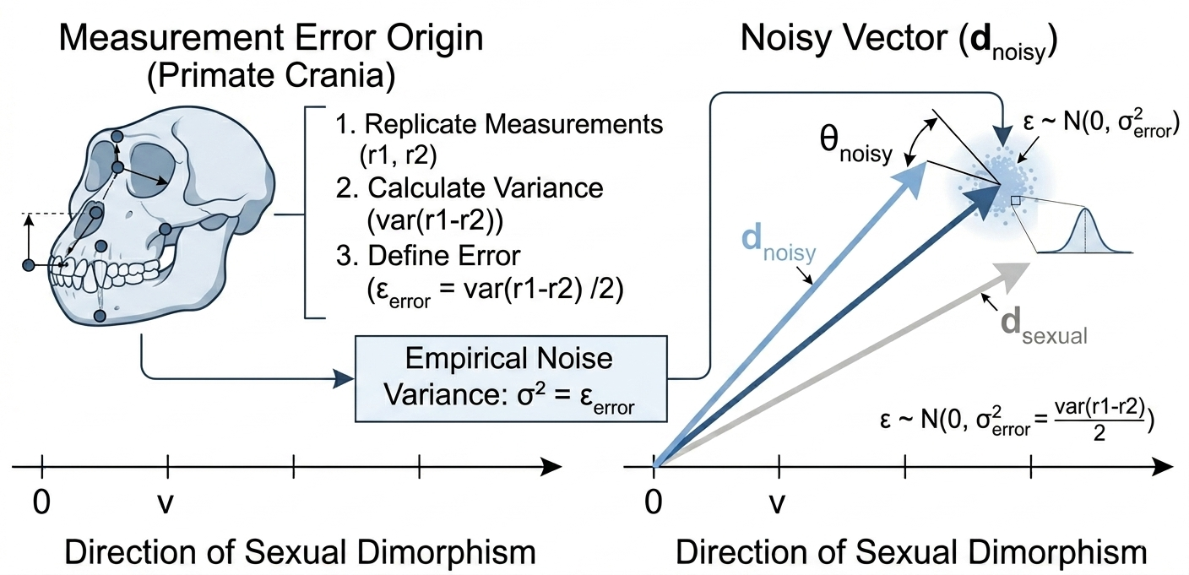
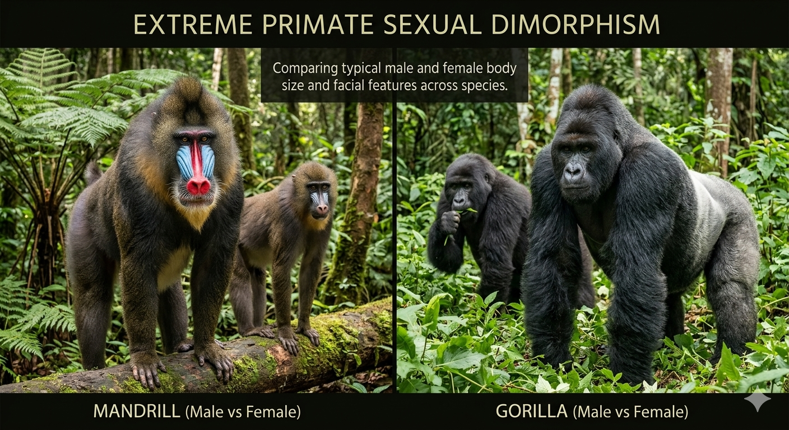
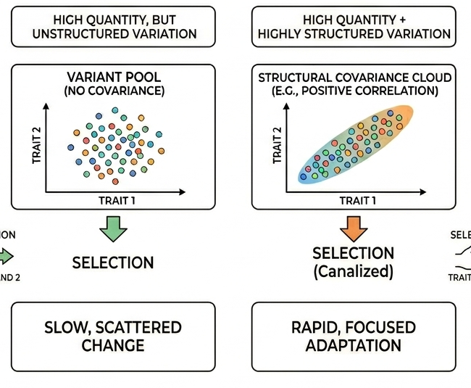
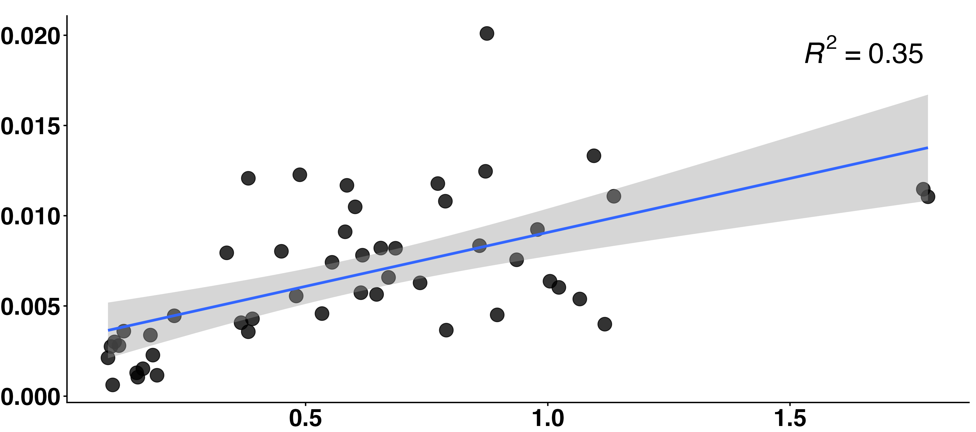
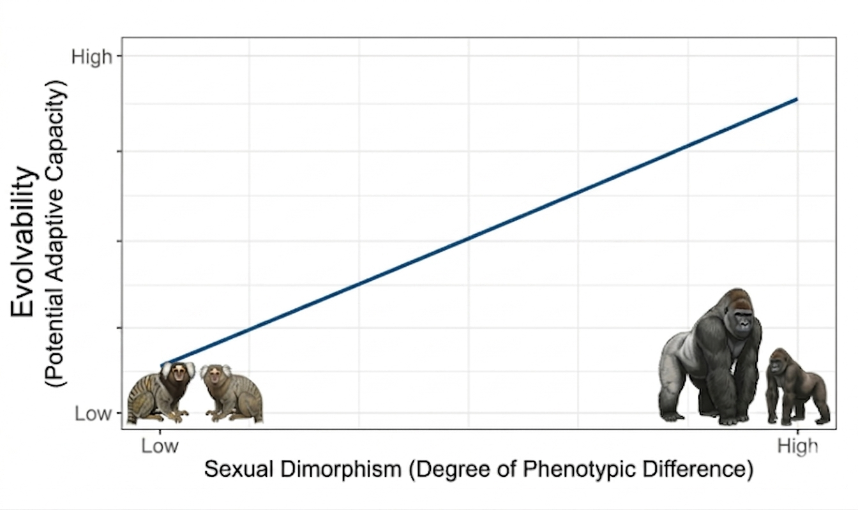
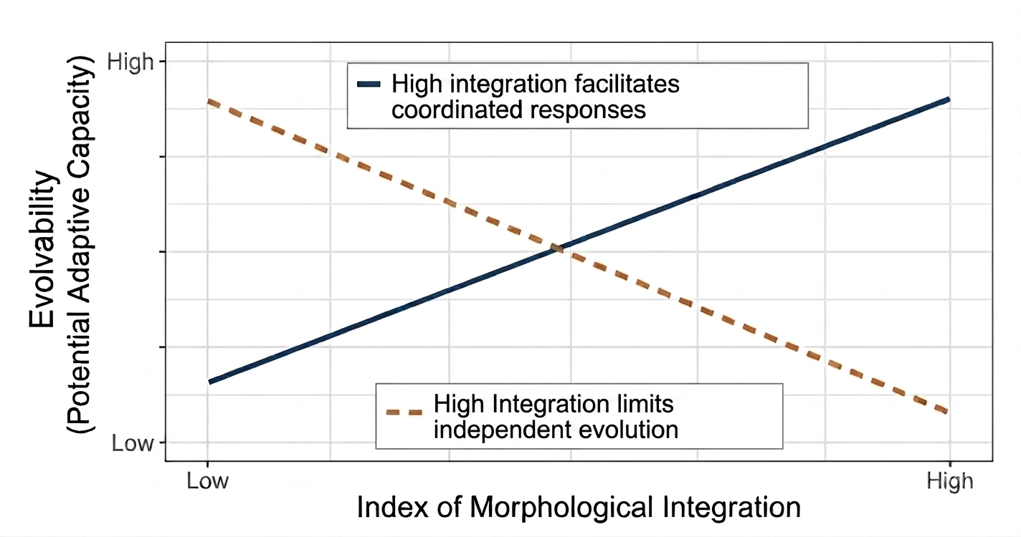
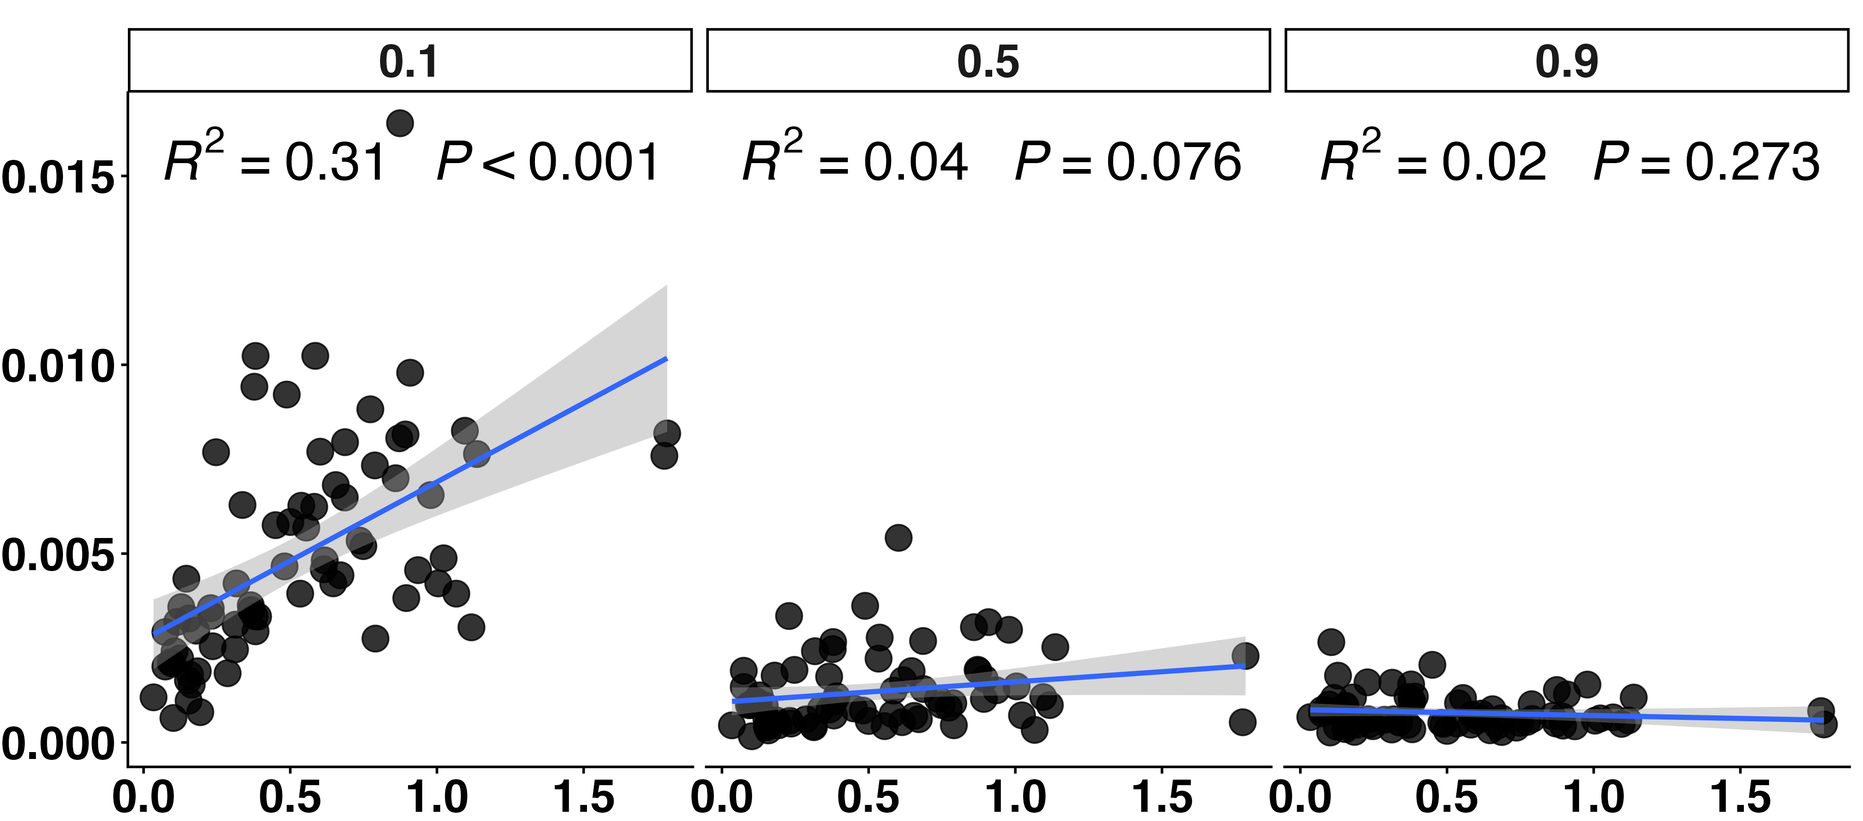
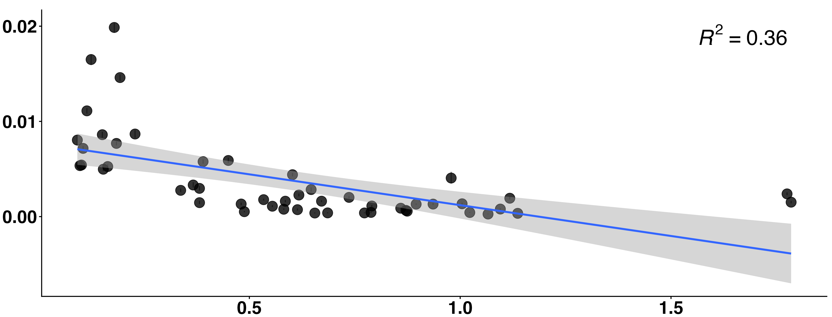
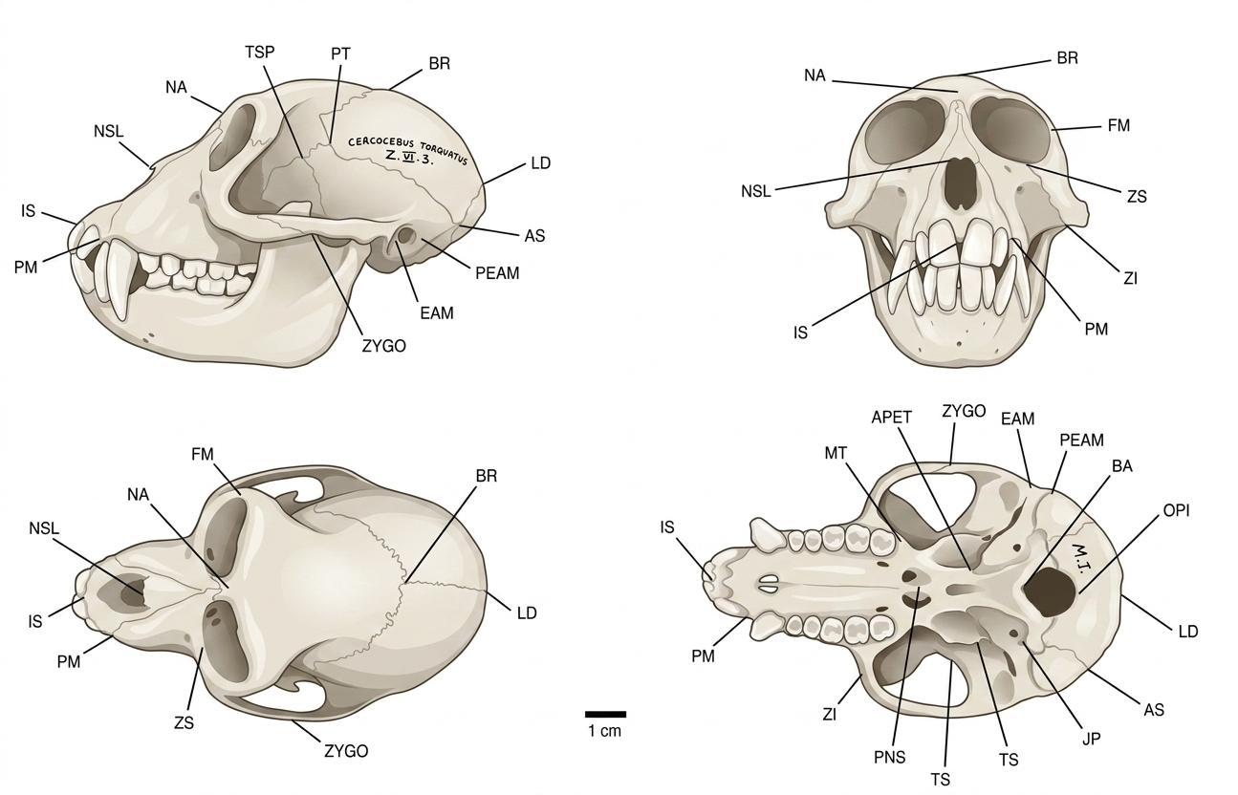
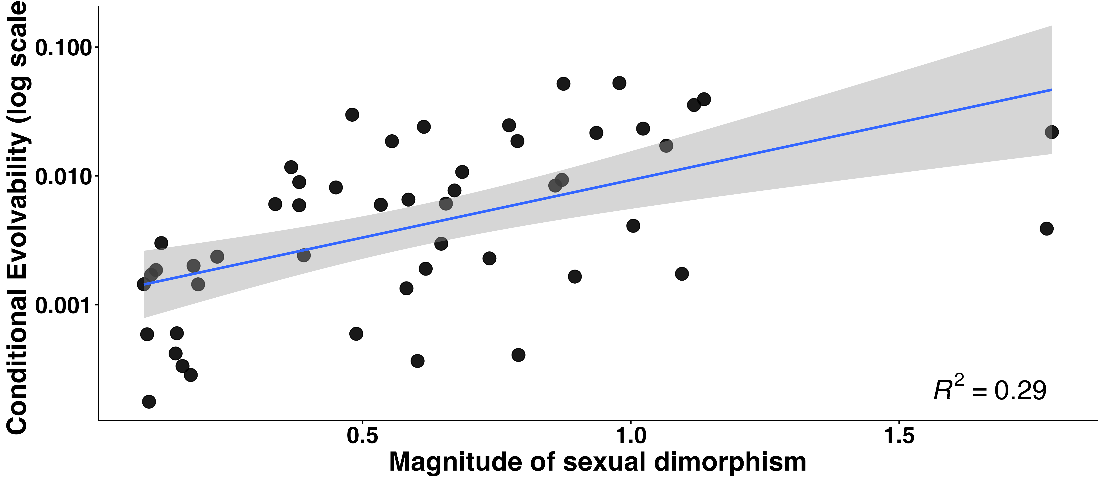
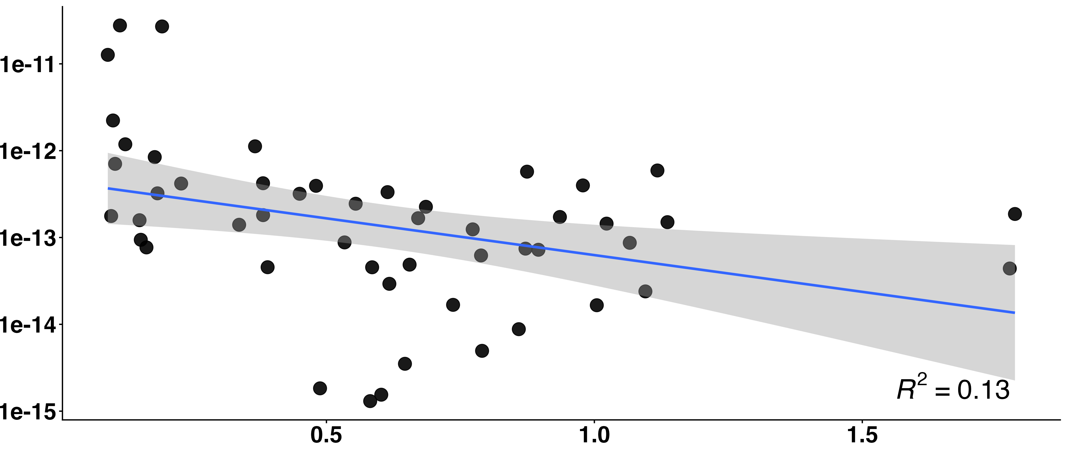
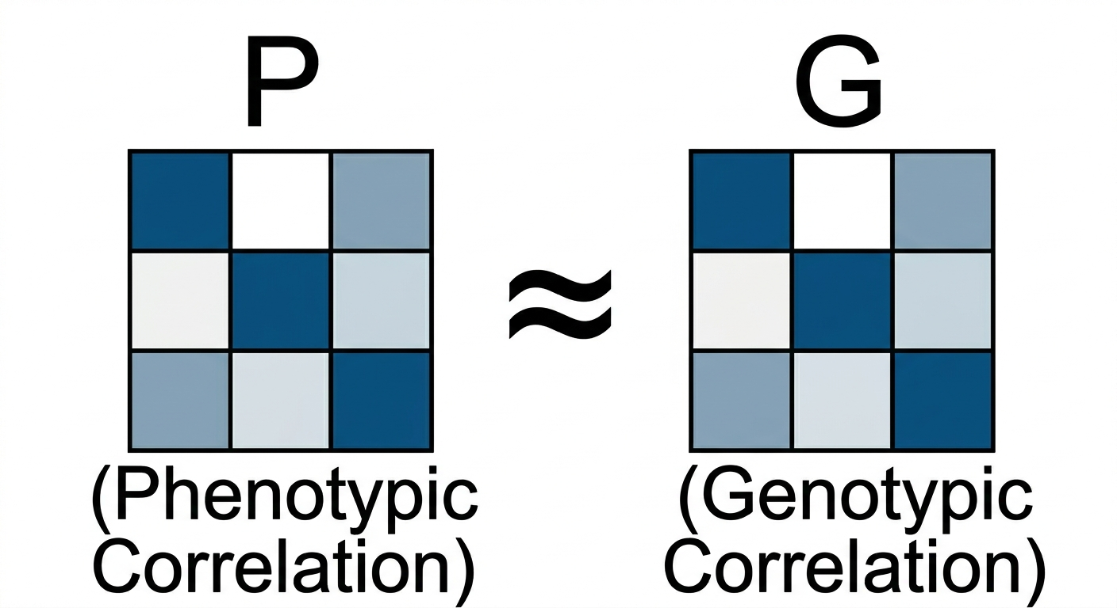
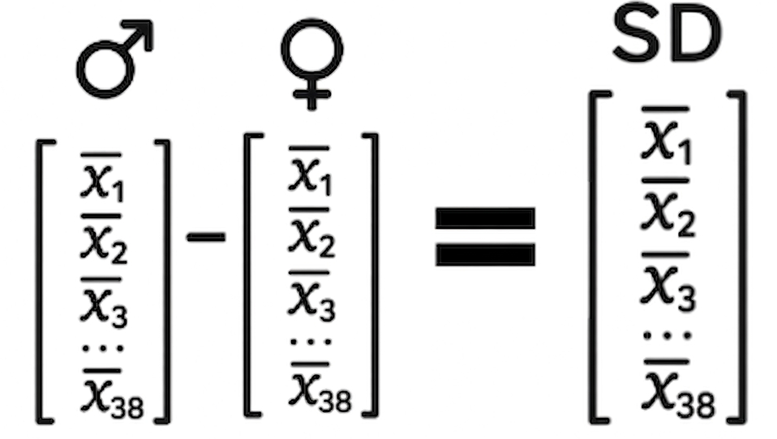
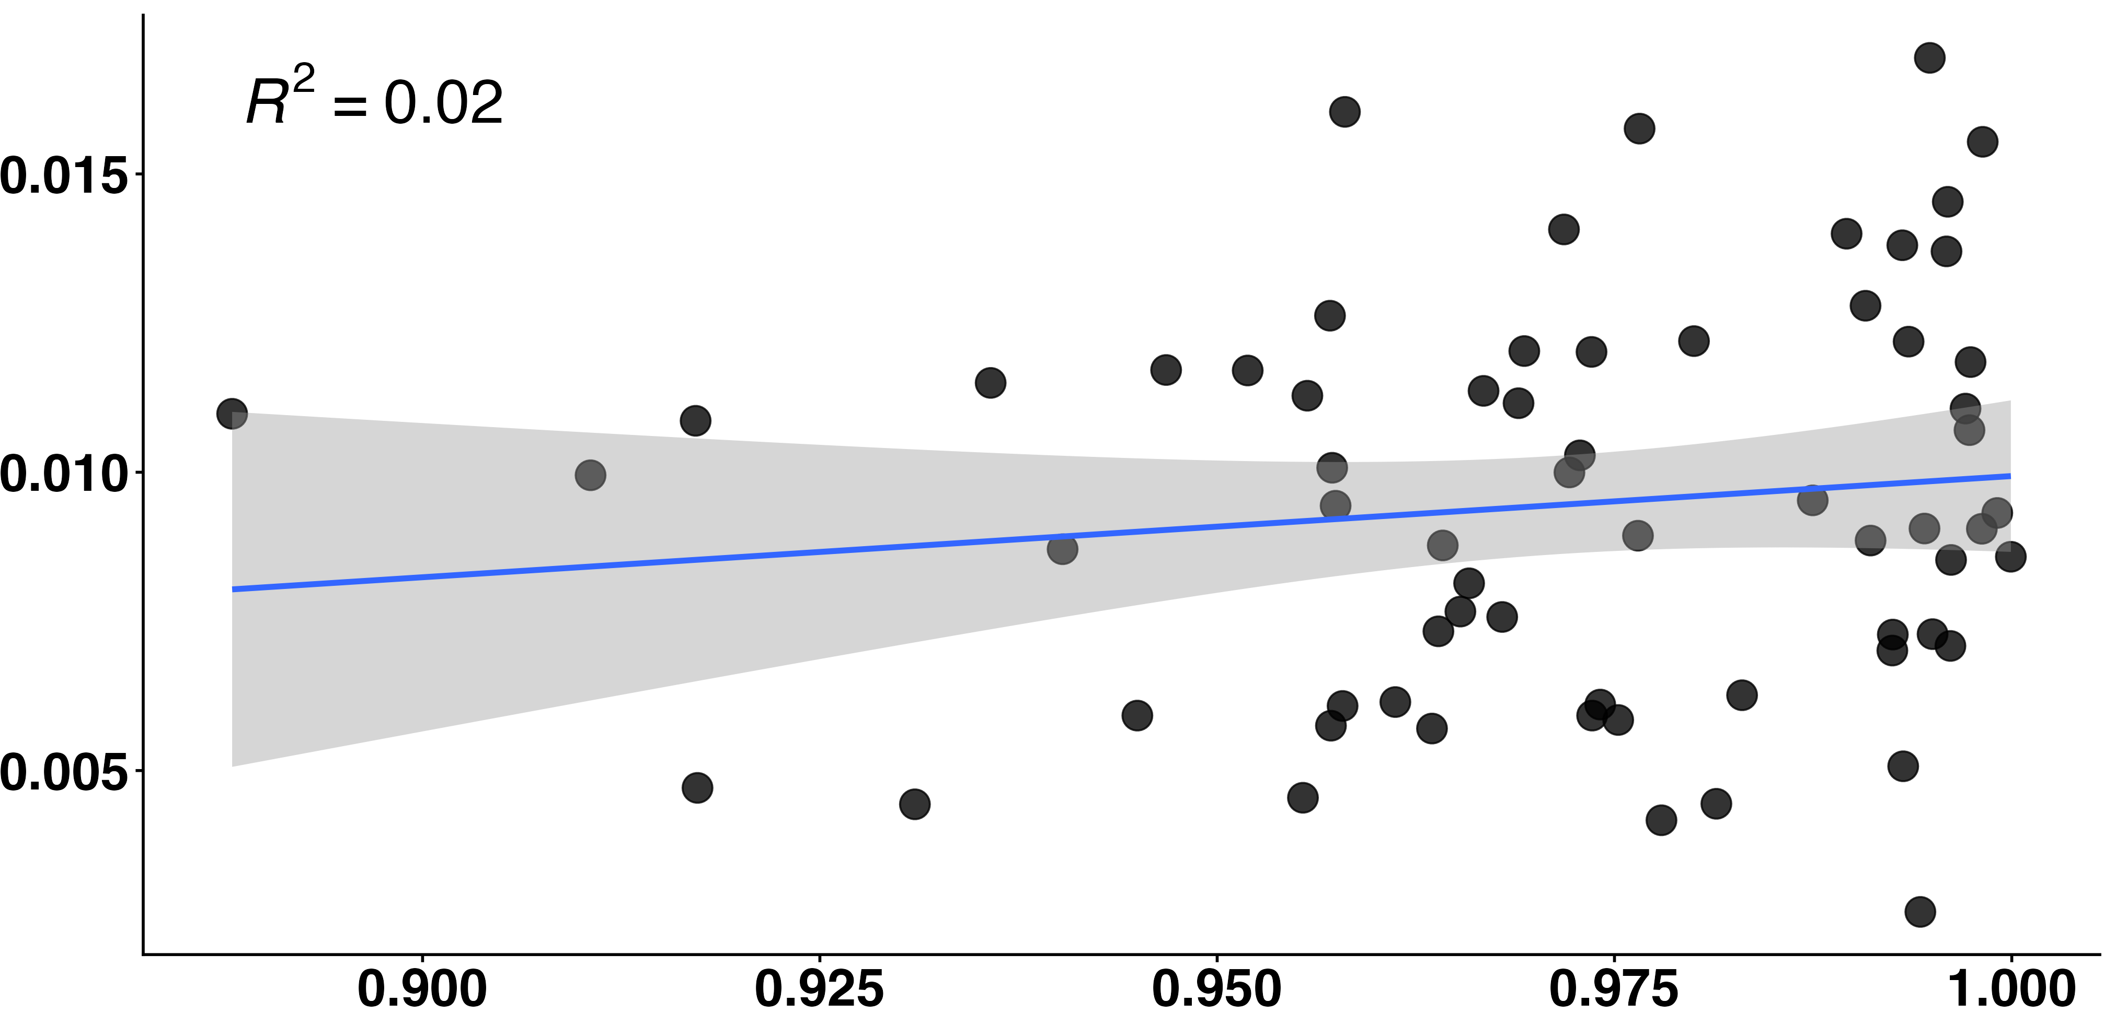
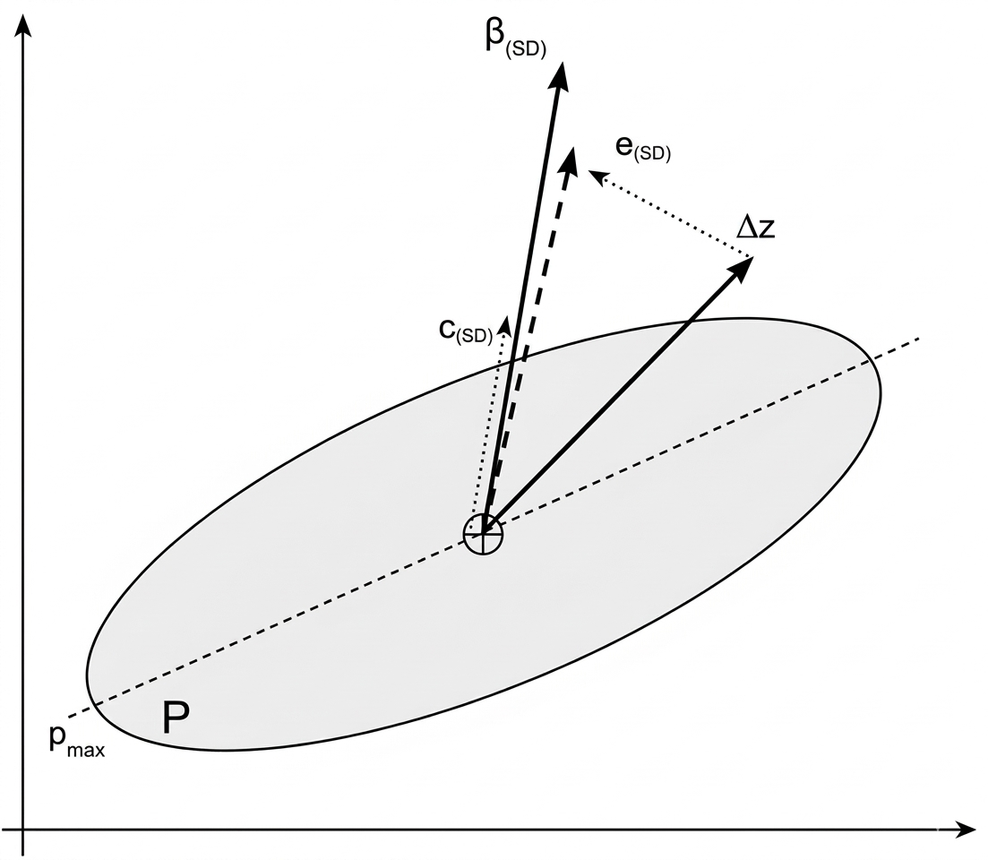
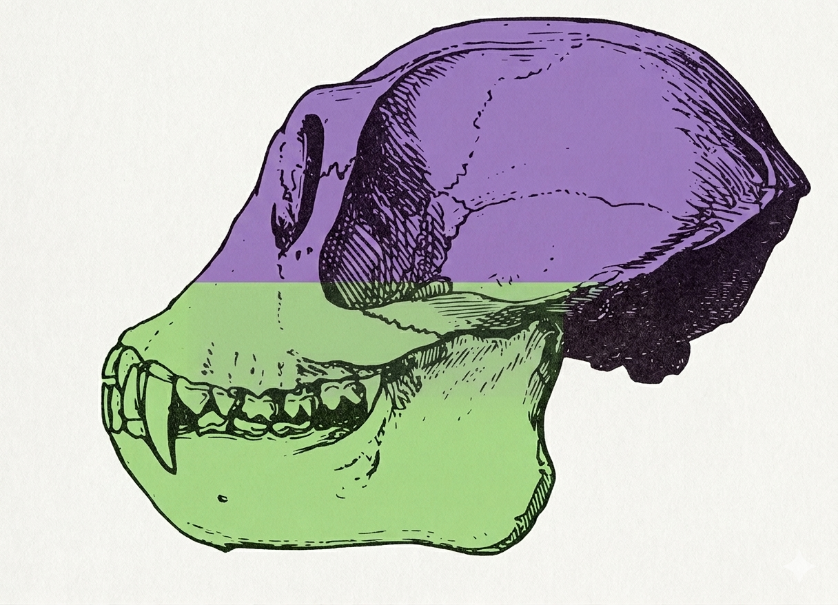
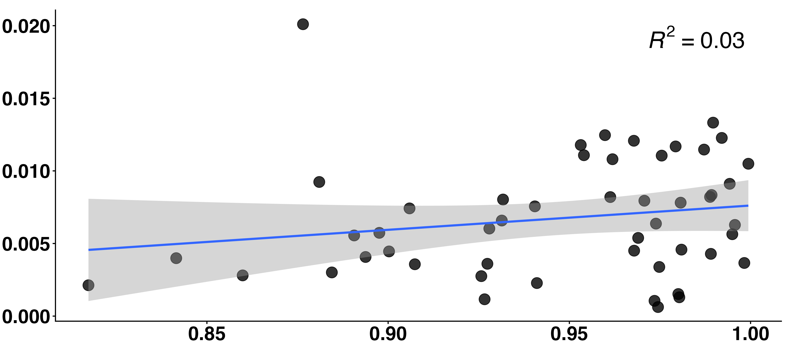





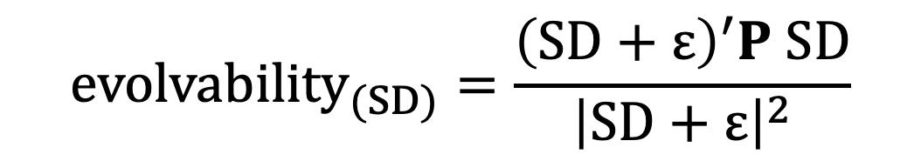
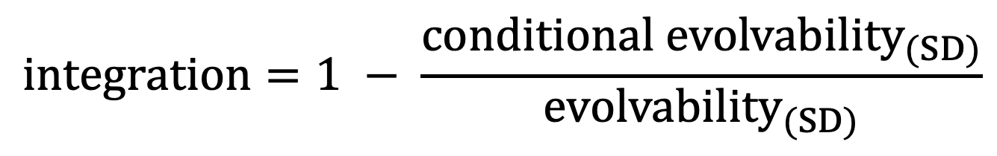
P265
The Role of Evolvability and Integration in Shaping Sexual Dimorphism in the Cranial Morphology of Simiiform Monkeys
Lucas A. Camacho¹, Thomas F. Hansen², Gabriel Marroig¹
¹Universidade de São Paulo (USP), Brazil
²University of Oslo (UiO), Norway
lucas.camacho@usp.br
Sexual Dimorphism
Sexual dimorphism shows extensive interspecific variation
The evolution of sexual dimorphism is likely multifactorial, but the role of evolvability remains unclear
Evolvability and Integration
Results
While low evolvability can slow the pace of evolutionary change, high evolvability may promote greater morphological diversification and faster evolution
The structure of the variation can influence the trajectory of evolutionary change
Greater sexual dimorphism is associated with higher evolvability in size
Empirical errors are small and does not influence the main pattern
Evolvability _{(SD Size)}
Sexual Dimorphism
Theoretical Error Values (σ²)
Hypothesis
Theoretical simulation of high measurement error shows that excessive noise can weaken the observed relationship between sexual dimorphism and evolvability.
Evolvability _{(SD Size)}
Sexual Dimorphism
Data
Evolvability _{(SD Shape)}
The relation between sexual dimorphism and evolvability in shape is nonlinear and inverse
50 species from two simian clades: Platyrrhini and Catarrhini
38 linear cranial measurements collected from simian skulls
~ 5.416 simian skulls measured
P matrices estimated for each species
Sexual dimorphism was measured as the norm of the vector difference between males and females
Sexual Dimorphism
ln Conditional
Evolvability _{(SD Size)}
Conditional evolvability of sexual dimorphism drops to practically zero after controlling for size
ln Conditional
Evolvability _{(SD Shape)}
ln Sexual Dimorphism
ln Sexual Dimorphism
Analysis
Average
Evolvability
Global Integration
No direct relation between Evolvability and Integration
Evolvability _{(SD Size)}
Integration _{(SD)}
Conclusions and Next Steps
Sexual dimorphism tends to evolve along highly evolvable directions
Measurement error can be important but does not substantially alter the empirical observed patterns
Test whether these patterns are phylogenetically widespread
Better examine the consequences of removing size on evolvability estimates
$${evolvability}_{(SD)}=\frac{{\left(SD+ε\right)}^{′}P SD}{{\left|SD+ε\right|}^{2}}$$
$$conditional {evolvability}_{(SD)}=\frac{1}{{SD}^{T}P^{−1}SD}$$
$$integration=1 − \frac{conditional {evolvability}_{(SD)}}{{evolvability}_{(SD)}}$$
10th European Society for Evolutionary Development Biology Meeting
2026
lucascamacho.github.io

