Slide 1


Systems and Software
Verification Laboratory
Software Security
Lucas Cordeiro
Department of Computer Science
lucas.cordeiro@manchester.ac.uk

Slide 2
Motivating Example
void main(){
int x=getPassword();
if(x){
printf(“Access Denied\n”);
exit(0);
}
printf(“Access Granted\n”);
}
int getPassword() {
char buf[4];
gets(buf);
return strcmp(buf, ”SMT”);
}
What happens if the user enters “SMT”?
On a Linux x64 platform running GCC 4.8.2, an input consisting of 24 arbitrary characters followed by ], <ctrl-f>, and @, will bypass the “Access Denied” message
A more extended input will run over into other parts of the computer memory
Barrett et al., Problem Solving for the 21st Century, 2014.

Slide 3
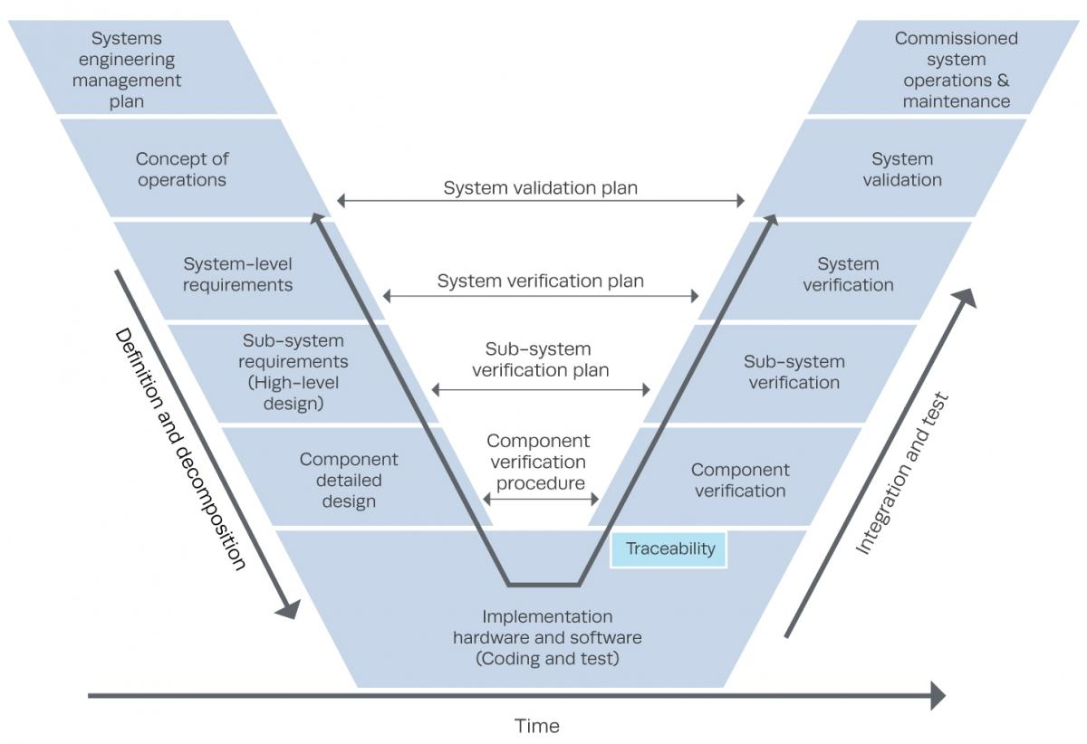
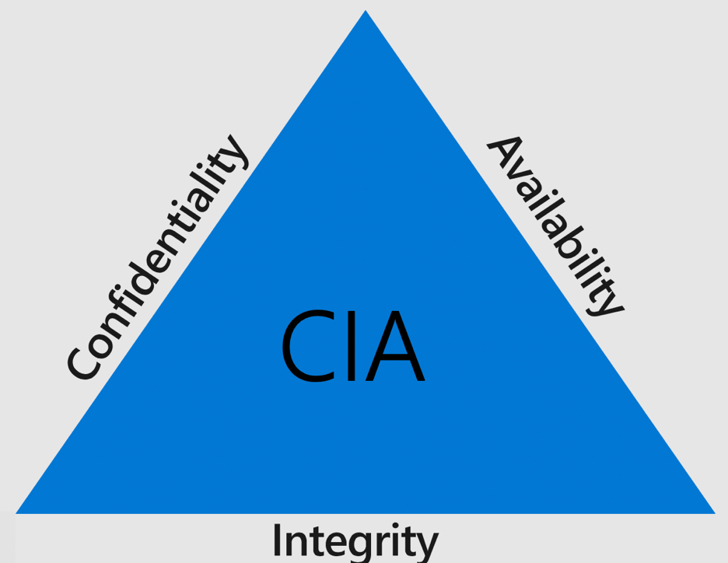
What is Safety and Security?
Safety
If the user supplies any input, then the system generates the desired output
Any input ⇒ Good output
Safe and protected from danger/harm
More features leads to a higher verification effort
Security
If an attacker supplies unexpected input, then the system does not fail in specific ways
Bad input ⇒ Bad output
Protection of individuals, organizations, and properties against external threats
More features leads to a higher chance of attacks

Slide 4


Overview
System
User
Attacker
Security consists of the following basic elements:
Honest user (Alice)
Dishonest attacker
How the attacker
Disrupts Alice’s use of the system (Integrity, Availability)
Learns information intended for Alice only (Confidentiality)
Boneh, D. and Mitchell, J., “Computer and Network Security”, 2009.

Slide 5
CIA Principle
System
User
Attacker
Confidentiality: Attacker does not learn the user’s secrets.
Integrity: Attacker does not undetectably corrupt system’s function for the user
Availability: Attacker does not keep system from being useful to the user
Boneh, D. and Mitchell, J., “Computer and Network Security”, 2009.

Slide 6
What does it mean for software to be secure?
A software system is secure if it satisfies a specified or implied security objective
This security objective specifies confidentiality, integrity and availability requirements for the system’s data and functionality
Example of Social Networking Service
Confidentiality: Pictures posted by a user can only be seen by that user’s friends
Integrity: A user can like any given post at most once
Availability: The service is operational more than 99.9% of the time on average

Slide 7
Security Failure and Vulnerabilities
A security failure is a scenario where the software system does not achieve its security objective
A vulnerability is the underlying cause of such a failure
Most software systems do not have precise explicit security objectives
These objectives are not absolute
They have to be traded off against other objectives such as performance or usability
Software implementation bugs can lead to a substantial disruption in the behaviour of the software

Slide 8
Software Security
Software security consists of building programs that continue to function correctly under malicious attack
Software
Requirements | Definition
Availability | services are accessible if requested by authorized users
Integrity | data completeness and accuracy are preserved
Confidentiality | only authorized users can get access to the data
Application
Firmware
OS
Services
Communication

Slide 9
Why are there security vulnerabilities?
Software is one of the sources of security problems
Why do programmers write insecure code?
Awareness is the main issue
Some contributing factors
Limited number of courses in computer security
Programming textbooks do not emphasize security
Limited number of security audits
Programmers are focused on implementing features
Security is expensive and takes time
Legacy software (e.g., C is an unsafe language)

Slide 10
Implementation Vulnerability
We use the term implementation vulnerability (or security bug) both for bugs that
make it possible for an attacker to violate a security objective
for classes of bugs that enable specific attack techniques
The Common Vulnerabilities and Exposures (CVE) is a publicly available list of entries
describes vulnerabilities in widely-used software components
it lists close to a hundred thousand such vulnerabilities

Slide 11
Critical Software Vulnerabilities
Null pointer dereference
Double free
Unchecked Return Value to NULL Pointer Dereference
Division by zero
Missing free
Use after free
APIs rule based checking

Slide 12
Common Vulnerability and Exposure
The number of software vulnerabilities has increased rapidly
More than 16000 vulnerabilities in 2018
https://www.cvedetails.com/

Slide 13
Common Vulnerability and Exposure
The most common vulnerabilities in 2018:
Code Execution
Overflow
XXS (Cross-site scripting)
Denial of Service

Slide 14

Why do we need to ensure software security?
Consumer electronic products must be as robust and bug-free as possible, given that even medium product-return rates tend to be unacceptable
Not only safety-critical systems
“Engineers reported the static analyser Infer was key to build a concurrent version of Facebook app to the Android platform.”
- Peter O’Hearn, FLoC, 2018

Slide 15


Industry NEEDS Formal Verification
“There has been a tremendous amount of valuable research in formal methods, but rarely have formal reasoning techniques been deployed as part of the development process of large industrial codebases.”
- Peter O’Hearn, FLoC, 2018.
“Formal automated reasoning is one of the investments that AWS is making in order to facilitate continued simultaneous growth in both functionality and security.”
- Byron Cook, FLoC, 2018.

Slide 16
Software BMC Applied to Security
void main(){
int x=getPassword();
if(x){
printf(“Access Denied\n”);
exit(0);
}
printf(“Access Granted\n”);
}
buffer overflow attack
int getPassword() {
char buf[4];
gets(buf);
return strcmp(buf, ”SMT”);
}
SSA & loop unrolling
sp0,sp1,sp2:BITVECTOR(8);
ip:BITVECTOR(8);
m0,m1,m2,m3,m4,m5 : ARRAY BITVECTOR(8) OF BITVECTOR(8);
in : ARRAY INT OF BITVECTOR(8);
ASSERT sp1 = BVSUB(8,sp0,0bin100);
ASSERT m1 = m0 WITH [sp1] := in[1];
ASSERT m2 = m1 WITH [BVPLUS(8,sp1,0bin1)] := in[2];
ASSERT m3 = m2 WITH [BVPLUS(8,sp1,0bin10)] := in[3];
ASSERT m4 = m3 WITH [BVPLUS(8,sp1,0bin11)] := in[4];
ASSERT m5 = m4 WITH [BVPLUS(8,sp1,0bin100)] := in[5];
ASSERT sp2 = BVPLUS(8,sp1,0bin100);
ASSERT ip = m5[sp2];
ASSERT NOT ip = m0[sp0];
CHECKSAT;
We wish to determine whether it is possible to set ip to a value that we choose instead of the location of the if statement
4-character array buf
reclaim the memory occupied by buf
ip is loaded with the location pointed to by sp
Barrett et al., “Problem Solving for the 21st Century”, 2014.

