Slide 1


Systems and Software
Verification Laboratory
Detection of Software Vulnerabilities:
Static Analysis
Lucas Cordeiro
Department of Computer Science
lucas.cordeiro@manchester.ac.uk

Slide 2
Motivating Example
Functionality demanded increased significantly
Peer reviewing and testing
Multi-core processors with scalable shared memory / message passing
Static and dynamic verification
void *threadA(void *arg) {
lock(&mutex);
x++;
if (x == 1) lock(&lock);
unlock(&mutex);
lock(&mutex);
x--;
if (x == 0) unlock(&lock);
unlock(&mutex);
}
void *threadB(void *arg) {
lock(&mutex);
y++;
if (y == 1) lock(&lock);
unlock(&mutex);
lock(&mutex);
y--;
if (y == 0) unlock(&lock);
unlock(&mutex);
}
Deadlock
(CS2)
(CS1)
(CS3)

Slide 3
Verification vs Validation
Verification: "Are we building the product right”
The software should conform to its specification
Validation: "Are we building the right product”
The software should do what the user requires
Verification and validation must be applied at each stage in the software process
The discovery of defects in a system
The assessment of whether or not the system is usable in an operational situation

Slide 4
Static and Dynamic Verification
Ian Sommerville. Software Engineering (6th,7th or 8th Edn) Addison Wesley

Slide 5
Detection of Vulnerabilities
Detect the presence of vulnerabilities in the code during the development, testing, and maintenance
Trade-off between soundness and completeness
A detection technique is sound for a given category if it concludes that a given program has no vulnerabilities
An unsound detection technique may have false negatives, i.e., actual vulnerabilities that the detection technique fails to find
A detection technique is complete for a given category, if any vulnerability it finds is an actual vulnerability
An incomplete detection technique may have false positives, i.e., it may detect issues that do not turn out to be actual vulnerabilities

Slide 6
Detection of Vulnerabilities
Achieving soundness requires reasoning about all executions of a program (usually an infinite number)
This can be done by static checking of the program code while making suitable abstractions of the executions
Achieving completeness can be done by performing actual, concrete executions of a program that are witnesses to any vulnerability reported
The analysis technique has to come up with concrete inputs for the program that triggers a vulnerability
A typical dynamic approach is software testing: the tester writes test cases with concrete inputs and specific checks for the outputs

Slide 7
Detection of Vulnerabilities
Detection tools can use a hybrid combination of static and dynamic analysis techniques to achieve a good trade-off between soundness and completeness
Dynamic verification should be used in conjunction with static verification to provide full code coverage

Slide 8
Static analysis vs Testing/Simulation
Checks only some of the system executions
May miss errors
A successful execution is an execution that discovers one or more errors
Simulation/ testing
OK
error

Slide 9
Static analysis vs Testing/Simulation
Exhaustively explores all executions
Report errors as traces
May produce incorrect results
Model Checking
OK
Error trace
Specification
Line 5: …
Line 12: …
…
Line 41:…

Slide 10
Bounded Model Checking
A graph G = (V, E) consists of:
V: a set of vertices or nodes
E ⊆ V x V: set of edges connecting the nodes
Bounded model checkers explore the state space in depth
Can only prove correctness if all states are reachable within the bound
k = 0
k = 1
k = 2
k = 3
k = 4
k = 5
k = 6

Slide 11
Symbolic Execution
Symbolic execution explores all paths individually
Can only prove correctness if all paths are explored

Slide 12
V&V and debugging
V & V and debugging are distinct processes
V & V is concerned with establishing the absence or existence of defects in a program, resp.
Debugging is concerned with two main tasks
Locating and
Repairing these errors
Debugging involves
Formulating a hypothesis about program behaviour
Test these hypotheses to find the system error

Slide 13
Formula Satisfiability (SAT)
The SAT problem asks whether a given Boolean formula is satisfiable
Example:
Φ = ((x₁ →x₂) ∨ ¬((¬x₁ ↔ x₃) ∨ x₄)) ∧¬x₂
Assignment: <x₁ = 0, x₂ = 0, x₃ = 1, x₄ = 1>
Φ = ((0 →0) ∨ ¬((¬0 ↔ 1) ∨ 1)) ∧¬0
Φ = (1 ∨ ¬(1 ∨ 1)) ∧1
Φ = (1 ∨ 0) ∧1
Φ = 1
SAT = {<Φ> : Φ is a satisfiable Boolean formula}

Slide 14
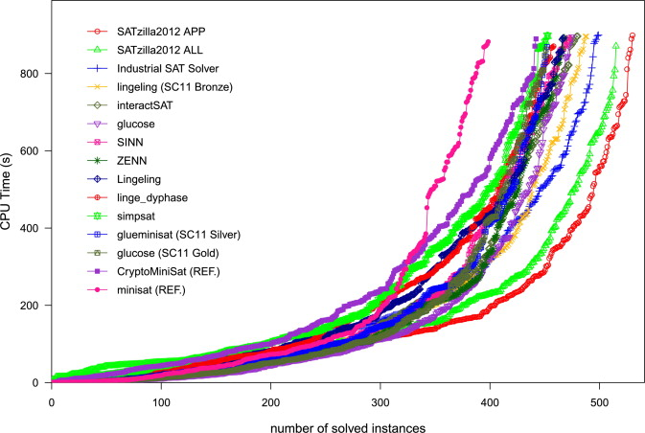
SAT Competition

Slide 15
Bounded Model Checking
Basic Idea: check negation of given property up to given depth
transition system M unrolled k times
for programs: unroll loops, unfold arrays, …
translated into verification condition ψ such that
ψ satisfiable iff ϕ has counterexample of max. depth k
has been applied successfully to verify HW/SW systems
property
¬ϕ₀
∨
¬ϕ₁
∨
¬ϕ₂
∨
¬ϕ_{k-1}
∨
¬ϕ_{k}
. . .
transition
system
M₀
M₁
M₂
M_{k-1}
M_{k}
bound
counterexample trace

Slide 16
Satisfiability Modulo Theories (1)
SMT decides the satisfiability of first-order logic formulae using the combination of different background theories (building-in operators)
Theory | Example
Equality | x₁=x₂ ∧ ¬ (x₁=x₃) ⇒ ¬(x₁=x₃)
Bit-vectors | (b >> i) & 1 = 1
Linear arithmetic | (4y₁ + 3y₂ ≥ 4) ∨ (y₂ – 3y₃ ≤ 3)
Arrays | (j = k ∧ a[k]=2) ⇒ a[j]=2
Combined theories | (j ≤ k ∧ a[j]=2) ⇒ a[i] < 3

Slide 17
Satisfiability Modulo Theories (2)
Given
a decidable ∑-theory T
a quantifier-free formula ϕ
ϕ is T-satisfiable iff T ∪ {ϕ} is satisfiable, i.e., there exists a structure that satisfies both formula and sentences of T
Given
a set Γ ∪ {ϕ} of first-order formulae over T
ϕ is a T-consequence of Γ (Γ ⊧_{T} ϕ) iff every model of T ∪ Γ is also a model of ϕ
Checking Γ ⊧_{T} ϕ can be reduced in the usual way to checking the T-satisfiability of Γ ∪ {¬ϕ}

Slide 18

Satisfiability Modulo Theories (3)
let a be an array, b, c and d be signed bit-vectors of width 16, 32 and 32 respectively, and let g be an unary function.
b' extends b to the signed equivalent bit-vector of size 32
replace b' by c−3 in the inequality
using facts about bit-vector arithmetic

Slide 19
Satisfiability Modulo Theories (4)
applying the theory of arrays
The function g implies that for all x and y,
if x = y, then g (x) = g (y) (congruence rule).
SMT solvers also apply:
standard algebraic reduction rules
contextual simplification

