Slide 1


Systems and Software
Verification Laboratory
Detection of Software Vulnerabilities:
Static Analysis
Lucas Cordeiro
Department of Computer Science
lucas.cordeiro@manchester.ac.uk

Slide 2
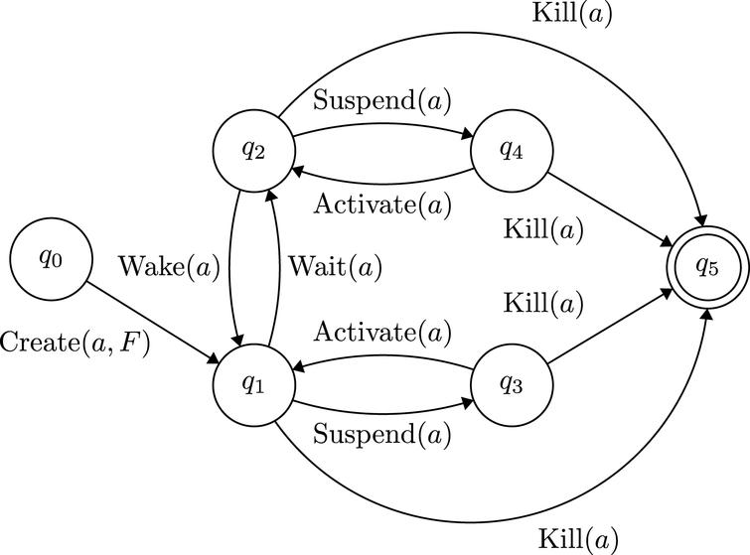
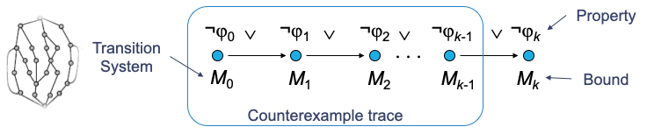
Revisiting BMC
Basic Idea: given a transition system M, check negation of a given property φ up to given depth k:
Translated into a VC ψ such that: ψ satisfiable iff ϕ has counterexample of max. depth k
BMC is aimed at finding bugs; it cannot prove correctness, unless the bound k safely reaches all program states

Slide 3
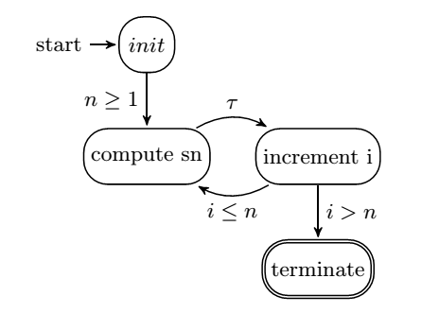

Difficulties in proving the correctness of programs with loops in BMC
BMC techniques can falsify properties up to a given depth k
they can prove correctness only if an upper bound of k is known (unwinding assertion)
» BMC tools typically fail to verify programs that contain bounded and unbounded loops
4,294,967,295
loop unwindings
i++
the loop will be unfolded 2^{n-1} times (in the worst case, 2³²⁻¹ times on 32 bits integer)
sn=sn+a
sn==n*a

Slide 4
Induction-Based Verification
k-induction checks...
base case (base_{k}): find a counter-example with up to k loop unwindings (plain BMC)
forward condition (fwd_{k}): check that P holds in all states reachable within k unwindings
inductive step (step_{k}): check that whenever P holds for k unwindings, it also holds after next unwinding
havoc state
run k iterations
assume invariant
run final iteration
iterative deepening if inconclusive

Slide 5
The k-induction algorithm
inserts unwinding assumption after each loop
k=initial bound
while true do
if base_{k} then
return trace s[0..k]
else if fwd_{k}
return true
else if step_{k} then
return true
end if
k=k+1
end
inserts unwinding assertion after each loop
havoc variables that occur in the loop’s termination condition
unable to falsify or prove the property

Slide 6
What --unwind k actually claims
SUCCESSFUL at bound k = no violation in any execution that fits within k loop unwindings.
The unwinding assertion is the honesty check:
if it FAILS, the bound truncated the loop — a bound problem, not a program bug.
if it holds, every execution was fully explored: the bounded verdict is a complete one.

Slide 7
unwind.c — the experiment
Run | Verdict | What it means
--unwind 5 | FAILED (unwinding assertion) | Loop can run more than 5 times
--unwind 20 | FAILED (unwinding assertion) | Still short
--unwind 60 | SUCCESSFUL | Complete proof — every n <= MAX=50 fits
--k-induction | UNKNOWN | See the next two slides
60 > MAX means no execution is truncated: the bounded check quantifies over ALL inputs.

Slide 8
k-induction: the three checks
Prove a loop safe for ANY bound with three bounded queries:
Base case — no violation in the first k iterations.
Forward condition — k iterations reach every reachable state (then the base case alone is a proof).
Inductive step — from ANY k safe consecutive iterations, iteration k+1 is also safe.
Each check is a bounded (finite) formula — same machinery as BMC, different question.

Slide 9
Why UNKNOWN on unwind.c
The inductive step starts from a havocked state: i and sum are ARBITRARY values, not values the program can reach.
From a mid-loop state where sum != 2*i, the step cannot conclude sum == 2*n at exit.
So the step fails — for every k. ESBMC answers:
VERIFICATION UNKNOWN
The assertion alone is not k-inductive. Nothing is wrong with the program — the proof needs help.

Slide 10
The missing invariant
sum == 2 * i /* holds at every loop head */
Add it and the inductive step closes: a havocked state must now satisfy the invariant, and the exit assertion follows (i == n there).
Stating loop invariants is exactly what deductive verifiers ask of you:
Dafny, Frama-C/ACSL — invariant annotations checked by a solver.
BMC needed no annotations but gave a bounded answer; invariants buy the unbounded one.

