Slide 1
Existing LSFM code and dataset
畅星兆
日期：2019.04.13

Slide 2
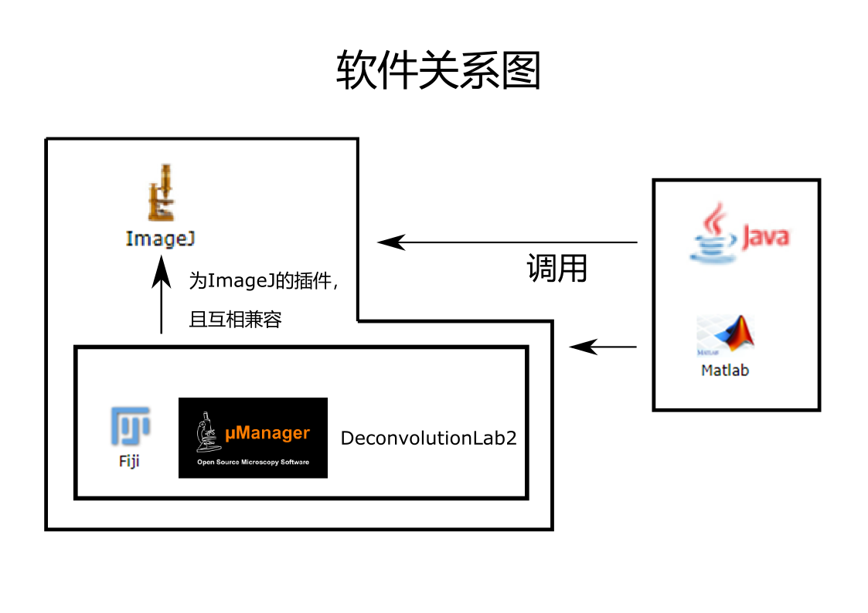
上周内容补充
可选：GPU编程，并行处理加快处理速度（需要安装CUDA）

Slide 3
结果整理 注：红色/黑色对应于软件代码、样本数据是可获取的/不可获取的
Reference | Availability
1. Whole-animal functional and developmental imaging with isotropic spatial resolution | CUDA-based code+1 dateset
2. Inverted selective plane illumination microscopy (iSPIM) enables coupled cell identity lineaging and neurodevelopmental imaging in Caenorhabditis elegans | matlab+ImageJ plug-in DeconvolutionLab, no dataset
3. 3D high- and super-resolution imaging using single-objective SPIM | Commercial software-Metamorph, no dataset
4. Reconstruction of Zebrafish Early Embryonic Development by Scanned Light Sheet Microscopy | matlab+dataset(does not meet the requirement)
5. OpenSPIM: an open-access light-sheet microscopy platform | μManager+Fiji, no dataset

Slide 4
6. Single Molecule Imaging of Transcription Factor Binding to DNA in Live Mammalian Cells | Commercial software-Metamorph, no dataset
7. In Toto Imaging and Reconstruction of Post-Implantation Mouse Development at the Single-Cell Level | CUDA-based matlab code(with video guide), no dataset
8. Efficient Bayesian-based multiview deconvolution | ImageJ plug-in ImgLib2/CUDA-based code+multiview deconvolution simulation ,11 datasets
9. DeconvolutionLab2: An open-source software for deconvolution microscopy | ImageJ plug-in DeconvolutionLab2, no dataset
10. Real-time multi-view deconvolution | CUDA-based code, no dataset

Slide 5
环境搭建
下载安装visual studio, Java development kit, CUDA。（已完成）
配置环境变量等，验证安装成功。（正在做）
对于ImageJ下的插件：熟悉软件使用，寻找合适数据并转换为相应格式，进行处理。
对于基于CUDA的程序：阅读理解代码，尝试运行。（耗时）

