Slide 1
水库计算
畅星兆
2019.05.18

Slide 2
ANN/CNNs: data flows in a single direction
RNN: internal feedback paths exist, promise in processing time series, more challenging to train (more complex algorithms and convergence stability)
Schiller and Steil (2005) showed that in traditional training methods for RNNs, where all weights (not only the output weights) are adapted, the dominant changes are in the output weights.

Slide 3
Reservoir Computing
reservoir computing: (1)Echo state networks; (2)Liquid state networks
The main idea is (i) to drive a random, large, fixed recurrent neural network with the input signal, thereby inducing in each neuron within this “reservoir” network a nonlinear response signal, and (ii) combine a desired output signal by a trainable linear combination of all of these response signals.

Slide 4
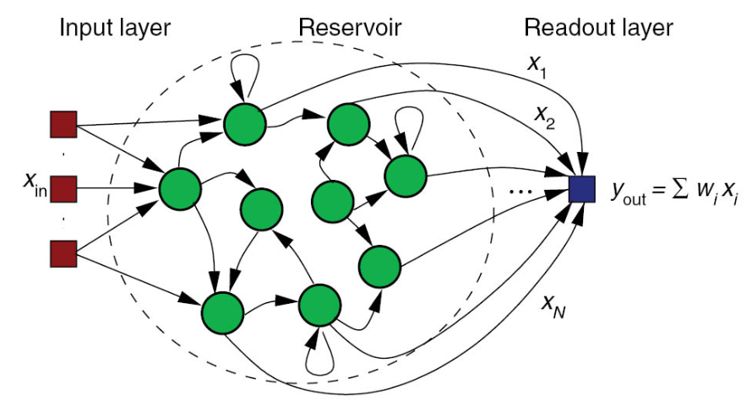
The recurrent part of the network remains hidden and is not trained. This allows much more efficient training to take place at the expense of some computational flexibility.
Model

Slide 5
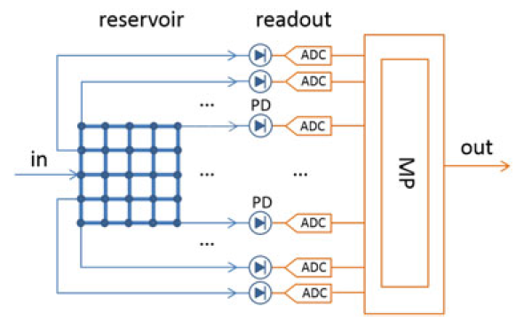
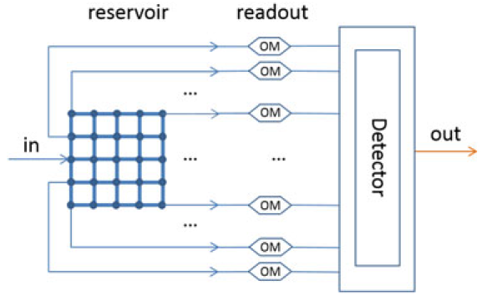
目前使用的结构
设想的结构

