Slide 1
文献综述：Optofluidics
畅星兆
2019.05.25
Reference: Sihui Chen et al., “Optofluidics in bio-imaging applications”, Photonics Research, 2019.

Slide 2
定义
Original: optofluidics is capable of manipulating light with on-chip fluidic processes or using light to control fluidic entities.
advanced optical/photonic methods to enhance performance of the system
出现原因
most imaging system have come close to practical limits
compatibility between sample and imaging systems

Slide 3
Components
Optofluidic Lasers
Optofluidic Prisms
Optofluidic Switches
Optofluidic Lenses

Slide 4
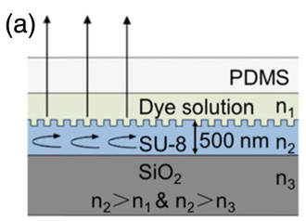
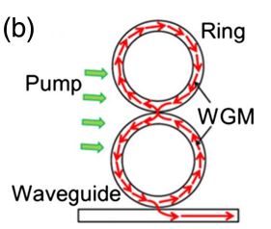
Optofluidic Lasers
1. based on a Fabry-Perot resonator
2. based on distributed-feedback gratings
3. optofluidic ring resonator laser system (Q = 1000)

Slide 5
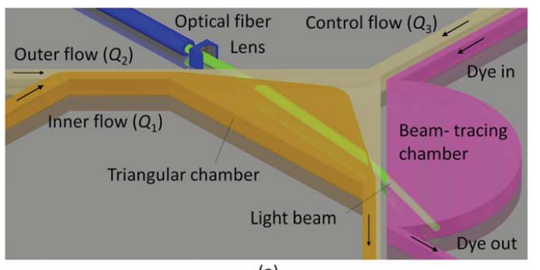
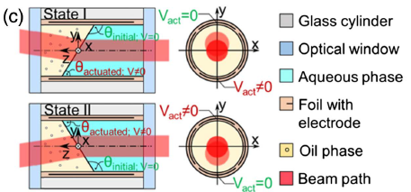
Optofluidic Prisms
use an optofluidic prism to manipulate the light path
converging three laminar flow streams
ratatable optofluidic prism

Slide 6
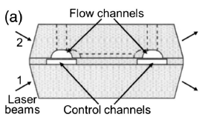
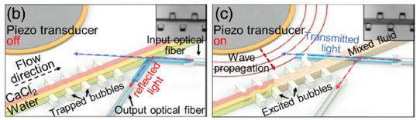
Optofluidic Switches
modify light path and intensity, both based on total internal reflection
by tuning the index of the mirror channel medium
turn on/ turn off piezoelectric transducer

Slide 7
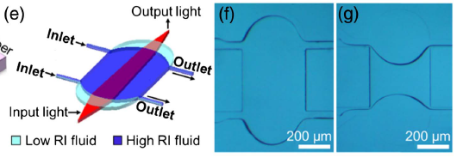
Optofluidic Lenses
By tuning the flow rates of the streams

Slide 8
Challenges
unstable and temperature-dependent
flow control

Slide 9
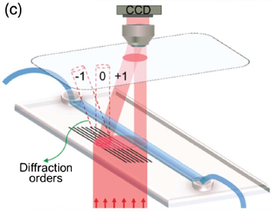
Optofluidic Imaging Methods
lens-based (most are SPIM)
obstacles
bulky instruments,
diffraction-limited resolution,
trade-off between field-of-view and resolution
lens-free
microscope
tomographic microscope

Slide 10
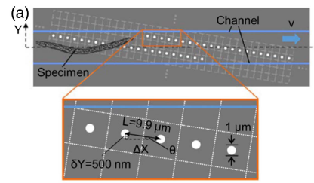
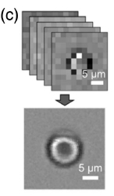
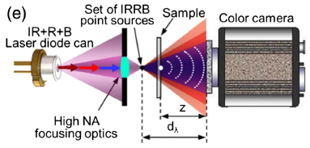
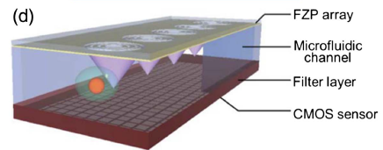
Optofluidic microscope
OFM
1. aperture: < 1 μm
2. CMOS/ CCD
3. resolution: 800 nm
4. rearranging 40–50 raw images
into a SR image
Fresnel zone plate (FZP) arrays act as high-NA microscope objective lenses and focus illumination light into a nanoscale.
slightly laterally and axially shifted
point sources (RGB) below the sample

Slide 11
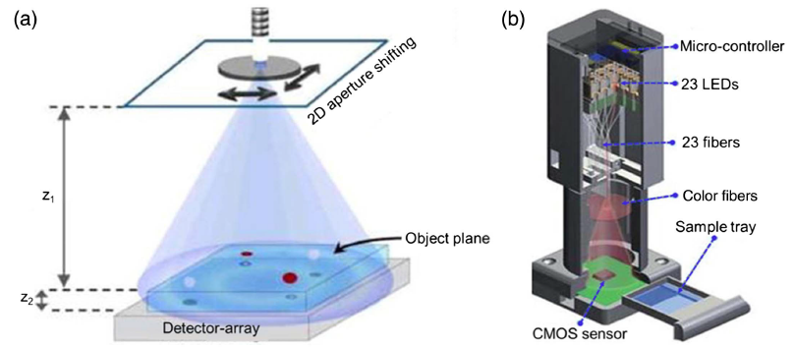
Tomographic Microscope
single perspective holography provides individual 3D sectioning information

Slide 12
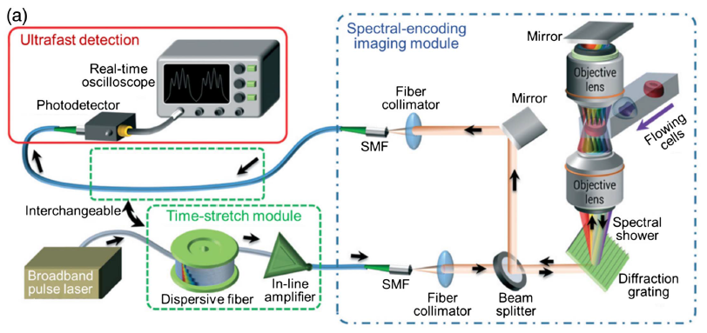
Ultra-fast imaging
The core concept of optical time-stretch imaging is to retrieve spatial information from the “time-stretch” spectrum in the one-dimensional (1D) temporal data stream.
Wong et al. ~100, 000 cells/s

