Slide 1
Summary: Deep Learning time
畅星兆，2019.08.28

Slide 2
Reference

Slide 3
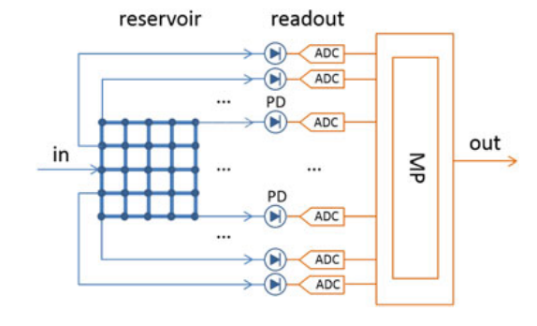
水库计算
强调new paradigm, analog computing,
Readout: machine learning on digital computers.
Micro processor
We show how passive reservoir computing chips can be used to perform a variety of tasks (bit level tasks, nonlinear dispersion compensation, etc.) at high speeds and low power consumption.

Slide 4
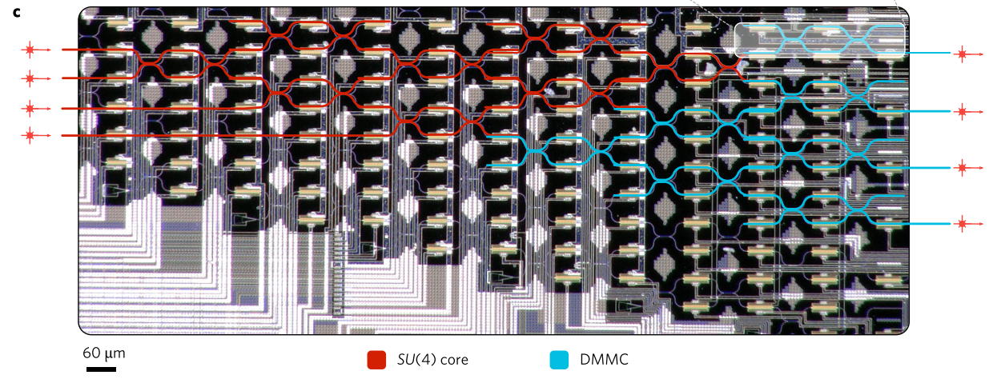
Featuring a cascaded array of 56 programmable Mach-Zehnder interferometers
Vowel recognition

