Slide 1
深度学习和物镜调研
畅星兆，2019.09.01

Slide 2
Photonics AI 训练时间
结论：
目前阶段，Photonics AI 仍然使用电路进行模型参数的计算
训练时间与传统计算机训练时间完全相同
优势
运行速度快，支持更快的input stream
power efficiency

Slide 3
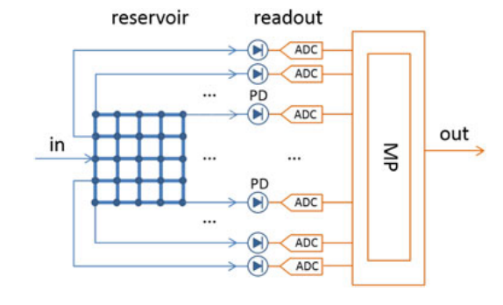
水库计算
强调new paradigm, analog computing,
Readout: machine learning on digital computers.
Micro processor
(Katumba et al., Neuromorphic Computing Based on Silicon Photonics and Reservoir Computing, IEEE Journal of Selected Topics in Quantum Electronics, 2018)
We show how passive reservoir computing chips can be used to perform a variety of tasks (bit level tasks, nonlinear dispersion compensation, etc.) at high speeds and low power consumption.

Slide 4
训练方法（ Optical Readouts ）
separate high-photodetectors
photodetectors tend to be costly due to footprint
can only measure the intensities
trains the weights based on simulation
fabrication tolerances
pretraining-retraining
fabrication tolerances
(prefered)single high-photodetectors
does take some time
still requires external microprocessor
使用与传统方法一样的机器学习算法
applied in the readout system to teach computer systems how to perform (or interpretate) complex tasks.
calculated in the electrical domain

Slide 5
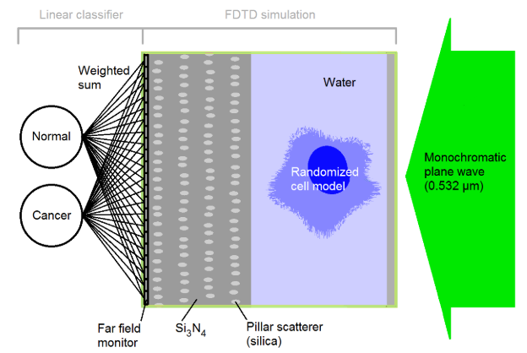
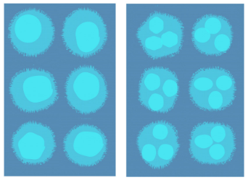
Pillar scatterer paradigm
monochromatic plane wave
pillar: randomly generated, kept fixed
simulation: cells and pillar scatterer (by setting some rules)
fast and energy efficiency: when running models (not training)
application: high throughput label-free cell sorting
Normal cells and cancer cells form two clusters after calculating weighted sum.
(Alessio Lugnan et al., Integrated pillar scatterers for speeding up classification of cell holograms, Optics Express, 2017)
generated“normal” and “cancer”cell

Slide 6
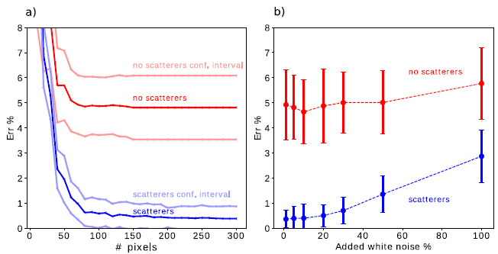
Result
参数： 4 layers, Ar = 150 nm, D = 2.85 um, UV (337.1 nm) laser source
a considerable error rate reduction
classification performance increase more than 50%
仿真结果证明添加柱状反射结构后，对于该系列图片的识别错误率明显下降。
问题：1. 添加该结构是否对分类任务有帮助？
2. 添加该结构是否对只对特定分类任务有帮助？

Slide 7
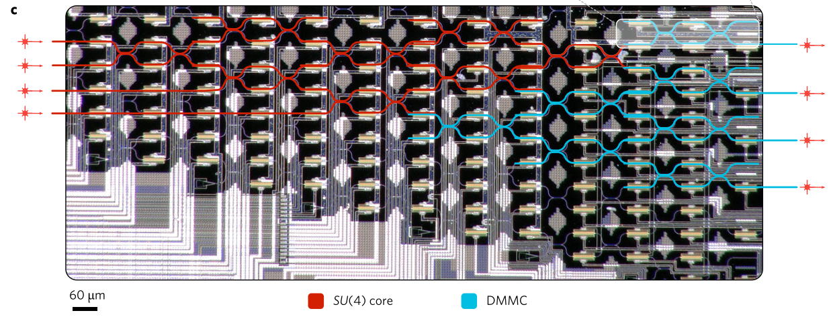
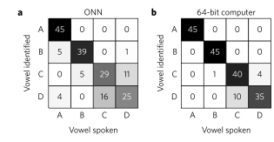
Deep Learning with coherent nanophotonic circuits
Featuring a cascaded array of 56 programmable Mach-Zehnder interferometers
Power efficiency
Vowel recognition
comparable results
(Shen Yichen etal., Deep learning with coherent nanophotonic circuits, Nature Photonics, 2017)
We trained the matrix parameters with the standard back-propagation algorithm using a stochastic gradient descent method on a conventional computer.

Slide 8
调研：翻折物镜
Thorlab调研
网站：未找到
销售代表：未找到
Olympus调研
网站：未找到
销售代表：正在整理（显微镜物镜切换盘？）

Slide 9
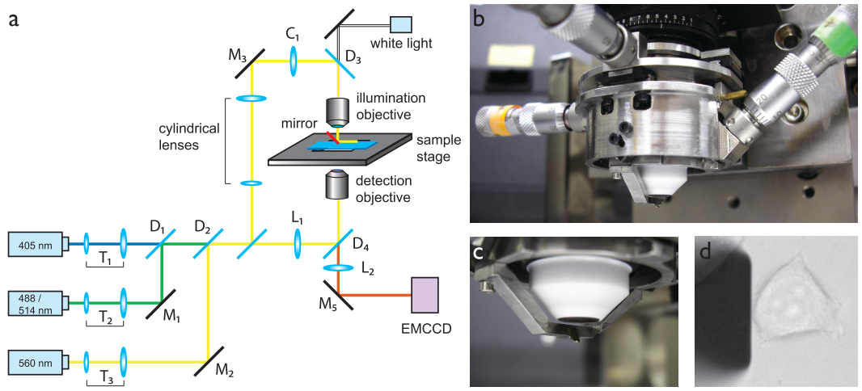
反射镜
组成：自制的xyz位移台+AFM悬臂（AFM cantilever）
自制的xyz位移台：4个不锈钢圆筒，第一个固定在物镜上，其余三个级联，分别用于控制悬臂在三个维度上运动。
AFM悬臂：通过镀膜形成反射镜。
a：示意图，b：实拍图，c：近照，d：宽场图像
(Gebhardt et al., Nature Methods, 2013)

Slide 10
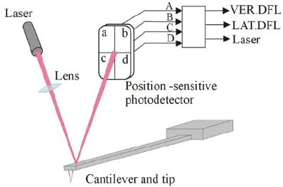
AFM Cantilever
AFM原理图
文中：HYDRA2R-100N-TL-10, Nanoscience（not found）
处理：(custom-coated, thermal evaporation)1 nm Ti layer followed by 40 nm Al layer
(https://wenku.baidu.com/view/ad63ad0b01f69e31433294db.html)

