Slide 1
Match Predictor
A general football-prediction engine —
aimed at Sunday’s World Cup final.
CODE THE CUP · CHALLENGE 1

Slide 2
What we built — in 90 minutes
A general match-prediction engine. Not World-Cup-specific — we pointed it at the final because it’s live and the most memorable thing to show today.
1
2
3
4
›
›
›
Data
Elo + form
Model
Output
49,518 internationals,
1872–2026
team-strength
features
a transparent
classifier
odds + a plain-
English “why”

Slide 3
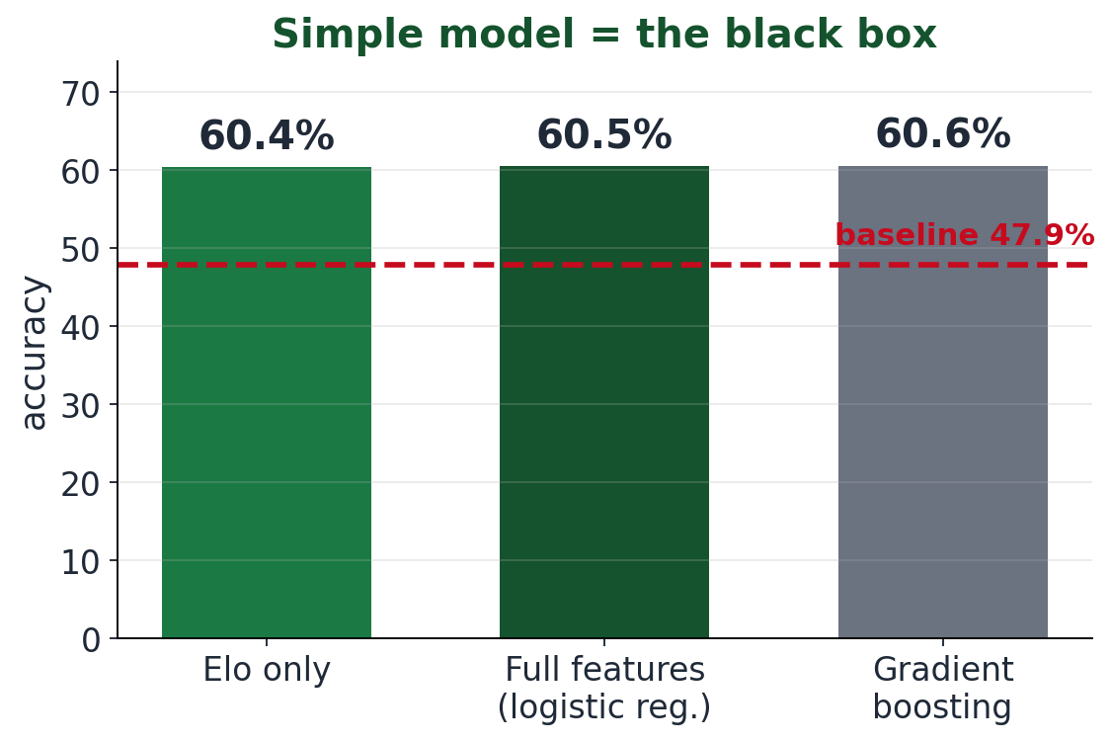
It works — and it’s honest
60.5%
accuracy on recent matches (baseline 47.9%)
0.020
calibration error — probabilities you can trust
Gradient boosting did no better — so we kept the model that explains itself.

Slide 4
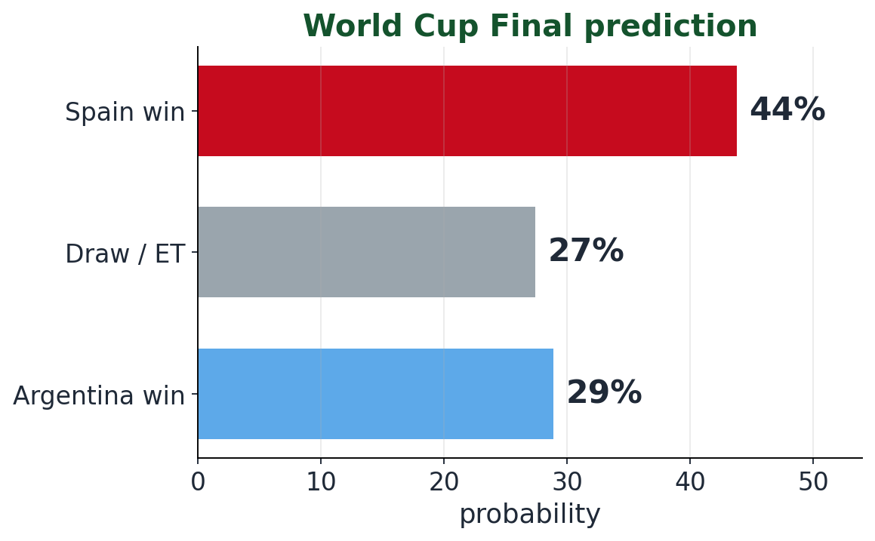
Sunday’s final
Spain vs Argentina · MetLife Stadium · July 19
Spain 57%
to lift the trophy
Argentina 43%
Why: Spain’s goal difference, Elo strength and form — the neutral venue keeps Argentina close.

Slide 5
Scoped by choice — built to extend
Club leagues — swap the dataset (seasons kicking off now)
Future World Cups — the same engine plugs straight in
Fan sentiment — the brief’s third signal, next to add
Thank you
Code the Cup · Match Predictor

Slide 6
