Slide 1
Benchmarking
pyMT-call vs Signac

Slide 2
PBMC Mike Data used
Trying to understand if Signac is detecting the same variants as my code is
If the number of variants is similar/the same
If Signac filtering gets rid of good variant/calls
If Signac filtering retains bad/variant calls
If Signac can be outperformed by pyMt-call in lineage tracing

Slide 3
No filtering on cells
Signac – 4708 variants on 8365 cells (run time unclear because signac does processing in multiple steps, estimate around 5 minutes)
pyMTcall – 4710 variants in 8365 cells (10:29 run time)
So, where are my extra two variants coming from, and are we detecting the same variants?

Slide 4
Variant matching
4708 variants match leaving two variants different
3107N>C and 3107N>T which are sequencing errors exist in my variants but not theirs. This will need to be fixed.
Sequencing artifacts believed to be in the mito genome by Lareau et al are:
301:302
309:311
316
3107:3109
16182:16183

Slide 5
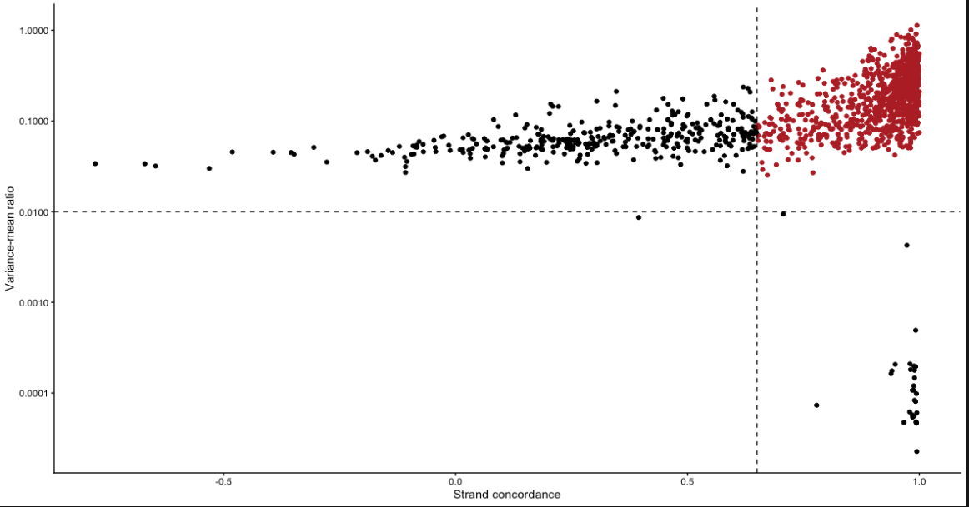
Signac Filtering on Variants
Variants in red are considered ”informative” variants because they have a high variance and high strand concordance

Slide 6
I intend to question this variant filtering strategy by asking a few questions:
Are all red selected variants truly informative?
Are all non-selected variants uninformative?
Do I retain more informative variants/cells?
Do I exclude uninformative variants/cells?

Slide 7
1. Are all red selected variants truly informative?
I have filtered based on Signac’s recommendations, taking into account the plot
Filters applied : n_cells_conf_detected >= 5, strand_correlation >= 0.65 and vmr > 0.01
From a starting set of 4708 variants, this leaves us with 167 variants, just 0.3% of the initial variant pool

Slide 8
1. Are all red selected variants truly informative?
The variants are detected in only 15 (0.01%) cells on average and just 7 (0.008%) cells median
These variants are unlikely to be informative if they are shared by so few cells
Despite Signac claiming this filtering is used to improve the ability to do clonotyping, they leave cells with uncertain variant calls in the data

Slide 9
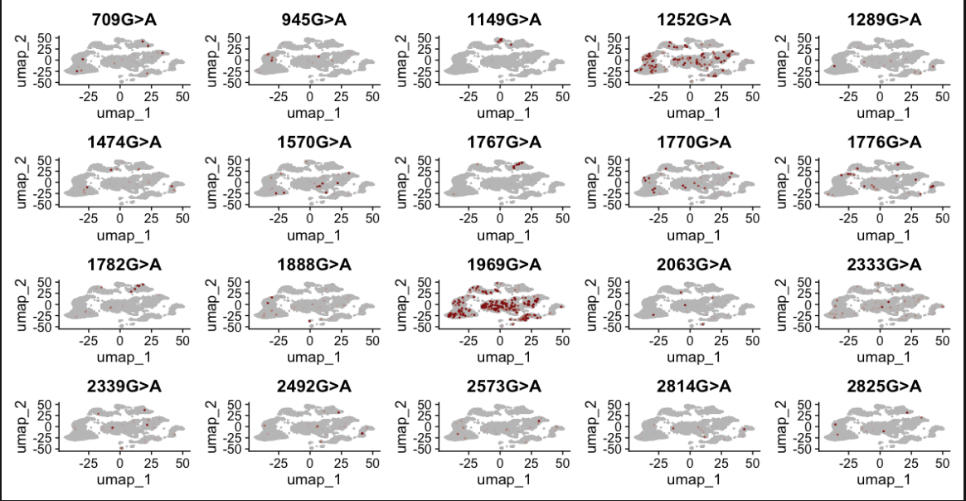
Few of these look informative

Slide 10
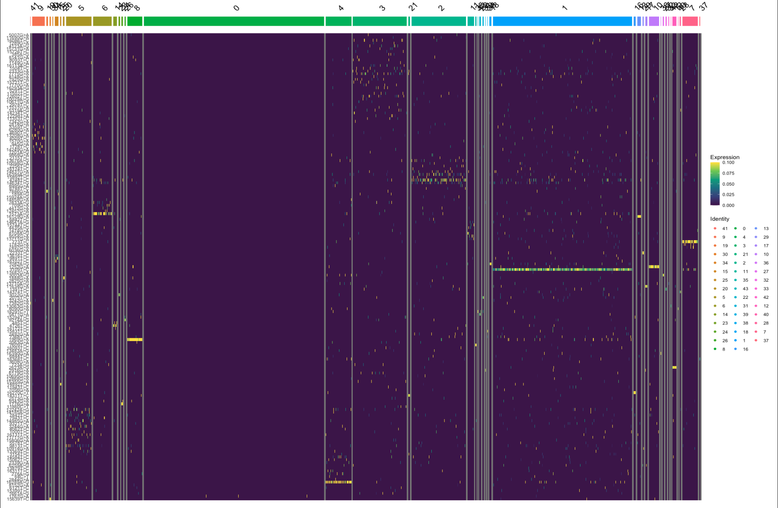
Clonotyping
There are a few clones in there that look interesting, clone1 is specific to a mutation, as is clone 4 and clone 8. However, there is quite a lot of noise, so any clonotyping assessed from this directly would likely be spurious at best

Slide 11
1. Are all red selected variants truly informative?
I do not think all selected variants are truly informative
There are likely informative variants selected that are specific to certain clusters and cell types, and may represent true clones. But there is significant noise
A lot of variants are filtered out, many of the variants that remain are represented in very few cells
Variants that do remain will often have calls in poor quality cells (show later on)

Slide 12
3. Do I retain more informative variants/cells?
Contrary to Signac, pyMt-Call does not filter on a per variant basis, instead it filters on a variant/cell basis
Each variant in each cell is treated as an independent observation, any variant/cell calls that do not reach filtering standard are removed
I hope this will retain more informative variants and remove more uninformative variants

Slide 13
We can use different filters for pyMtCall
Firstly, we can use a knuckle approach to identify the depth required to accurately detect the VAF of a variant
We would expect true variance in VAF to exist at all depth values
If an increase in depth causes changes in VAF then it’s likely that insufficient depth is the cause of variance in VAF values
We can therefore find a knuckle where increasing depth no longer has an appreciable impact on VAF

Slide 14
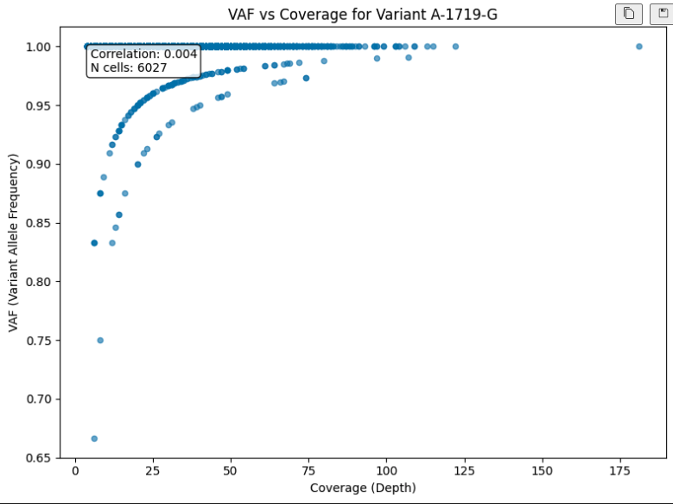
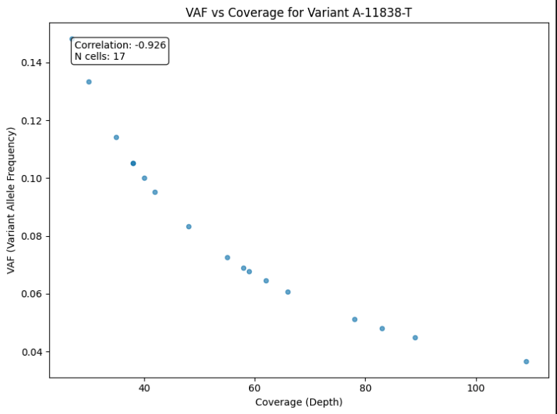
Examples of knuckle

Slide 15
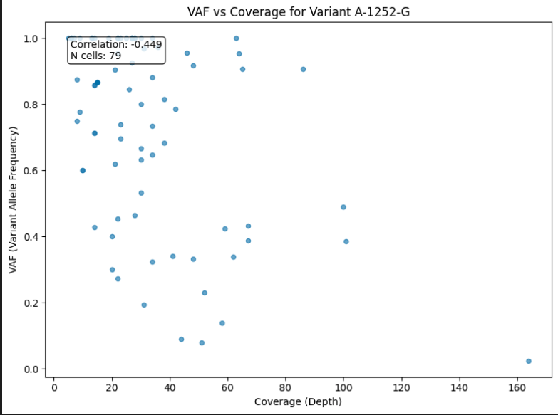
Example of “true” VAF spread

Slide 16
pyMT-Call filtering
Mean coverage of >=20
Strand concordance of >=0.4
VAF of 0.1 or higher
Leaves us with 2363 variants or 57% of the original pool of variants

Slide 17
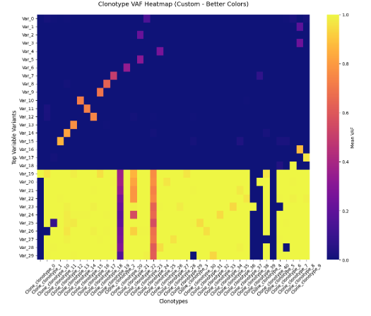
Despite more variants with more permissive filters, I think the clonotypes look more informative

Slide 18
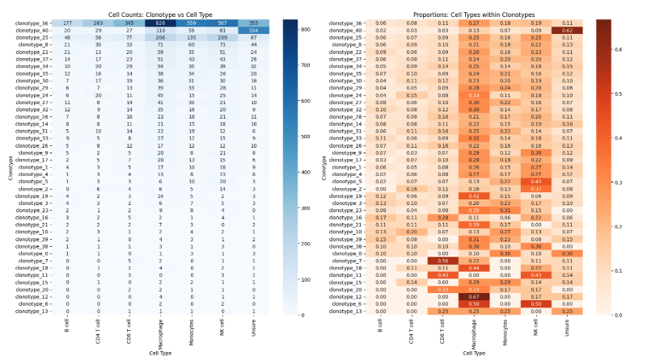
Clonotyping Cont

Slide 19
3. Do I retain more informative variants/cells?
I retain more cells and more variants
The variants that I do retain exist in far more cells spread across more cell types
When clonotyping is executed on these variants/cells, even without specific clonotyping filters, the clones look much more informative
Further analysis of the clones discovered by each method is required to determine whether these clones are truly Biologically representative

Slide 20
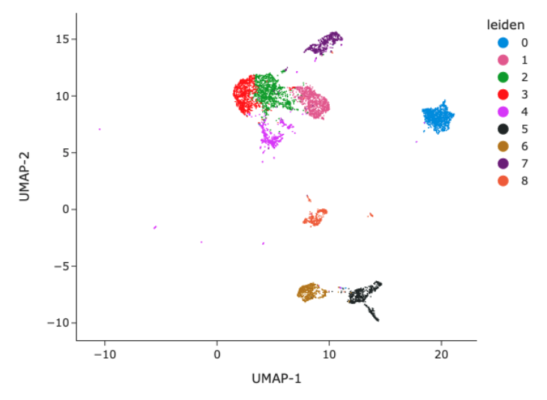
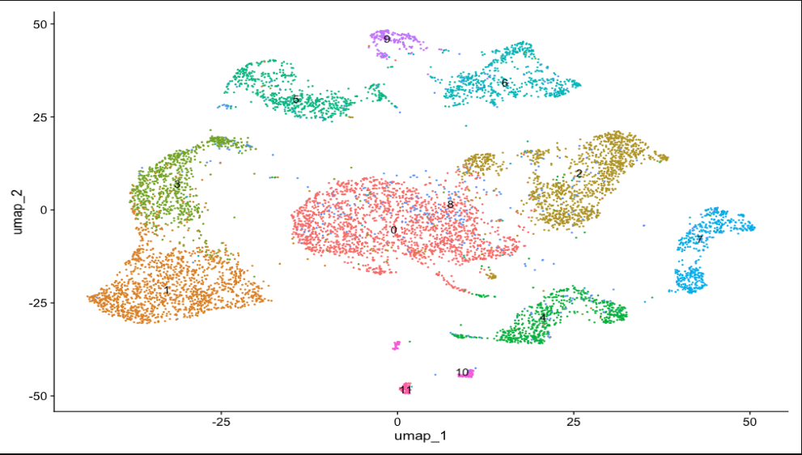
Clustering looks worse with Seurat - Aside
Left: UMAP produced by Seurat, Right: UMAP produced by snapATAC2

