Slide 1
Making Py-mTCall
A python implementation of some of the functionality of Signac

Slide 2
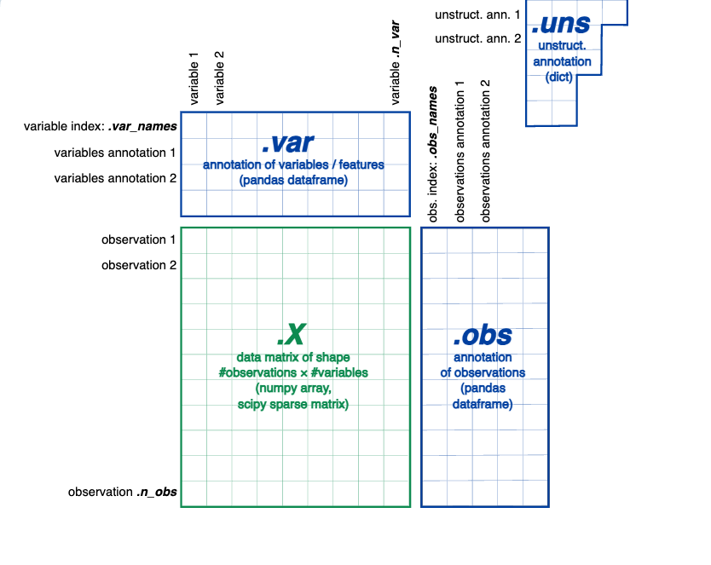
Anndata is designed for matrix like data such as scRNA-Seq data
With scRNA-Seq, each row corresponds to a cell with a barcode, each column to a gene with an id.
Each cell and each gene might have additional metadata like donor information or alternative gene symbols.
Finally, there might be other unstructured metadata like colour palletes used for plotting.
So the basic counts matrix will be stored in .X
Observation annotations like cell IDs will be stored in .obs
Gene annotations will be stored in .var
Any unstructured annotations like colours will be stored in .uns

Slide 3

Mitochondrial Variant Calling
Mgatk is a python based tool for generating mitochondrial variant data from BAM files
It simply gives outputs of per-cell, per-strand counts of all alleles at all positions in the mitochondrial genome
You also get a few other helpful files like overall depth in each cell and at each position

Slide 4
Signac variant filtering method
Signac is the variant filtering method written by the authors of mgatk to integrate variants into Seurat objects (similar to anndata objects) in R
Alleles are called as variants if there are at least two calls at that position with the allele on both strands
Strand concordance of counts is measured with pearson correlation, and variants with low concordances are cut
Finally variance mean ratio (VMR) is calculated and variants with very low VMR are also cut (indicative of sequencing bias etc)

Slide 5
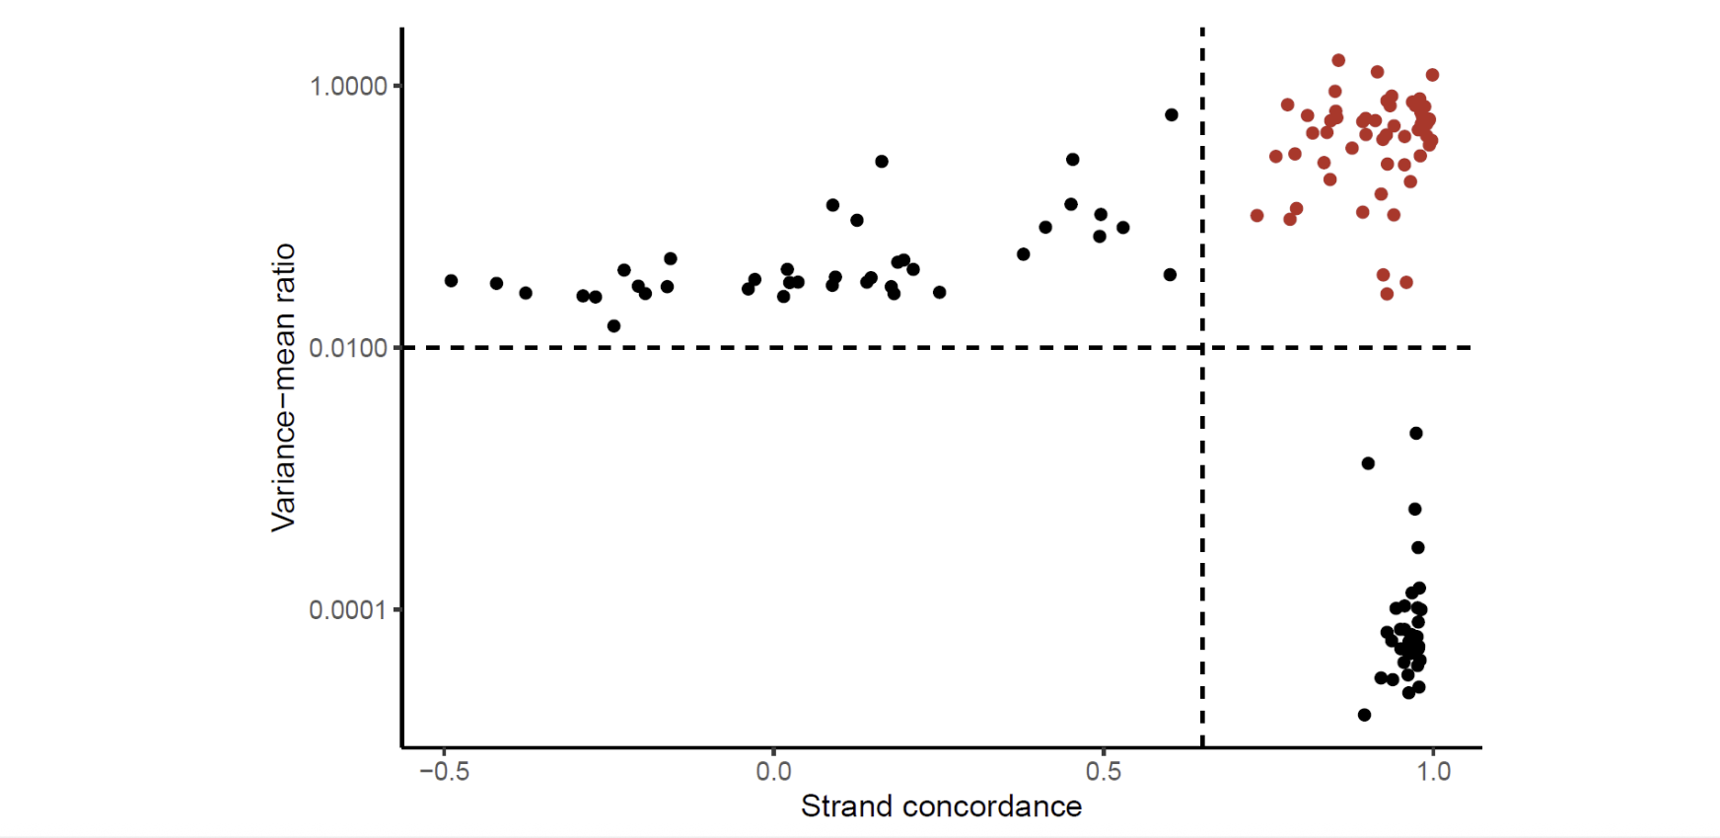
Red cells indicate good mutation calls (NOT CELLS)

Slide 6
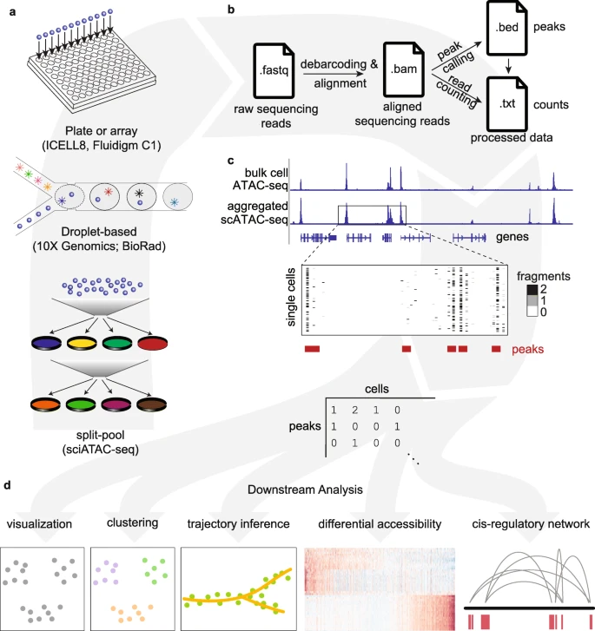
Integrating ATAC-Seq data with mitochondrial variant calling
Raw sequencing reads are scanned for barcodes and then aligned to the genome (b)
Peak regions and counts are returned (c)
A peak matrix can be constructed from fragments and counts in each cell (c) (think back to anndata)
Common computational steps are done after this construction (d)
Lareau et al; 2019

Slide 7
Computational Challenges with scATAC-Seq
Inherent sparsity of data due to low copy number of DNA in cells
Identifying how features relate to genes is challenging as there is not a clear method to tie features to their gene targets
A very large feature set as there are 100,000 – 250,000 accessible chromatin peaks but only 20,000 human genes

Slide 8
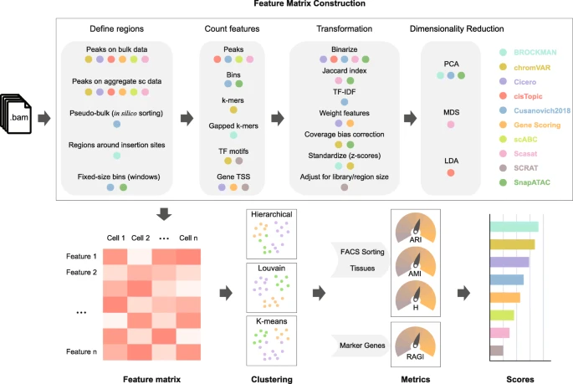
scATAC-Seq Method Comparison
There are lots of different ways to process scATAC-Seq data
The main differences comprise of defining regions of interest, feature counting and transformation
Most programs use similar steps after this for constructing UMAPs
Note that signac is not included but it defines regions by peaks on bulk data, counts features based on peaks and transformation is TF-IDF
All of these steps differ from snapATAC
Lareau et al; 2019

Slide 9
Maths: Signac
Peak Region | Cell 1 | Cell 2 | Cell 3 | Cell 4
1:100 | 10 | 20 | 30 | 40
2:100 | 20 | 30 | 40 | 50
Total | 30 | 50 | 70 | 90
LSI in Signac
TF = C_{ij}/F_{j} Where C = total counts for peak “i” in cell j
F = total number of counts for cell j
IDF = N/n_{i} Where N = total number of cells in dataset
n_{i} = total number of counts for peak ”i” across all cells

Slide 10
Signac Maths Cont
Peak Region | Cell 1 | Cell 2 | Cell 3 | Cell 4 | Total Cells
1:100 | 10 | 20 | 30 | 40 | 100
2:100 | 20 | 30 | 40 | 50 | 140
Total Peaks | 30 | 50 | 70 | 90
So TF(cell 1, peak 1) = 10/30 = 0.333
IDF (peak 1) = 100+140/100 = 2.4 So TFxIDF = 0.7992

Slide 11
Results
Peak Region | Cell 1 | Cell 2 | Cell 3 | Cell 4
1:100 | 0.8 | 0.96 | 1.02 | 1.06
2:100 | 1.14 | 1.03 | 0.98 | 0.95
You can see that it is essentially a normalisation step taken directly from the peaks identified in the dataset
This means it is sensitive to both number of peaks identified and number of peaks per cell identified

Slide 12
Snap ATAC Maths
SnapATAC segments the genome into uniformly sized bins (not related to fragments)
Adjusts for differences in library size between cells using a regression based normalization-method
Genome is split into equally sized bins
Bins with extremely high coverage are discarded as they are predicted to be sequencing noise
A similarity matrix is constructed, where 1 indicated presence of expression in that cell in that bin and 0 indicates absence

Slide 13
SnapATAC Maths cont (Jaccard Index Matrix)
Bin | Cell 1 | Cell 2 | Cell 3
1 | 1 | 1 | 0
2 | 1 | 1 | 1
3 | 0 | 1 | 1
Jaccard index (pair of cells) = how many accessible bins they share, normalised by how many bins they cover in total or: Jaccard(A,B) = A overlap B/ A union B Jaccard(cell1, cell2) = Cell 1 accessible bins = 1, 2 /
Cell 2 accessible bins = 1, 2, 3
= 2 overlap / 3 union = 2/3 = 0.67

Slide 14
Results
Bin | Cell 1 | Cell 2 | Cell 3
1 | 1 | 0.67 | 0.25
2 | 0.67 | 1 | 0.50
3 | 0.25 | 0.50 | 1
This has much more variability than Signac as it does not account for sequencing depth
A normalisation step is done after this to make the matrix more representative
The normalisation is OVE (observed over expected) Jaccard index under random bin accessibility

Slide 15
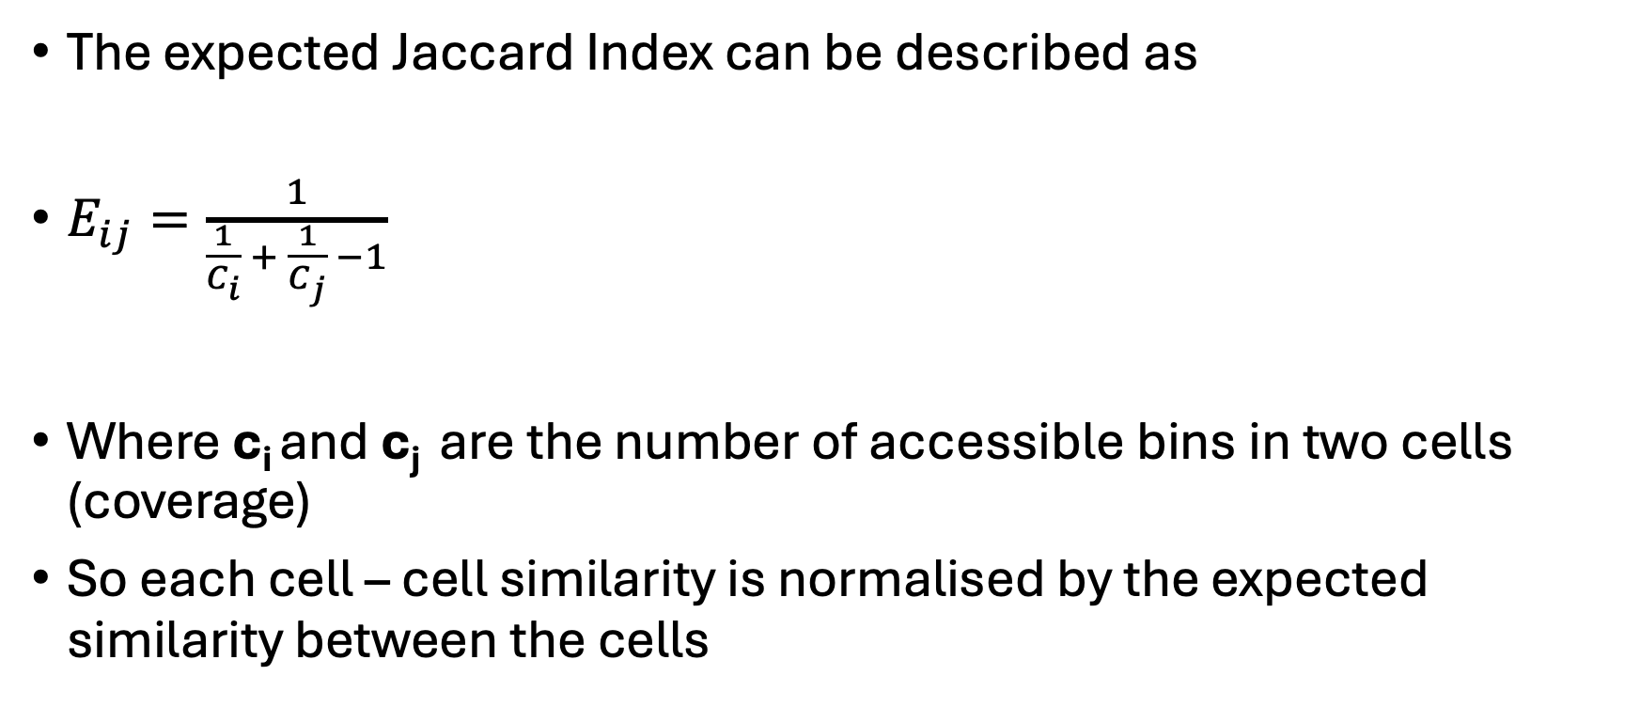
Expected Jaccard Index
The expected Jaccard Index can be described as
$E_{ij}=\frac{1}{\begin{aligned}\frac{1}{C_{i}} + \frac{1}{C_{j}} −1 \\ \end{aligned}}$
Where c_{i} and c_{j} are the number of accessible bins in two cells (coverage)
So each cell – cell similarity is normalised by the expected similarity between the cells

Slide 16
How do these differences manifest in data?

Slide 17
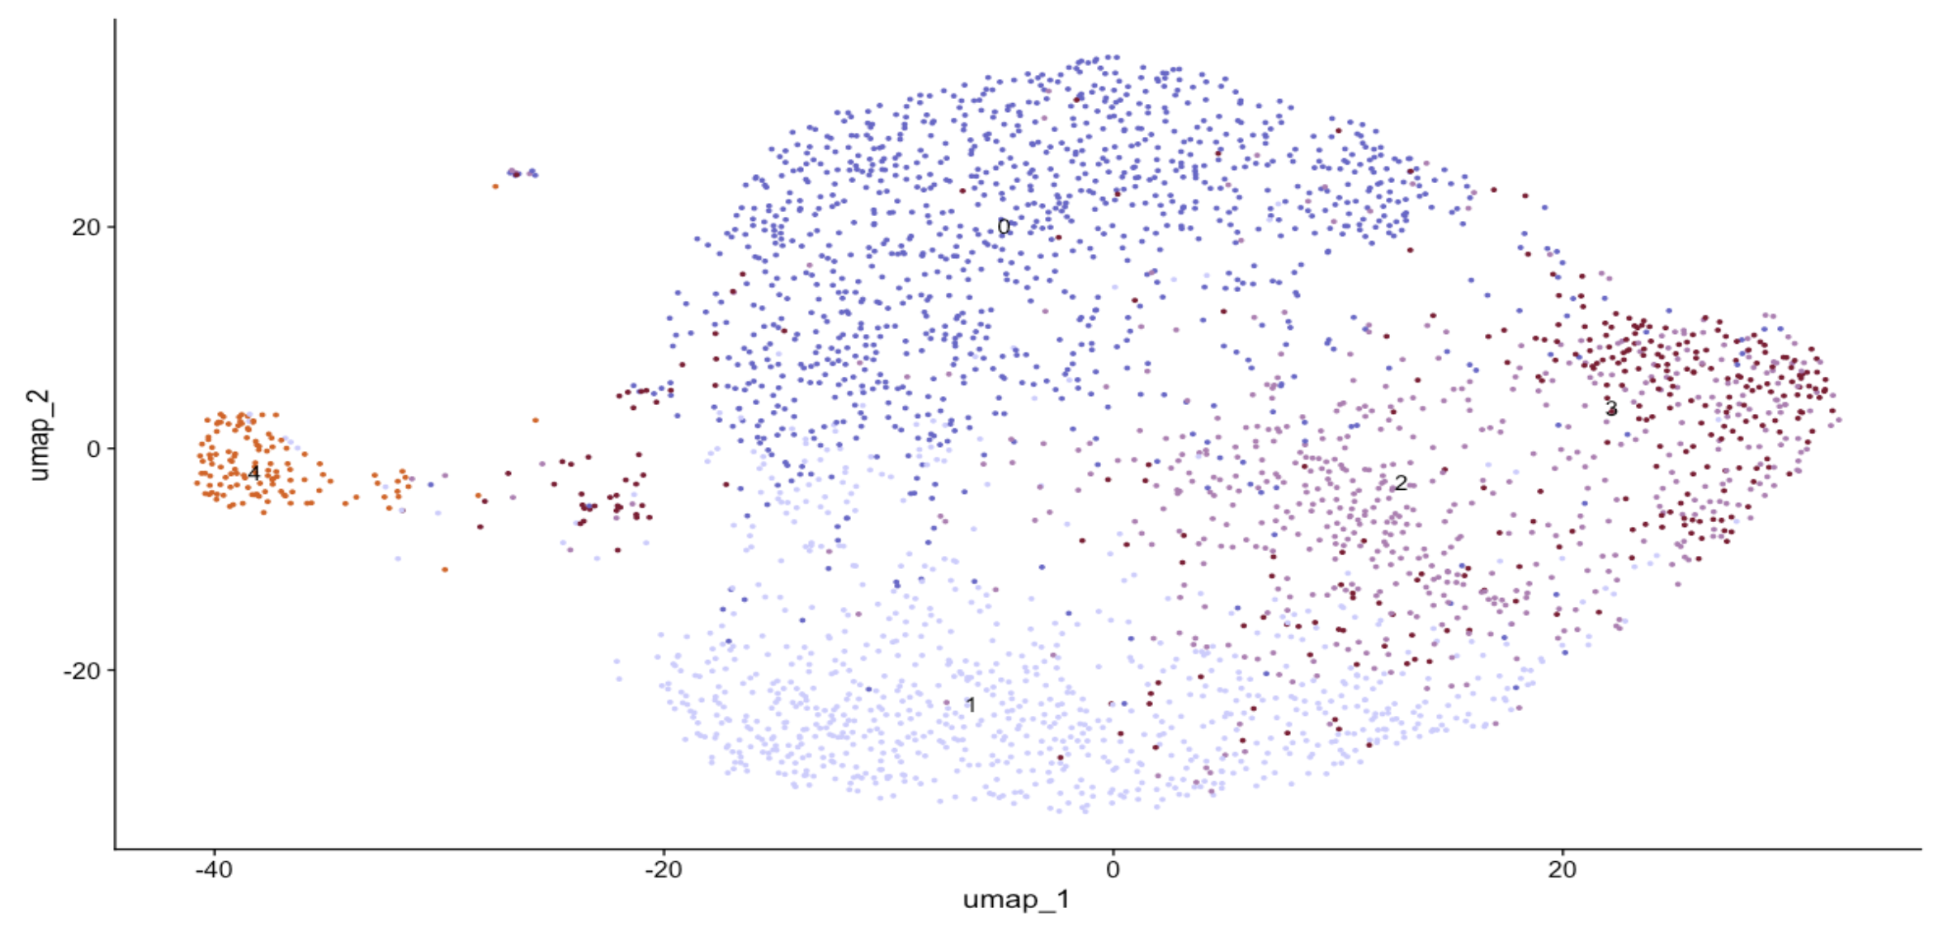
Imogen Sample 2 (T cells only) Signac

Slide 18
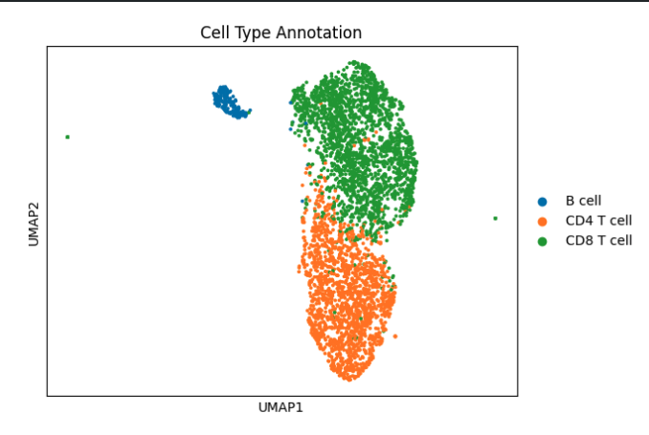
Imogen Sample 2 (T cells only) SnapATAC

Slide 19
Py-mTCall Method
Follows Signac Methodology generally
Heavy use of sparse arrays for efficiency, sparse arrays are arrays where only non-zero locations are stored
Instead of calculating strand concordance and VMR on all positions, I calculate it only on confidently detected positions, increasing efficiency
Instead of calculating VAF, Strand Concordance and VMR separately, I calculate these in one step. Simplifying the calls

Slide 20
Usage and Outputs
Py-mTCall uses standard python packages and can be easily called as such:
Where the path is the directory to your mgatk folder and gene_matrix is your adata object
Entire code takes 3 minutes which is quite quick

Slide 21
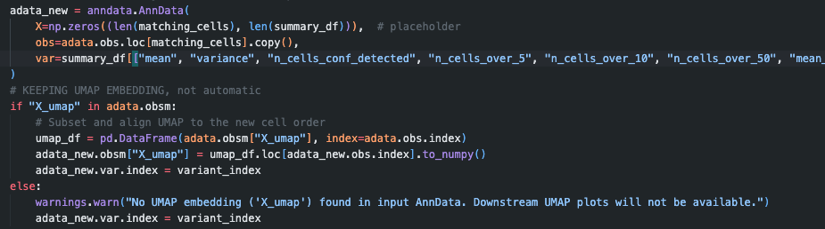
Py-mTCall adata integration
After calculations are completed, the input adata object is copied
Counts and VAF are added to obs
Variance and Concordance is added to var
UMAP embedding is copied back in

Slide 22
Final adata object
This means that the adata object can be inspected and shown to have all of the information it had before, but with added data

Slide 23
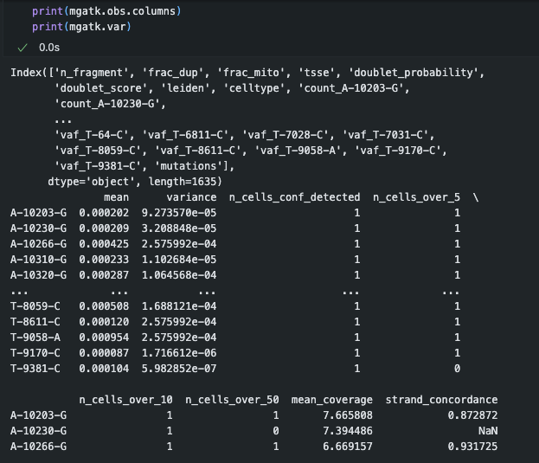

Slide 24
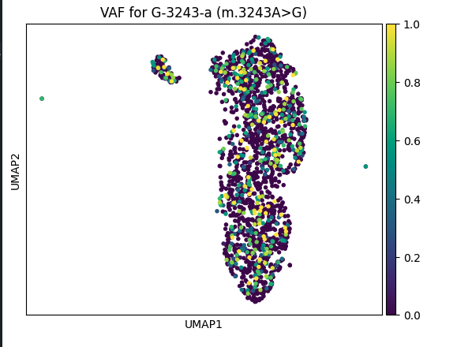
Applying py-mTCall

Slide 25
Limitations
Py-mTCall does not yet include lineage tracing, which Signac supports
Py-mTCall is documented by me, untested by other users
Py-mTCall probably doesn’t scale well with non-sparse data
I wrote it, so there’s bound to be something wrong with it that I haven’t noticed yet

Slide 26
Extra

Slide 27
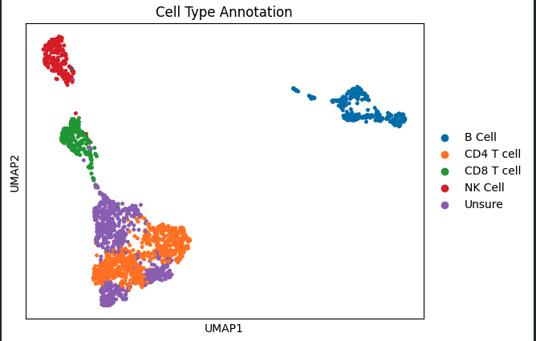
Imogen Sample 1

Slide 28
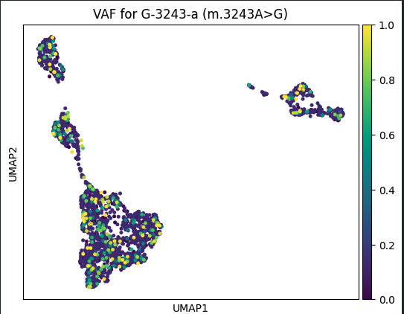

Slide 29
Mitochondrial Clonotyping
Clonotyping generally refers to the identification of unique VDJ sequences which you can track across single cells
Because of Mitochondria’s high mutation rate, it is possible to use variants as a proxy for true clonality
The results will probably not represent ”true clones” but can still provide insights into cell development dynamics
Clonality analysis can also aid in identifying specific cell types and cell-specific disease progression

Slide 30
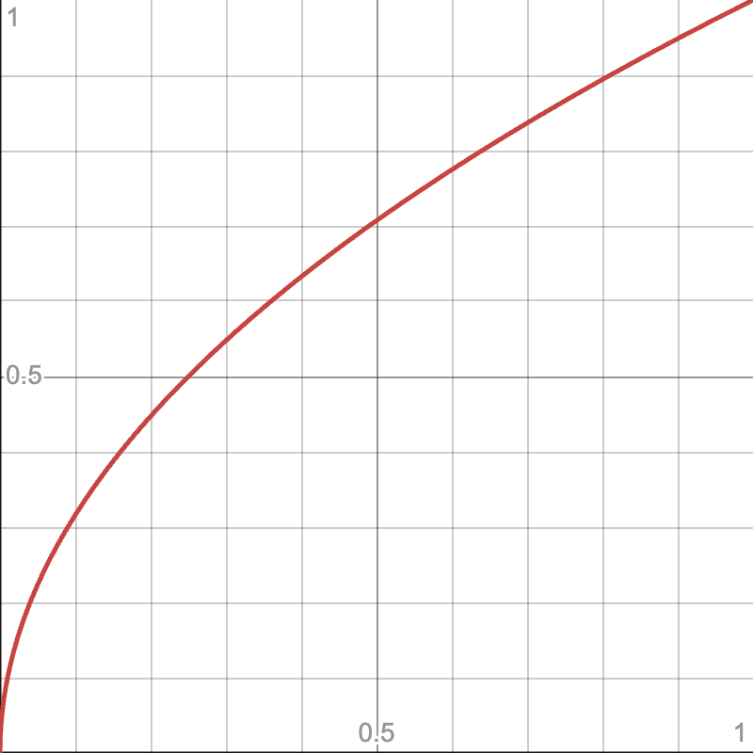
Signac Clonotyping
sqrt of numbers 0-1
Cell to cell interactions are calculated by taking the square root of VAF values (to normalise for high VAF)
Cells are then clustered for similarity using Leiden or Louvain clustering to create clonotype clusters

Slide 31
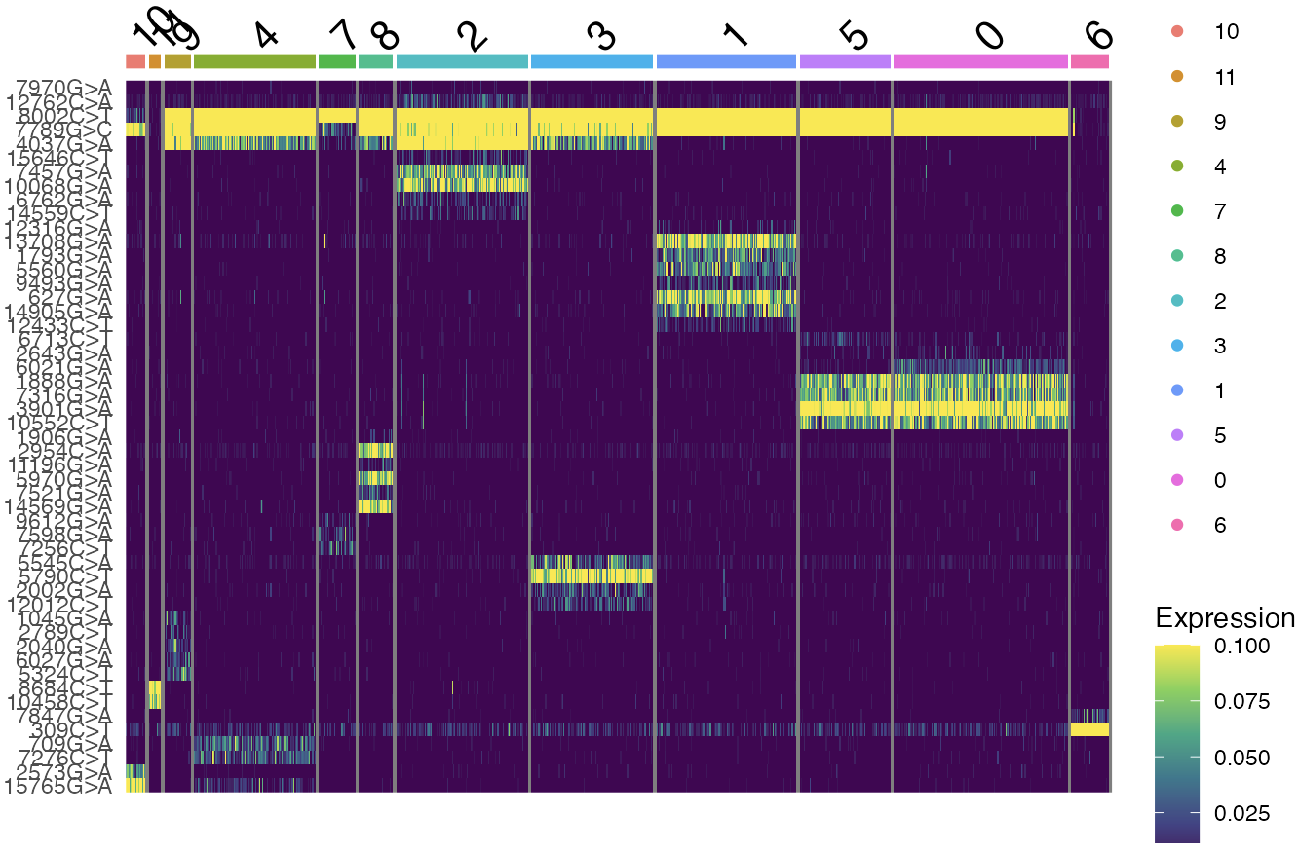
Signac Clonotyping
Mean VAF for each clonotype is calculated
Cosine similarity between clonotypes is calculated to hierarchically cluster the clonotypes
This allows us to see what variants contribute to the clonotypes, as some clonotypes will have overlapping variants

Slide 32
Py-mTCall Implementation
Following on from Py-mTCall’s successful variant identification I decided to apply clonotyping
Porting over from R was quite simple as the clustering functions have direct synonyms in Python
Since VAF has already been calculated by previous steps, the only requirement is to take the square root and then apply clustering functions

Slide 33
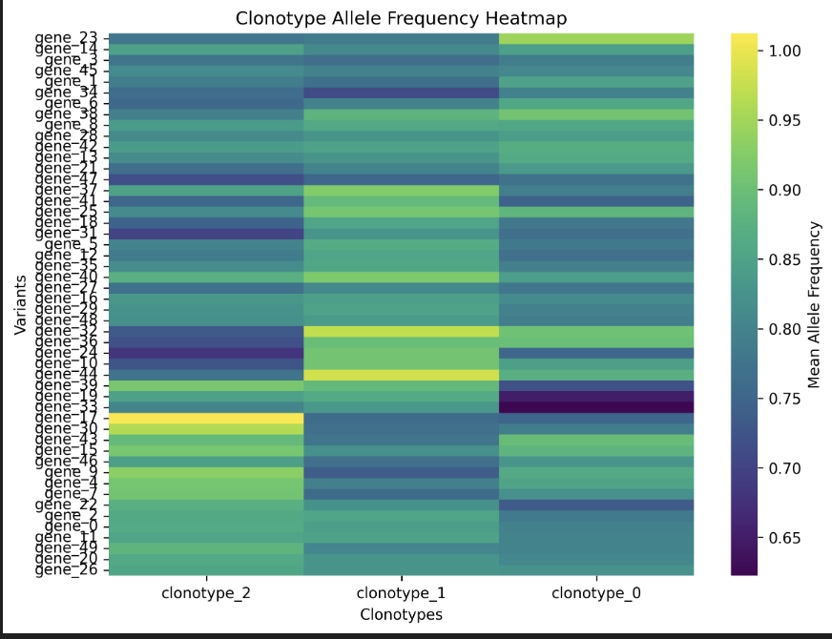
Example Result

