Slide 2
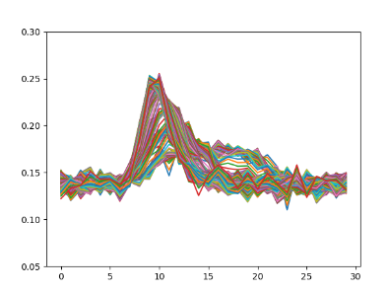
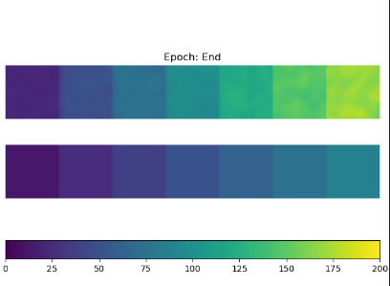
W_res = 100, spatial filter, sd=2.5, 5000 ep

Slide 3
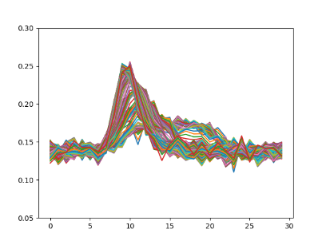
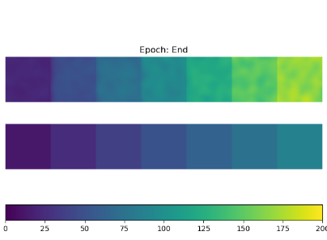
W_res = 1, spatial filter, sd=2.5, 5000 ep
Converges faster

Slide 4
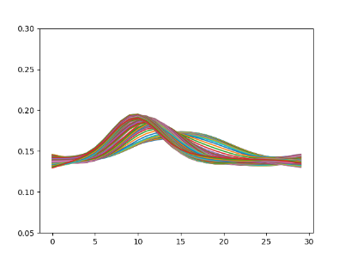
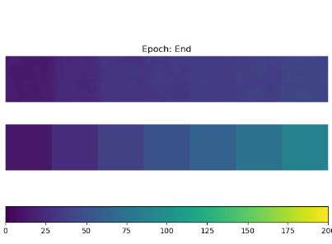
W_res = 1, spatio-temporal filter, sd=2.5, 5000 ep
Lower curves due to smoothing

Slide 5
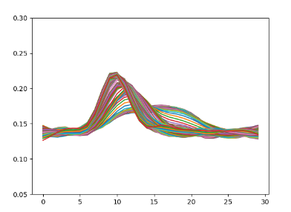
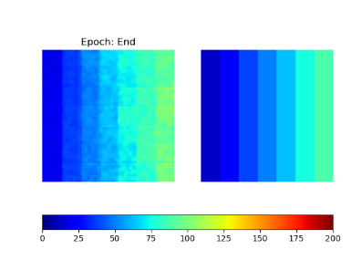
W_res = 1, spatio-temporal filter, sd=(2.5, 2.5, 2.5/2 (time)), 5000 ep

Slide 6
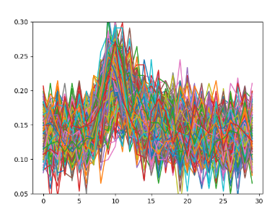
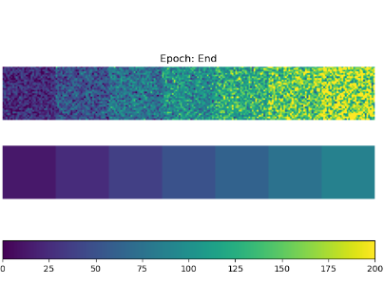
W_res = 1, no filter, 5000 ep
No smoothing,

Slide 7
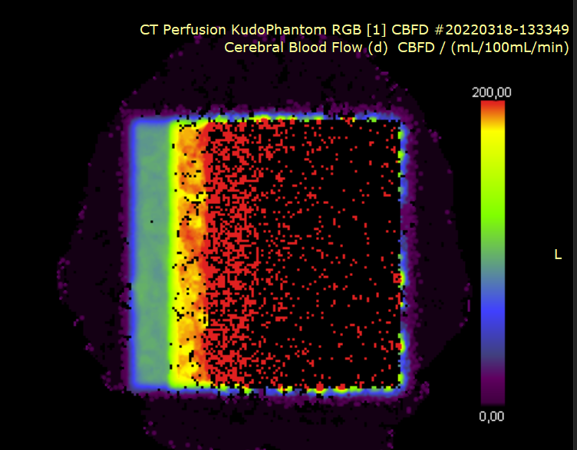
Sygnovia

Slide 8
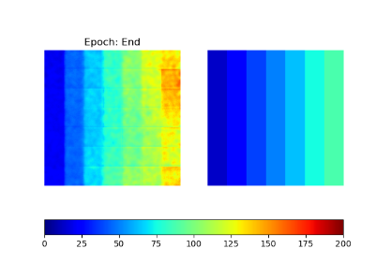
With fixed delay times and MTT

Slide 9
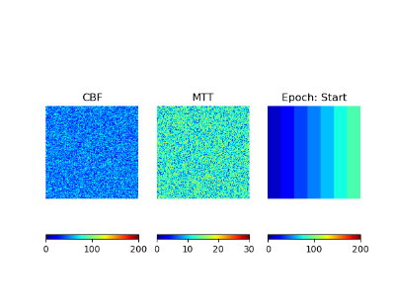
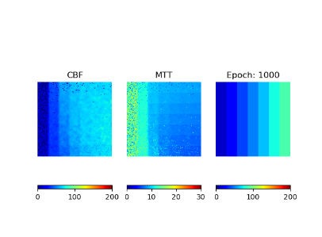
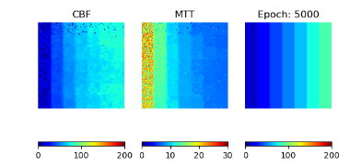
Free MTT spatiotemporal filter (2.5, 2.5, 1.25)

Slide 10
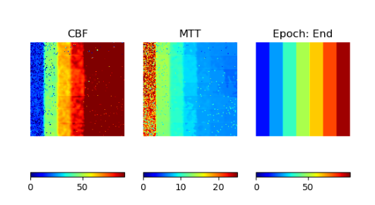
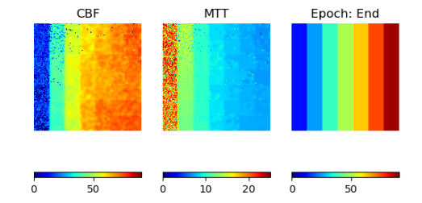
Free MTT spatial filter (2.5, 2.5)
Note: different scale
Free MTT spatio-temporal filter (2.5, 2.5, 1.25)

Slide 11
Questions
Do I fit t_delay or do I merely use it to assess how the method works for delayed curves?
I dont know if my spatial gaussian filter is the same as Edwins. No filter size defined, only standard deviation. Will it make a difference?

Slide 12
