Slide 1
College of Western Idaho SWDV 265 Content Management Systems
Week 2
Notes:
Test2008Joomla: joomla_25

Slide 2
Day 1 Lab
Unzip \\swdvdc1\StudentFiles\SWDV265FA18\Week2Day1Lab.zip. There are two projects in it, ColorList and ColorLoop. Copy them to a local folder.
Each project has 3 errors which prevent it from compiling. Correct the errors, set UWP as default, run the project, and do a screen grab to document success. The result should be similar to what is on the next two pages.
Paste images into a Word document named Week2Day1Lab, upload both to BB to Week2 Day1Lab, & submit. 50 points per image.

Slide 3
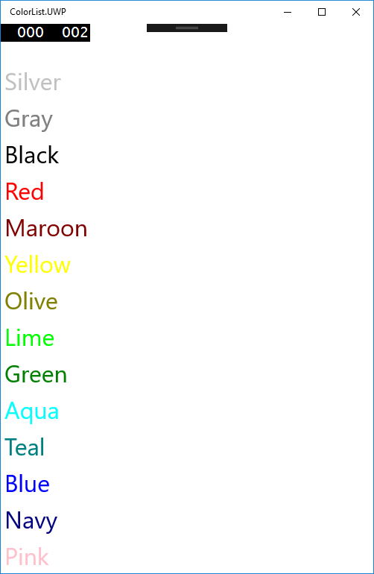

Slide 4


