Slide 1
The problem
“
Have you ever received an AI-generated answer that sounds brilliant until you realize it made no sense?
“
Notes:
(about 25 seconds) Ask the question and pause for a moment. Most of us have trusted an AI answer that sounded confident and turned out wrong. For developers, that answer becomes code they can’t explain, review or fix.

Slide 2



The solution
An AI that grows with you
1. Learn
2. Prove
3. Build with AI
Every developer gets a learning tree for the languages they use.
Short challenges verify each concept, with the AI paused.
The assistant unlocks exactly what you’ve proven, nothing more.
Notes:
(about 35 seconds) verifAI is an AI that grows with you. You learn a concept, you prove it in a short challenge, and only then can the assistant build with it for you. The more you know, the more the AI can do.

Slide 3
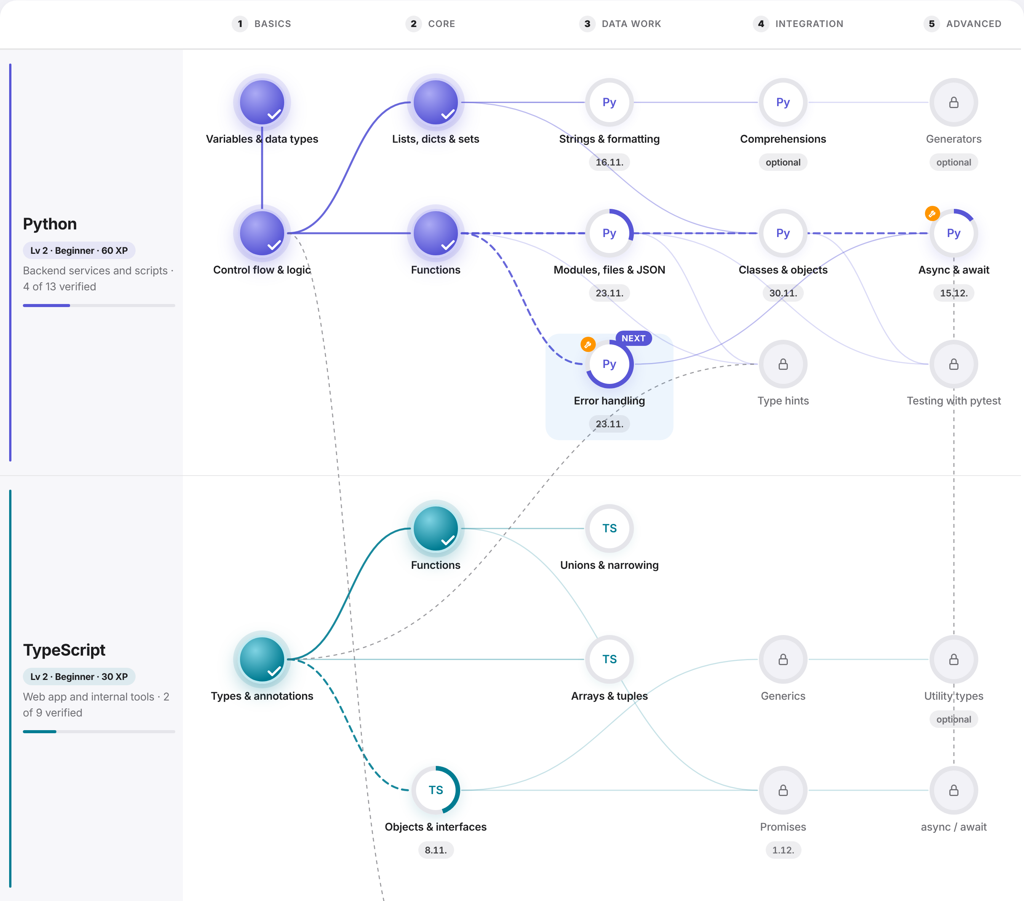
Every skill has to be proven first
Learn it, prove it
A learning tree for Python, TypeScript and Go
Short challenges unlock each concept, with the AI paused
Or learn it while doing real work in a guided task
Notes:
(about 40 seconds) This is an employee’s learning tree, here with Python and TypeScript. Filled circles are verified, rings are in progress, faded ones are locked. To unlock a concept, the employee solves a short challenge with the assistant paused, or learns it in a guided task on a real ticket, where the tutor teaches and the employee writes the code.

Slide 4


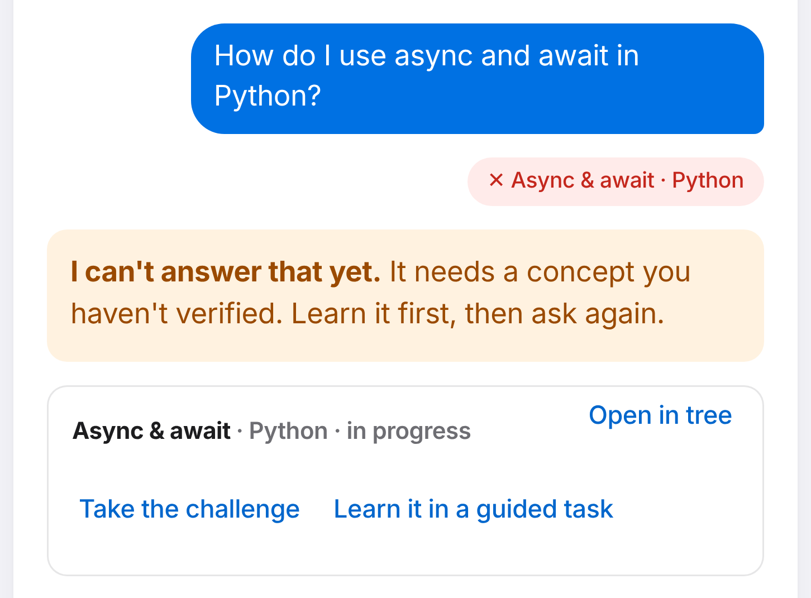
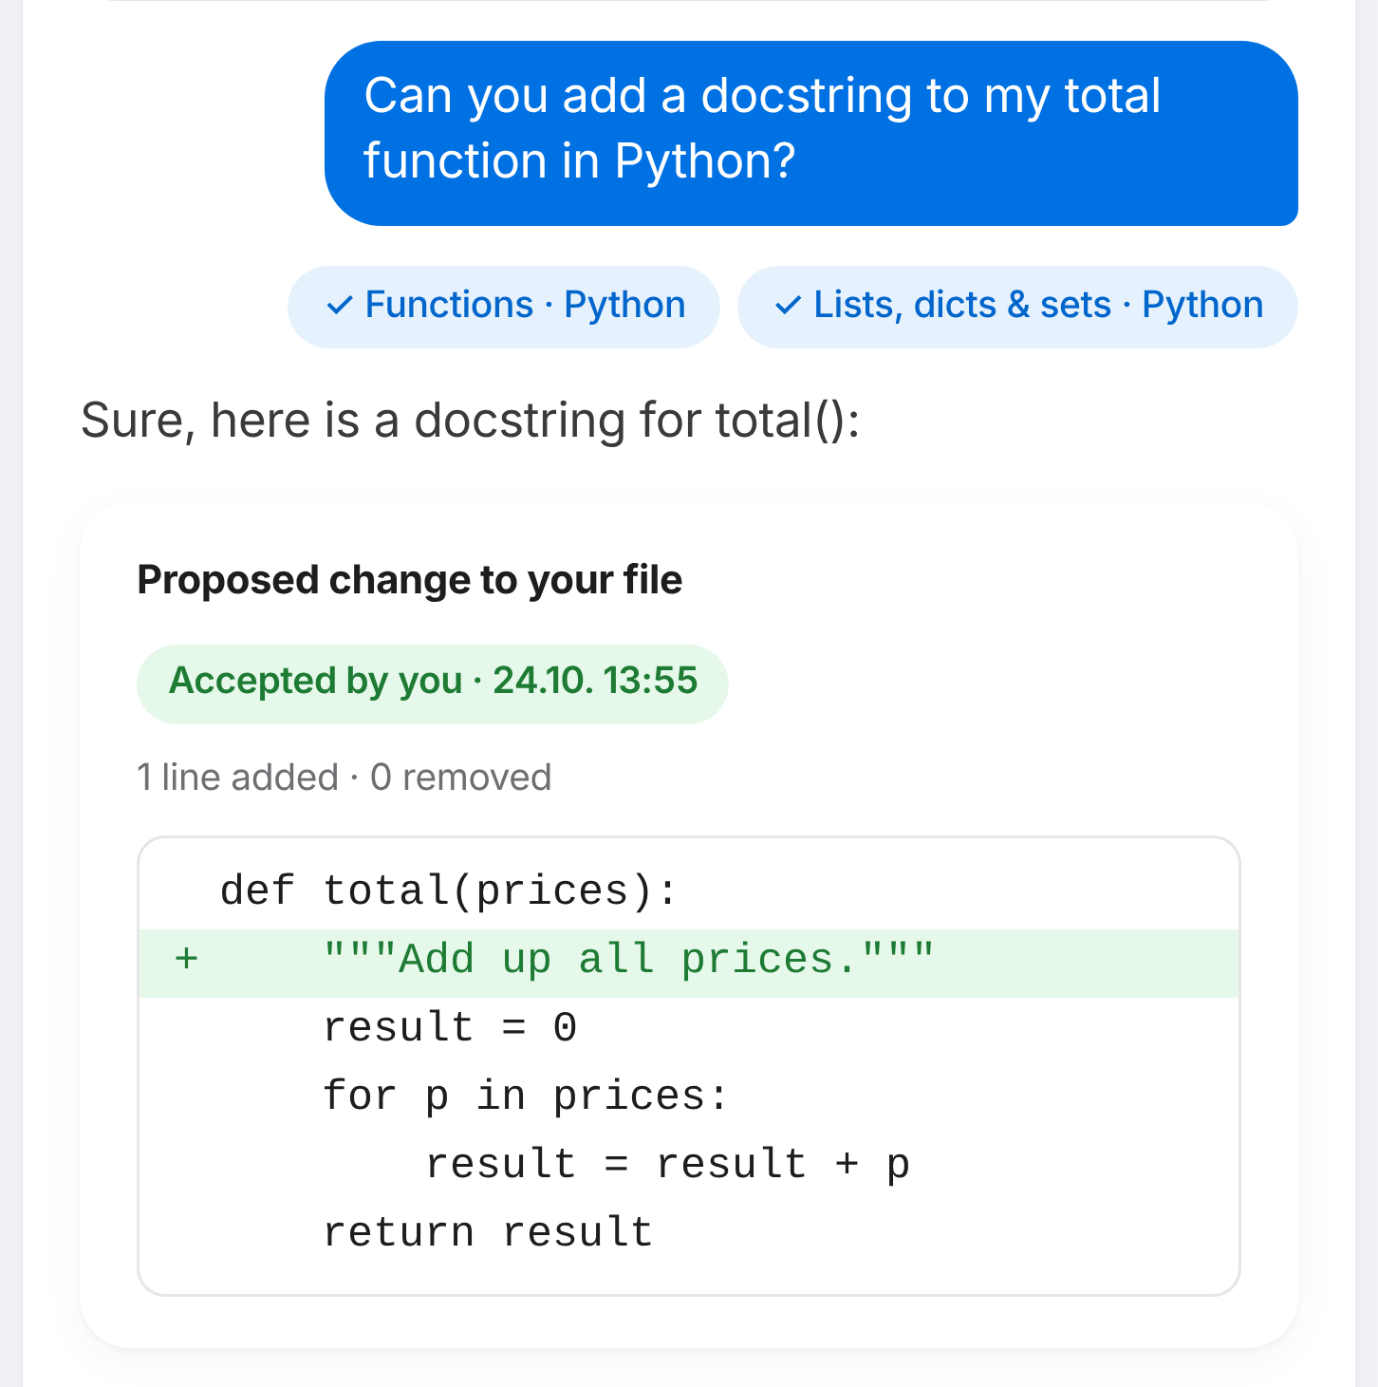
The AI only works with proven skills
Build with AI, safely
Not verified yet: the AI says no
Verified: AI does it, employee approves
Async & await isn’t in the employee’s tree, so the question never reaches the model.
Functions is verified. The AI proposes the change; it’s applied only after the employee accepts.
Notes:
(about 50 seconds) Left: the employee asks about async and await. It isn’t verified yet, so the assistant refuses and shows where to learn it. Right: the employee asks for a docstring on a function, a verified skill. The AI writes it, but nothing changes until the employee reviews the diff, confirms they understand it and accepts. You can see it says Accepted by you.

Slide 5
verifAI
Learn it. Prove it. Then let AI build with it.
Also in the demo: guided tasks · career levels · manager view · bring your own AI model
Notes:
(about 20 seconds) verifAI: an AI that grows with you. The demo also has guided tasks, career levels with salary ranges, a manager view and your choice of AI model. Thank you, happy to show it live.

