Slide 1
ENGI 301 RC Airboat PCB Proposal
11/15/2021
Lucas Esnaola

Slide 2
Background Information
I am proposing the construction of a 3D printed airboat fitted with two motors controlled by the beagle bone black either via cord, preprogramming, or through wireless means.
https://github.com/lucasesnaola/ENGI301/tree/main/python/RCboat
https://www.hackster.io/lre3/hardware-base-for-a-remote-controlled-fanboat-566de3
What changes (if any) are you going to make based on your prototype?
I am going to finish printing the airboat and installing the circuitry to achieve a fully functional RC boat
I am also going to make some small tweaks to the code to improve operation.

Slide 3
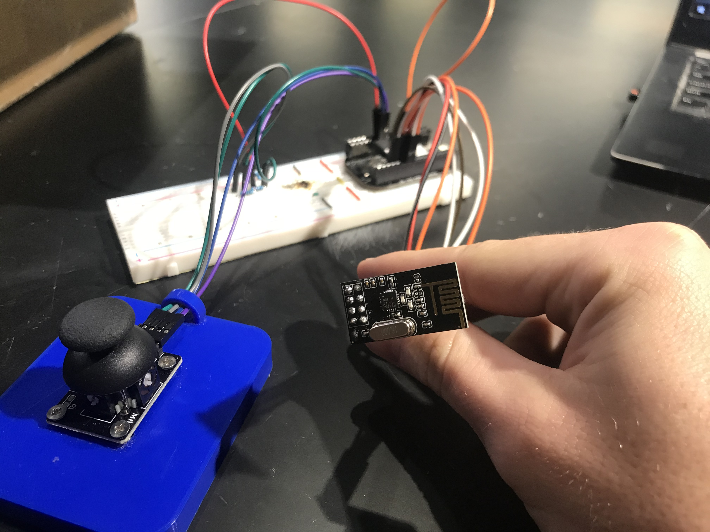
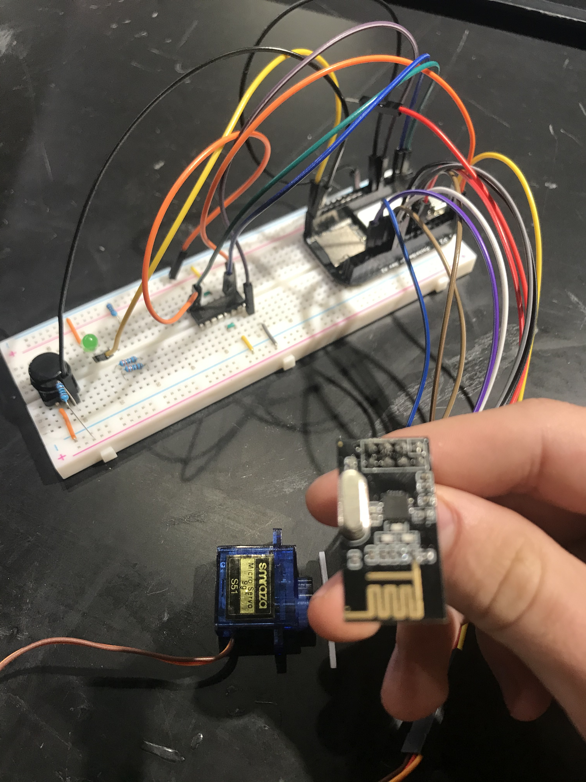
Pictures of the Design

Slide 4
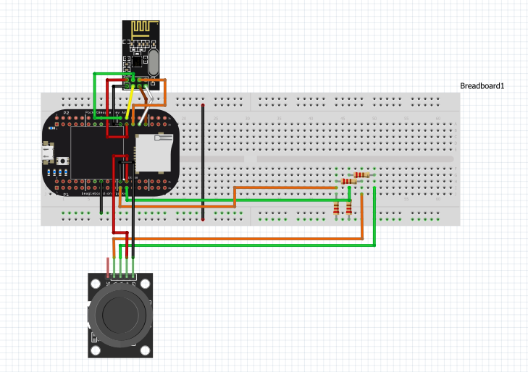
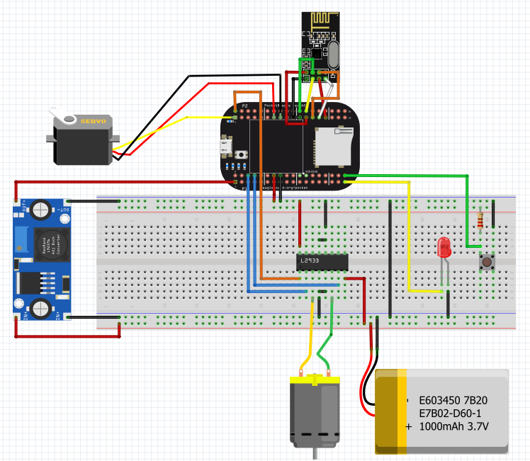
System Block Diagram

Slide 5
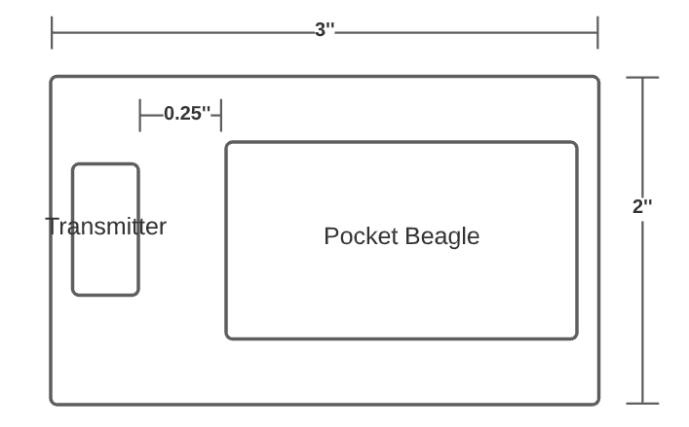
Mechanical Block Diagram - Remote
Create a Mechanical Block Diagram

Slide 6
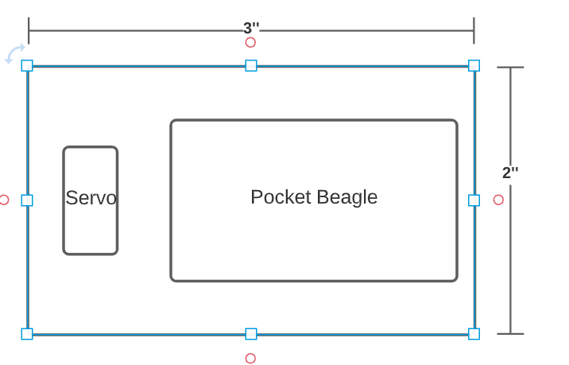
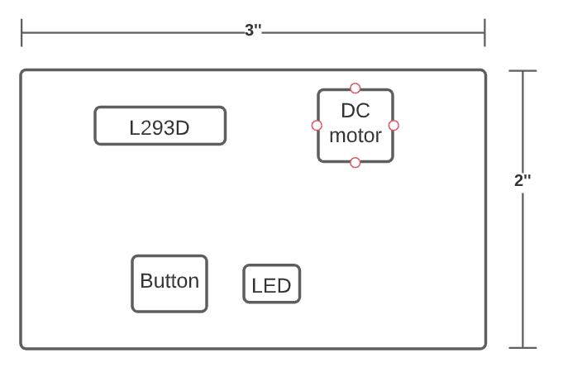
Mechanical Block Diagram - Onboard
Back
Front

Slide 7
Components Required
Create a list of all the components that you require for the PCB
I should have all needed components for the final project
I already emailed you about the DC motor and propeller

