Slide 1
Premier League Football Analytics Database Project
Schema Squad

Slide 2
Intro
Developed a dual-database system for football analytics.
Operational DB for match data entry & Analytical DB for trend analysis.
ETL pipelines to extract, transform, and load data from CSVs.
Supports complex analytical queries and reporting.

Slide 3
Intro
Fully-functional OLTP database with normalized schema.
OLAP star schema for analytical queries.
ETL pipelines for data ingestion and transformation.
Robust query support for match, team, and referee analytics.

Slide 4
Operational Database (OLTP)
Key tables: Teams, Seasons, Referees, Divisions, Matches, MatchStatistics, Bookmakers, Markets, BettingOdds.
Normalized design ensures data integrity and efficient transactions.

Slide 5
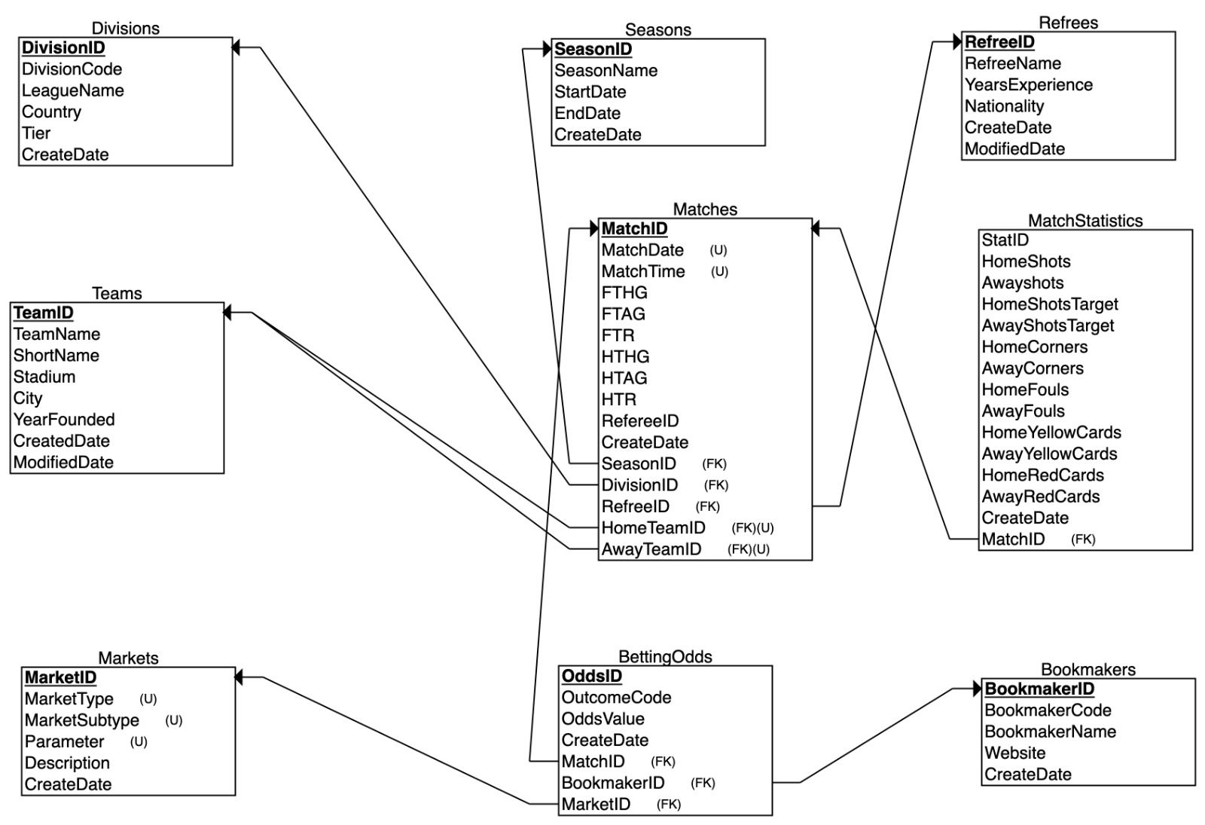
Relational Schema

Slide 6
ETL Process
Extraction: Load CSVs, validate data, track processing metadata.
Transformation: Clean data, derive metrics, handle foreign key relations.
Loading: Populate OLTP database with clean data.

Slide 7
Analytical Database (OLAP)
Star schema: Fact tables - MatchResult, TeamMatchStats, LeagueSnapshot.
Dimension tables: Time, Team, Season, Referee, Location.
Supports historical trend, seasonal performance, and regional comparison.

Slide 8
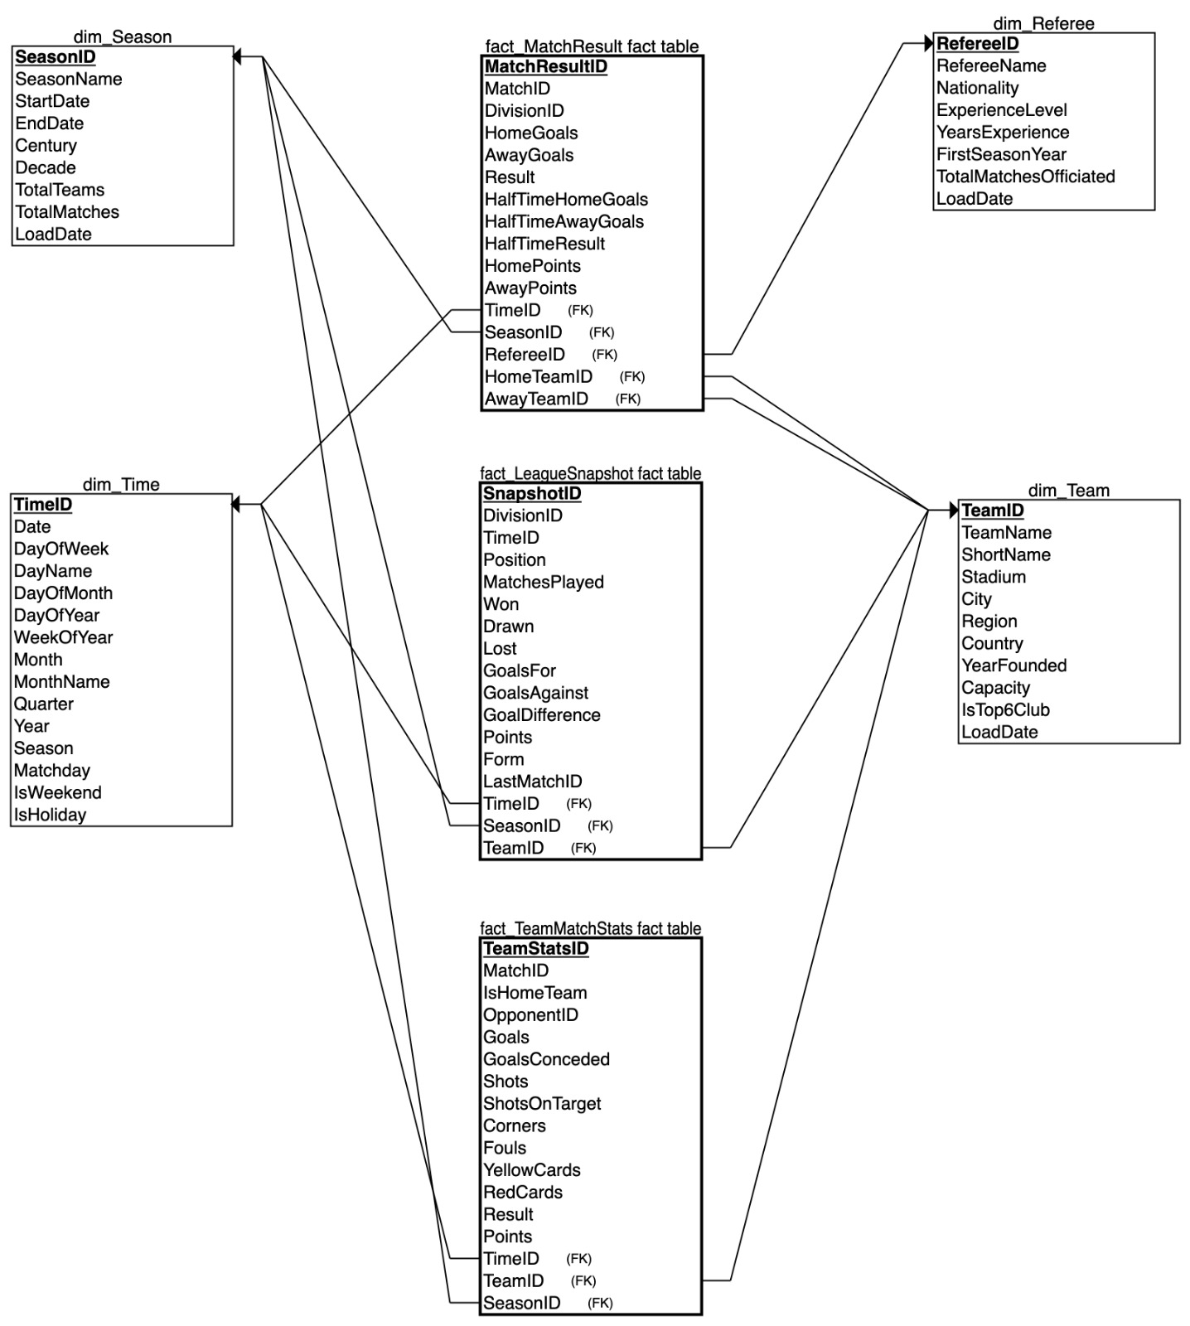
Star Schema

Slide 9
Technical Challenges & Solutions
Reserved words resolved with backticks in MySQL.
Adapted schema for variable CSV formats.
Ensured FK integrity via transaction management.
Optimized OLAP queries using pre-aggregated fact tables.

Slide 10
Key Analysis Capabilities
Regional performance trends and home advantage insights.
Comparison between top clubs vs. others.
Seasonal performance breakdowns.
Referee influence on match outcomes.

Slide 11
DEMO

Slide 12
Conclusion
Robust, scalable system for football analytics.
ETL and data modeling demonstrate advanced database skills.
Supports powerful insights for teams, analysts, and fans.
Real-world application of OLTP + OLAP integration.

