Slide 1
Bookstore Inventory Analysis:
Cost and Acquisitions
Non-fiction
Lucas G. Freeman
March 6, 2026
Fiction

Slide 2
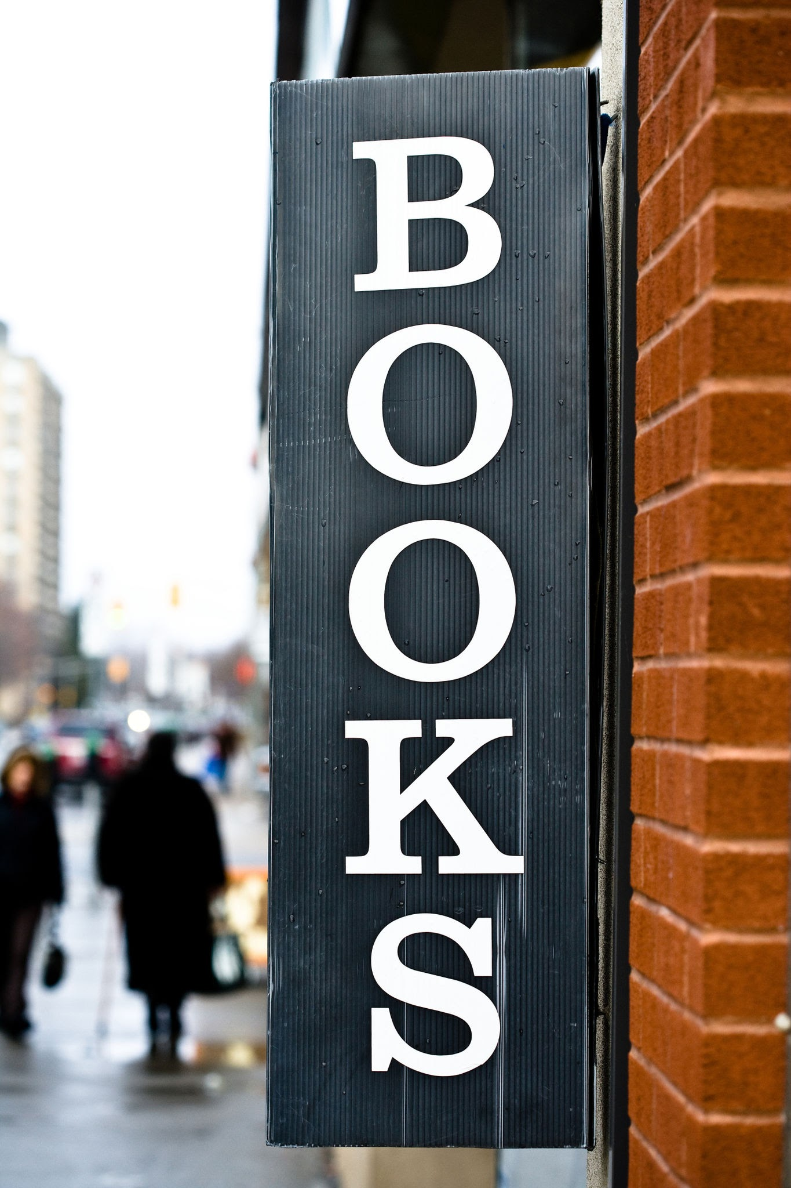


How did this idea start?
Love of books fuels a dream and a vision to open a bookstore someday.
I mention bookstore vision to my wife, who loves the idea of starting a business.
With over 500 books, I must now assess stock and plan future acquisitions.
2000/2001
December 2025
January 2026
February 2026
March 2026
I acquire a large donation of books left over from an estate sale.
My bookselling and book collecting experience informs low-cost acquisition strategies.
Lucas G. Freeman
Bookstore Inventory Analysis
Notes:
My history in bookselling includes an online store at Half.com selling used textbooks, and work experience at Barnes & Noble. I also did college work-study at two separate libraries.

Slide 3
Project Overview
01
Context
I have amassed a foundational inventory of 522 used books acquired through donations, thrift stores, and library sales.
02
Objectives
As part of my business plan, I seek to understand my inventory in terms of genre distribution, acquisition cost, and method of acquisition.
03
Outcomes
Insights will help me manage future acquisitions and costs, and achieve a more balanced inventory in a cost-efficient way.
Lucas G. Freeman
Bookstore Inventory Analysis
Notes:
By getting an idea of early trends, I hope to steer acquisition efforts toward more cost-efficient avenues.

Slide 4

Context & Caveats
• Total book count is likely dependent on the size of the leased space. • Acquisition costs reflect bulk purchase averages; format (hardcover vs. paperback) not assessed.
• Analysis is focused on genres, acquisition costs, and acquisition methods to identify opportunities for genre diversity and cost-efficiency.
• No sales data yet; still in inventory acquisition stage.
Lucas G. Freeman
Bookstore Inventory Analysis
Notes:
Future analysis will likely include format, and assessments of fiction vs non-fiction vs poetry vs graphic novel. My current ratios are about on par with bookstore industry averages.

Slide 5
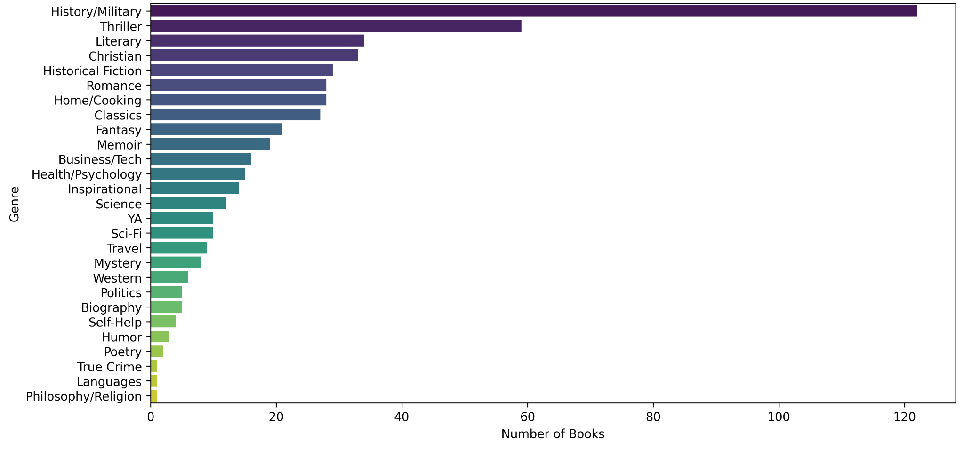
Number of Books per Genre
Assessment: About a quarter of inventory so far is history and military books. While some genres are underrepresented, inventory standards vary by bookstore, location, and reader interest.
Lucas G. Freeman
Bookstore Inventory Analysis
Notes:
The history and military topics in questions are mostly WWII and the U.S. Civil War. Any genre can be divided further for deeper analysis, though current sample size may limit significance of those results.

Slide 6
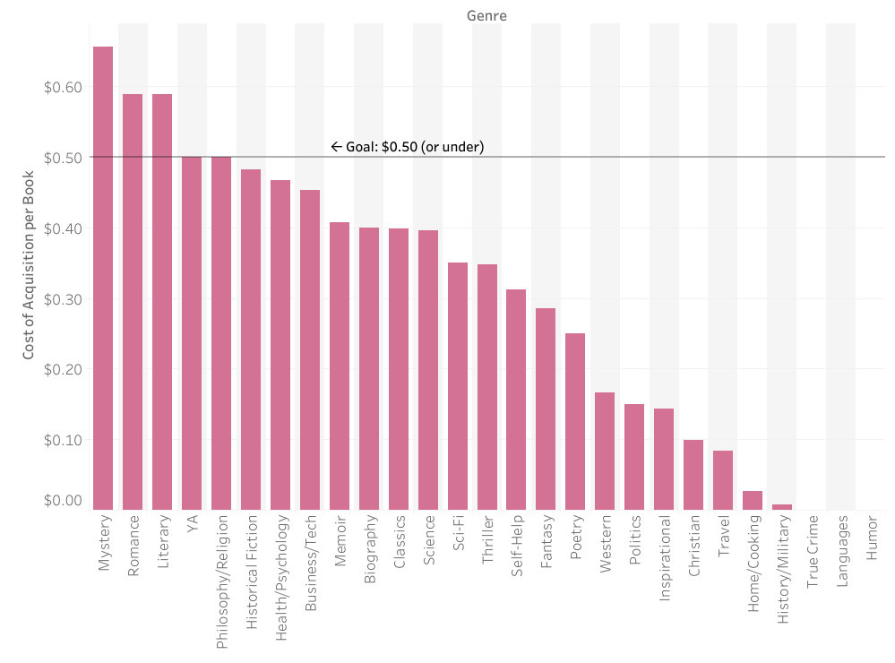
Acquisition Cost per Book (by Genre)
Target: $0.50 per book
Mystery, romance, and literary fiction acquisitions exceeded this target.
History and military books, though abundant, were predominantly donated.
Key Takeaway:
Average acquisition cost per book overall is $0.27. Success spans many genres, not solely driven by donated history and military titles.
Lucas G. Freeman
Bookstore Inventory Analysis
Notes:
Note: These high-priced genres all fall under fiction. I suspect romance may not have high resale value. This will be subject to further analysis.

Slide 7
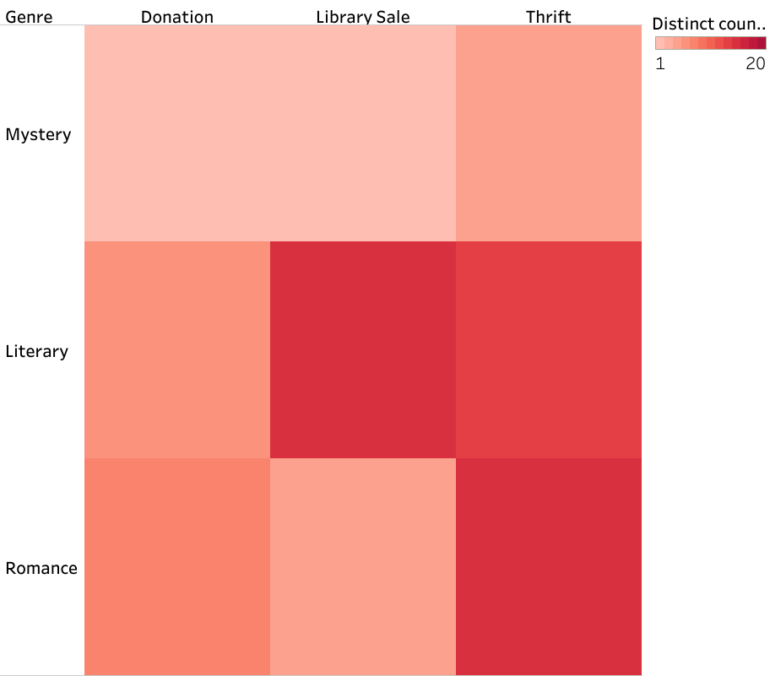
3 Priciest Genres on Average
(Acquisition Method Breakdown)
Assessment: Mystery, romance, and literary fiction have been heavily sourced through thrifting, though these genres can also be obtained through library sales or donations, offering multiple sourcing options.
Lucas G. Freeman
Bookstore Inventory Analysis
Notes:
More of these books overall were sourced through thrifting, but the next slide provides a cost breakdown.

Slide 8
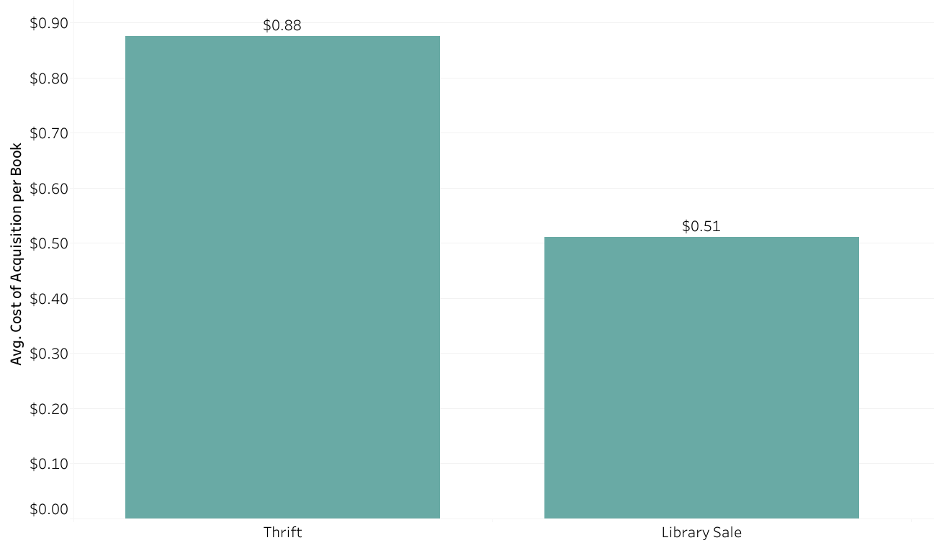
Average cost of Acquisitions per Book (by Method)
Thrifting far exceeded the $0.50 per book acquisition goal, while library sales were roughly on track.
**Donations not included due to acquisition cost being zero.
Lucas G. Freeman
Bookstore Inventory Analysis
Notes:
Again, format (hardcover vs paperback) was not assessed due to averaging of bulk purchases, but acquisition ratio is roughly even so far and on par with industry standards.

Slide 9

Conclusions
• Thrifting may fill gaps in underrepresented genres or high-margin titles, but should not be the primary sourcing method for used books.
• Continue leveraging donations and library sales, which provide cost-efficient acquisitions.
• Explore additional sourcing options, such as yard sales, estate sales, online purchases, or direct from individuals.
• Consolidating some categories (e.g. self-help with psychology) may fill out emptier shelving and balance genre groups.
• Current strategy is robust to outlier donations, suggesting scalability—efficient acquisitions remain possible even if donations shift.
Lucas G. Freeman
Bookstore Inventory Analysis
Notes:
Thrifting may also be the easiest way to source books due to ubiquitousness, so balance will be key.

Slide 10

Thank you!
Questions?
lucasgfreeman@gmail.com
Lucas G. Freeman
Bookstore Inventory Analysis

