Slide 1
DATASET
TASKS
VISUALIZATIONS
WEBSITE

Slide 2

Data Visualization
Final Project
Lucas Gabriel Mocellin Teixeira
LUISS 2023

Slide 3
Overlook
1
2
Dataset
Tasks
3
4
Visualizations
Website

Slide 4
Overlook
1
2
Dataset
Tasks
3
4
Visualizations
Website

Slide 5
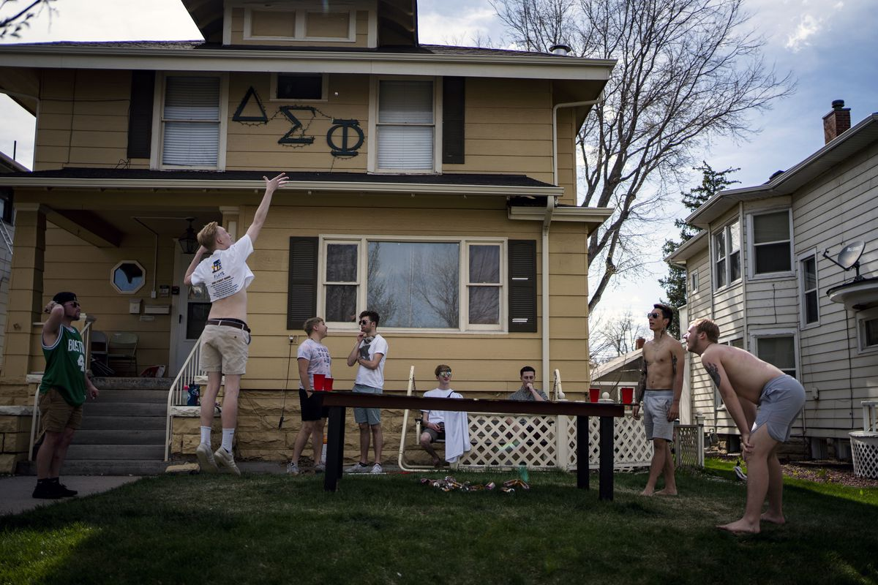
Dataset
Interactions among 58 students living in a fraternity at a West Virginia College.
DATASET
TASKS
VISUALIZATIONS
WEBSITE

Slide 6


Dataset
BEHAVIORAL
COGNITIVE
Observed interactions every 15 min, 21h/day
Self-reported interactions
Symmetric, valued matrix
Non-symmetric, valued matrix
Value represents frequency of interaction
Value represents rank from 0 to 5
Undirected, edge-weighted social network
DATASET
TASKS
VISUALIZATIONS
WEBSITE

Slide 7
Overlook
1
2
Dataset
Tasks
3
4
Visualizations
Website

Slide 8




Tasks
Identify clusters and communities
Identify the most socially connected students
Analyse degree distribution
Compare self-reported interactions to observed interactions
DATASET
TASKS
VISUALIZATIONS
WEBSITE

Slide 9
Overlook
1
2
Dataset
Tasks
3
4
Visualizations
Website

Slide 10
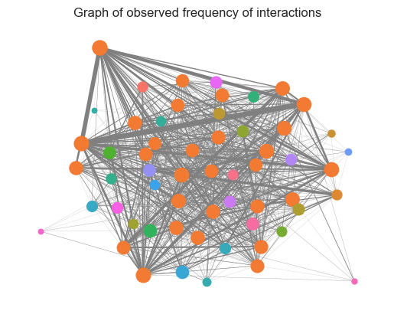
Community Visualization
Girvan Newman method;
30 communities;
Size ∝ degree centrality;
Edge-width ∝ Frequency of interaction.
DATASET
TASKS
VISUALIZATIONS
WEBSITE

Slide 11
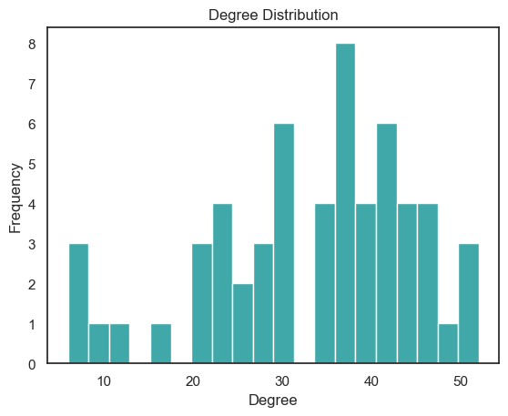
Degree Distribution
Not a power-law;
Large hub of well-connected individuals.
DATASET
TASKS
VISUALIZATIONS
WEBSITE

Slide 12
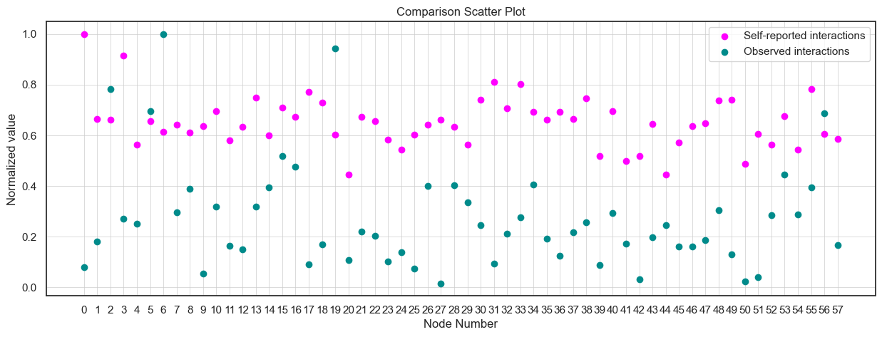
Comparison between observation and self-report
Who is wrong?
DATASET
TASKS
VISUALIZATIONS
WEBSITE

Slide 13

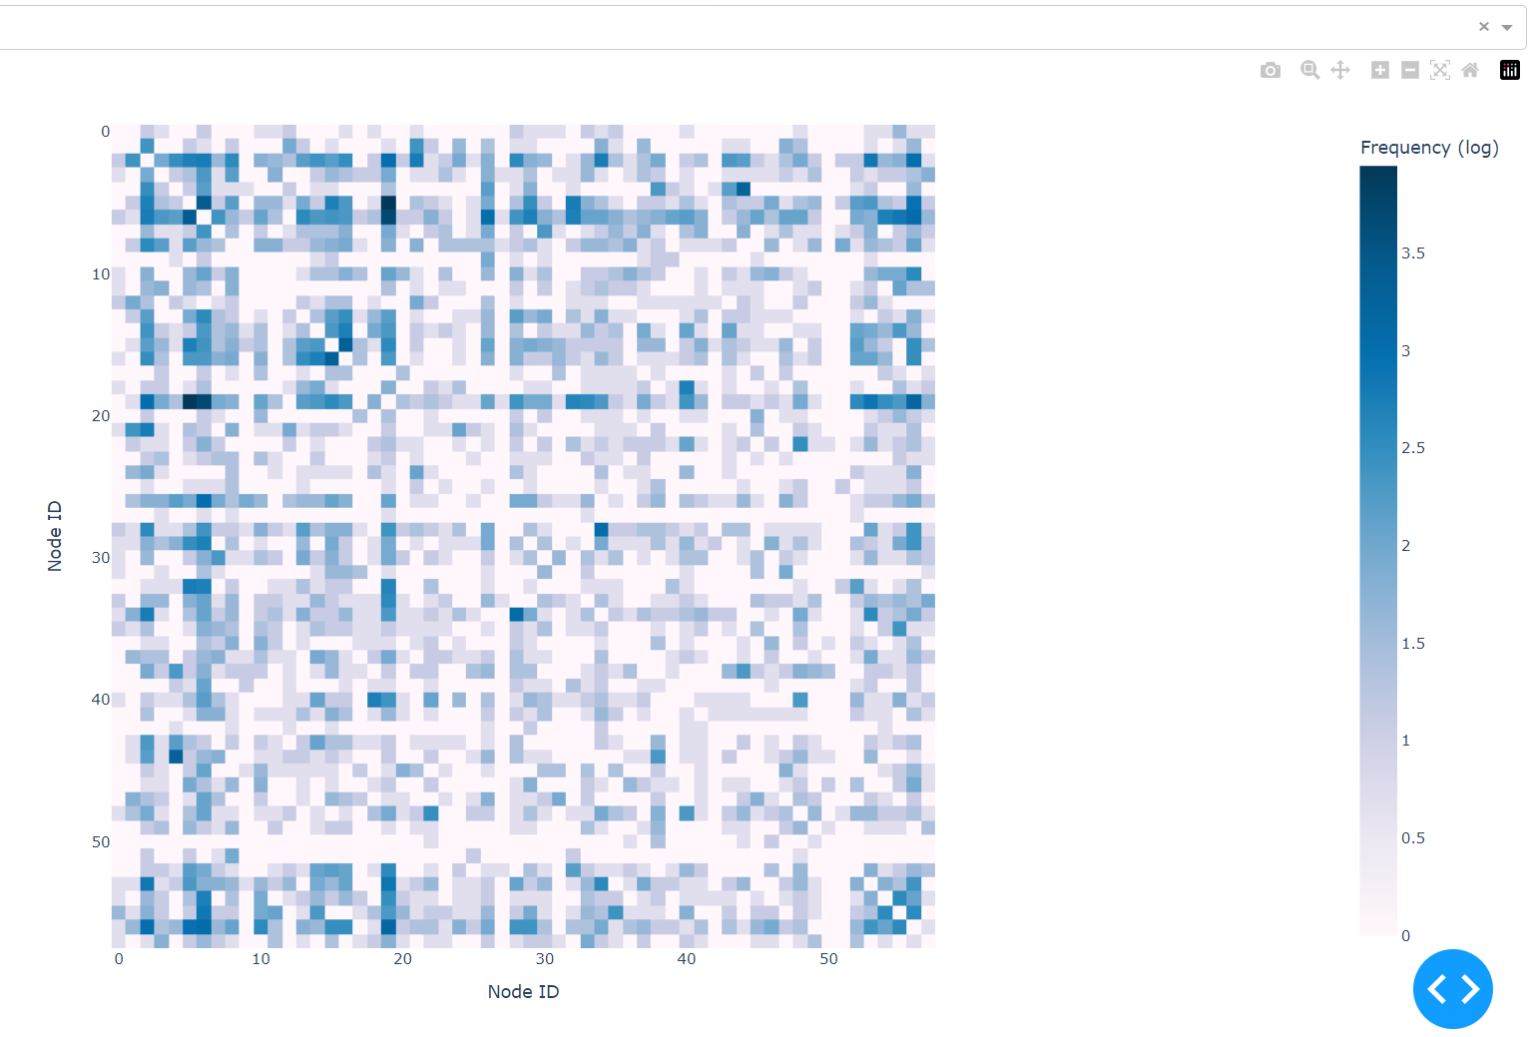
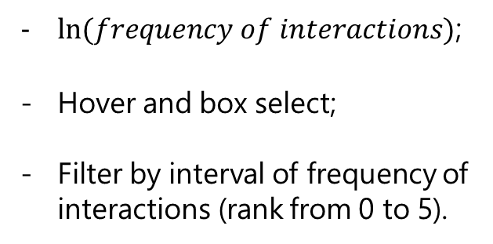
Interactive Heatmap
$ln⁡(frequency of interactions)$;
Hover and box select;
Filter by interval of frequency of interactions (rank from 0 to 5).
DATASET
TASKS
VISUALIZATIONS
WEBSITE

Slide 14
Overlook
1
2
Dataset
Tasks
3
4
Visualizations
Website

Slide 15
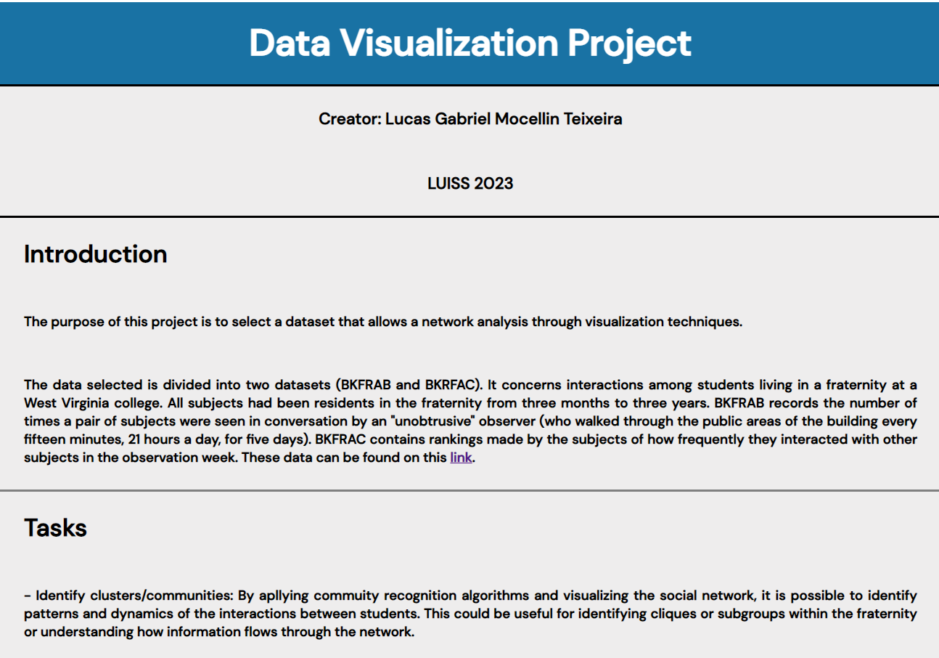
Website
HTML and CSS;
5 pages;
Github.io.
DATASET
TASKS
VISUALIZATIONS
WEBSITE

