Slide 1
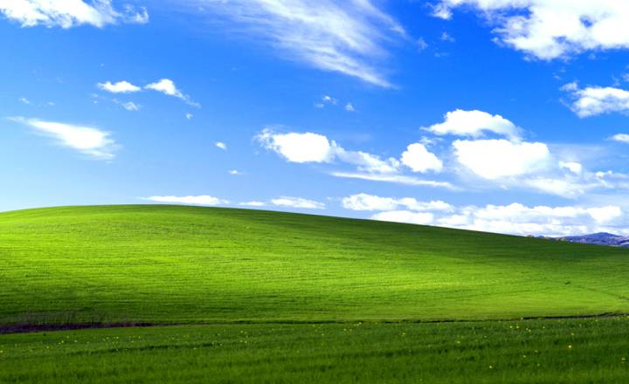
Microsoft
Name: Lucas Augusto Hartmann

Slide 2
What is Microsoft?
Microsoft is a technology company founded in 1975 by Bill Gates and Paul Allen. It is best known for creating Windows, the world's most popular computer operating system
In its early years, Microsoft focused on dominating the operating systems market, launching MS-DOS and Windows
Now the company is focusing on AI and cloud computing

Slide 3
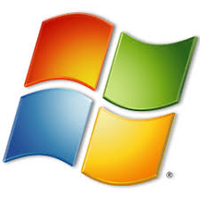
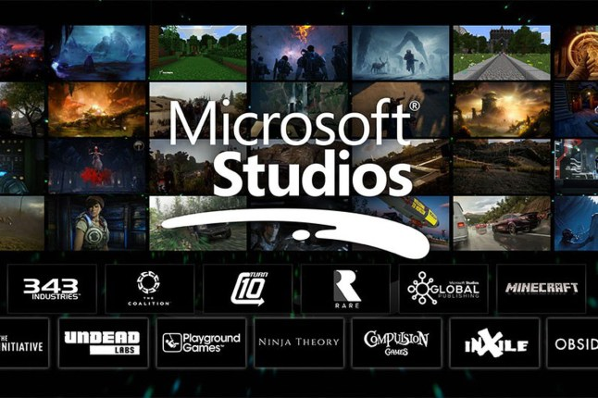

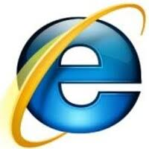
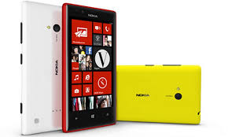
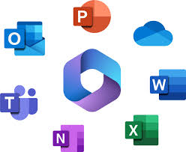
Microsoft – In the Past
1981 – MS-DOS
1985 – Windows 1.0
1982 – Microsoft Flight Simulator
1989 – Microsoft Office
1995 – Internet Explorer
2010 – Windows Phone 7

Slide 4

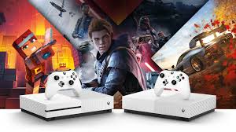
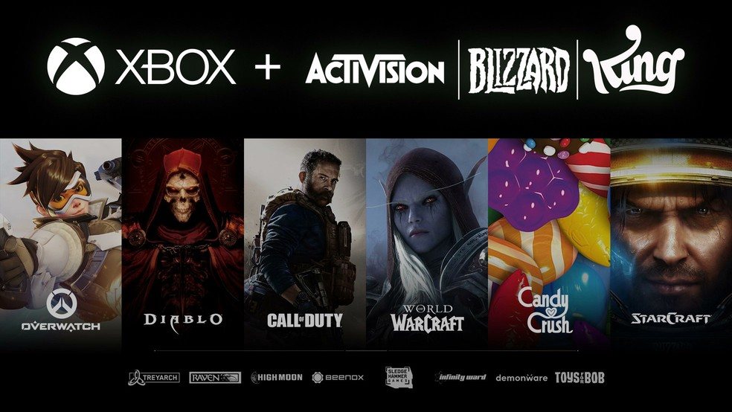
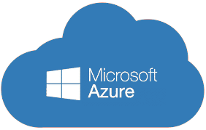



Microsoft – Present Day
2001 - Xbox
2008 - Azure
2014 - OneDrive
2016 – bought Linkedin
2018 – bought Github
2021 - Copilot

Slide 5
Microsoft and Artificial Intelligence
Microsoft began investing in artificial intelligence decades ago through Microsoft Research, founded in 1991. In the 2010s, the company expanded its focus on machine learning, speech recognition, and cloud-based AI services.
The partnership with OpenAI started in 2019 with a $1 billion investment. Microsoft Azure became the exclusive cloud provider for OpenAI.
Azure is Microsoft’s cloud computing platform. It provides infrastructure, data storage, computing power, and AI services for businesses and developers.
Microsoft Copilot is Microsoft’s AI assistant integrated into products like Windows and Microsoft 365. It uses advanced language models to help users write, analyze data, code, and automate tasks.
Microsoft’s goal is to lead the AI-powered cloud market, increase productivity through AI integration, and strengthen Azure as the core infrastructure for advanced artificial intelligence services.

Slide 6
Why Microsoft is Important
Microsoft is important because it has played a central role in shaping the modern technology industry. Its software has influenced how people work, communicate, and use computers for more than four decades.
One of the main reasons Microsoft is so significant is that Microsoft Windows is the most widely used desktop operating system in the world. Windows runs on the majority of personal computers, making it a global standard for businesses, schools, and home users.
Microsoft is also a leader in cloud computing through Microsoft Azure, which powers digital services and infrastructure for companies worldwide. In addition, its productivity tools like Microsoft 365 are essential for organizations, and its investments in artificial intelligence and gaming continue to expand its global influence.

Slide 7

Conclusion
In conclusion, Microsoft remains one of the most influential technology companies in the world. With Microsoft Windows as the most widely used desktop operating system, a strong presence in cloud computing through Azure, and growing leadership in artificial intelligence, the company continues to shape how people and businesses use technology. Its ability to adapt, innovate, and integrate new technologies into everyday tools ensures that Microsoft will remain a key player in the global digital economy.

