Slide 1
Use Case Background & Task
Methods Approached
Insight & Findings
AWS Usage (Architecture)

Slide 2
Use Case
A Dataset containing 3 months’ transactions for 100 hypothetical customers.
Gather Data Insight & Analysis
Build a Regression Model & Decision-Tree Model for a Predictive Analysis
Measure its Models’ Accuracy

Slide 3
Methods Approached
I. Data Discovery & Data Cleansing
II. Gain Data Insights
III. Correlation Heatmap
IV. Linear Regression vs Decision-Tree
(Build > Train > Test)

Slide 4
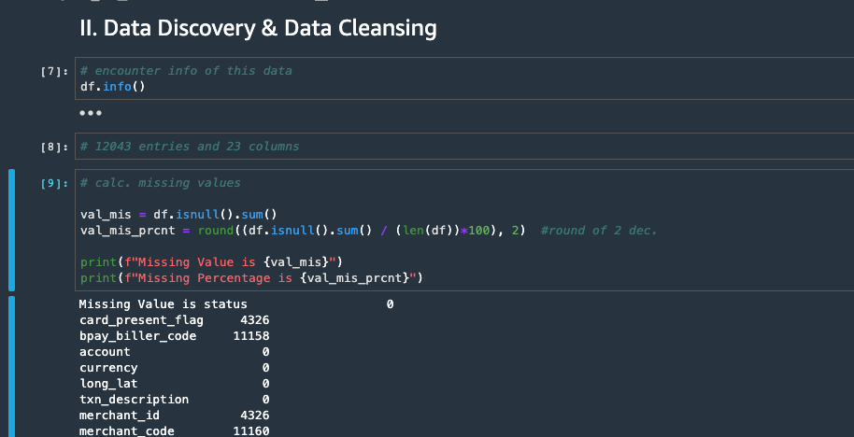
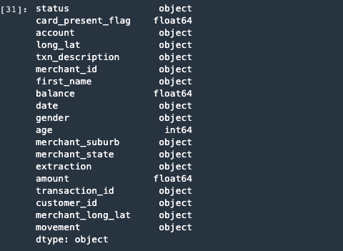
Data Discovery & Data Cleansing
Eliminate unnecessary columns
Gather Data Types
Encounter Key Columns / Metrics

Slide 5
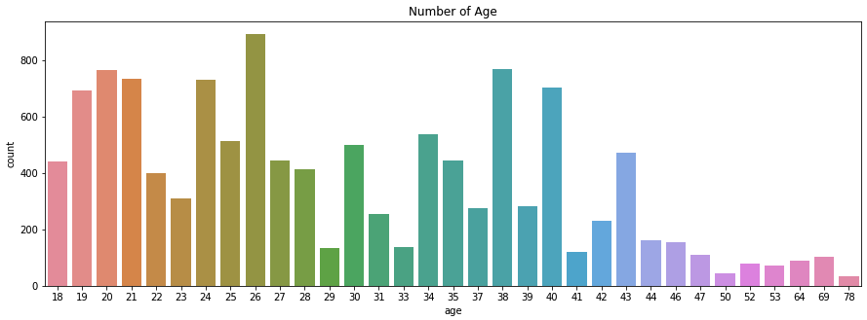
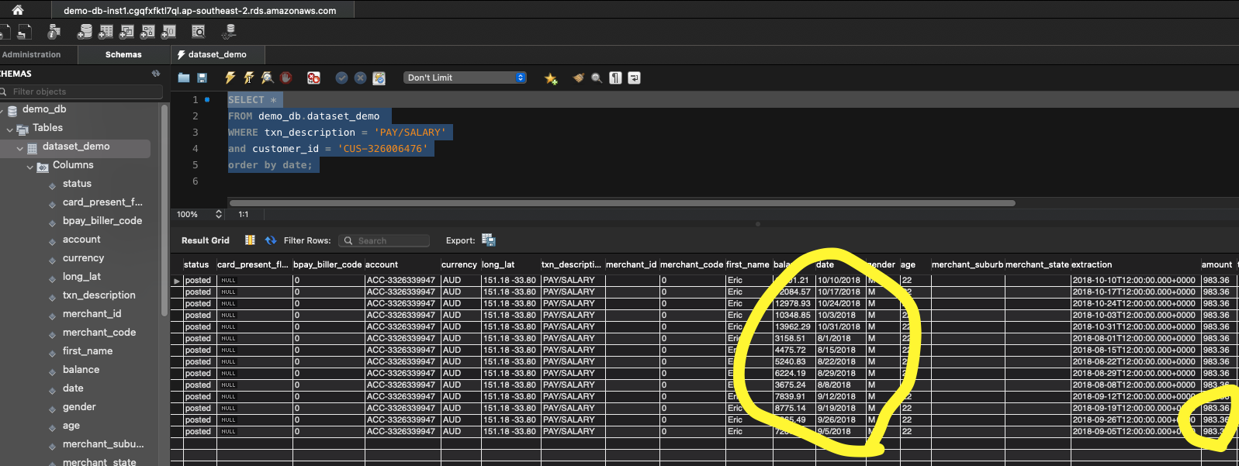
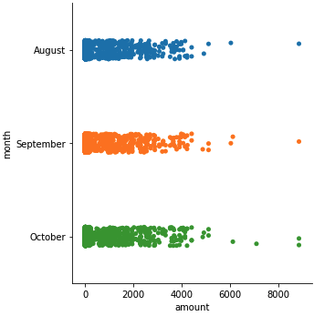
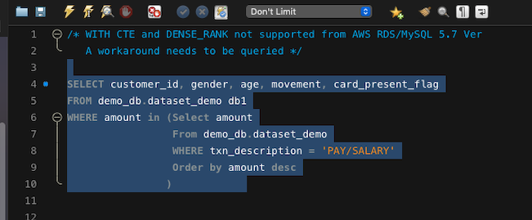
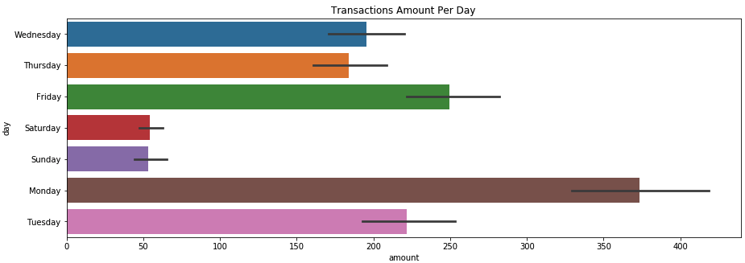
Data Insights

Slide 6
Initial Findings
All records occurred in August 2018 - October 2018
Majority of Age Population is between 20 - 40
More transactions during week > weekends
More transaction amounts during week > weekends
Male/Female ratio was similar (52% M, 48% F)
Majority Transactions from NSW, VIC, QLD
7.33% Transactions is Customers’ Salary Payment

Slide 7
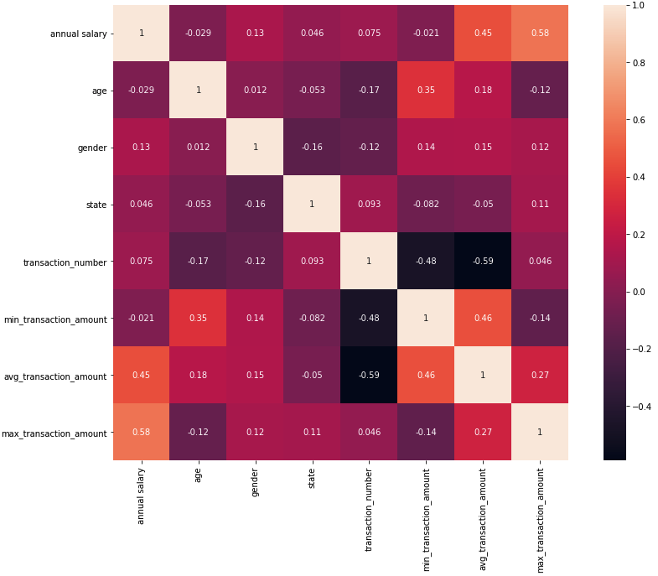
Correlation Heatmap
Correlation Between:
Annual Salary and Max. Transaction Amount
Annual Salary and Average Transaction Amount
Age and Minimum Transaction Amount
Avg. Trans. Amount & Min. Trans. Amount

Slide 8
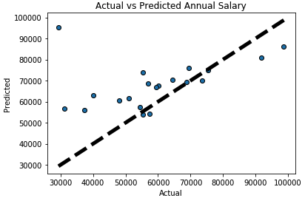
Linear Regression
X: Age, Min. Trans, Max. Trans
Y: Annual Salary
Y = mx + b
Coefficient Result for X:
108.09822091 146.37188442 11.22568182
Coefficient Determination:
0.36360553632088377
First Run
MAE: 12453.730866882699
MSE: 356618843.919129
RMSE: 18884.35447451485
The Coefficient of Determination was around 0.36 while RMSE exceeded over 2000
This concludes how Linear Regression Model is inefficient to use
Second Run
MAE: 12453.730866882699
MSE: 356618843.919129
RMSE: 18884.35447451485

Slide 9
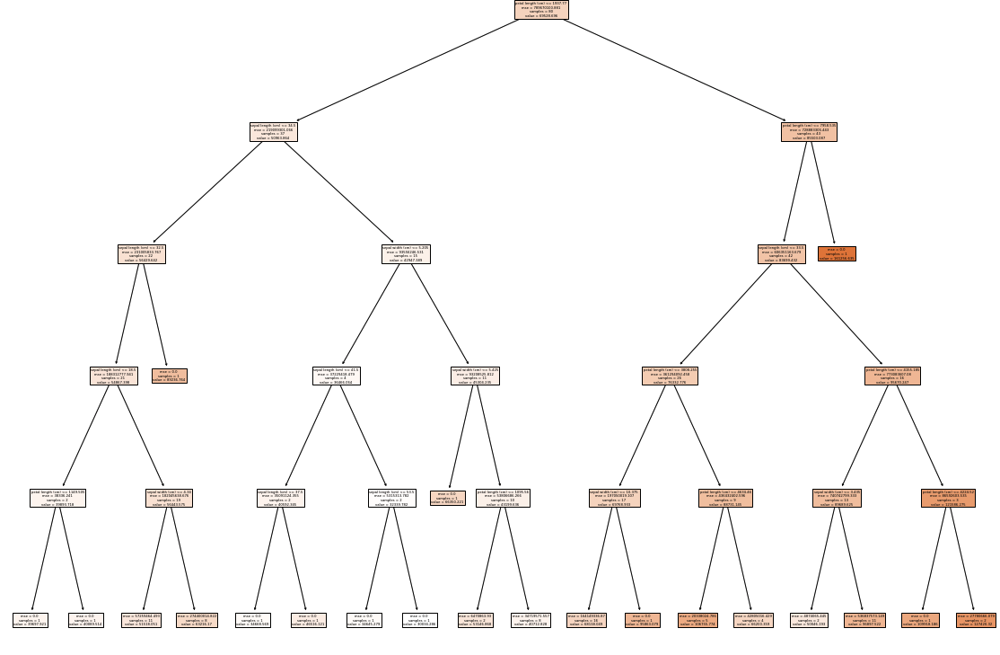
Decision-Tree
Coefficient Determination:
0.8102756001809144
Indicates the relationship with y-axis
(Annual Salary)
MAE: 16458.262715105266
MSE: 476533563.2350582
RMSE: 21829.64871991893
RMSE results is still 20000, close to the Linear Regression Model.

Slide 10
Conclusion on Predictive Analysis
Decision Tree Model and Linear Regression Models are inefficient to use.
There are 2 recommendations at this stage:
Revisit Analysis Model to tweak X-axis and Y-axis
Apply other scientific models for further analysis
** Running parallelly can be cost

Slide 11
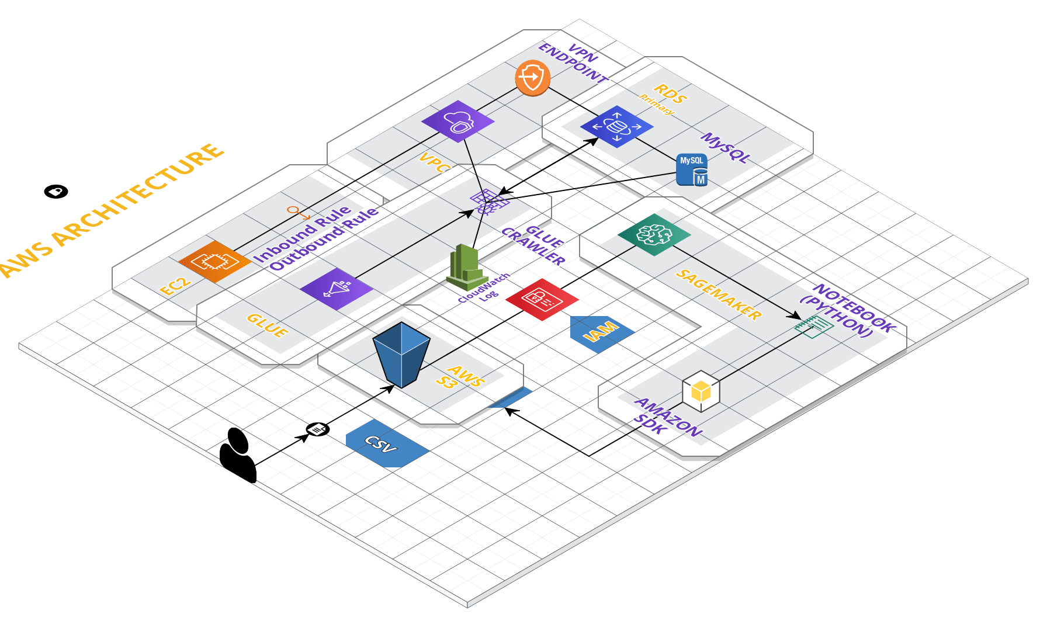
AWS Architecture

