Slide 1


[Accenture]

Slide 2


Today's agenda
Project recap
Problem
The Analytics team
Process
Insights
Summary

Slide 3

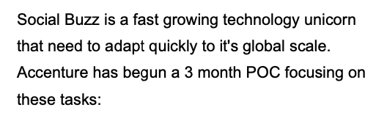
s
Project Recap
An audit of their big data practice
Recommendations for a successful IPO
An analysis of their content categories that highlights the top 5 categories with the largest aggregate popularity

Slide 4


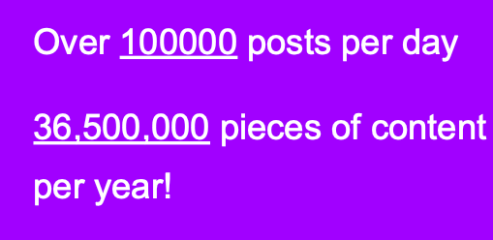
Problem
An analysis of their content categories that highlights the top 5 categories with the largest aggregate popularity

Slide 5



Andrew Fleming
(Chief Technical Architect)
The Analytics team
Marcus Rompton (Senior Principle)
Lucas Zheng
(Data Analyst)

Slide 6
Removing irrelevant columns
Process
1
Merging of three datasets
2
Removing Missing Value rows
3
Data Type Consistency
4

Slide 7

Insights
There are 16 reaction types provided by Social Buzz.
There are 16 categories provided by Social Buzz.
There are 1000 contents with 25,000 reactions in the dataset. There are many active users in the platform.

Slide 8
Reaction Type with Score
Content Categories
heart | 60
want | 70
disgust | 0
hate | 5
interested | 30
indifferent | 20
love | 65
super love | 75
cherish | 70
adore | 72
like | 50
dislike | 10
intrigued | 45
peeking | 35
scared | 15
worried | 12
Category
animals
science
healthy eating
technology
food
culture
travel
cooking
soccer
education
fitness
studying
dogs
tennis
veganism
public speaking

Slide 9
Categories with Total Score
Category | Total_score
animals | 74965
science | 71168
healthy eating | 69339
technology | 68738
food | 66676
culture | 66579
travel | 64880
cooking | 64756
soccer | 57783
education | 57436
fitness | 55323
studying | 54269
dogs | 52511
tennis | 50339
veganism | 49619
public speaking | 49264

Slide 10

Top 5 Categories with most popularity
Category
animals
science
healthy eating
technology
food
Summary

Slide 11

Thank you!
ANY QUESTIONS?

