Slide 1
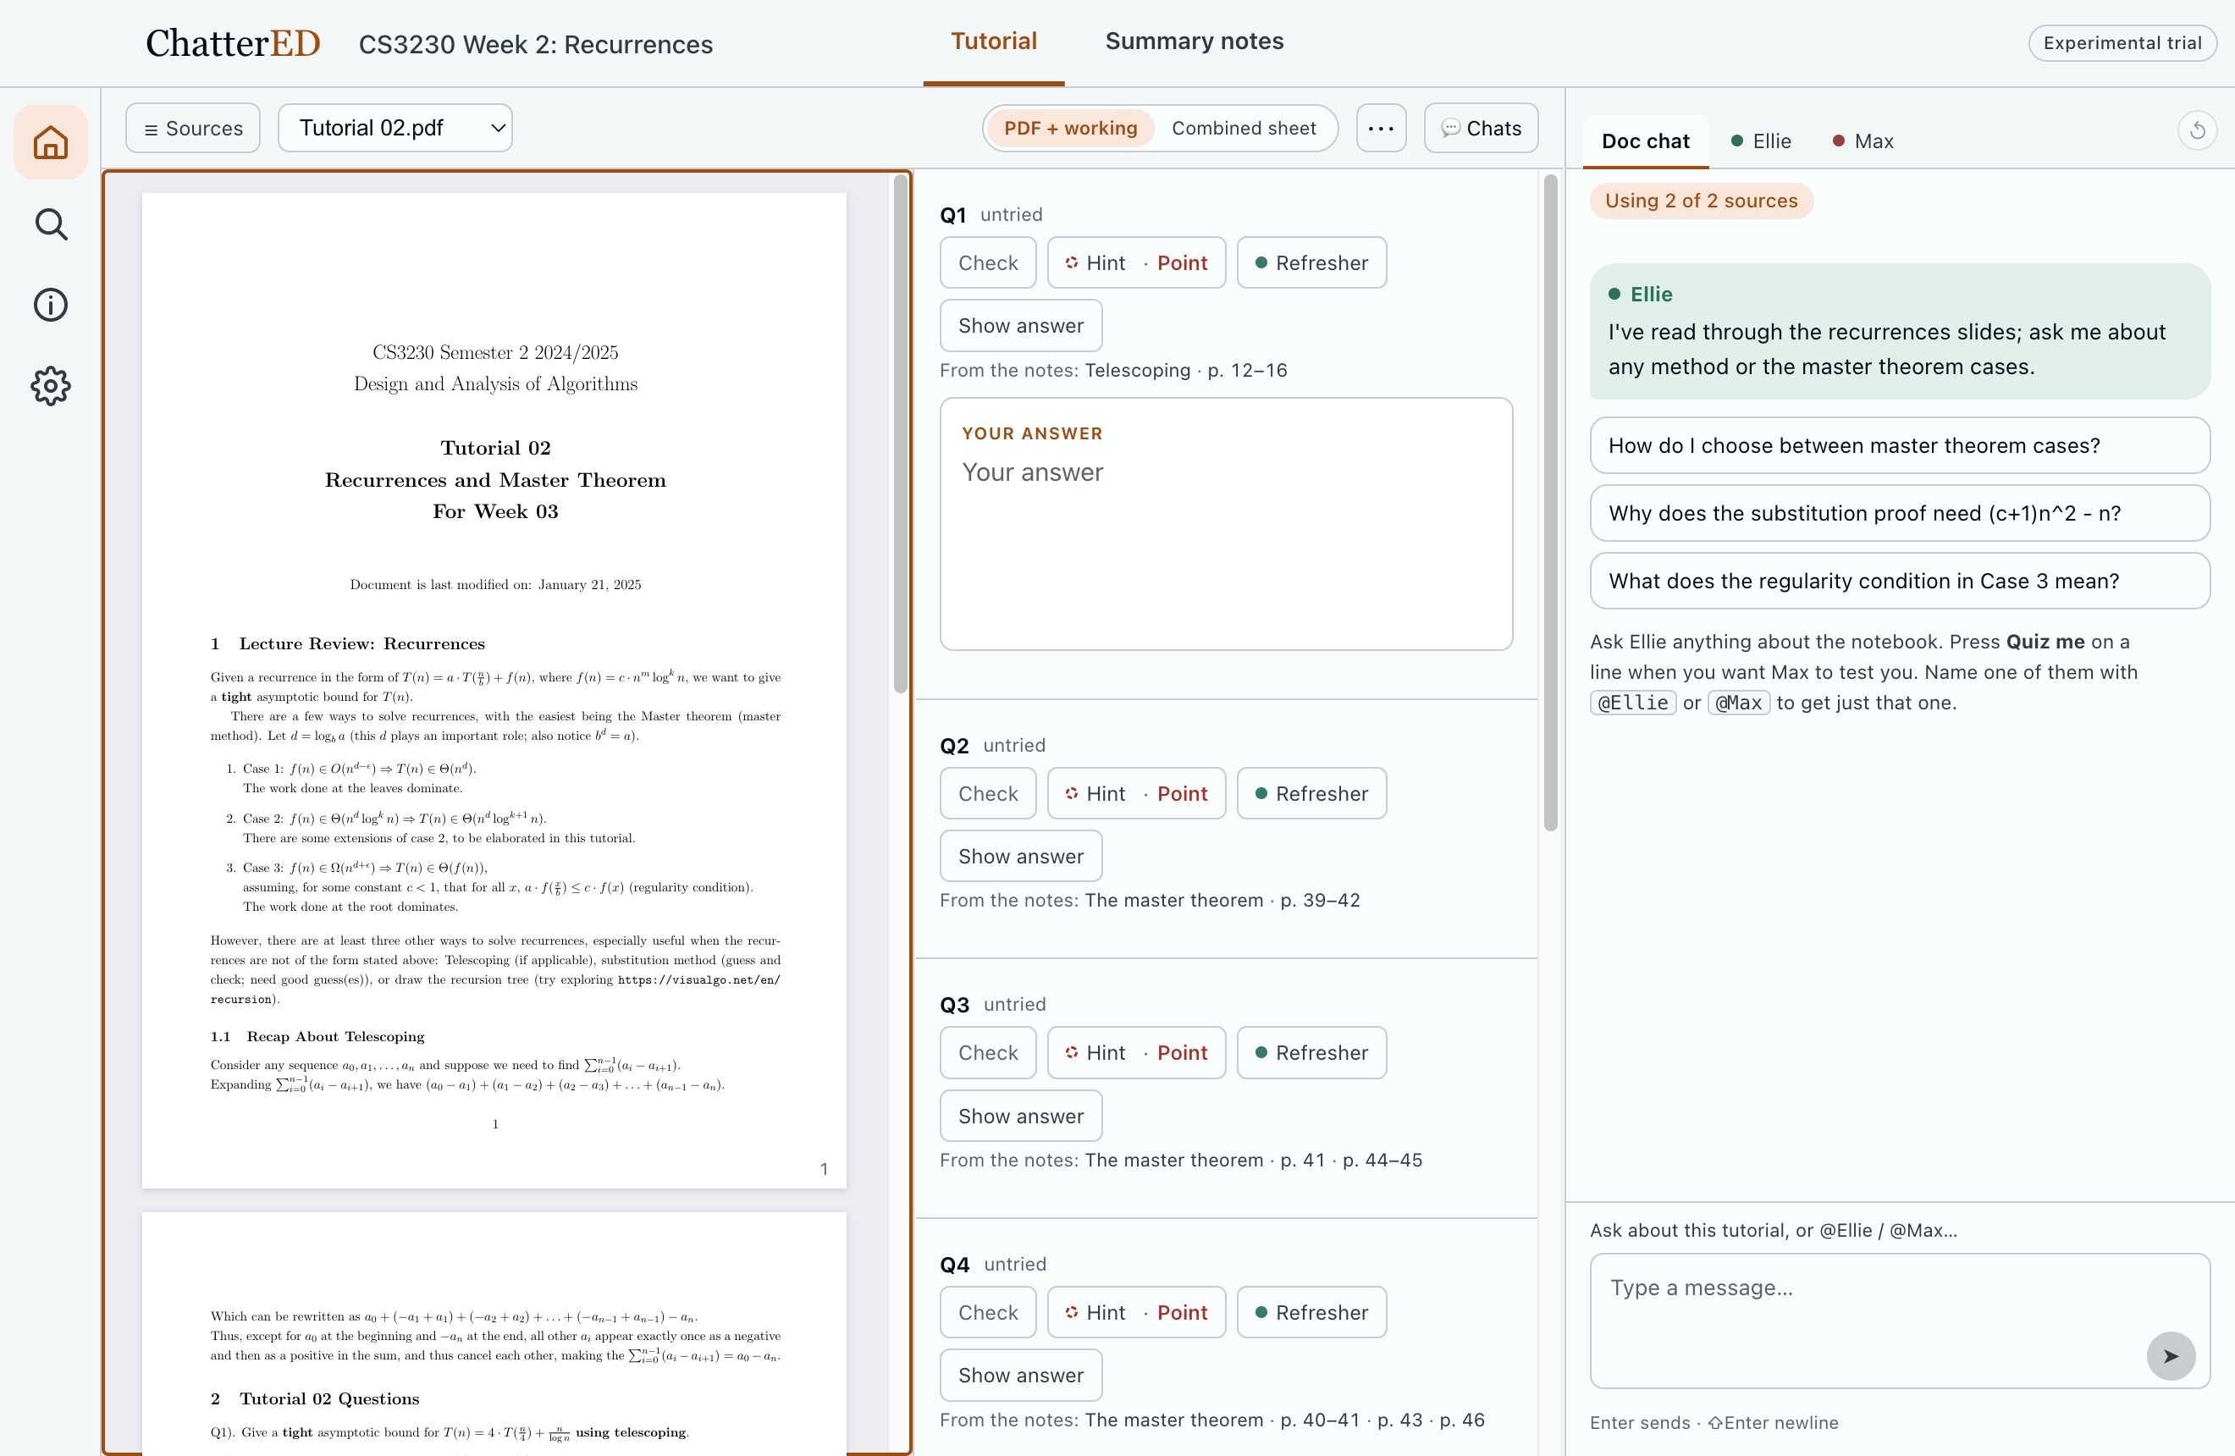
TutorED
AI study help for tutorials
Text-based
Learning
Multi-agent
Lucas Loh / Valerie Lim
CS3249 / AY2627 S1 / Final Presentation
Notes:
[LUCAS · 0:00–0:15]
Hi, we're Lucas and Valerie. TutorED is AI study help for tutorials, where the student does the reasoning and code decides the help. Today: what changed since mid-project, a live demo, and the design of our user study.
---
The app's title bar still says ChatterED; TutorED is the name we showed at mid-project (#63 is still open). Say so if it comes up during the demo.

Slide 2
Students do the work where the AI cannot see it
Where we left off
WHAT WE SAW
FIVE DESIGN GOALS, FROZEN AT MID-PROJECT
0 of 31
DG1 Learner tries first
An answer slot under every part
student messages to the AI held their own attempt (5 real chats)
DG2 Gives up → system recovers
Help one rung at a time; a separate Show answer
4 of 6
DG3 Every line traces to the slide
Parts link to notes; replies cite pages
students' accounts of their AI use did not match their logs
DG4 Short: room to think
A verdict in the sheet; detail in the thread
So: watch what they do, then ask why.
DG5 Only your own words count
A shown answer fills nothing
Joint analysis of both A1 datasets: 8 interviews, 6 real AI chats (152 turns). Evidence ids L-T1…L-T5. Details in Backup B5.
Notes:
[LUCAS · 0:15–1:15]
A one-minute reminder. We interviewed eight students and read six real AI study chats. Students do try first, but zero of 31 chat messages held their own attempt. The AI answers the question as worded, and the student then spends their effort steering it.
From that came five design goals, frozen at mid-project. They have not changed. Everything since has been about making them hold up in real use, and about how we will test that.
---
0 of 31 = learner turns in L-T1…L-T5. 4 of 6 = accounts that did not match the log (joint-analysis.md). "No visible attempt" is not "no attempt": some of it happened off-chat, which is the point.

Slide 3
What changed since mid-project, and why
Design iteration
 | At mid-project | Now | Why
Home | Notes first; the tutorial behind a switch | Opens on the tutorial. Tutorial and Summary notes are the two modes | The attempt is only visible in a tutorial, so that is where DG1 can hold
The sheet | An AI-copied sheet only | Your original PDF beside your working; the copied sheet is optional | Copying can lose figures and question text
Feedback | The model judged everything | Where a solutions file or a formal check exists, code holds the grade | In testing, Max contradicted a key the app had already read correctly (#69)
Max | Could end in a riddle | Plain feedback from a hidden model answer; closes after three tries | Every reply pointed to a page; both test quizzes ended in an angry give-up (our own use)
Reach | A developer install on our Macs | A per-participant copy with its own key, a credit cap and a first-run path | Real students, real use. Team pilot on the real API: about $0.03–0.04 per question
Study | Lab session against usual AI chat | One week of real use, then interviews matched to the logs | Prof relaxed the requirement; a real week tests the goals where the problem occurs
Frozen and unchanged: DG1–DG5, the three group features (answer slot, help ladder, lecture links). Tests: 3,182 on 5 Oct → 3,620 on 1 Nov.
Notes:
[LUCAS · 1:15–3:00]
The goals stayed; five things around them changed.
One, the tutorial stopped being a switch you could find. It is now where the app opens, because that is the only place a student's attempt is visible.
Two, the study build: friends cannot run a developer install, so each participant gets their own copy with a credit limit, which we piloted on the real API.
Three, Max stopped asking riddles. He runs each question by a hidden model answer and closes after three tries.
Valerie will show the other two, the PDF view and the answer checks, and then the demo.
Finally, the study itself changed, and I'll come back to that.
---
Test count: 3,182 on 5 Oct; 3,620 on 1 Nov (npm test on 8198994). The riddle change came from our own testing, not from participants: say so if asked.

Slide 4
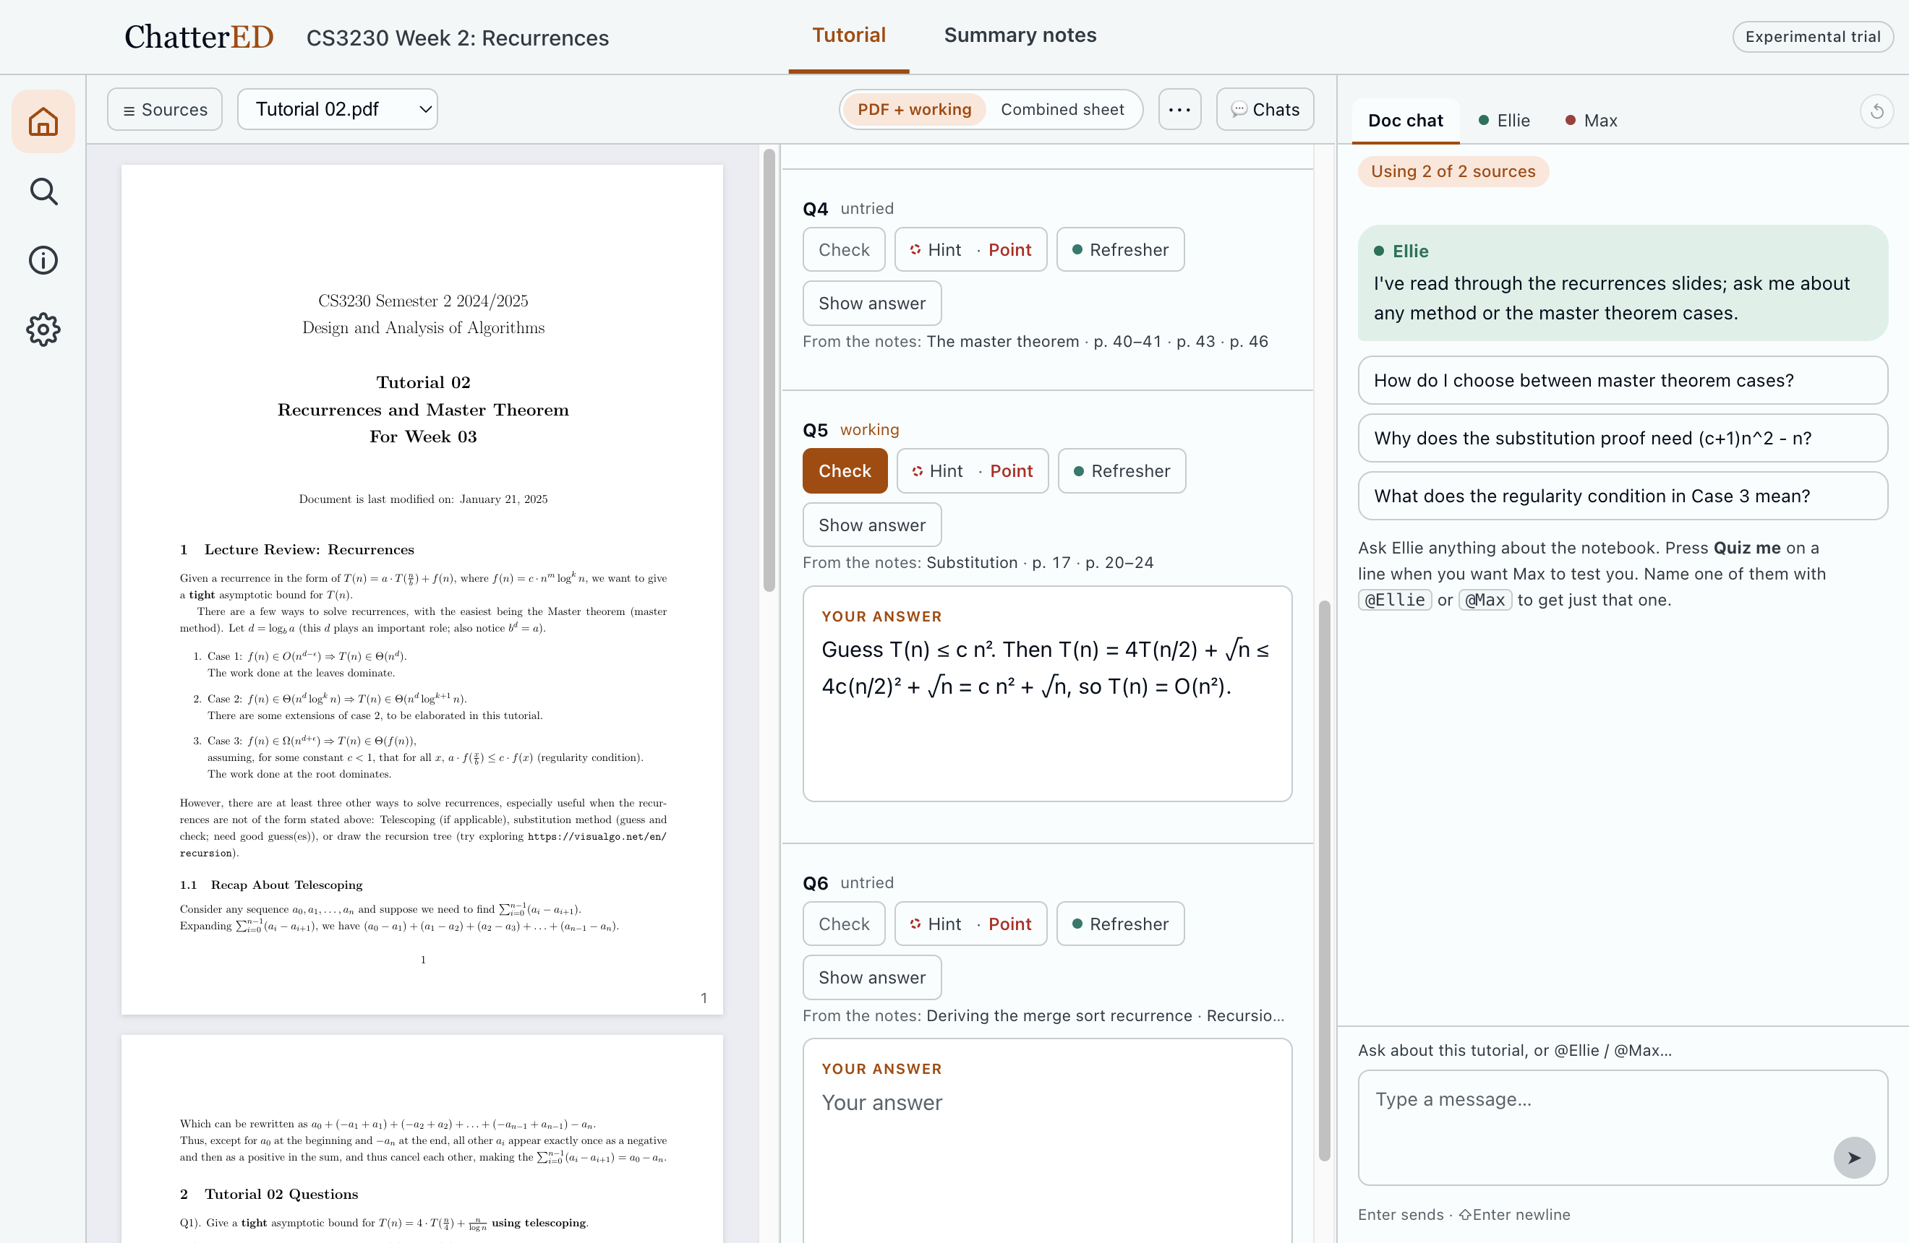
The student works beside their own sheet, not a copy of it
Design iteration · the workspace
1
The original PDF
1
Rendered as published: figures and numbering intact.
2
One slot per part
3
The attempt goes with every request for help (DG1).
2
3
Help sits on the part
Check · Hint · Refresher · Show answer. One rung at a time (DG2).
Added since mid-project. Same part ids, slots and threads as the copied sheet: only the view changed.
Notes:
[VALERIE · 3:00–3:45]
This is the workspace now. On the left is the tutorial exactly as it was published. We added this because copying a sheet with a model can lose figures and numbering, and a student should not have to wonder whether the question is the right one.
In the middle, one answer slot per part: the attempt goes here, and it travels with every request for help. On the right, the chat.
Check, Hint, Refresher and Show answer sit on the part, so asking for help happens next to the work. If a student wants the copied sheet with the notes links inline, it is one click away.
---
Honest limit: in this view, multiple-choice options do not appear yet (CSS in the working pane). Demo those in Combined sheet. Fix before the study.

Slide 5
Where a key exists, code holds the grade
Design iteration · answer checks
WHO SETS THE GRADE, IN ORDER
Formal check
A code simulation where the answer is formal
Grade + option labels
Max explains
Written by code, shown first. One answer list decides both.
The model writes the words, given that list. Direct contradictions are removed.
Verified key
A solutions PDF, tied to a page. Image-only keys need two agreeing reads
Hidden model answer
Otherwise: the model's worked answer. Provenance is shown
WHAT TRIGGERED IT
WHAT WE DO NOT CLAIM
Key A, D, G. Picked A, D, E, F, G. The count was right, but Max called E and F right and G wrong.
No accuracy claim. A proof is still the model's judgement, and a wrong PDF key on a non-formal question can still mislead. Open in #69.
Regression tests: 175 in npm run test:tutorial. app/docs/TUTORIAL-ANSWER-TESTING.md.
Notes:
[VALERIE · 3:45–4:30]
This one came from testing. On a multiple-select question the uploaded solutions said A, D and G. The app counted correctly, but Max generated his own explanation and told the student something else: E and F right, G wrong. Two voices, one wrong.
So the grade now comes from one place. A formal checker first, then a key verified against a page of the solutions PDF, and only then the model. Max is handed the same answer list that set the grade, and direct contradictions of it are filtered out.
This is not a claim that the app is always right. A proof is still the model's judgement, and the app says so. It fits DG3: the student can see where a verdict came from.
---
"Correctness is not an HCI claim" (group-project.md §6) still holds: no accuracy claim. What is new is consistency: one source of truth per grade, and visible provenance. Still open in #69: semantic contradictions that name no option; a wrong but readable PDF key on a non-formal question.

Slide 6
Live demo: one proof, from a wrong attempt to a right one
System demonstration · live
1
DG1
2
DG4
3
DG3
Attempt in the slot
Check
Open the page on the part
Q5, the classic wrong proof
"Not yet" at the part, detail in the thread
p. 24, the slide Max pointed at
4
DG2
5
DG5
6
DG2
Hint on Q1
Revise Q5, Check
Show answer on Q1
Point, then Break it down
Correct, in my own words
Confirmed; counts for nothing
Then: a multiple-choice part, marked by code. Backup if anything fails: recording on slide B1.
Content: CS3230 Lecture 2 and Tutorial 02, used as sample course material. Replies are real, from Claude through the app. The app's title bar reads ChatterED.
Notes:
[VALERIE · 4:30–8:00, LIVE]
Switch to the app. It is already open on the prepared workspace; do not read a sheet in live (it takes about 2 minutes).
1. "This is a real CS3230 tutorial." Q5, substitution method.
2. Type the classic wrong proof (it is in the run sheet) in the slot. "I try first. There is nothing to ask until I do."
3. Press Check. "Max says Not yet in one line at the part, and in the thread he points to page 24, A common mistake, without giving me the fix."
4. On the Q5 part, press the p. 20–24 link, then Next four times to p. 24. "Here is the slide it came from." Close it.
5. On Q1, press Hint. "One rung: where to look. Press it again and the same part breaks into smaller questions."
6. Back on Q5, revise with the stronger hypothesis. Check. "My own words, correct. That is what counts."
7. On Q1, press Show answer and confirm. "I gave up, so I get the answer. It does not count."
8. Combined sheet, Q2, tick option 3, Check. "Here code marks it, and Max is told the result."
9. Summary notes: "Two of six, not three. The one I gave up on does not count."
If the network or the model fails: go to Backup B1, the recording, and narrate it.
---
AVOID on stage: the "Substitution" notes link on the part and the page links inside Max's reply. Both open the notes at the wrong section (seen 1 Nov). The p. 17 and p. 20–24 links on the part open the right slide. Multiple-choice options only show in Combined sheet. The √ sign is blank in chat replies (it renders in the sheet); if asked, it is a known rendering bug. Build the workspace on a fresh profile the night before: lecture first, open it, wait for the overview, then add the tutorial. Adding both together leaves the parts with no notes links. Replies took 10–25 s in rehearsal: "Max is reading; the wait is real."

Slide 7
From a lab hour to a real week
User study · why this design
PLANNED AT MID-PROJECT
THE DESIGN NOW
Lab comparison
A week of real use
Two set proofs, 18 minutes each
Usual AI chat vs our app, within subjects
Good for: a comparison on one task
Blind to: whether anyone would open it unprompted
Their own tutorials, at their own pace
App logs show what they did
Interviews ask what they think, and why
Then we match the two, person by person
Kept from the lab: one first task, watched on Day 0
The trade-off: no comparison group, so a pattern with explanations, not an effect. We will not claim the app caused a change, or that anyone learned more.
Notes:
[LUCAS · 8:00–8:45]
I'll take the user study. The prof has let us present the design at this milestone, and we have not run it yet. So everything from here is a plan, with its rules fixed before any data.
At mid-project we planned a lab comparison: two set proofs, one in the student's usual AI chat and one in our app. That shows whether behaviour differs on one task. It cannot show whether anyone would open the app on their own, and our finding is about real study. So we test it there: a week on their own tutorials.
We keep one thing from the lab. On Day 0 we watch one first task: that is our usability check. The price is no comparison group, so we report a pattern with explanations, not an effect.
---
The lab design stays on record in docs/group/user-study.md. If asked: the relaxation covers this presentation; the report still asks for at least 6 participants, and we plan to run it.

Slide 8
The log comes first, and it decides what we ask
User study · method
RQ1
Uptake
RQ2
Behaviour
RQ3
Said vs did
Over a week of their own coursework, do students come back to tutorial mode, and for what?
How do they get into and through a part: attempt, help, revision, source?
What do they say about it, and where does their account differ from their log?
EXPLANATORY SEQUENTIAL MIXED METHODS: QUAN → QUAL
A week of use
App logs: quantitative strand
Log digest
Per person: picks 3–4 moments
Interview
Opinion, then those moments
Joint display
Numbers beside account
Join 1, building: the log chooses what the interview asks.
Join 2, interpreting: each measure beside the person's account.
Why both: 4 of 6 accounts did not match the logs, and a number can move for the wrong reason.
Fetters, Curry & Creswell (2013). Achieving integration in mixed methods designs. Health Services Research 48(6pt2), 2134–2156.
Notes:
[LUCAS · 8:45–9:35]
Three questions. Do students come back, and for what? How do they get into and through a part: is the attempt there when they ask for help, how high do they climb the ladder, do they open the lecture? And what do they say about it, and where does that differ from what they did?
The method is explanatory sequential mixed methods: the log first, then the interview, joined at two points. The log picks the moments we ask about, and at the end a joint display puts each person's numbers beside their account.
Why both? In our A1 data, four of six students' accounts did not match their logs. And a number alone can move for the wrong reason: an attempt written only because the slot nags.
---
Fetters, Curry & Creswell (2013). Not convergent, because the interview depends on the log. Not exploratory: that phase was A1 and the joint analysis.

Slide 9
Six students, one week, one interview each
User study · participants and procedure
WHO (TARGET 6)
Day 0
30 min
Consent, background form, install. Then one part of their own sheet, thinking aloud: we watch, we do not help
NUS undergraduates
A tutorial sheet in the study week
Already use AI for coursework
Apple Silicon Mac, macOS 13+
Not on the team; have not seen the demo
Days 1–7
their choice
Own tutorials. No minimum, no reminders. Day 3: technical check only
Day 7
5 min
They export their data and email the zip. A two-item usability form (UMUX-Lite)
WHY SIX IS ENOUGH HERE
Days 8–9
30 min, us
Log digest; pick 3–4 moments
Information power: narrow aim, specific people, interviews anchored in their own log. It cannot show that themes are complete.
Days 8–10
30 min
Interview
Malterud, Siersma & Guassora (2016). Sample size in qualitative interview studies: guided by information power. Qualitative Health Research 26(13), 1753–1760.
Notes:
[LUCAS · 9:35–10:30]
Six NUS undergraduates: a tutorial that week, already using AI for coursework, an Apple Silicon Mac, and not on the team.
Day 0 is thirty minutes: consent, a background form, install. Then they work one part of their own sheet, thinking aloud, and we watch without helping. That is the usability check: can a first-time user write an attempt, take a hint, open the lecture and act on a Check, unaided?
Then seven days on their own, with no minimum and no reminders. On Day 7 they export their data and fill in a two-item usability form. We read the log, pick three or four moments, and interview them.
Six rests on information power, not saturation: a narrow aim and interviews anchored in each person's own log.
---
Day 0 task: a 10-minute cap. Reading in a sheet takes 1–2.5 min, so start it first. We step in only after a minute stuck, and count it. SEQ after the task (Sauro & Dumas 2009); UMUX-Lite on Day 7 (Lewis, Utesch & Maher 2013). Four copies built, two more needed; $50 of credit each. Malterud, Siersma & Guassora (2016).

Slide 10
Each design goal: what the log shows, what we ask
User study · measures
Goal | Observed in the log | Asked in the interview | Logged today?
Usability, first use | Day 0 task: core steps done unaided, assists, ease (SEQ). Day 7: UMUX-Lite | Where did you get stuck the first time? | Watched
Uptake | Sessions, days active, sheets, parts touched | Why did you come back, or stop? What else did you use? | Yes
DG1 tries first | Help requests with an attempt in the slot; time to first attempt | Did the slot help you start, or feel like a demand? | To add
DG2 recovers | Highest rung per part; Show answer rate; retries after Not yet | What had happened just before you pressed Show answer? | Yes
DG3 traces | Lecture links opened; pages cited in replies | Did you check what it told you? What made you check? | Links to add
DG4 short | Words per reply; steering messages, hand-coded | Was anything too long or too thin? | Yes
DG5 own words | Parts correct in their own words vs revealed | Did the progress mean anything to you? | Yes
Audited against the code: five small logging additions go in before the build goes out, and none changes what students see.
A1 numbers (0 of 31; 4 of 6) are context, not a baseline to beat. Audit detail on Backup B2.
Notes:
[LUCAS · 10:30–11:30]
Each row is one thing we measure: what we see, and what we ask. The first row is usability, from Day 0 and the form. The rest follow the design goals. Take DG2: the log gives the highest hint per part and the Show answer rate, and in the interview we ask what happened just before they pressed Show answer.
The last column is honest. We audited the logging against the code. Help, checks, reveals, replies and progress are recorded today. Whether the slot had text at a help request, when the first text was written, and which lecture links were opened are not, so those go in before the build goes out. None of them changes what the student sees.
The A1 numbers are context, not a baseline to beat.
---
If asked: usability is whether they can use it; usefulness is whether they choose to, and why. Uptake and the interview answer that. Audited on 8198994, 1 Nov. We log sizes and flags only, never the text. Full list on B2.

Slide 11
Opinion first, then their own log
User study · interview
8 min
Opinion
THE OUTPUT: A JOINT DISPLAY PER PERSON
How did you use it? What else did you use? Which would you open next week?
ILLUSTRATIVE ROW, NOT DATA
What they said | "I always try before asking."
What the log shows | Help requests with an empty slot: 4 of 9
The moment we asked about | Q3, Hint pressed 20 s after opening
Agree? | No
Their explanation | "I only wanted to know which method it was."
What it means for DG1 | Some help before an attempt is orientation, not avoidance
4 min
Their account
Do you write before asking for help? How often did you ask for the answer?
14 min
Cued moments
First attempt, highest hint, a Show answer, a stop: what were you thinking here?
4 min
Said vs did
Here is your week. Does this match how it felt?
Thematic analysis (Braun & Clarke, 2006): DG1–DG5 as starting codes, plus open codes. Two coders, working separately.
Notes:
[LUCAS · 11:30–12:25]
The interview runs in a fixed order. Opinion first, before they see anything, so the log does not prime them. Then their habits, in their own words. Only then do we show moments from their log and ask what they were thinking. Last, we show the summary of their week and ask whether we have misread it.
On the right is the output: one joint display per person. This row is made up; no one has done this yet. A student says they always try first. The log shows four of nine help requests with an empty slot. The moment we asked about explains why. That last column is what neither source gives alone.
---
The row is illustrative and labelled so on the slide. Never present it as a finding. Full guide on B3.

Slide 12
What each result would make us change
User study · analysis and what we would change
ANALYSIS
If we see | We would change
Two or more stuck at one step on Day 0 | Fix that step first, before reading the logs as behaviour
Few return after Day 2 | Start-up cost, before anything else
Help asked with empty slots | Whether Hint should need a line of attempt first
Show answer right after rung 1 | The ladder is friction: shorten it, or strengthen rung 1
Long replies, then no next action | DG4's sizing for that kind of task
Links never opened, and "I trust it" | DG3 is checkable but not checked: bring the source into the reply
High attempt-first, but "it nags me" | The number moved for the wrong reason: a behaviour they would not keep
Logs
A timeline per person. Counts and medians, side by side. No significance tests.
Interviews
Thematic analysis from DG1–DG5, plus open codes. Lucas and Valerie code separately; disagreements stay visible.
Together
A joint display per person; a said-vs-did matrix across all.
Usability
Day 0 problems ranked by severity, with how many hit each; UMUX-Lite per person.
Rules fixed before any data is collected. Braun & Clarke (2006). Using thematic analysis in psychology. Qualitative Research in Psychology 3(2), 77–101.
Notes:
[LUCAS · 12:25–13:25]
Analysis. Logs become a timeline per person: counts and medians side by side, no significance tests at six. Interviews are de-identified, then coded thematically from the five goals plus open codes. Valerie and I code separately and keep disagreements visible. Day 0 problems are ranked by severity.
The rubric asks what we would change. We have not run it, so we fix the rules now, before any data. If two people get stuck at the same step on Day 0, we fix that step first. If few come back after Day 2, it is start-up cost. Show answer right after the first hint means the ladder is friction. Links never opened, with "I trust it", means DG3 is checkable but not checked. And attempt-first with "it nags me" means the number moved for the wrong reason.
---
Braun & Clarke (2006). Severity on Nielsen's 0–4 scale. Fixing the rules beforehand keeps us honest.

Slide 13
What it cannot show, and how we protect participants
User study · limits and ethics
WHAT IT CANNOT SHOW
HOW PARTICIPANTS ARE PROTECTED
No causal claim
They hand over the data
No comparison group
Local storage, no server. They export by hand, after consent
No learning claim
Anonymised
No test before or after
A random id; no student ids, emails or PDFs
Friendly participants
Disclosed
From our networks. We ask for faults; the log checks
What they send goes to the AI provider; the notice says so
Being observed
Their choice
They know they are logged, and Day 0 is watched
Any folder can be excluded. Audio takes separate consent
Mixed content
Over-reliance
Their own sheets, so parts are not compared across people
A shown answer never counts, and we report how often it is used
Notes:
[LUCAS · 13:25–14:15]
What it cannot show. No control group, so no causal claim. No test, so no learning claim. Participants come from our networks and may be kind, so we ask for faults directly and let the log check them. They know they are logged, and Day 0 is watched. Each brings different sheets, so we do not compare parts across people.
How they are protected. Nothing leaves the Mac on its own: they export the file by hand, it is anonymised, and their PDFs are never included. What they type goes to the model provider, and the notice says so. Any folder can be excluded, and audio needs separate consent. Over-reliance is part of the question: a shown answer never counts, and we report how often it is used.
Valerie will take us through the plan.
---
Compliance and ethics are handled by Lucas with the prof and TAs. The export uses a random P- id and drops student ids and emails. Notice: app/src/shared/trial.ts. The local cost cap is not secure against deleting app data; keys are revoked when the study ends.

Slide 14
From this presentation to 23 November
Project plan
This week
2–6 Nov
Start by 9 Nov
Week 13
By 16 Nov
17–20 Nov
23 Nov
due
Final presentation
Add logging; fix the PDF view
Rebuild copies; 10-min pilot
Day 0 for six participants
A week of use
Tutorials still running
Exports in
Digests built
Interviews done
Two coders
Joint displays
Said-vs-did matrix
Final report
Functional system
WHO DOES WHAT
THE REAL CONSTRAINT
Lucas: logging, the study build, participants.
Valerie: workspace fixes, answer checks.
Both: interviews and coding.
Tutorials end in Week 13. After about 9 Nov, students would be working past sheets for exams, which is a different task.
Notes:
[VALERIE · 14:15–14:50]
This is what stands between the design and the data. Before the build goes out: the logging additions, the fixes we found while preparing today, and a rebuild.
The real constraint is the calendar. Tutorials end in Week 13. If the week of use slips past about the ninth, students will be working past sheets for exams, which is a different task. So we start this week.
The report on 23 November carries the participants, the findings and the implications.
---
We were told the relaxation covers this presentation. The report still asks for at least 6 participants; confirm with the prof. Week dates are from the mid-project timeline.

Slide 15

TutorED
The learner reasons first; code decides the help.
Next: a real week, then ask why.
Questions?
Lucas Loh / Valerie Lim
B1 Recording
B2 Log audit
B3 Interview guide
B4 Pilot
B5 Evidence
B6 Architecture
B7 References
Notes:
[BOTH · 14:50–15:00]
So that is TutorED: the learner reasons first, code decides the help. Next, a real week, and then we ask why. Thank you. We're happy to take questions.
---
Q&A prep is in the presenter pack PDF. Lucas: study method, n = 6, no control, ethics, logging. Valerie: PDF view, answer checks, what would change, the demo.

Slide 16
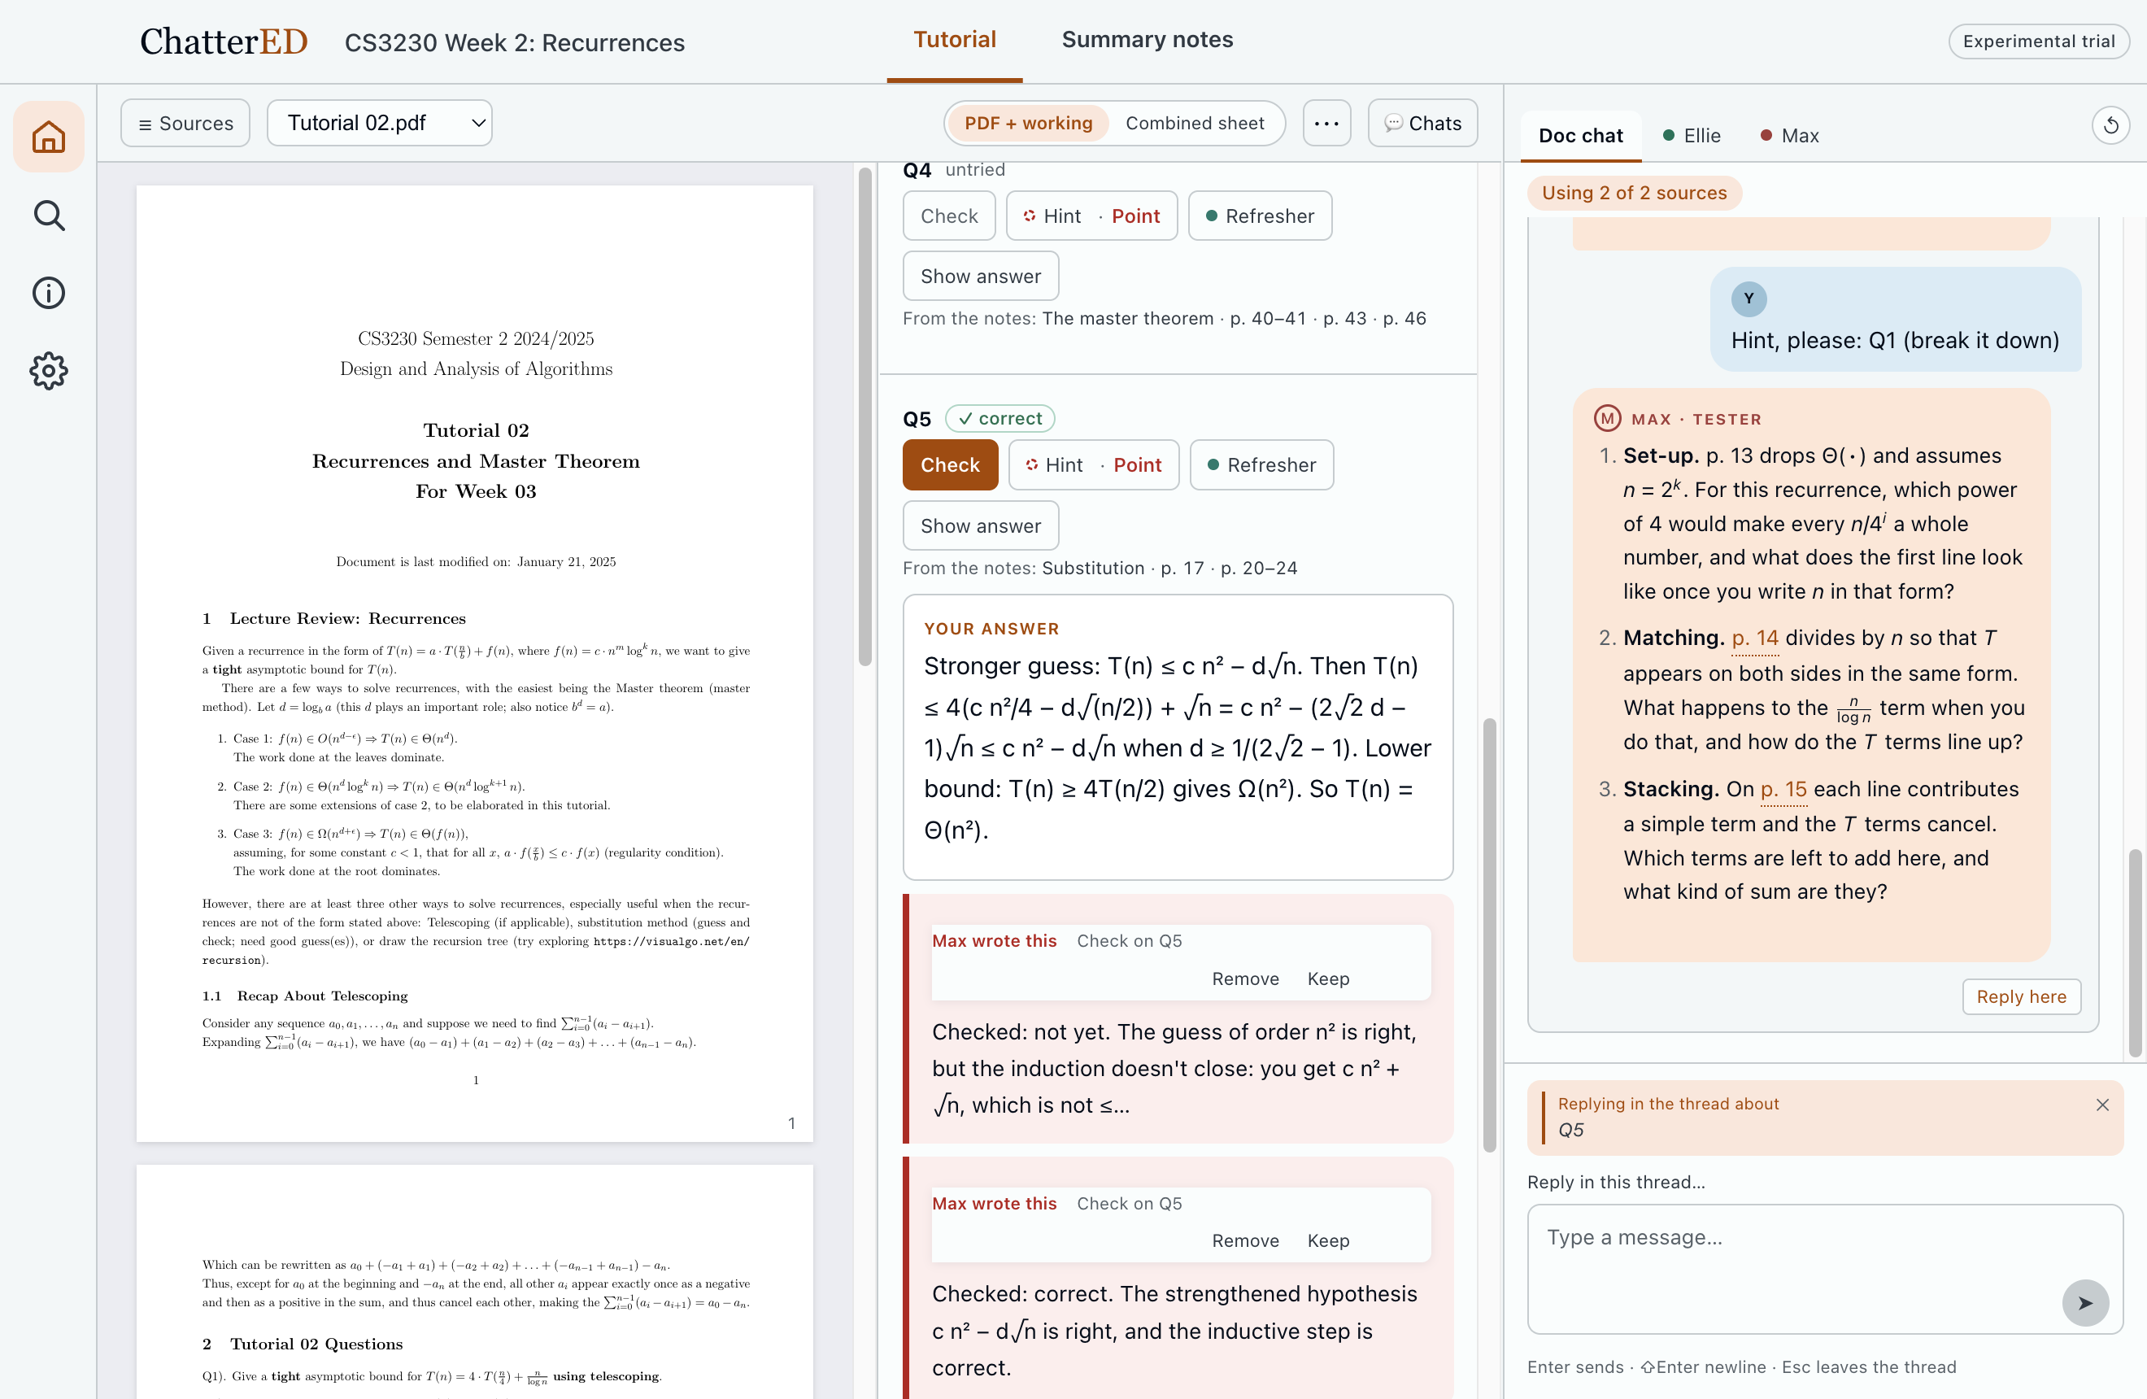
B1 · Recorded demo: real app, real replies
Backup · B1
Notes:
[BACKUP: if the live demo fails]
Play the recording and narrate over it using the demo steps. It is silent, from the real app and real replies (1 Nov, on the merged build), and has no mouse cursor. Three minutes.

Slide 17
B2 · Logging audit: what is recorded, what must be added
Backup · B2
RECORDED TODAY
ADD BEFORE THE BUILD GOES OUT
App start and quit
Each Hint: part, kind, rung
Each Check: verdict, attempt count, rung reached, key source
Show answer: part, time
Replies in a part's thread
Every message, with time; the final document, with who wrote what
Model, tokens, cost per call
An attempt present on each help request (a flag and a count)
Time of the first text in each slot
Lecture links opened
Which view is in use: PDF + working or Combined
Writing in PDF drafts for questions with no part (a count, or move to the database)
Dropped: "stalls" from the lab design. In a real week, an idle app is not a stall.
To check: the app log keeps 4 × 4 MB. A heavy week must fit.
Additions log flags and counts, never text. None changes what the student sees.
Notes:
[Q&A · backup (Lucas)]
Audited on 8198994, 1 Nov. Recorded: help, check, reply, reveal events with time; messages; outcomes; the final document with author marks. Additions log flags and counts, never text.

Slide 18
B3 · Interview guide
Backup · B3
1 · Opinion (8 min)
2 · Their account (4 min)
Walk me through how you used it this week.
What did you use for tutorials besides it?
Which would you open for next week's tutorial, and why?
When did the help feel the right size? Too much? Too little?
Do you usually write something before asking for help?
How often did you ask for the answer?
Did you open the lecture from a question?
3 · Cued moments (14 min)
4 · Said vs did (4 min)
[Show the part and timeline]
What were you thinking here?
What did you want from the AI right then?
What did you expect to happen?
[Show the summary of their week]
Does this match how it felt?
Anything we have misread?
Notes:
[Q&A · backup]
Full guide in docs/group/field-study.md. About 30 minutes. Audio with separate consent.

Slide 19
B4 · The study build: measured in a team pilot
Backup · B4
56 s
≈$0.09
≈$0.03–0.04
$0.5064
to read a tutorial sheet (8 parts), about $0.12
for the overview of a 58-page deck
per question to Ellie, with its doc edit
stopped at a $0.50 test cap: one call over
How the credit works. Each participant has their own key and $50. So $50 is about 1,000 questions: heavy use for a week stays well inside it. The credit bar is the app's own count, so it stops ordinary use but is not secure against deleting app data. Keys are revoked when the study ends. After the credit, a student can switch to Claude Code or their own key.
Technical pilot by the team (no participants) on 25 Oct 2026, claude-sonnet-5-5 through the API. app/docs/STUDY-RELEASE.md §5.
Notes:
[Q&A · backup (Lucas)]
Pilot 25 Oct: packaged preloaded copy, Sonnet 5.5 on the API, $0.50 budget. It found the API refusing three schemas, fixed before the build was final. From app/docs/STUDY-RELEASE.md §5.
---
The four built copies predate Valerie's revamp, so they must be rebuilt.

Slide 20
B5 · The evidence behind the goals
Backup · B5
Measure | Value | Note
Learner turns holding the learner's own reasoning (5 sessions) | 0 of 31 | "No visible attempt" is not "no attempt"
Accounts that did not match the log | 4 of 6 | Why this study matches interviews to logs
AI verdicts on one student's work that were wrong | 12 of 21 | 11 refuted by running the queries on PostgreSQL
Answer requests, before and after a student's own rule | 5 → 2 | The rule also lowered the difficulty
Interviews, none on the team | 8 | CS, Mech Eng, DSE, Global Studies, Maths; Y3–Y4
Real AI study chats, shared with consent | 6 | 152 turns; ChatGPT, Claude, Perplexity
docs/group/joint-analysis.md; evidence ids L-T1…L-T6, L-P1…L-P3, N-P1…N-P5.
Notes:
[Q&A · backup]
From the mid-project deck and joint-analysis.md. Do not say whose sessions these were.

Slide 21
B6 · Architecture: the model proposes, code decides
Backup · B6
UI
Tutorial and Summary notes modes · original PDF + one slot per part, or the copied sheet · a thread per part
Rules
Code, before any model call: next hint rung · when an answer is released · who speaks · the guard on learner text · progress only on their own correct answer
Grading
New: a formal check, then a verified solutions key, then the model. One answer list sets the grade and goes to Max
Model calls
The words only: feedback, the wording of each hint, the notes overview
Storage
Local SQLite and app log: the study's data source · a research export the participant runs by hand
Backends
Study key on the API with a credit cap · then Claude Code or the student's own key
macOS Electron, Svelte 5, TypeScript. 3,620 automated tests. Principle: rules govern LLMs (CS3249 Lecture 6); Houde et al. (2025), IUI '25.
Notes:
[Q&A · backup]
Same principle as at mid-project. Since then: the answer-checks layer, the study build and the research export. Test count from npm test on 8198994.

Slide 22
B7 · References
Backup · B7
Bastani, H., et al. (2025). Generative AI without guardrails can harm learning. PNAS 122(26), e2422633122.
Braun, V., & Clarke, V. (2006). Using thematic analysis in psychology. Qualitative Research in Psychology 3(2), 77–101.
Fetters, M. D., Curry, L. A., & Creswell, J. W. (2013). Achieving integration in mixed methods designs: principles and practices. Health Services Research 48(6pt2), 2134–2156.
Houde, S., et al. (2025). Controlling AI agent participation in group conversations. IUI '25.
Kapur, M. (2008). Productive failure. Cognition and Instruction 26(3).
Kestin, G., et al. (2025). AI tutoring outperforms in-class active learning. Scientific Reports 15, 17458.
Kim, S. S. Y., et al. (2025). Fostering appropriate reliance on large language models. CHI '25.
Lewis, J. R., Utesch, B. S., & Maher, D. E. (2013). UMUX-LITE: When there's no time for the SUS. CHI '13, 2099–2102.
Malterud, K., Siersma, V. D., & Guassora, A. D. (2016). Sample size in qualitative interview studies: guided by information power. Qualitative Health Research 26(13), 1753–1760.
Sauro, J., & Dumas, J. S. (2009). Comparison of three one-question, post-task usability questionnaires. CHI '09, 1599–1608.
Wood, D., Bruner, J. S., & Ross, G. (1976). The role of tutoring in problem solving. J Child Psychol Psychiatry 17(2), 89–100.
Notes:
[Q&A · backup]
Methods references checked online on 1 Nov 2026. Others carried from the mid-project deck.

