Slide 1
WRAP-UP 16:45–17:05
One more thing before you go
Friday's tool: scikit-learn
The same tool as today — now done properly.
Real data is messy. Here is the recipe that keeps you honest.
Which SDG it has to serve, you find out on the day. Now: eight small steps, one messy dataset. Everything is in the last section of today's notebook — no need to write along.
AI for Good · Week 5 Thursday · scikit-learn, done properly
1 / 13
Notes:
16:45. Nobody packs up — 'one more thing', twenty minutes. Say the tool, not the SDG: 'Friday's tool is scikit-learn — the one you used all day. Which SDG it has to serve, you hear on Friday.' Then the honest part: today we cheated a little. The breast-cancer data was clean, all numbers, no gaps. Tomorrow you bring data you found yourself, and it will be messy. So the next twenty minutes are the recipe for doing it properly. Promise them: every step is small, and all of it is in the last section of today's notebook, ready to copy. They do not need to take notes.

Slide 2
WRAP-UP · THE HONEST PART
Today's data was too clean
The breast-cancer data was a gift. Your Friday data will not be.
Today — handed to you
Real data — what you will find
✓ only numbers
✓ no empty cells
✓ no weird values
✓ every column allowed
✓ answers nicely mixed
✗ words instead of numbers ("male", "S")
✗ empty cells everywhere
✗ values that cannot be true
✗ a column that secretly holds the answer
✗ 90 % of the rows say the same thing
The model is one line of code. Everything around it is the actual job — and a model trained on badly prepared data does not crash. It quietly gives you a wrong number with two decimals.
AI for Good · Week 5 Thursday · scikit-learn, done properly
2 / 13
Notes:
One minute. Left card: what today's data gave us for free. Right card: what real data does to you. Read two or three of the right-hand items with a face. Then the sentence in the band, and say it twice: the model is one line of code — .fit(). Everything around that line is the actual job, and it is also where almost every mistake happens. A model trained on badly prepared data does not crash; it just quietly gives you a wrong number with two decimals. That is what makes this dangerous.

Slide 3
WRAP-UP · THE MAP
The proper recipe: eight small steps
Same names, same order as the last section of the notebook.
1
Look before
you touch
2
Split first
3
Set a baseline
4
Clean inside
a Pipeline
▶
▶
▶
gaps · balance · weird values · cheat columns
lock the exam away before anything else
what does a lazy model get?
fill gaps · words → numbers · same scale
5
Pick your
scoreboard
6
Tune with
practice exams
7
The final exam,
once
8
Check the groups,
then use it
▶
▶
▶
which mistake hurts people more?
cross-validation, never the test set
one table, lazy model on row 1
does it work for everyone?
Our messy example for all eight: the Titanic — 891 real passengers, one question: who survived?
AI for Good · Week 5 Thursday · scikit-learn, done properly
3 / 13
Notes:
One minute — the map. Eight steps, in this order, and the order matters. Walk the arrows quickly; each one gets its own slide. The notebook's wrap-up section has the same eight steps with the same names, so tomorrow they can literally go down the list. Point at step 2: we split BEFORE cleaning. That is the one people get wrong most often. Our example for all eight: the Titanic — 891 real passengers, and the question 'who survived?'. It has every problem your Friday data will have, and it asks the question this course keeps asking: who did the system favour?

Slide 4
WRAP-UP · STEP 1
STEP
1
Look before you touch
Four questions, four lines. Every one finds a problem in the Titanic data.
import pandas as pd
df = pd.read_csv("titanic.csv")
df.isna().sum() # 1. gaps?
df["survived"].value_counts(
normalize=True) # 2. balanced?
df.describe() # 3. weird values?
df.duplicated().sum() # 4. duplicates?
Gaps
177 ages missing · deck empty for 688 of 891 → fill age, drop deck
Balance
only 38 % survived → a lazy "nobody survived" is right 62 % of the time
Weird
15 people paid a fare of 0 — crew? free? a gap in disguise? Find out, write it down
Duplicates
107 look identical — here different people. Same person twice? Remove one
⚠ The cheat column. The file has a column alive — that is survived in words. A model that sees it scores 100 %, and is useless. Ask of every column: would I know this before I need the prediction? Too good to be true = a bug, not a victory.
AI for Good · Week 5 Thursday · scikit-learn, done properly
4 / 13
Notes:
Two minutes. Step 1, look before you touch. Four questions, four lines of pandas — show the code, do not teach pandas; the notebook explains the four lines. Then the Titanic answers: 177 ages missing, deck almost empty (drop it), only 38% survived — remember that number — and 15 people with a fare of 0. Ask the room: is a fare of 0 real? Crew? Free ticket? A gap in disguise? Answer: you cannot tell from the numbers; you have to find out and write down what you decided. Then the red box — the cheat column. The Titanic file has a column 'alive' which is just 'survived' in words. A model that sees it scores 100%. Rule of thumb, make them repeat it: a score that looks too good to be true is a bug, not a victory. On Friday: for every column ask 'would I know this BEFORE I need the prediction?'

Slide 5
WRAP-UP · STEPS 2 + 3
Split first. Then meet the lazy model.
Two steps before any cleaning or training happens.
2 · The sealed envelope
3 · The lazy model
train 80 % — clean, tune, learn
test
20 %
DummyClassifier always says the most common answer: "did not survive". It learns nothing.
✉ The test set goes in a drawer before you clean, fill or tune anything. You open it once, at the very end.
61 %
0
accuracy
survivors found
train_test_split(X, y, test_size=0.2,
stratify=y, random_state=42)
Every real model has to beat it. And accuracy is the wrong scoreboard when one answer is much more common → step 5.
stratify=y → both parts get the same 38 % survivors.
AI for Good · Week 5 Thursday · scikit-learn, done properly
5 / 13
Notes:
Two minutes. Left: split first. The test set is an exam in a sealed envelope; it goes in the drawer before you clean, fill or tune anything, and you open it once, at the end. New word: stratify=y — both parts get the same 38% survivors. Always, for classification. Right: the lazy model. DummyClassifier always says the most common answer — 'did not survive' — and scores 61% accuracy while finding zero survivors. Let that sink in: 61% for a model that learned nothing. So every model has to beat the lazy model, and accuracy is the wrong scoreboard when one answer is much more common. That is step 5.

Slide 6
WRAP-UP · STEP 4
STEP
4
Clean: three jobs
A model only eats numbers, with no gaps — and KNN wants them on the same scale.
Fill the gaps
Words → numbers
Same scale
177 ages are empty.
Fill in the middle value (median) of the training passengers.
SimpleImputer
sex
sex_female
sex_male
KNN measures distance. Fare goes 0–512, siblings 0–8: a fare gap of 50 would shout 50× louder than one sibling.
StandardScaler
male
0
1
female
1
0
One yes/no column per word.
OneHotEncoder
Proof, same KNN, same data: F1 0.59 without scaling → 0.72 with scaling. (Trees do not care about scale — but it does not hurt them.)
AI for Good · Week 5 Thursday · scikit-learn, done properly
6 / 13
Notes:
Two minutes. A model eats only numbers, with no gaps, and KNN and logistic regression want them on the same scale. Three jobs, three tools — you do not need to remember the class names, they are in the notebook. Gaps: fill with the median of the training passengers. Words: one-hot — 'sex' becomes two yes/no columns; show the mini table. Scale: this is the one to make intuitive. KNN measures distance. A difference of 50 in fare counts fifty times more than one extra sibling — not because fare matters more, but because its numbers are bigger. Scaling makes every column equally loud. The proof in the green box: same KNN, same data — 0.59 without scaling, 0.72 with. One line of code, a big jump.

Slide 7
WRAP-UP · STEP 4
STEP
4
The Pipeline: cleaning and model on one recipe card
It learns the median and the scale from the training part only. That is how you avoid peeking.
✗ Peeks in the envelope
✓ Split first, then a Pipeline
# median + scale computed with the
# test passengers included ...
X_all = StandardScaler().fit_transform(X)
# ... and only then split
X_train, X_test, ... = train_test_split(
X_all, ...)
X_train, X_test, ... = train_test_split(X, ...)
model = Pipeline([
("prep", prep), # fill, words, scale
("model", KNeighborsClassifier()),
])
model.fit(X_train, y_train) # learns from
# train only
Leakage = information from the test set sneaking into training. Your score gets a little too good and you never notice. Put every cleaning step inside the Pipeline and you do not have to think about it any more — it is the seatbelt.
AI for Good · Week 5 Thursday · scikit-learn, done properly
7 / 13
Notes:
Two minutes. The Pipeline is a recipe card: the cleaning steps and the model glued into one object. Why it matters: leakage. Left, the wrong way — scale and fill the whole table, then split. The median and the scale were computed WITH the test passengers, so you peeked in the envelope; your test score is a little too good and you will never notice. Right: split first, then put everything in a Pipeline. When you fit it, it learns the median and the scale from the training part only, and applies exactly those numbers to anything new — the test set, or a new passenger. The good news: if you use a Pipeline, you do not have to think about leakage any more. It is the seatbelt.

Slide 8
WRAP-UP · STEP 5
STEP
5
Pick your scoreboard before you play
Each score is just a question about the confusion matrix you already know.
Recall
Precision
F1
Of all the real "yes" cases, how many did we find?
Of everyone we said "yes" to, how many really were?
A balance of recall and precision, in one number.
Care about it when a miss is worst — a sick person sent home
Care about it when a false alarm is worst — an innocent person flagged
Care about it when both mistakes matter
Example: 100 passengers, 40 survived. The model says "survived" to 30 people; 24 of them really did.
Recall = 24 / 40 = 0.60
Precision = 24 / 30 = 0.80
Choose before you train.
Ask: which mistake hurts the people your model is about more? That is an ethical question, not a coding one.
AI for Good · Week 5 Thursday · scikit-learn, done properly
8 / 13
Notes:
Two minutes — the one decision that is not about code. Three scores, each is just a question about the confusion matrix they already know. Recall: of all the real yeses, how many did we find? Precision: of everyone we said yes to, how many really were? F1: the balance. Walk the example: 100 passengers, 40 survived, the model says survived to 30, 24 of them right — recall 0.60, precision 0.80. Then the rule: pick the scoreboard BEFORE you train, because afterwards you are tempted to pick whichever number looks best. And how to pick: which mistake hurts the people your model is about more? A miss, or a false alarm? That is an ethical question, not a coding one — and it is the most important sentence in their notebook on Friday.

Slide 9
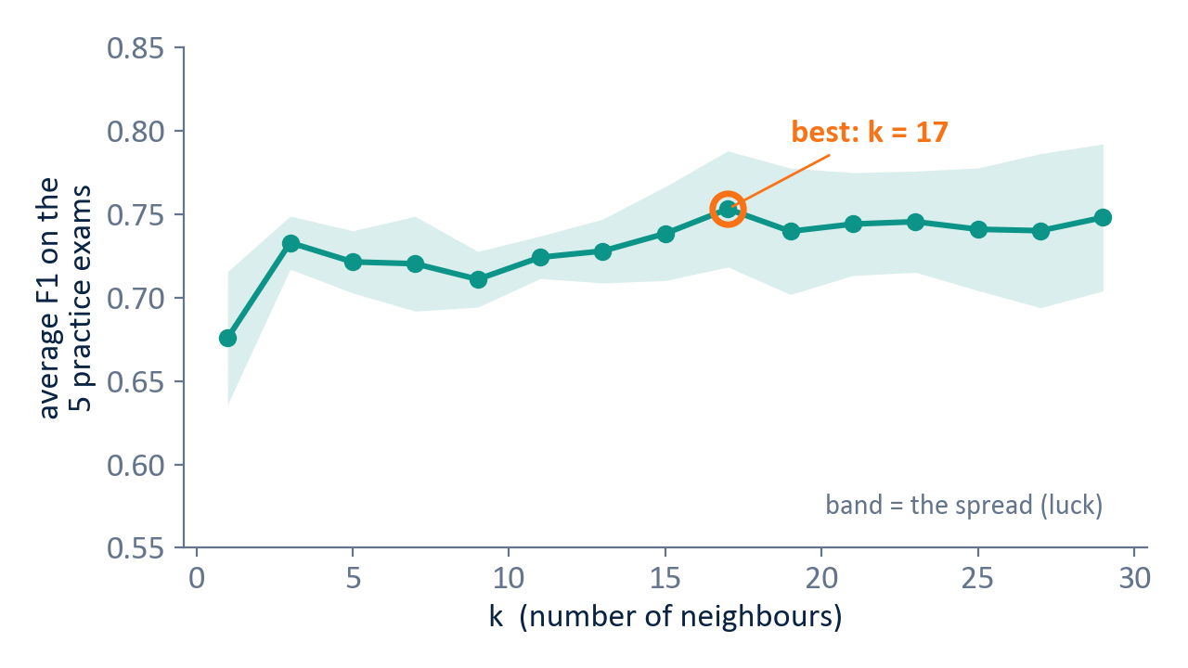
WRAP-UP · STEP 6
STEP
6
Tune with practice exams
Cross-validation: find the best setting without opening the envelope.
The training data, cut into 5 parts:
round 1
exam
round 2
exam
round 3
exam
round 4
exam
round 5
exam
→ 5 scores. The average says how good a setting is. The spread says how much luck is in it.
KNN, k = 1 … 29, five practice exams each. The band is the luck: everything from k = 15 to 29 is about equally good.
cross_val_score(model, X_train, y_train,
cv=5, scoring="f1")
Same practice exams for every model — or the comparison is not fair.
AI for Good · Week 5 Thursday · scikit-learn, done properly
9 / 13
Notes:
Two minutes. Tuning: n_neighbors=5 today was a guess. How do we find a better one without opening the envelope? Practice exams. Cut the training data in five parts; each part takes a turn as the practice exam; five scores. The average says how good a setting is; the spread says how much luck is in it — that band on the chart. Right: we tried k = 1, 3, 5 … 29, five practice exams each. Best: k = 17. Point at the band: the differences between k = 15 and k = 29 are smaller than the band, so they are all about equally good. That idea — 'is the difference bigger than the luck?' — comes back on the next-but-one slide. Important: same practice exams (same random_state) for every model, otherwise the comparison is not fair.

Slide 10
WRAP-UP · STEP 6
STEP
6
GridSearchCV: the for-loop, done for you
Give it the Pipeline and a dictionary of settings. It tries them all on the same practice exams.
search = GridSearchCV(
Pipeline([("prep", prep),
("model", KNeighborsClassifier())]),
{"model__n_neighbors": list(range(1, 31, 2))},
cv=practice_exams, scoring="f1")
search.fit(X_train, y_train) # envelope stays closed
search.best_params_ # {"model__n_neighbors": 17}
search.best_score_ # 0.753
One knob per model that matters most
KNN n_neighbors
how many neighbours vote
Logistic regression C
how eagerly it bends towards the training data — small = cautious
Decision tree max_depth
how many questions deep — deep = memorising (overfitting)
model__n_neighbors = "the n_neighbors of the step called model". Copy it from the notebook.
AI for Good · Week 5 Thursday · scikit-learn, done properly
10 / 13
Notes:
One minute. What they just saw was a for-loop — Week 2. It is so common that scikit-learn has it built in: GridSearchCV. Give it the Pipeline and a dictionary of settings — Week 3 — and it tries every one on the same practice exams and keeps the best. The table: the one knob per model that matters most. KNN — how many neighbours vote. Logistic regression — C, how eager it is to bend towards the training data. Tree — max_depth, how many questions deep; deep means memorising, which is today's overfitting. The double underscore in model__n_neighbors just means 'the n_neighbors of the step called model'. They do not need to understand it — copy it from the notebook.

Slide 11
WRAP-UP · STEP 7
STEP
7
The final exam, once: one table
Open the envelope. Every tuned model takes the test once. Lazy model on row 1.
model | best setting | train F1 | practice F1 | test F1 | precision | recall
Lazy model | — | 0.00 | 0.00 | 0.00 | 0.00 | 0.00
KNN | k = 17 | 0.76 | 0.75 ± 0.04 | 0.73 | 0.82 | 0.65
Logistic regression | C = 1 | 0.74 | 0.73 ± 0.03 | 0.72 | 0.79 | 0.67
Decision tree | depth 4 | 0.76 | 0.73 ± 0.03 | 0.67 | 0.86 | 0.55
Gap = overfitting
Inside the luck band = a tie
Recommend with reasons
train much higher than practice or test? It memorised. The tree drops the most on the test.
0.75 vs 0.73 with a spread of ±0.03 is luck, not skill. Choose on other grounds.
Logistic regression: gives a probability, every weight explainable. "None of them" is allowed too.
AI for Good · Week 5 Thursday · scikit-learn, done properly
11 / 13
Notes:
Two minutes. Step 7: now, and only now, open the envelope. Every tuned model takes the test once, and everything goes in one table with the lazy model on the first row — that is also exactly the table the hackathon asks for. How to read it: train vs practice/test — a big gap is overfitting; the tree's test score drops the most. And the key lesson: KNN, logistic regression and the tree are within about 0.03 of each other on the practice exams — that is inside the luck band. So it is a tie. When it is a tie, choose on other grounds: logistic regression gives a probability and you can explain every weight; the tree is readable but misses the most survivors. That reasoning is what a recommendation looks like. And: never re-tune after seeing the test score — then the exam becomes another practice round.

Slide 12
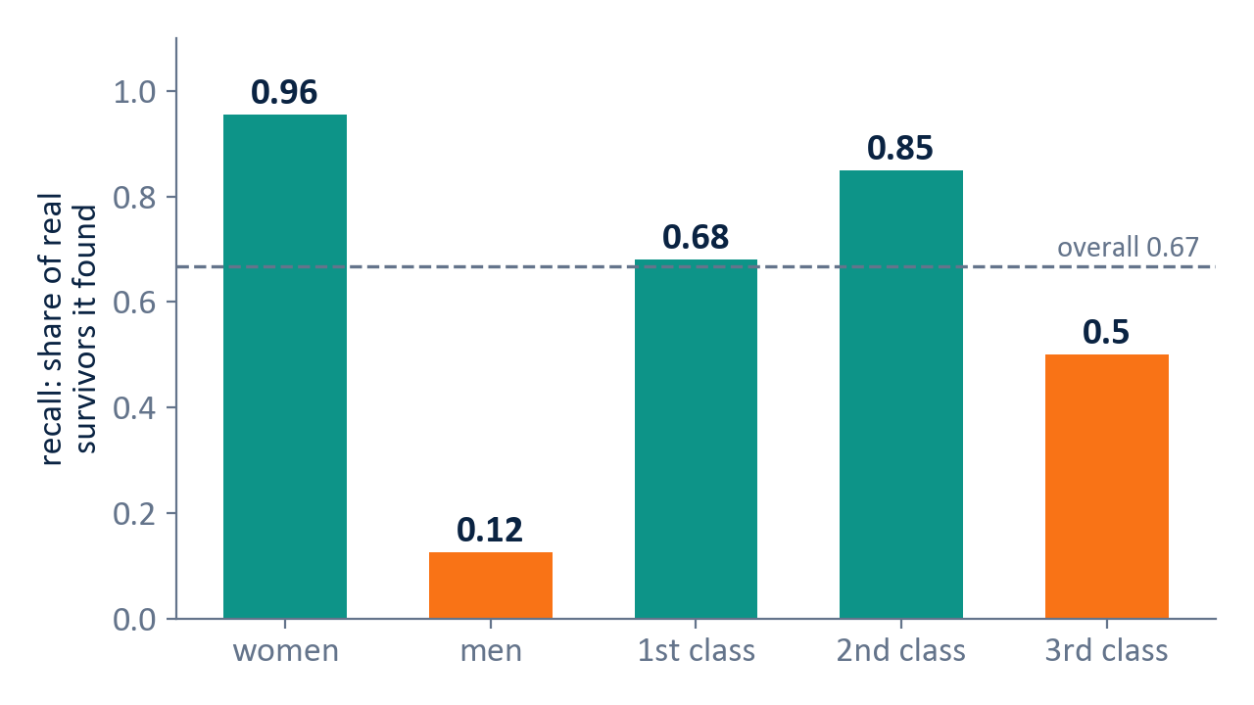
WRAP-UP · STEP 8
STEP
8
Check the groups, then use it
One average can hide that a model works for one group and fails another.
Then use it: a new case in, an answer and a probability out
new = pd.DataFrame([{"pclass": 3,
"sex": "male", "age": 25,
"sibsp": 0, "parch": 0,
"fare": 8.0, "embarked": "S"}])
model.predict(new) # [0]
model.predict_proba(new) # 10 % survive
Always show the probability: "survived, 51 % sure" is a very different message from "95 % sure".
It learned the rule of 1912 — "women and children first" — and turned it into "women survive, men do not".
The history inside the data becomes the model's rule. All three models learned it; a better algorithm does not fix it — checking and writing it down does.
AI for Good · Week 5 Thursday · scikit-learn, done properly
12 / 13
Notes:
Two minutes — the AI-for-Good slide; slow down. Step 8: split the test results per group. Overall recall 0.67 looks fine. Per group: it finds 96% of the women who survived and 12% of the men. It learned the rule of 1912, 'women and children first', and turned it into 'women survive, men do not'. Third class: half. Ask: if a model like this decided who gets help first in a disaster today, what would go wrong? Then the general point: the history inside the data becomes the model's rule — confidently. Every one of our three models learned the same thing; a better algorithm does not fix it. People do: by checking the groups and writing down who the model serves worst. Right side: using it — a new passenger in, an answer AND a probability out. Always show the probability: 'survived, 51% sure' is a different message from '95% sure'.

Slide 13
CHECKLIST · BEFORE FRIDAY
Ways to fail without noticing
Homework
☐
I looked at gaps, balance, weird values and cheat columns — and wrote down what I decided
Run the last section of today's notebook to the end.
Do the four "Your turn" cells.
Check that pandas, scikit-learn and matplotlib import in your editor.
☐
I split first, with stratify and a random_state
☐
All cleaning is inside a Pipeline
☐
My models beat the lazy model
☐
I chose my scoreboard before training — for the people, not the number
☐
I tuned with practice exams only, the same ones for every model
☐
I opened the envelope once, and did not re-tune after
Friday: your pair, the SDG, and a dataset you find yourself.
The model is one line.
The recipe is the job.
☐
I checked the groups and wrote down who it serves worst
☐
Restart & Run All works, from raw file to final table
AI for Good · Week 5 Thursday · scikit-learn, done properly
13 / 13
Notes:
One minute. The checklist is the recipe as a list of ways to fail without noticing — it is also the last cell of the notebook. Homework: run the wrap-up section to the end, do the four 'Your turn' cells (the tree tuning plot is the most useful one), and check that pandas, scikit-learn and matplotlib import in their editor. Close: 'Friday: your pair, the SDG, and a dataset you find yourself. The model is one line. The recipe is the job.' If you are running late, cut slide 10 (GridSearchCV — the notebook covers it) and shorten slide 7 to the one-line rule: everything inside a Pipeline, split first.

