Slide 1
Matlab package for R
Presentation by Lucas Jeay-Bizot
Class CS 510

Slide 2
Preliminary steps
Please go to https://github.com/lucasjeaybizot/PresentationCS510_MatlabPackage_R
You will find there a git repository with information on the matlab package for R
Notes:
Maybe this link can be sent in the zoom chat by copy and paste: https://github.com/lucasjeaybizot/PresentationCS510_MatlabPackage_R

Slide 3
What is it ?
This package was designed by P. Roebuck in June 2014
This package simulates a set of useful MATLAB functions in R
Package website: http://cran.r-project.org/package=matlab
Notes:
Same as before, this link can be copy/pasted in the chat: http://cran.r-project.org/package=matlab
Orally: Matlab is another programming language – being able to simulate some of its functions in R can simply interoperative coding or projects involving members with diverse coding backgrounds.

Slide 4
How to install it ?
Run the command install.packages(“matlab”) in Rstudio
Alternatively you can run the install_package.R script available in the github repository
Before using it in a session, call library(“matlab”)

Slide 5
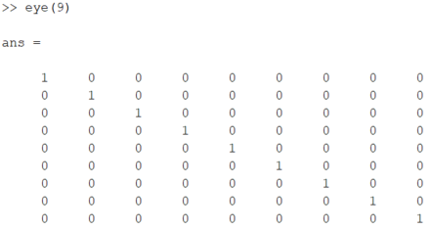
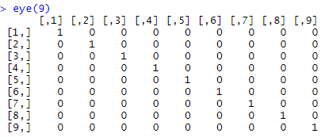
What does it do ? - 1
It allows you to use a large set of matlab functions in R (full list available here: (https://cran.r-project.org/web/packages/matlab/matlab.pdf )
For instance the eye() function in matlab can now be run in R
In R
In MATLAB
Notes:
Same as before, this link can be copy/pasted in the chat: https://cran.r-project.org/web/packages/matlab/matlab.pdf
eye(n) creates an n-by-n identity matrix

Slide 6



What does it do ? - 2
Another example is the matlab function linspace()
Or the function primes()
In R
In MATLAB
In R
In MATLAB
Notes:
linspace(a,b,c) gives a vector of steps in the linear spacing ranging from a to b in c number of steps
primes(n) gives the list of primes smaller than or equal to n

Slide 7
Where can I find out more about it ?
You can visit the github repository: https://github.com/lucasjeaybizot/PresentationCS510_MatlabPackage_R
Open examples.R to find a list of the packages’ functions and accompanying examples
Open exercise.R to practice using the repository a little

Slide 8
Exercise.R walkthrough solution
Convert the code below from MATLAB to R using the matlab package in R:
A = magic(6);
A = reshape(A,2,18);
B = numel(A);
C = factor(B);
D = isprime(C);
The line by line code in R:
library(“matlab”)
A <- magic(6)
A <- reshape(A,2,18)
B <- numel(A)
C <- factors(B)
D <- isprime(C)
Notes:
If time allows, ask for participation from the audience
Orally:
Animation 1: remember to upload the library in order to be able to access its functions
Animation 2: ‘=‘ in R becomes ‘<-’ and ‘;’ disappears
Animation 4: factor() is an exception in this toolbox, to avoid ambiguous usage, in the toolbox it has to be translated to factors()
Animation 5: in the code file the ‘%’ also have to be converted to ‘#’
Underline the simplicity of the translation from MATLAB to R → thus the usefulness of the toolbox

Slide 9
Similar packages
R.matlab: permits to read and write mat files from within R as well as call MATLAB
Reticulate: R interface to python
Notes:
These other packages might be useful for people who really want to work on projects that will involve more than one programming language

Slide 10
Thank You!

