Slide 1
The Conference Cloud Connection
Live Oracle Public Cloud PaaS demo
by
Team X

Slide 2
Challenge
Realize a conference support system on as many Oracle Public PaaS cloud services as possible and meaningful
ACCS
Sites CS
SOA CS
MCS
OSN
Doc CS
ICS
APIM CS
DBaaS
IoT CS
PCS
JCS

Slide 3
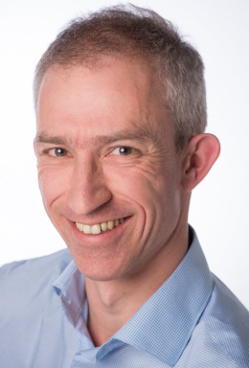
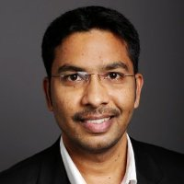
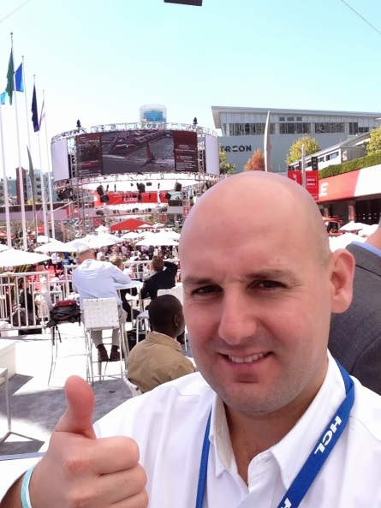

The Team
Distributed
Three countries, Two continents, Four Locations
The Cloud is omnipresent
Conferences are everywhere

Slide 4





Barcode Scanners, Room Sensors, Audience Happiness Detectors
SaaS Financial System
IoT CS
ACC
OSN
Beacons
PCS
Doc CS
API CS
MCS
ICS
Conference Partners
JCS
ACC
SOA CS
DBaaS
Compute CS
Storage CS

Slide 5

Send email to speakers about schedule (changes) and evaluation results
Tweet about new speakers & sessions
Hand over new attendees for invoicing
Barcode Scanners, Room Sensors, Audience Happiness Detectors
SaaS Financial System
Monitor number of people in room, temperature and sound levels, exact location of attendees
Conference WebApp – register attendee, submit session, showroom …
Judge Session Proposal and gather documents (picture, video, slides, agreement)
Conference App for attendees – session details, my schedule, evaluation
IoT CS
ACC
OSN
Beacons
Govern/expose public and restricted mAPIs
PCS
Mobile Backend & Analytics tracking
Doc CS
API CS
MCS
Conference Backoffice application – create schedule, plan stuff, manage data
ICS
SaaS Cloud Integration Hub
REST/JSON APIs , Excel generation
Conference Partners
JCS
ACC
SOA CS
DBaaS
Storage of ‘technical’ documents (cache,…)
Exchange schedule details with editor/printer, send numbers and dietary wishes to caterer, send names etc. to badge-manufacturer
Compute CS
Conference Database
Storage CS

Slide 6
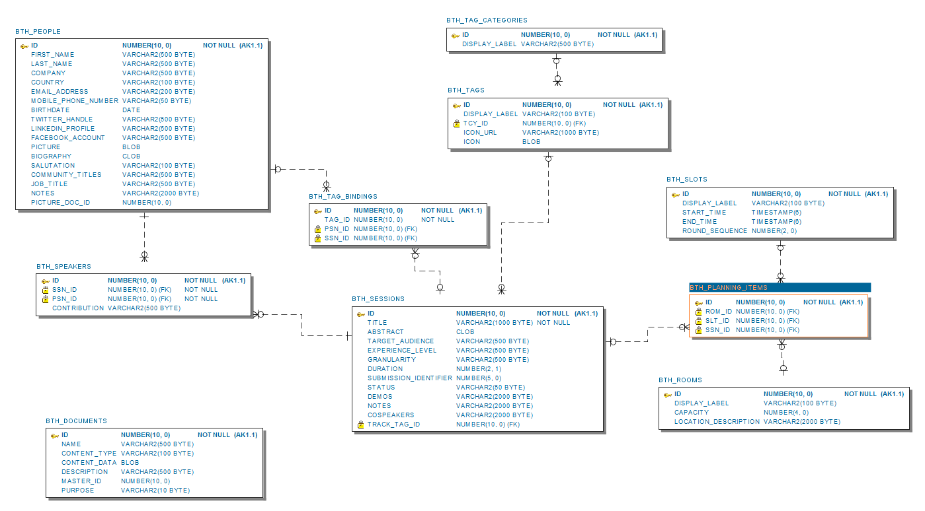
Database Model

