Slide 1

Some script (SoapUI, Postman)
Real “Things” (Pis, Arduino’s, …)
audience
1
Our webapp
IoT CS
DBaaS
Storage CS
4
2
ICS
SOA CS
PCS
3
5
Sites CS
DCS
MCS
OSN?
JET on
AppContainer CS (or JCS)
6
ABCS

Slide 2
Some script (SoapUI, Postman)
Real “Things” (Pis, Arduino’s, …)
Collect and analyze audience input; forward findings to REST service
Expose REST API [for PCS to invoke] to register a proposed artist and a supporting image; record artist details persistently [with some enrichment]; publish Tweet about new proposal
audience
Our webapp
IoT CS
DBaaS
Storage CS
Run human workflow based on suggested artist; approve/reject, add image and description; forward to REST service
ICS
SOA CS
PCS
Sites CS
DCS
MCS
OSN?
JET on
AppContainer CS (or JCS)
Publish REST APIs that expose data on proposed artists including the selected image
(could be from MCS, ICS, JCS, ABCS or SOA CS)
Expose User Interface that contains the proposed artist with some enrichment, based on REST APIs (exposed from MCS, ICS, JCS, ABCS or SOA CS)

Slide 3
Some script (SoapUI, Postman)
Real “Things” (Pis, Arduino’s, …)
Collect and analyze audience input; forward findings to REST service
Expose REST API [for PCS to invoke] to register a proposed artist and a supporting image; record artist details persistently [with some enrichment]; publish Tweet about new proposal
Torsten
audience
Our webapp
DBaaS
Storage CS?
IoT CS
Lucas
Name of artist, Number of votes, Source (Twitter/Voting Machine/ WebApp/…, Timestamp?
SOA CS
Run human workflow based on suggested artist; approve/reject, add image and description; forward to REST service
ICS
XML: list of proposed acts: Name of artist, #votes, Source, Timestamp, Description, Bio, Image, Discography
PCS
Name of artist, Number of votes, Source, Timestamp, Description, Image (base64 or URL to DCS or internet)
Node.js on ACC?
Sites CS
DCS
MCS
ICS?
OSN?
Pretty JSON: List of candidate acts (name, description, bio, imageurl, #votes, source, date of candidacy, discography?)
Lonneke
Mark
JET on Node.js on
Application Container CS
Expose User Interface that contains all proposed artists based on REST APIs – and some (static) content about OOW, SFO etc)
Publish REST APIs that expose data on proposed artists including the selected image
(could be from MCS, ICS, JCS, ABCS or SOA CS)
Wilfred

Slide 4



Some script (SoapUI, Postman)
Real “Things” (Pis, Arduino’s, …)
Collect and analyze audience input; forward findings to REST service
audience
Expose REST API [for PCS to invoke] to register a proposed artist and a supporting image; record artist details persistently [with some enrichment]; publish Tweet about new proposal
Our webapp
IoT CS
DBaaS
ACC
Run human workflow based on suggested artist; approve/reject, add image and description; forward to REST service
ICS
SOA CS
PCS
Sites CS
DCS
MCS
OSN
JET on
AppContainer CS (or JCS)
Publish REST APIs that expose data on proposed artists including the selected image
Expose User Interface that contains the proposed artist with some enrichment, based on REST APIs (exposed from MCS)

Slide 5



IoT CS
ACC
ICS
Compute
SOA CS
Storage
DBaaS
JCS
Compute
PCS
DBaaS
Storage
DCS
Compute
OSN
Sites CS
Storage
MCS
ACC
Compute
Storage

Slide 6
IoT CS
ACC
ICS
Compute
SOA CS
Storage
DBaaS
JCS
Compute
PCS
DBaaS
Storage
DCS
Compute
OSN
Sites CS
Storage
MCS
ACC
Compute
Storage

Slide 7
IoT CS
ACC
ICS
Compute
SOA CS
Storage
DBaaS
JCS
Compute
PCS
DBaaS
Storage
DCS
Compute
OSN
Sites CS
Storage
MCS
ACC
Compute
Storage

Slide 9
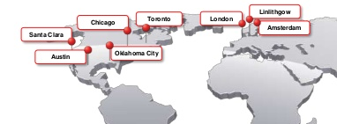



Sites CS
DCS
OSN
ICS
PCS
ACC
MCS
JCS
DBaaS
SOA CS
mediator-proxy
IoT CS
Valencia

Slide 10

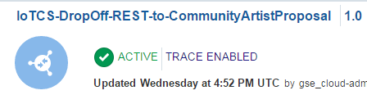
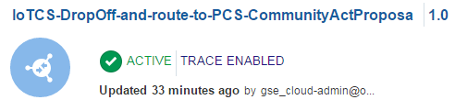
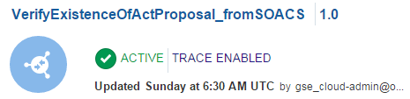
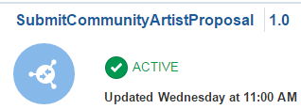
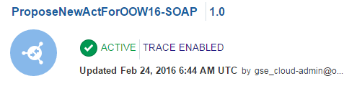
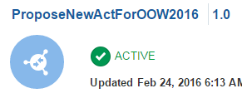
REST
(publishes a Tweet through SaibotAirport )
REST
(hand off artist finding in proprietary IoT CS JSON format); forwarded to SOA CS
SOAP
(returns Y or N depending on whether a proposal exists using SOA CS)
IoT CS
ICS
REST
(hand off artist finding in proprietary IoT CS JSON format); forwarded to PCS
SOA CS
REST
(submit a proposal for an artist in decent JSON format; links to PCS to ask for approval of the proposal
SOAP
(calls to SOA CS to create enriched proposal in DB; this service is to be called by PCS)
PCS
REST API
(calls to SOA CS to create enriched proposal in DB)

