Slide 1
Soaring through the Clouds
Live Oracle Public Cloud PaaS demo
by
The ACE Director Cloud Team

Slide 2
Challenge
Do a live and integrated demo of as many Oracle Public PaaS cloud services as possible
ACC
Sites CS
SOA CS
MCS
OSN
Doc CS
ICS
DBaaS
IoT CS
PCS
JCS

Slide 3
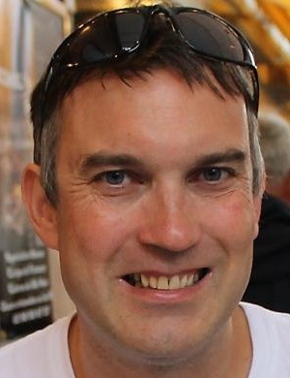
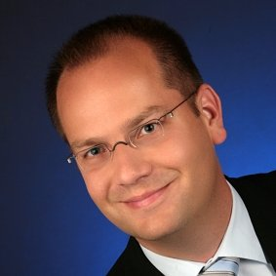
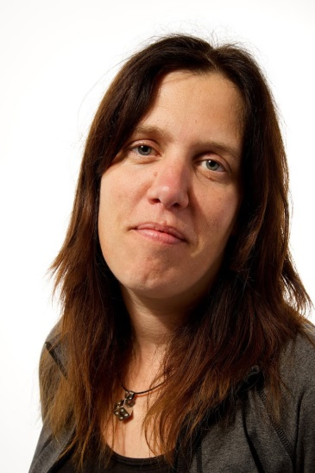

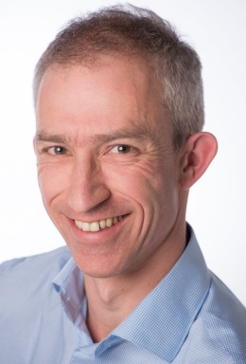
The Team
Distributed
Three countries, Five partners, Five Locations
The Cloud is omnipresent
except when there is a form of outage

Slide 4




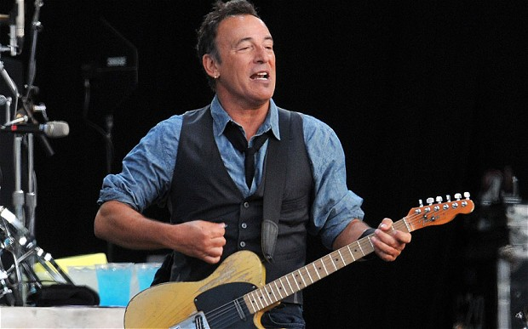
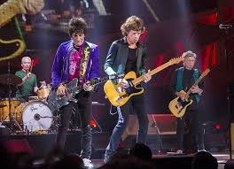
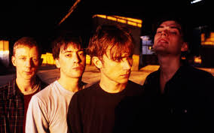
Story Line to create a credible flow across the clouds
Analyze Twitter traffic
& Voting Machines
Evaluate Proposal
Publish Approved Proposals on Web & App
Oracle OpenWorld 2016

Slide 5



Real “Things” (Pis, Arduino’s, …)
audience
IoT CS
DBaaS
ACC
ICS
SOA CS
PCS
Sites CS
Doc CS
MCS
OSN
JET on
AppContainer CS (or JCS)

Slide 6
Collect and analyze audience input; forward findings to REST service on ICS
Torsten
Real “Things” (Pis, Arduino’s, …)
audience
Expose SOAP API [for ICS to invoke] to register a proposed artist and a supporting image; record artist details persistently [with some enrichment retrieved from external services]; publish Tweet about new proposal
IoT CS
DBaaS
ACC
Run human workflow based on suggested artist; approve/reject, add image (on Doc CS) and description; discuss on OSN; forward outcome to service on ICS
Lucas
ICS
SOA CS
PCS
Expose SOAP and REST services to facilitate inetgration (from IoT CS to PCS, from PCS to SOA CS and from SOA CS to Twitter)
Sites CS
Doc CS
MCS
OSN
Lonneke
Mark
JET on
AppContainer CS (or JCS)
Publish REST/JSON APIs that expose data on proposed artists including the selected image (based on SOAP services on SOA CS)
Expose Rich, Responsive, Mobile enabled User Interface that contains the proposed artist with some enrichment, based on REST APIs (exposed from MCS)
Wilfred

Slide 7



All the cloud services involved – and how they are connected
IoT CS
ACC
ICS
SOA CS
Compute
DBaaS
JCS
Storage
Compute
Torsten’s laptop
DBaaS
Storage
PCS
Compute
Doc CS
Storage
EMEA2
OSN
Sites CS
MCS
ACC
Compute
US2
Storage

Slide 8
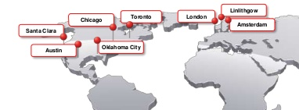

Geographic spread of our demo
Sites CS
Doc CS
OSN
ICS
PCS
ACC
MCS
JCS
DBaaS
SOA CS
Netherlands
IoT CS
Valencia

Slide 9
Oracle JET on ACC
JET Web App : http://bit.ly/acesdemo
MCS
ACC
Compute
Storage

Slide 10
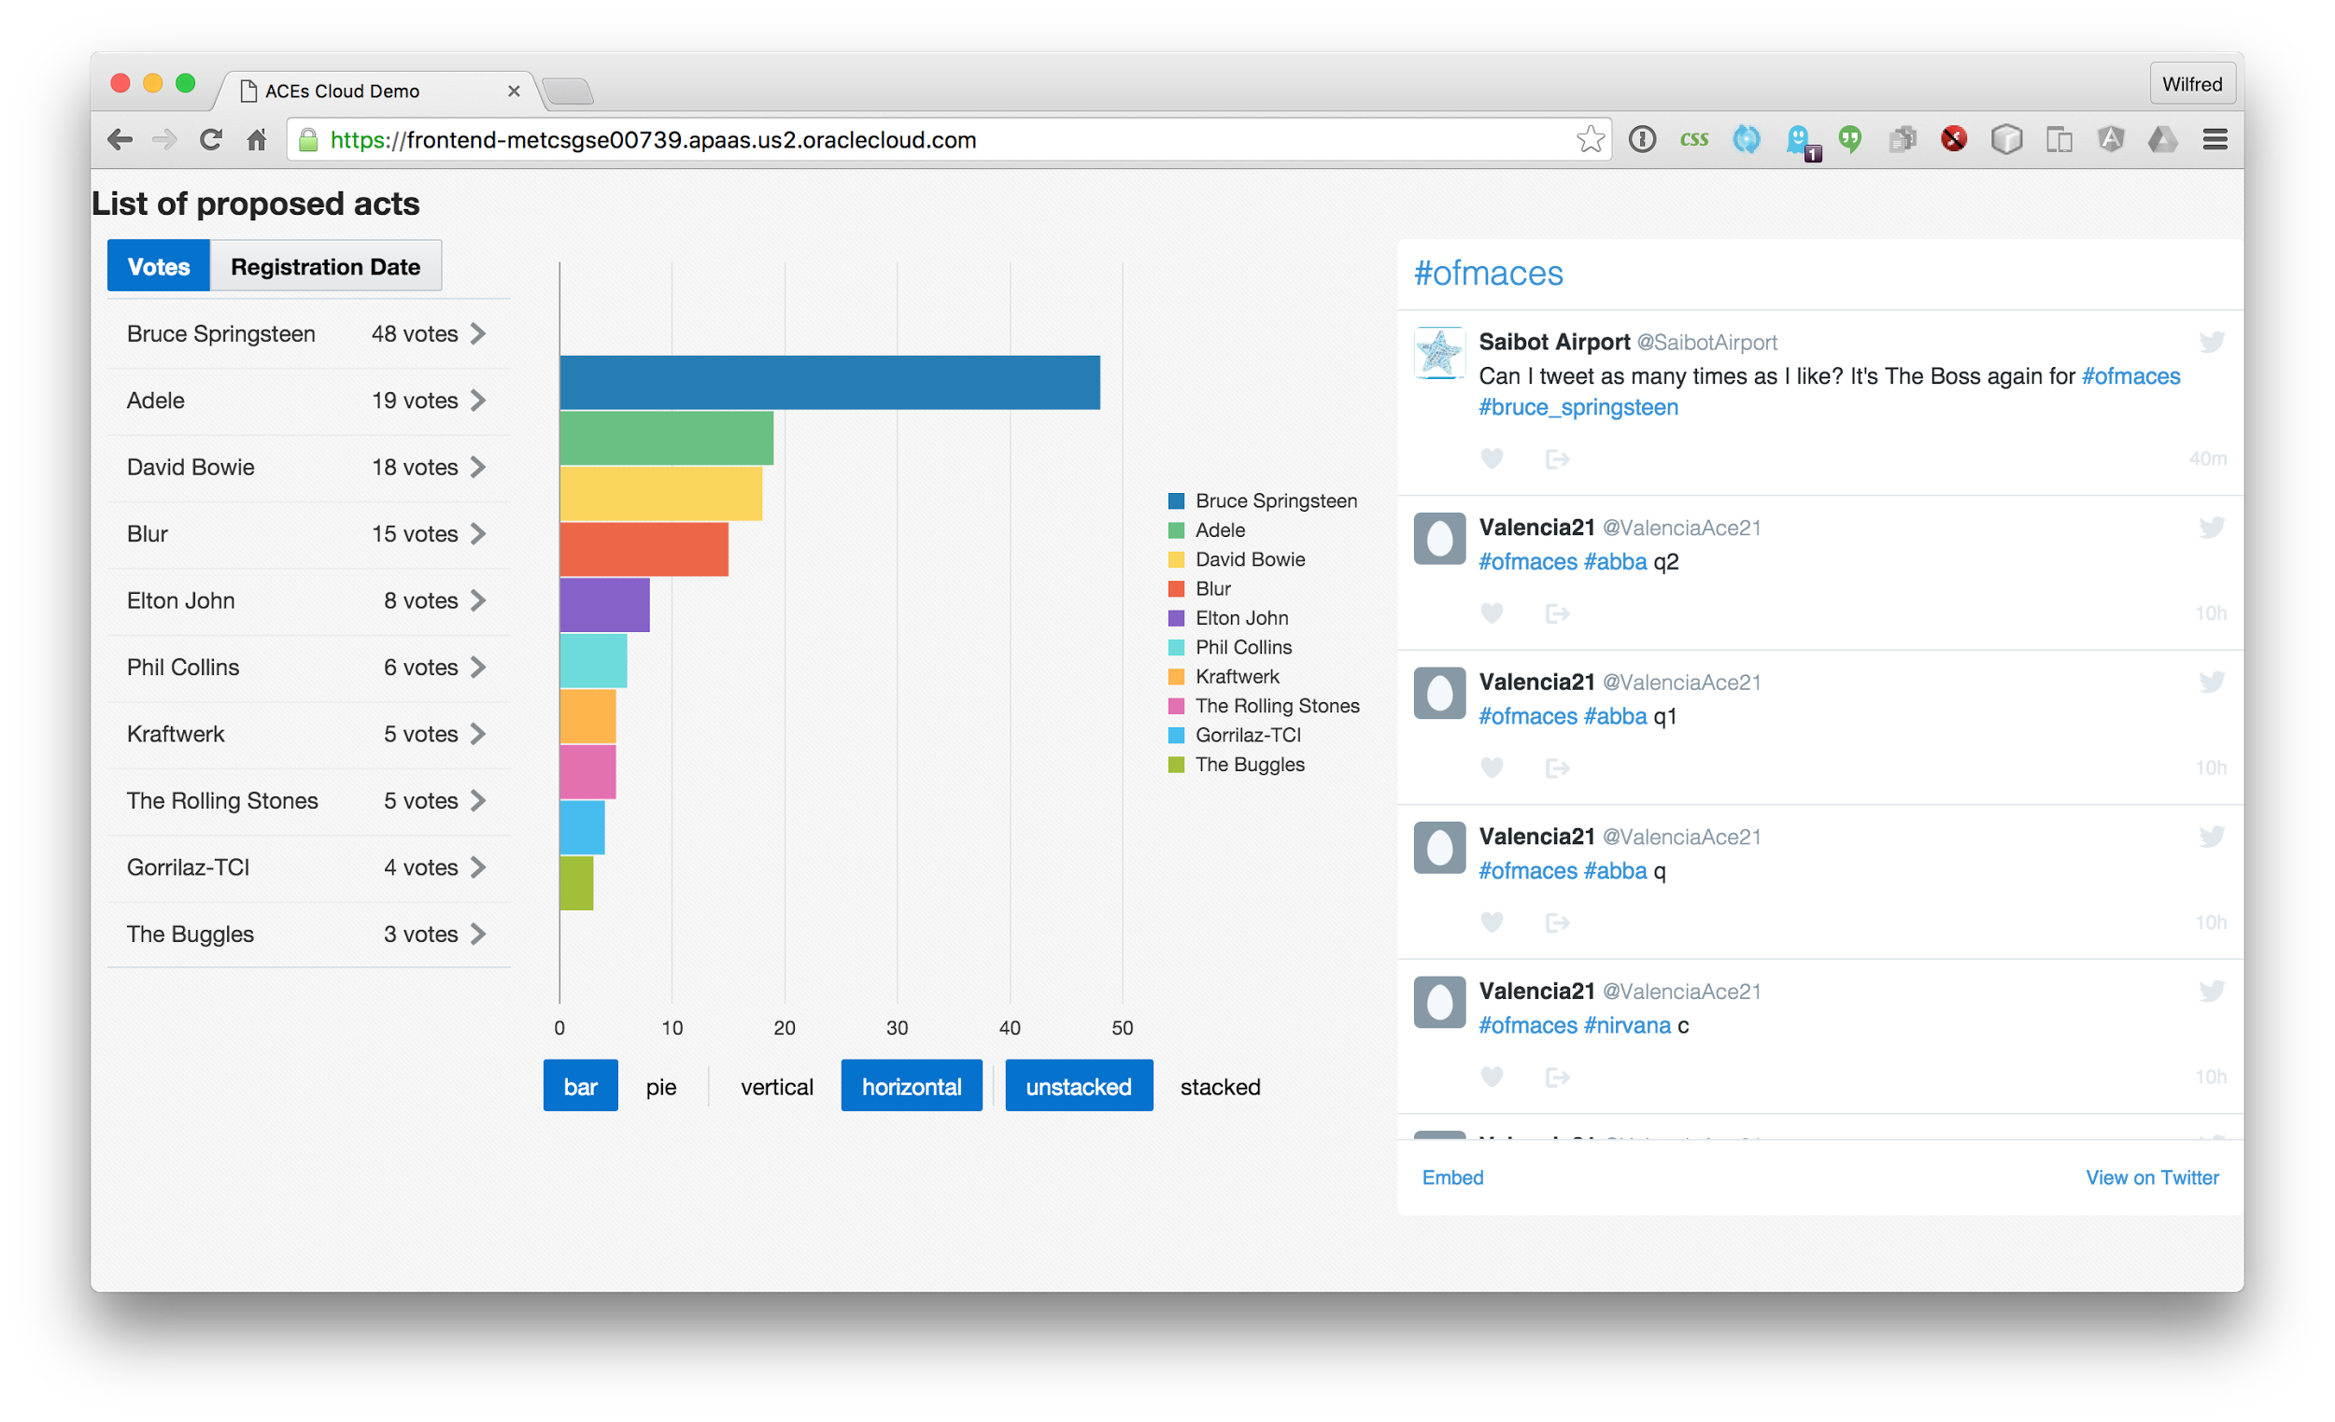
JET Web App : http://bit.ly/acesdemo

Slide 11
JET Web App : http://bit.ly/acesdemo
REST call to nodejs which calls MCS
Browser invokes twitter API
/mobile/custom/artistapi/acts

Slide 12
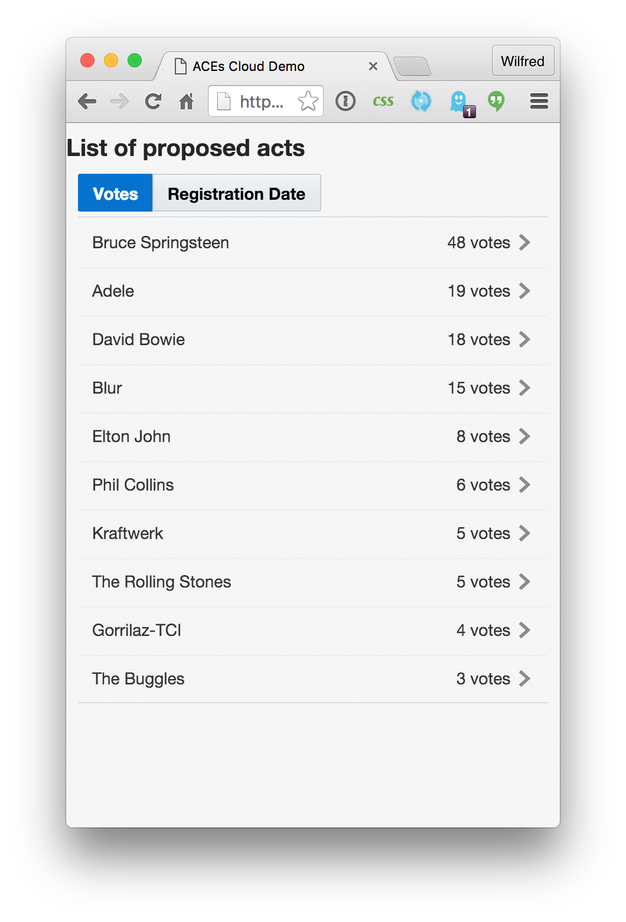
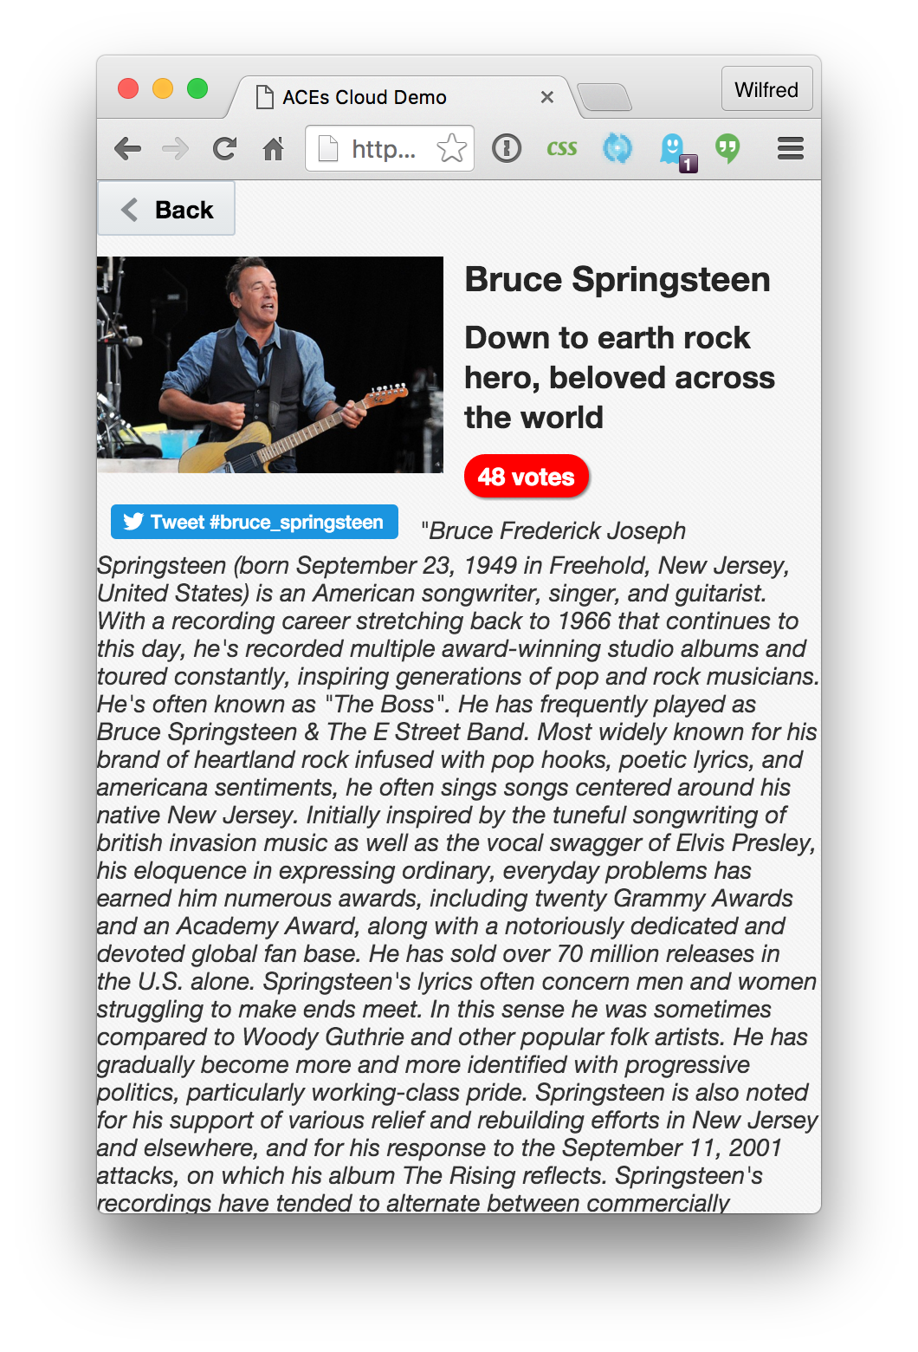
JET Web App : http://bit.ly/acesdemo
Responsive layout -small screen
/mobile/custom/artistapi/acts/678

Slide 13
REST API: /mobile/custom/artistapi/acts
JET Web App : http://bit.ly/acesdemo
[
{
"id": 661,
"name": "Bruce Springsteen",
"numberOfVotes": 48,
"registrationDate": "2016-03-14T11:47:48.709198+00:00"
},
... more acts ...
]

Slide 14
REST API: /mobile/custom/artistapi/acts/661
JET Web App : http://bit.ly/acesdemo
{
"id": 661,
"name": "Bruce Springsteen",
"numberOfVotes": 48,
"description": "Down to earth rock...",
"genres": "[\"roots rock\",\"singer-songwriter\"]",
"biography": "Bruce Frederick .....",
"imageURL": "http://i.telegraph.co.uk/...",
"discography": [
{"title": "Born In The U.S.A.", "imageURL": "..."},
... more albums ...
]
}

Slide 15
JET Web App : http://bit.ly/acesdemo
BROWSER
Adds http request headers:
oracle-mobile-backend-id
authorization
NodeJS server on Application Container Cloud Service
Having the browser invoke a REST API on same server that hosts html and js prevents Cross-Origin issues
REST API on Mobile Cloud Service

Slide 16
Configuring AppContainerCS nodejs
JET Web App : http://bit.ly/acesdemo
manifest.json
deployment.json
{
"runtime": {
"majorVersion": "0.12"
},
"command": "sh start.sh"
}
{
"environment": {
"MCS_BACKEND_ID": "55bc25a9-...",
"MCS_URL": "...us2.oraclecloud.com:443",
"MCS_USER": "MCSDEM0001...",
"MCS_PWD": "dy6ou5..."
}
}
start.sh
#!/bin/sh
unset http_proxy
unset https_proxy
node ./index

Slide 17
JET Web App : http://bit.ly/acesdemo
index.js (nodejs code)
var express = require('express');
var app = express();
var request = require('request');
app.use(express.static('public'));
app.use('/bower_components', express.static('bower_components'));
app.use('/mobile/*', function (req, res) {
var url = process.env.MCS_URL + req.originalUrl;
req.pipe(request({
url: url,
headers: { 'oracle-mobile-backend-id': process.env.MCS_BACKEND_ID },
auth: { user: process.env.MCS_USER, pass: process.env.MCS_PWD }
})).pipe(res);
});
var PORT = process.env.PORT || 3000;
app.listen(PORT, function () {
console.log('Example app listening on port ' + PORT + '!');
console.log('MCS backend id is ' + process.env.MCS_BACKEND_ID);
});

Slide 18
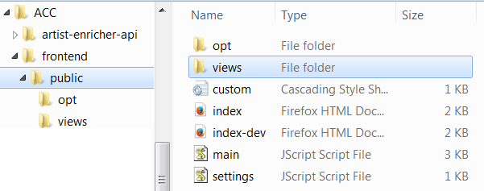
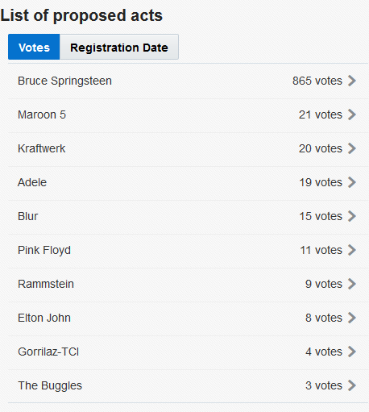
Node.js backend
index.js
/public
acts.js
acts.html
drill.html
drill.js
index.html
main.js

Slide 19
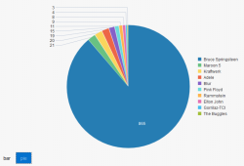
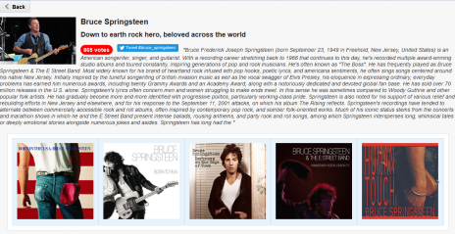
Node.js backend
index.js
/public
chart.js
chart.html
acts.js
acts.html
details.html
details.js
drill.html
drill.js
index.html
main.js

Slide 20
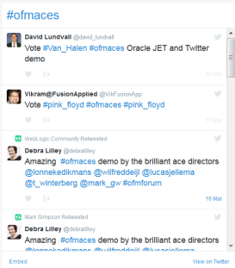
MCS
Node.js backend
index.js
/mobile/custom/artistapi/acts
/mobile/custom/artistapi/acts/<id>
/public
chart.js
chart.html
acts.js
acts.html
details.html
details.js
drill.html
drill.js
index.html
main.js

Slide 21
Deployment
JET Web App : http://bit.ly/acesdemo
via REST
...or simply use cloud web interface
var form = new FormData();
form.append('name', name);
form.append('runtime', 'node');
form.append('subscription', 'Hourly');
form.append('manifest', fs.createReadStream('manifest.json'));
form.append('deployment', fs.createReadStream('deployment.json'));
form.append('archive', fs.createReadStream('frontend.zip'));
formData.submit({
method: method,
protocol: 'https:',
host: 'apaas.us2.oraclecloud.com',
path: '/paas/service/apaas/api/v1.1/apps/myDomain',
auth: 'admin:password',
headers: { 'X-ID-TENANT-NAME': 'myDomain'}
});

Slide 22



Architecture
MCS
ActService

Slide 23
Mobile backend
Mobile back end
Act API
Act SOAP connector
Proposed Acts Service
/acts
/acts/{id}
PlatformAPI

Slide 24
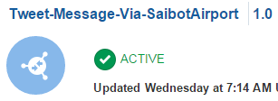
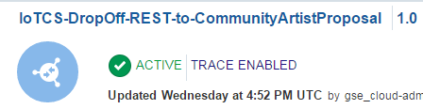
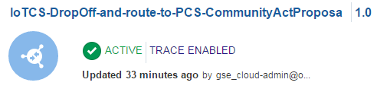
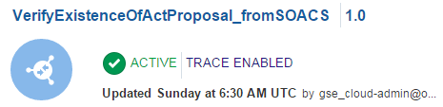
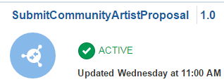
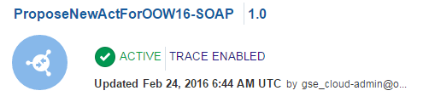
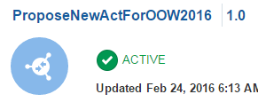
REST
(publishes a Tweet through SaibotAirport )
REST
(hand off artist finding in proprietary IoT CS JSON format); forwarded to SOA CS
SOAP
(returns Y or N depending on whether a proposal exists using SOA CS)
IoT CS
ICS
REST
(hand off artist finding in proprietary IoT CS JSON format); forwarded to PCS
SOA CS
REST
(submit a proposal for an artist in decent JSON format; links to PCS to ask for approval of the proposal
SOAP
(calls to SOA CS to create enriched proposal in DB; this service is to be called by PCS)
PCS
REST API
(calls to SOA CS to create enriched proposal in DB)

Slide 25
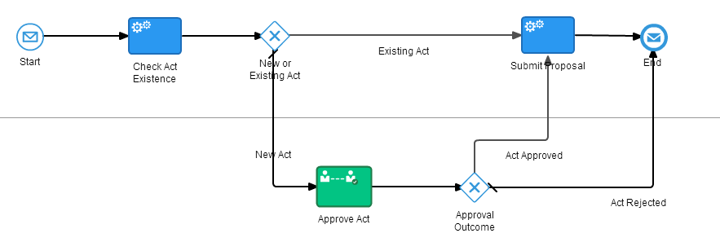
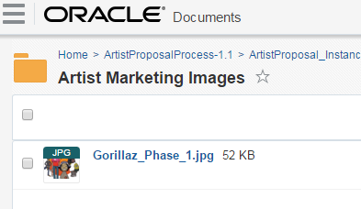
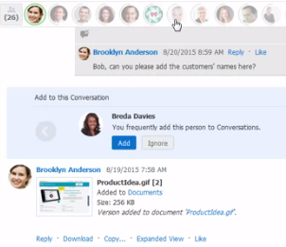
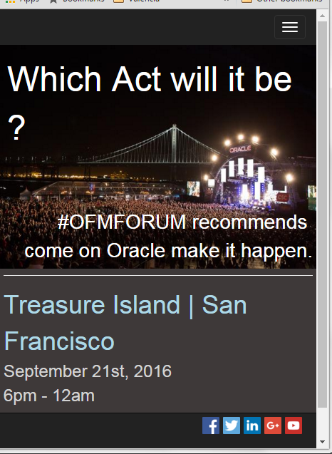
Microsites: http://tinyurl.com/ACEDCLOUD-KW
Content and Process
Doc Cloud used to store marketing images for display in JET app and Sites Page
PCS
Doc CS
OSN
Sites CS
Business Process receives IoT message and sends to reviewer for ennrichment and authorisation
Responsive Microsite Page Built with the authorised Image stored in DCS
Social Network used to discuss the marketing image, description and approval

Slide 26

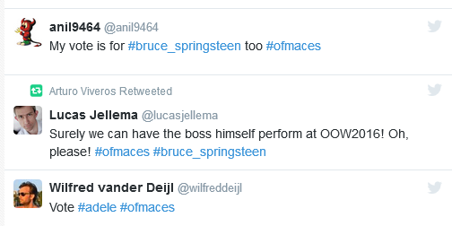
Now you tweet your Artist Proposal for OOW 2016
JET Web App : http://bit.ly/acesdemo
Use the hashtag #ofmaces to get noticed by IoT CS
and add your favorite artist as the second hashtag

