Slide 1

Javascript and ADF
Lucas Jellema
AMIS ADF SIG – July 2017

Slide 2
Agenda
What can using JavaScript add to the out of the box ADF 12c framework?
Introducing JavaScript
How do we plug our JavaScript into ADF Faces
Tooling, Debugging, logging, production preparation
Pure client side – richer and leaner
Integrating rich client 3rd party components
Client to Server communications – in addition to full page request and declarative partial page rendering and navigation
Server to Client communication
Trigger JavaScript after PPR, Pure Push

Slide 3
Why custom JavaScript in ADF?
Improve user experience
Faster & leaner
Richer
(pro) Active
Exploit HTML5 & 3rd party rich client components
Productivity & maintenance
Some things are much harder or even impossible on the server
Some things
Reduce load on server or network

Slide 4
Introduction Javascript
History
Standardization
Functions
Function as parameter
Callback
Closure
Variables
Untypes/dynamically typed
Scope
Object vs. JSON

Slide 5
Javascript in browser
Facilities
DOM manipulation
HTTP calls
Subscribe to SSE and WebSocket
HTML5 APIs (persistence, web worker, service worker, upload file, ..)
Driven by events
Browser (load page)
User activity
Time
jQuery
Notes:
Read files - https://www.html5rocks.com/en/tutorials/file/dndfiles/

Slide 6
Events around input element
Events happen on a component as a result of users action
And indirectly on parent and all ancestor components (bubble up)
Events can be handled by (JavaScript) event handlers
That respond to a specific event
That may cancel further bubbling of an event
That have access to the event object including a reference to the component that first triggered the event and the current component it has bubbled up to
That may be dynamically attached to components
Events can be triggered programmatically
Emulate a user action
Notes:
https://www.slideshare.net/scribbblings/the-fine-art-of-javascript-event-handling
On the Fly Tracer $.getScript('http://yphoenix.github.io/ jsEventTracer/Demo/jsEventTracer.js'); // OR (function(u) {var s=document.createElement("script");s.setAttribute(" type","text/ javascript");s.setAttribute("src",u);document.getElement sByTagName("head")[0].appendChild(s);})('http:// yphoenix.github.io/jsEventTracer/Demo/ jsEventTracer.js');

Slide 7


Events for an input element
cut
keypress
copy
paste
invalid
keydown
keyup
select
input
change
focus
The Value
blur
mousedown
mousemove
mouseout
mouseenter
mouseleave
dblclick
contextmenu
click
mouseup
auxclick
mouseover
wheel
Notes:
https://www.w3schools.com/tags/ref_eventattributes.asp
Live demo: http://yphoenix.github.io/jsEventTracer/Demo/Demo.html

Slide 8

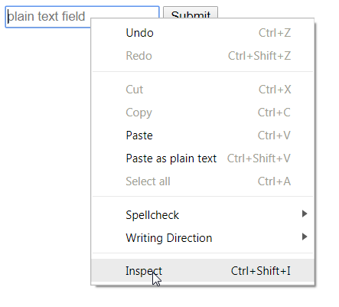
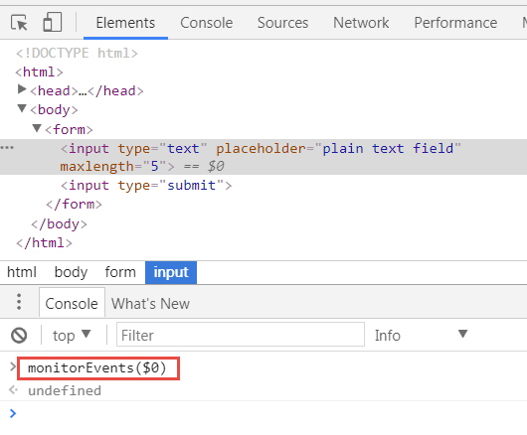
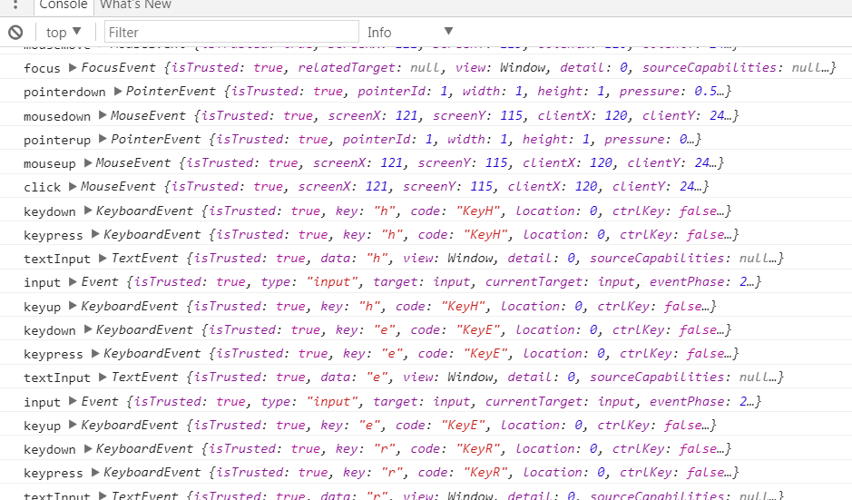
Finding out about events
Open page in Chrome browser
Rightclick on element
Select Inspect from Context Menu
Open the Console and type: monitorEvents($0)
The console will now show an event trace of events
Alternatively: use debugger to listen for selected events

Slide 9

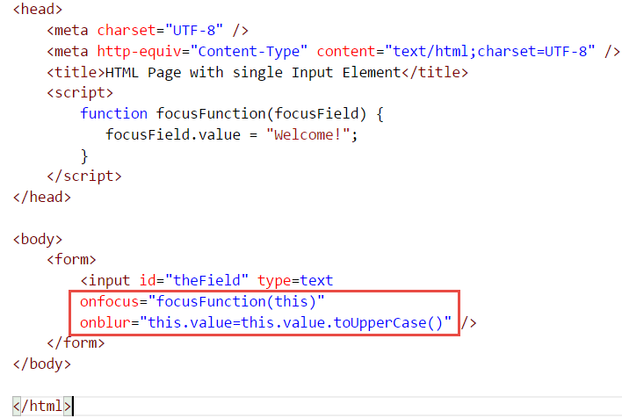
Respond to events: javascript event listeners
A JavaScript callback function can be associated with a specific event on an HTML DOM element
To get notified by the browser when the event occurs
To act on the event – prepare for, respond to manipulate, suppress, log, …

Slide 10
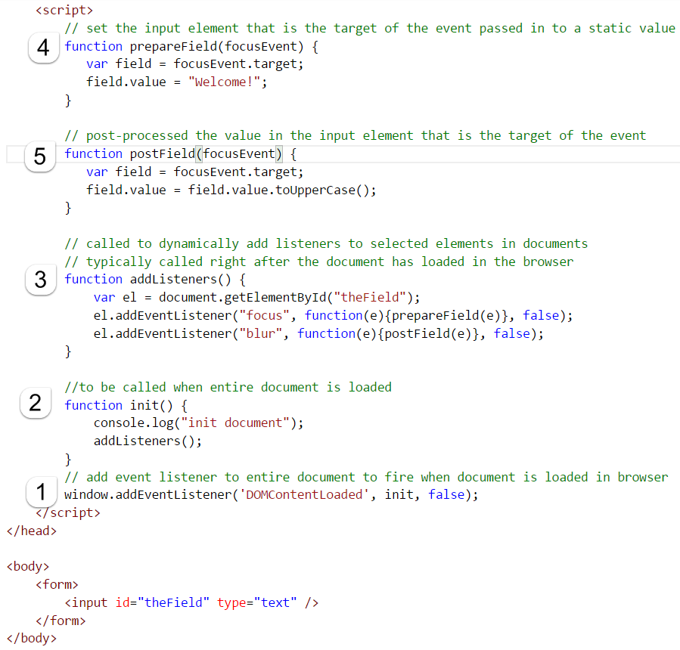
Event listeners can be added programmatically
Hooking into the ‘document has loaded’ event
Programmatically add event listeners for DOM elements
Note: also works on HTML documents rendered by ADF Faces

Slide 11
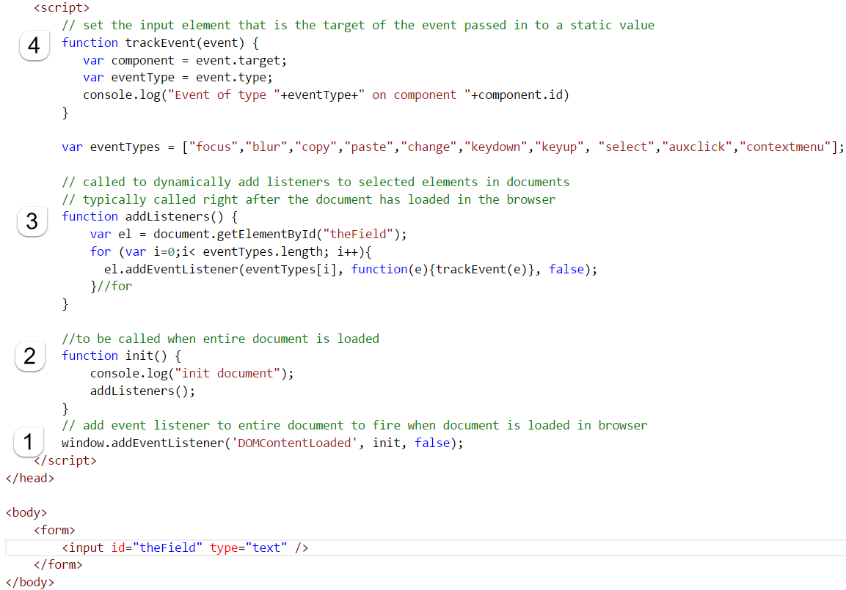
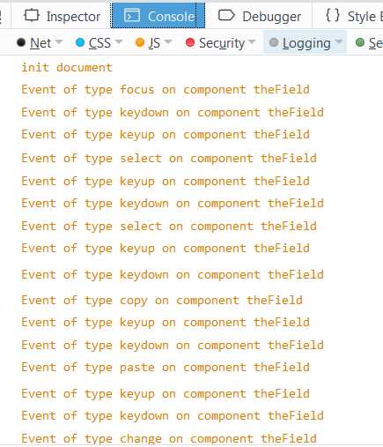
Tracking eventS to learn about which and when

Slide 12
Javascript in ADF Faces 12c
Out of the box
Rich components
Client side behavior for converters, validators
Lazy loading
Partial page refresh
Rich Client API
https://docs.oracle.com/middleware/1221/adf/api-reference-javascript-faces/toc.htm
Declarative hooks
Client Listeners
Notes:
http://download.oracle.com/otndocs/OTNVDD-REA/ppt/OTNVDD-Skinning&JavaScript.pdf
https://docs.oracle.com/middleware/1221/adf/develop-faces/GUID-CABBFBE1-6D7B-4818-A666-3F6A241A1471.htm#ADFUI361
http://www.oracle.com/technetwork/developer-tools/jdev/1-2011-javascript-302460.pdf

Slide 13
Inject JS into ADF
Snippet in Client Listener
Snippet in af:resource tag
Local file loaded in af:resource tag
Verbatim – file loaded from local web server or remote server
JS written in ADF server
through Extended RenderKit Service
through servlet filter directly on HTTP response

Slide 14
Example: force value in input text to uppercase
Server side valueChangeListener
CSS style
onChange
onBlur?
Or: onKeyUp
Notes:
Check https://docs.oracle.com/middleware/1221/adf/api-reference-javascript-faces/toc.htm
https://docs.oracle.com/middleware/1221/adf/api-reference-javascript-faces/oracle/adf/view/js/component/rich/input/AdfRichInputText.html

Slide 15
Client listener
“Keyboard and mouse events wrap native DOM events using the AdfUIInputEvent subclass of the AdfBaseEvent class, which provides access to the original DOM event and also offers a range of convenience functions for retrieval of key codes, mouse coordinates, and so on. The AdfBaseEvent class also accounts for browser differences in how these events are implemented. Consequently, you must avoid invoking the getNativeEvent() method on the directly, and instead use the AdfUIInputEvent API.”
Notes:
https://docs.oracle.com/middleware/1212/adf/ADFUI/af_event.htm#ADFUI12242

Slide 16
Javascript development Tools, debugging, logging
Browser Console
Browser Developer Tools
See JavaScript!
See network traffic
Debugging
Logging
ADF Logger
Assertions

Slide 17
Pure Client – Richer UX
Force correct input (uppercase, number, postal code)
Instant validation and conversion
Add message on component (cookbook)
Smart Data Entry
Intra page navigation – vertical scrolling (scroll component into view), arrow based navigation
Focus on relevant component
Show/Hide and Enable/Disable components; prepare LOVs/Dropdown
Copy & Derive values
Use rich popups for data entry (without server interaction)
Suppress standard browser context menu
Use of Function Keys and Shortcuts

Slide 18
On page load/on ppr
<af:document>
<af:clientListener method="init" type="load"/>
Partial Page Refresh
Add to ERKS
Property change listener (map from bean timestamp, add as partial target)

Slide 19
Find components
Event source
Relative
Absolute
“trick” using dummy css class
Warning: compression/obfuscation
Using clientAttribute, UI Component, Bean
Duncan Mills’ method

Slide 20
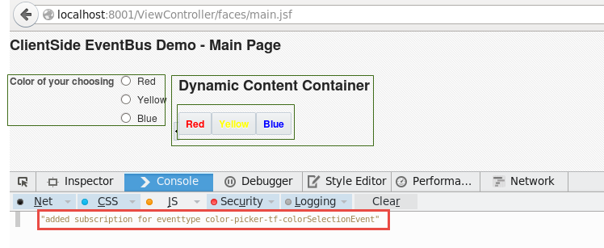
Page
Taskflow
Taskflow
Fragment
Fragment
Taskflow
Fragment

Slide 21


1. Subscribe to the ‘color selection event’ – register JavaScript function as callback consumer
2. (when button is pressed ) Publish an instance of the ‘color selection event’ – with the color in the payload
3. Invoke callback function with the payload of the published instance of the event
Page
Client Side Event Bus
Taskflow
Taskflow
Fragment
Fragment
Taskflow
6. Partial Refresh of SelectOneRadio (governed from server)
Fragment
serverListener
4. Process payload of event and manipulate select one radio; also queue custom event for serverListener
JavaScript function
Server
MenuBean
5. Push custom event with color payload to server
handleColorSelection(ClientEvent) { retrieve new color set bean color proprty add selectOneRadio as partial target
componentReference to selectOneRadio

Slide 22
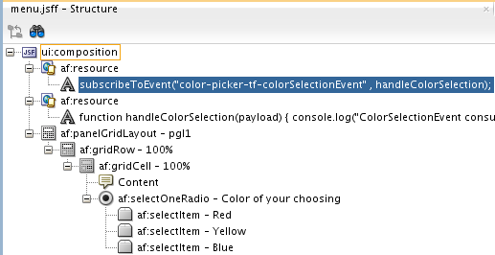
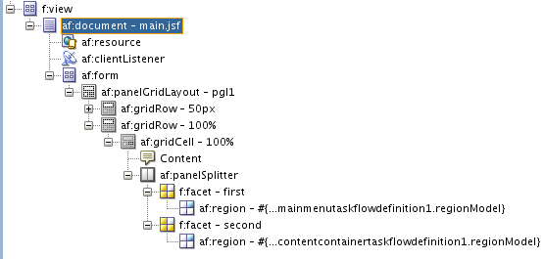
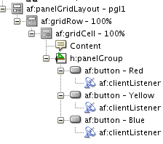
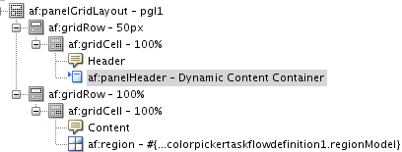

Slide 23
Integrate 3rd party components
HTML5 Components and APIs
Drag & Drop, SVG, Canvas, Media, GeoLocation
Persistence, WebWorker, Service Worker
Use jQuery/Dojo/… in ADF Faces
Google Maps
D3
Client Side Event Bus
Generate JSON into client from ADF Data Binding
For LOVs/dropdown, smart conversion in rich text, fuel 3rd part components

Slide 24
Client
JavaScript
Components
manipulate
component
JavaScript Function
clientListener
user action
component
partialSubmit autoSubmit
component
user or programmatic action
Load JSON, CSS, Image, XML, JS
Request data or Push message
property change
poll
partial triggers, added targets
setPropertyListener
Queue Custom Event
serverListener
ERKS ‘ppr script’
activeOutputText
partial page refresh
Full page reload
push
Server (middle tier)
add JS to execute (ERKS)
component
activeOutputText
add components as partial target
component
actionListener, valueChangeListener, …Listener
Bean
serverListener
Object
Active Data Model
Beans & Objects
Components
push (DB QRCN)
Database

Slide 25
Client to server communications
PPR – declarative
setPropertyListener
Through JavaScript: queue action on button with partialSubmit
Target tag – specify which components to submit and to refresh (cookbook)
Server Listener
Plain old Ajax
ITank Help button
Function Key triggers server side operation
Create record, delete record, validate/calculate something
Extend client side event bus
Have taskflow respond server side to other taskflow
Property Listener? (used in ADS Nudge)
Partial Navigation (cookbook)

Slide 26
Partial Page Refresh
Several aspects to PPR
Only update selected areas in a page
Update areas that have “expressed their interest” (partialTriggers) in certain “change agents” (updated fields, clicked upon buttons and links, …)
Allow activation through an AJAX background call (rather than a full page post)
Programmatically add candidate UI components to be refreshed
Using method addPartialTarget(UIComponent) on AdfFacesContext
Auto PPR through Change Event Policy property on ADF BC based data bindings
That make UI components associated with a changed ADF BC bindings refresh

Slide 27
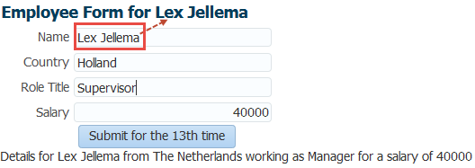
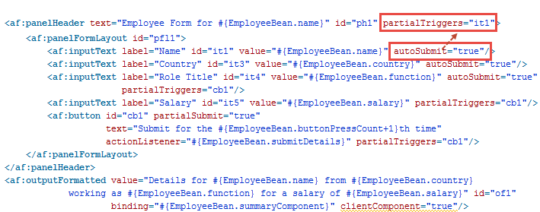
Demo
autoSubmit is similar to publish
partialTriggers is similar to subscribe

Slide 28
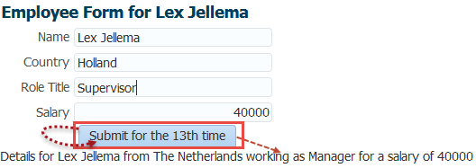
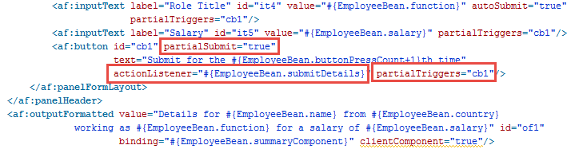

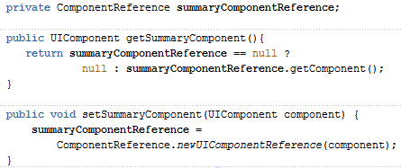
Explicit, Programmatic PPR

Slide 29
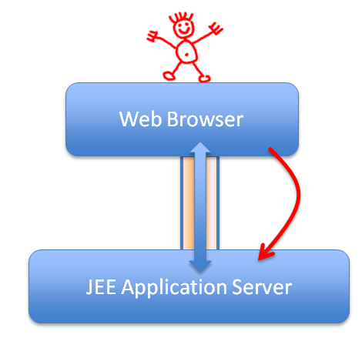
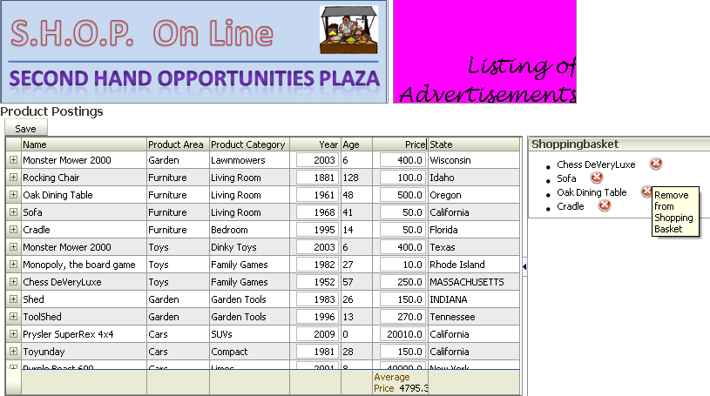
Use setPropertyListener to push data to the server
The setPropertyListener will pass from value to the to target when type event occurs on parent
A very simple way to inform the server about an event and the data associated with the event
Supported types: action, focus, poll, query, rangeChange, selection, sort, rowDisclosure, valueChange and many more
<af:image id="removeFromSetImage“
source="/images/removeFromSet.png“
shortDesc="Remove from Shopping Basket"/>
<af:setPropertyListener from="#{item}“
to="#{shoppingBasket.itemToRemove}"
type="action"/>
</af:commandLink>

Slide 30
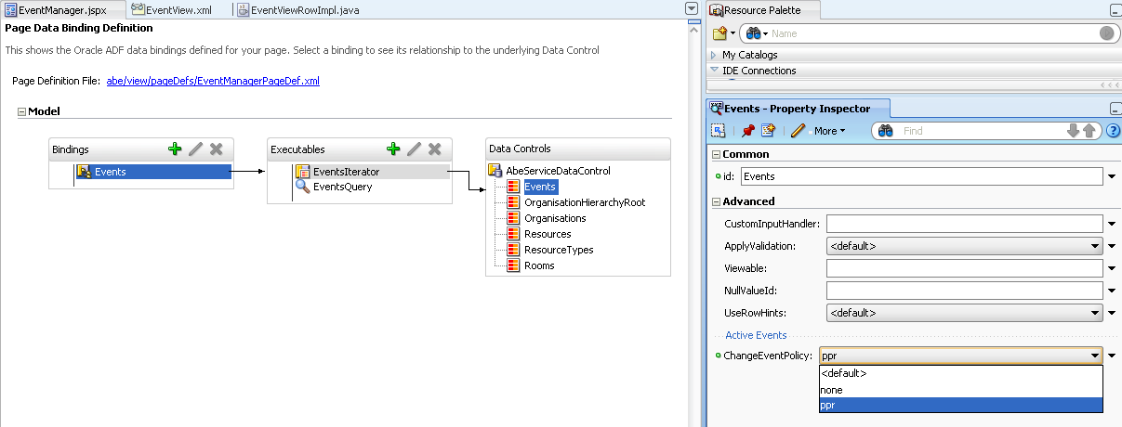
Auto-PPR for immediate refresh of Data Bound components
To have ADF automatically refresh data bound components when underlying value binding has changed its value
Set changeEventPolicy=ppr on iterator
Refresh as piggy back on any request cycle
No partialTriggers attribute required!
Notes:
%

Slide 31
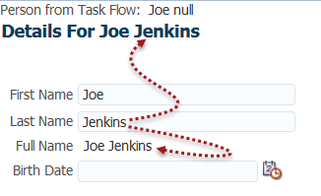
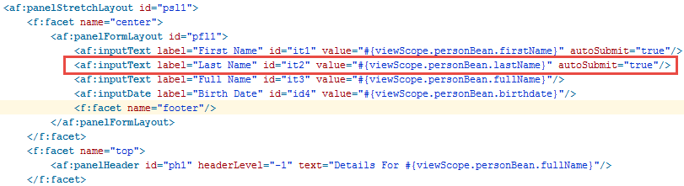
Custom Smart Auto PPR
http://www.adfplus.com/2013/05/automatic-partial-page-rendering-across.html
Notes:
http://www.adfplus.com/2013/05/automatic-partial-page-rendering-across.html

Slide 32
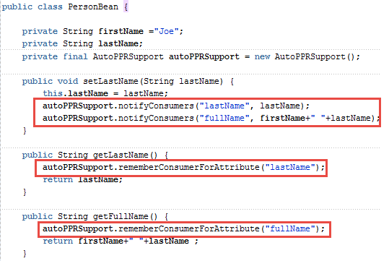
Implicit subscribe and publish from a regular managed bean
Subscribe to auto ppr through a call to getLastName() and getFullName()
Get PPR-ed whenever the setLastName() has been invoked

Slide 33
(implicit) subscription to be notified
AutoPPRSupport
::ph1
::it3
notifyConsumer
PersonBean
rememberConsumer
lastname
set
fullname
fullname
get

Slide 34
Flow from (implicit) subscription to notification
PPR:
::ph1
::it3
AutoPPRSupport
::ph1
::it3
fullname
notifyConsumer
PersonBean
rememberConsumer
lastname
set
fullname
fullname
get

Slide 35
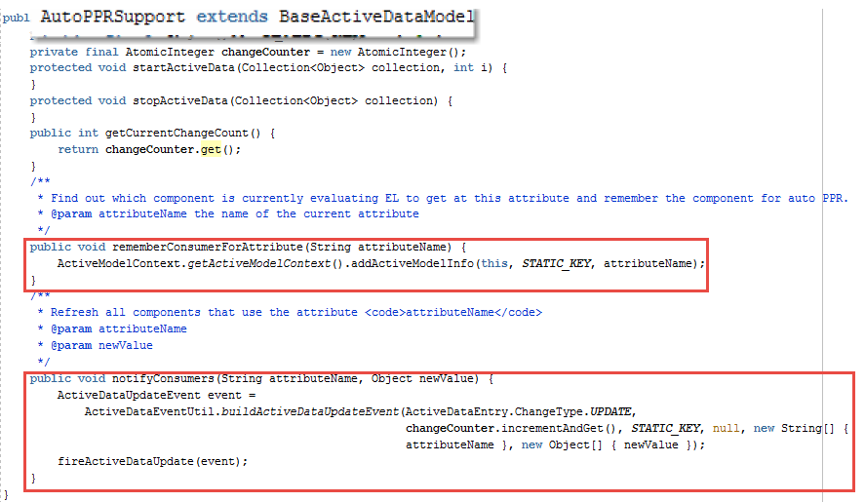
Underlying magic…
Reusing the logic behind the auto-ppr for ADF BC bindings

Slide 36
Client to server
Block user input
customEvent.preventUserInput(); customEvent.queue(isPartial)
To let the framework know that no response is expected, you use the AdfBaseEvent.noResponseExpected() method.
Notes:
https://docs.oracle.com/middleware/1221/adf/develop-faces/GUID-CABBFBE1-6D7B-4818-A666-3F6A241A1471.htm#ADFUI361
6.3.4 How to Block UI Input During Event Execution

Slide 37
Server to client
ERKS
Set focus - https://blogs.oracle.com/jdevotnharvest/how-to-programmatically-set-focus-on-an-input-component
Lazy loading
Poll
True Push
ADS, SSE, WebSocket
Notes:
https://blogs.oracle.com/jdevotnharvest/how-to-programmatically-set-focus-on-an-input-component

Slide 38



Blog: technology.amis.nl
Email: lucas.jellema@amis.nl
: lucasjellema
: lucas-jellema
: www.amis.nl, info@amis.nl +31 306016000 Edisonbaan 15, Nieuwegein

