Slide 1
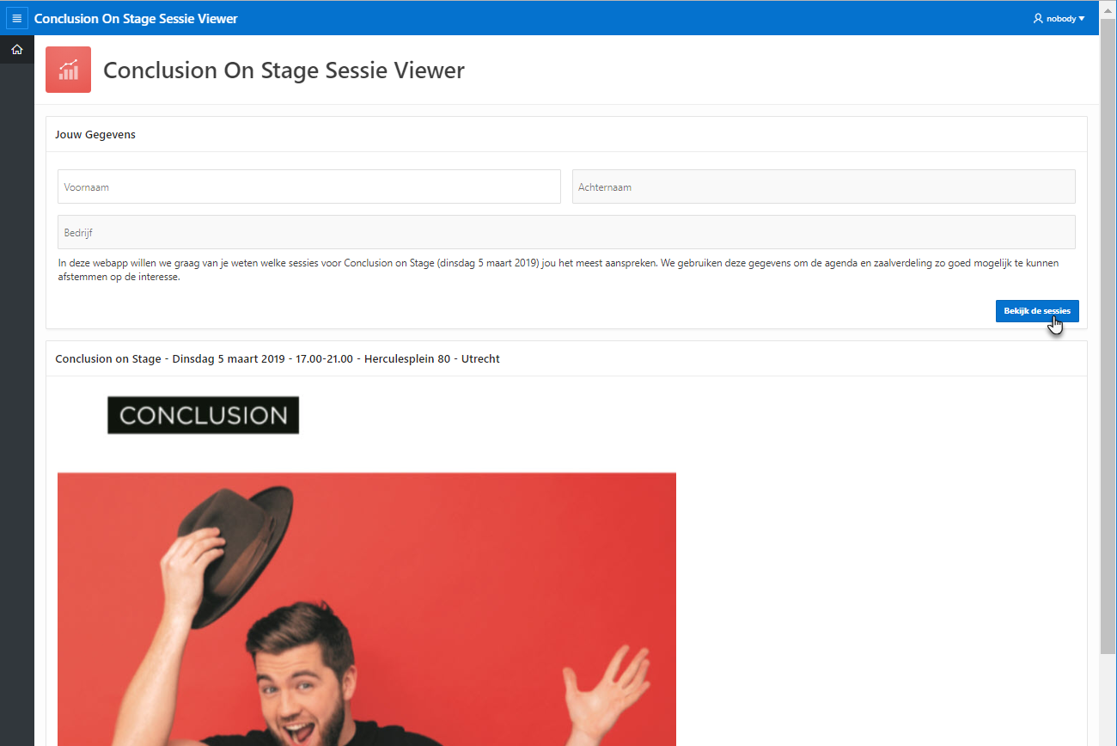
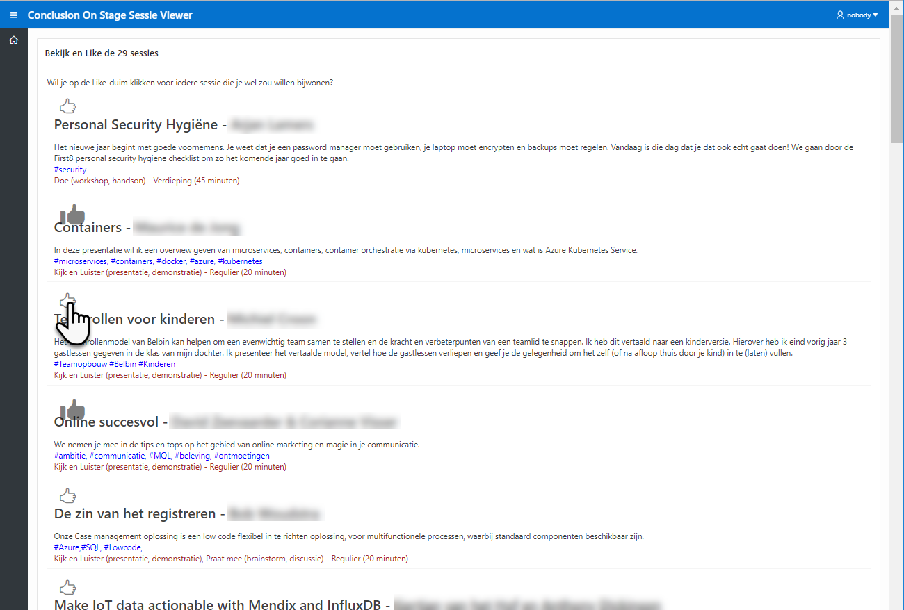
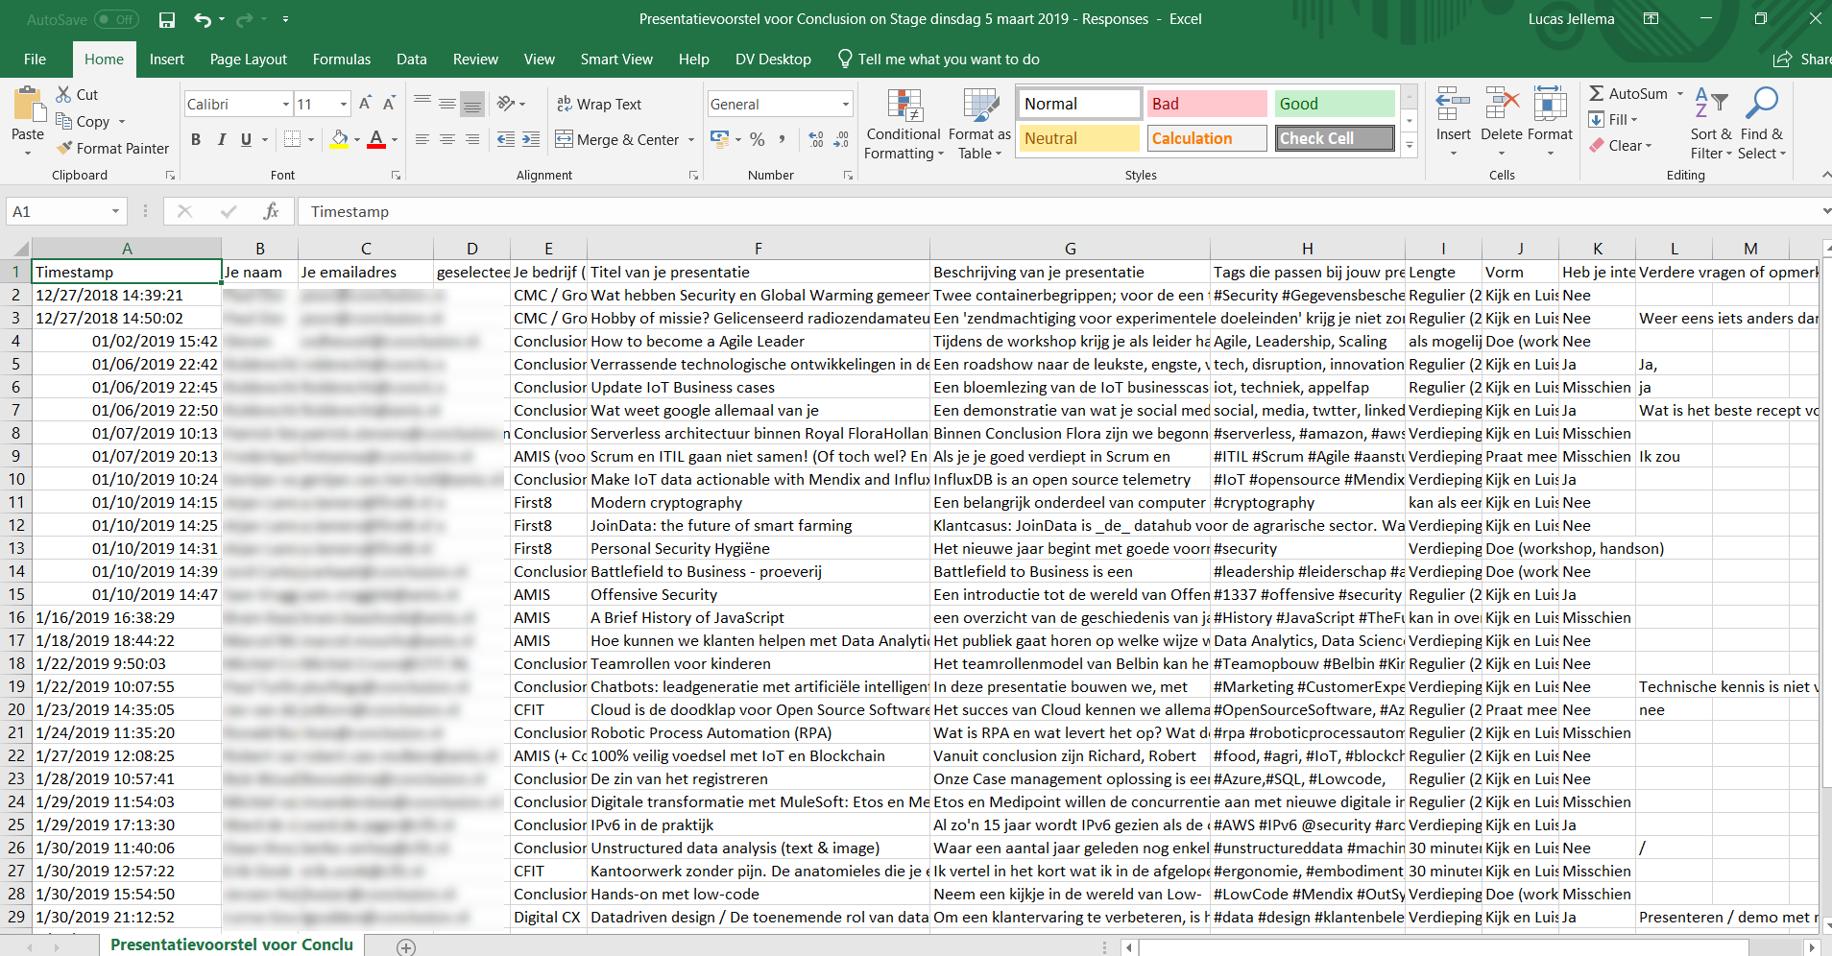
9
PL/SQL: Generate Like Records for Colleague - using P4_COL_ID
6
3
Link to Page 4 – copy P1_ID to P4_COL_ID
2
P1_ID
11
JavaScript: - toggle image
- set value of P4_LIKE_ID
Hidden item, default value SYS_GUID()
7
P4_COL_ID
4
P4_LIKE_ID
APEX Session State
12
8
P1_ID
P4_COL_ID
query
13
WHERE COL_ID = APEX_UTIL.GET_SESSION_STATE ('P4_COL_ID')
Dynamic Action
Update LIKES … where id = substr(:P4_LIKE_ID,2);
10
V_SESSION _LIKES
Colleagues
5
insert
Likes
1
Sessions
14

