Slide 1
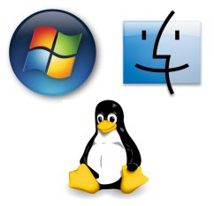


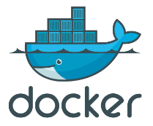


Slide 2


Slide 3
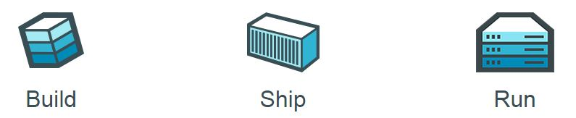

Node application
checkpoint
Node application
start from checkpoint

Slide 4


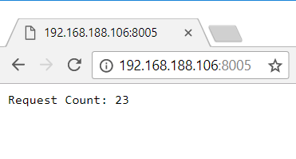
2
3
Node application
4
1
checkpoint
5
6
7
Node application
start from checkpoint
8

Slide 5
Manage Test Data Set for (automated) tests After a new (Sprint) Release
Run Container for Previous Release
Apply DDL to Upgrade Application
Manage Data Set – test cases to cater for new features
Commit and Tag with new (Sprint) Release label
AppTest:R17.49.1
AppTest:R17.51.1
DDL
R17.51.1
DML scripts or Export for Test Data Updates R17.51.1

Slide 6

Run (Automated) Test using Docker Snapshot (1)
docker container run
-d -p 1521:1521
--name=AppTestR17491 -rm AppTest:R17.49.1
Run container image for designated release
start database
Create Container Checkpoint for running container
AppTest:R17.49.1
Oracle Database
Test Data
Application
docker checkpoint create --checkpoint-dir=${chkptdir}
--leave-running=false AppTestR17491 AppTestR17491CheckPoint
Oracle Database
Test Data
Application
AppTestR17491CheckPoint
Notes:
https://docs.docker.com/engine/reference/commandline/checkpoint_create/

Slide 7

Run (Automated) Test using Docker Snapshot (2)
AppTestR17491CheckPoint
Start Container Checkpoint
0..3 seconds
Execute test
No set up, no tear down
Stop Container
Next test – or even in parallel
Oracle Database
Test Data
Application
Oracle Database
Test Data
Application
docker container start -–checkpoint=AppTestR17491CheckPoint
--checkpoint-dir=${chkptdir}
AppTestR17491
AppTest:R17.49.1
Notes:
https://docs.docker.com/engine/reference/commandline/checkpoint_create/
https://yipee.io/2017/06/saving-and-restoring-container-state-with-criu/

