Slide 1
Proposals are submitted for an artist to perform at an event
Initiated
ProposalId
In Process
Each proposal is checked for duplicates, then validated (against business rules)
Artist
Event
#votes
motivation
Duplicate
Invalid
Surviving proposals are submitted to a human actor for triage (approve/reject)
Under Consideration
One or more approved proposals are selected to enter negotiotation phase with artist
Rejected
Approved
Under negotiation
When the negotation is successful, the proposal is converted to ‘engagement’; all other proposals are closed at that point
When the negotation is not successful, the proposal is converted to ‘not feasible’. Another one of the approved proposals can now be promoted
Engagement
Closed
Not feasible

Slide 2
EvaluateArtistProposal
SOA Composite
SendInArtistProposal
SOAP
BR
B
SOA Composite
M
SOA Composite
T
B
JudgeArtistProposal

Slide 3
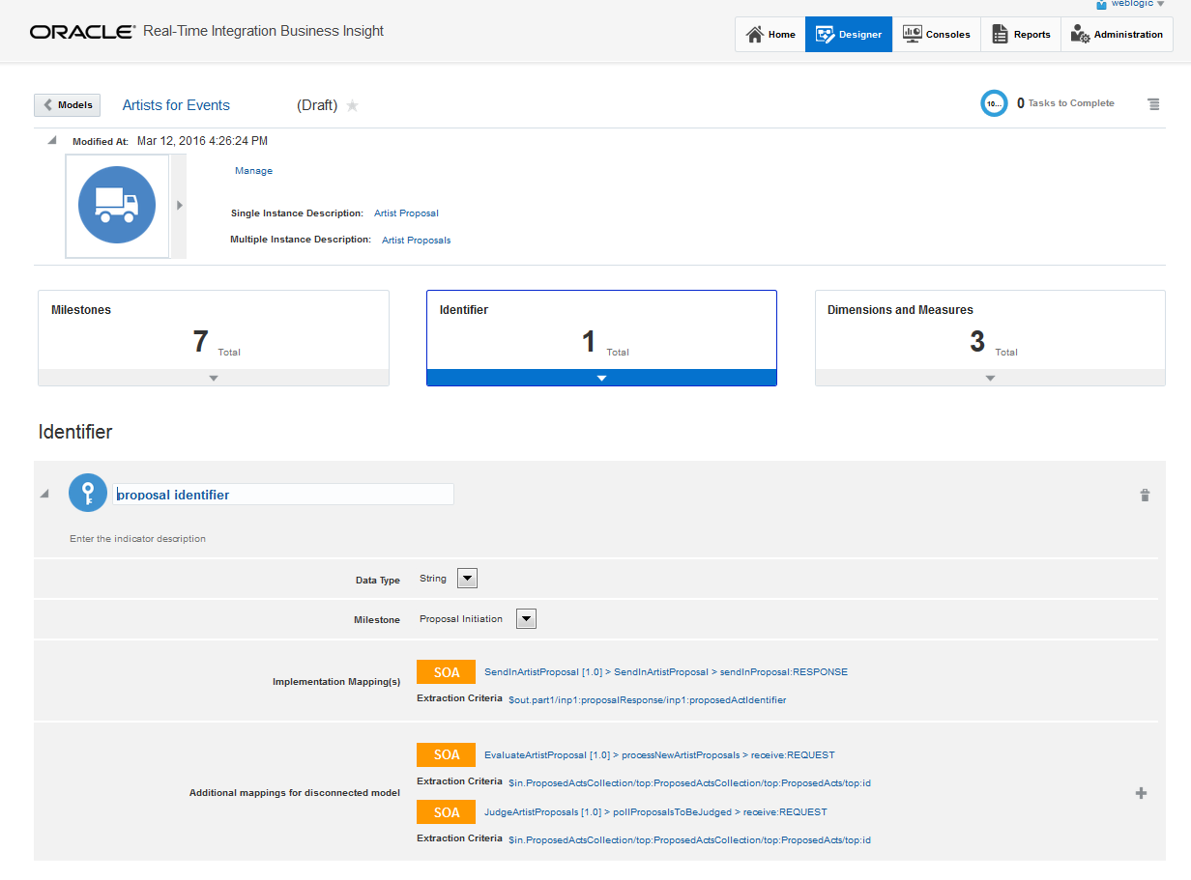

Slide 4
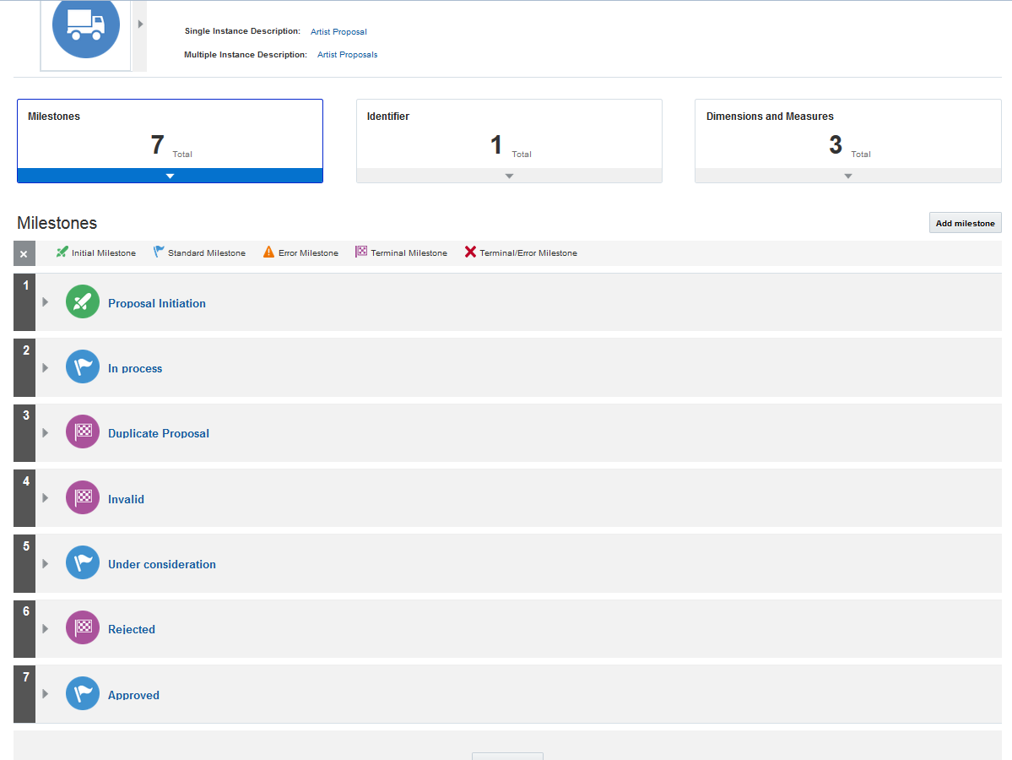

Slide 5
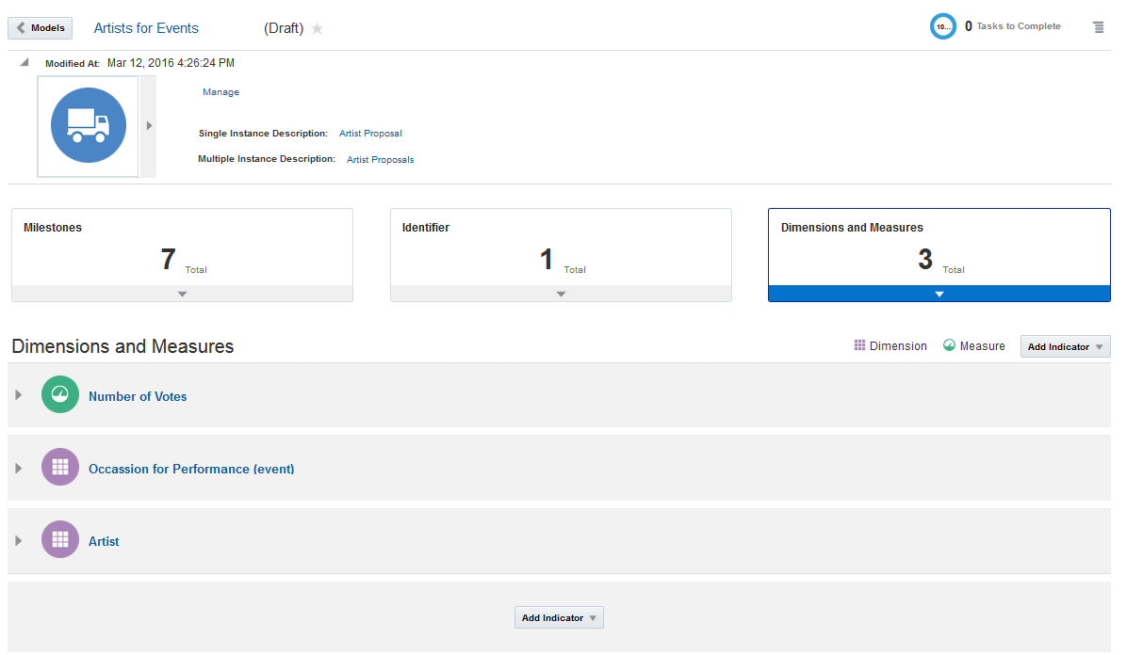

Slide 6
EvaluateArtistProposal
SOA Composite
SendInArtistProposal
SOAP
BR
B
SOA Composite
REST
M
SB
PS
SOA Composite
BS
PL
T
B
JudgeArtistProposal

