Slide 1
Proposals are submitted for an artist to perform at an event
Initiated
ProposalId
In Process
Each proposal is checked for duplicates, then validated (against business rules)
Artist
Event
#votes
motivation
Duplicate
Invalid
Surviving proposals are submitted to a human actor for triage (approve/reject)
Under Consideration
One or more approved proposals are selected to enter negotiotation phase with artist
Rejected
Approved
Under negotiation
When the negotation is successful, the proposal is converted to ‘engagement’; all other proposals are closed at that point
When the negotation is not successful, the proposal is converted to ‘not feasible’. Another one of the approved proposals can now be promoted
Engagement
Closed
Not feasible

Slide 2
EvaluateArtistProposal
SOA Composite
In Process
SendInArtistProposal
REST
BR
Duplicate
B
Invalid
Artist
Event
#votes
motivation
Service Bus
Under Consideration
Pipe
line
Initiated
SOA Composite
T
B
Rejected
Approved
JudgeArtistProposal

Slide 3
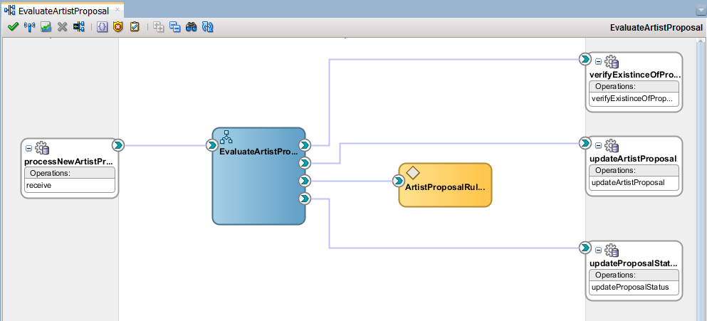
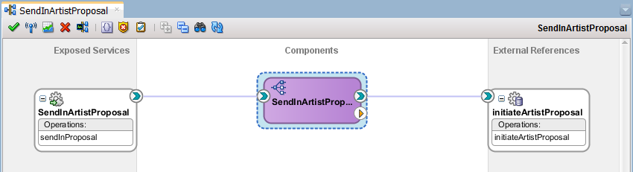
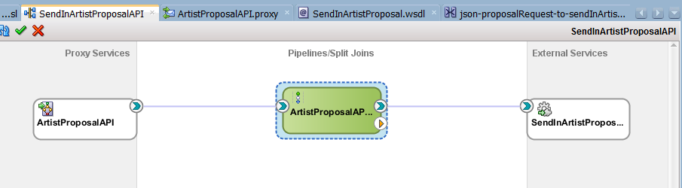
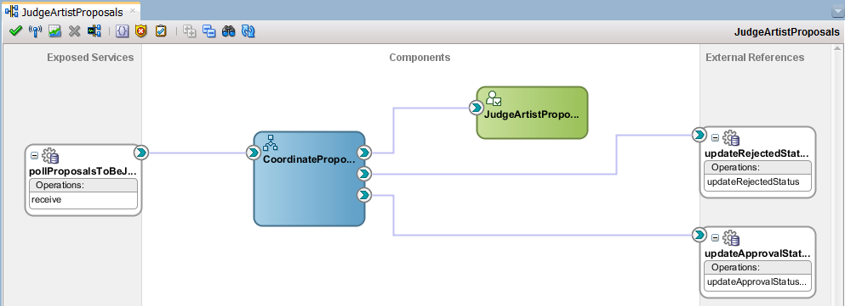
In Process
Duplicate
Invalid
Under Consideration
Initiated
Rejected
Approved

Slide 4
AgentNegotiator
SOA Composite
BR
NegotiateAndEngage
B
SOAP
ProposalIdentifier
MaximumFee
SOA Composite
Under Negotiation
BPEL
SOA Composite
B
Not Feasible
Closed
Engagement
ProposalClosure

Slide 5
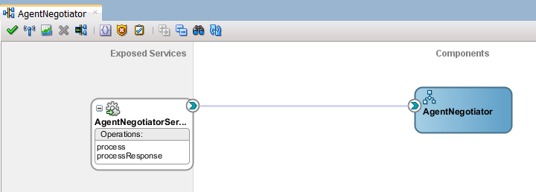
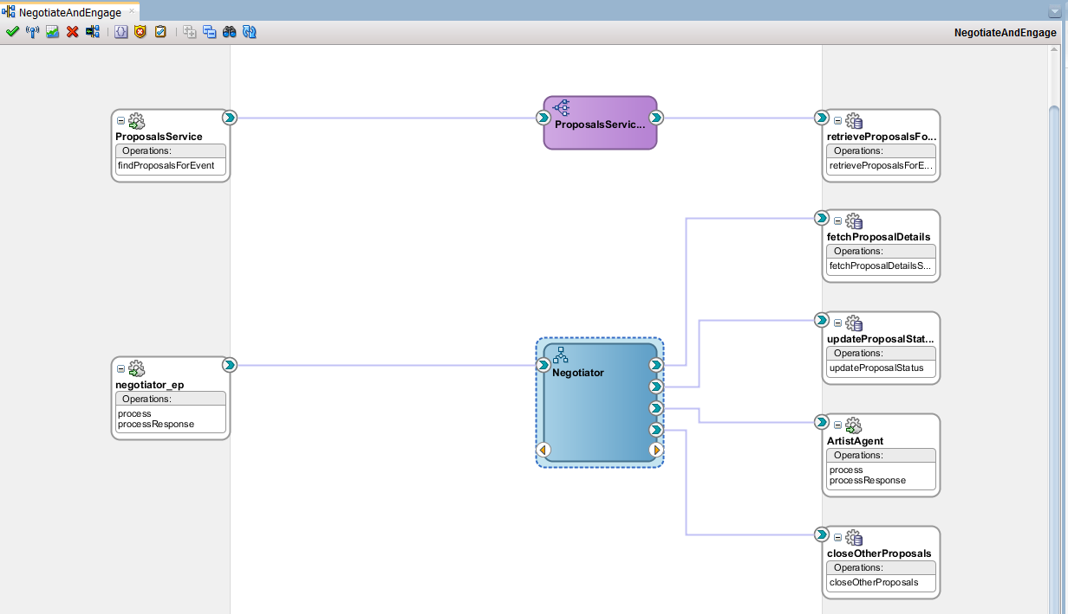
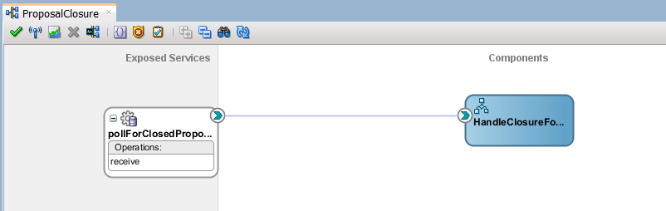
Under Negotiation
Not Feasible
Engagement
Closed

Slide 6
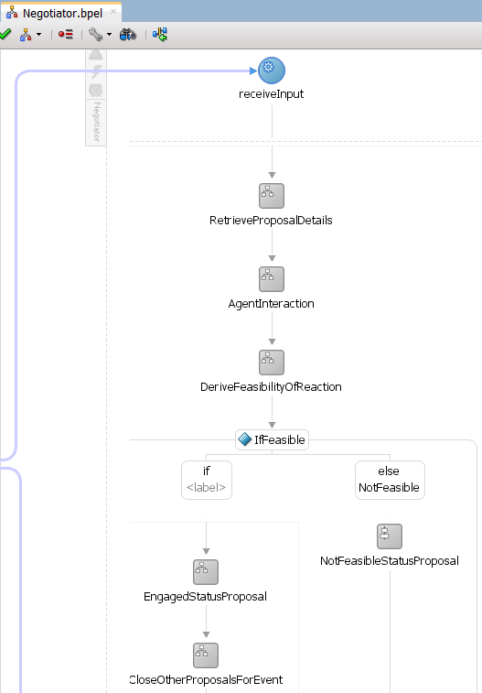
Under Negotiation
Not Feasible
Engagement

Slide 7
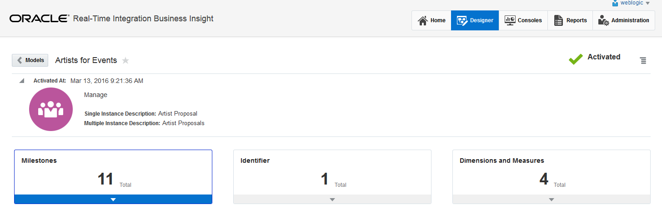

Slide 8
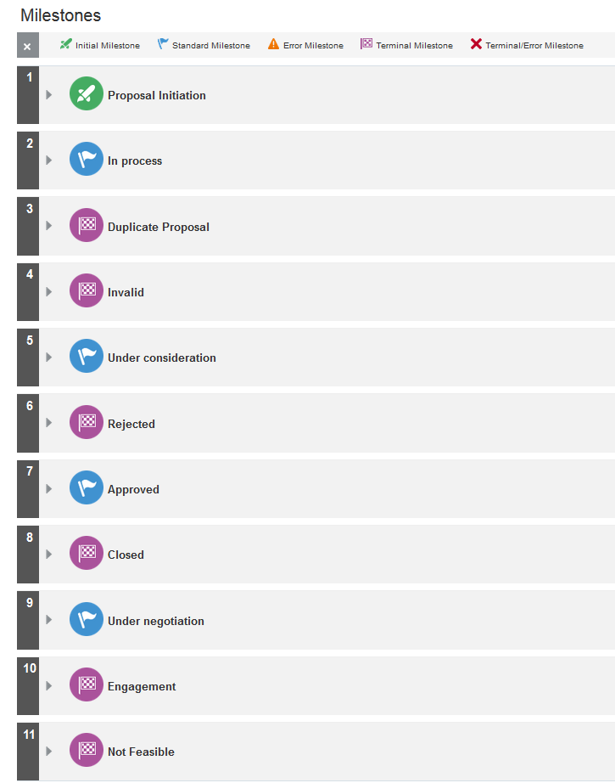

Slide 9
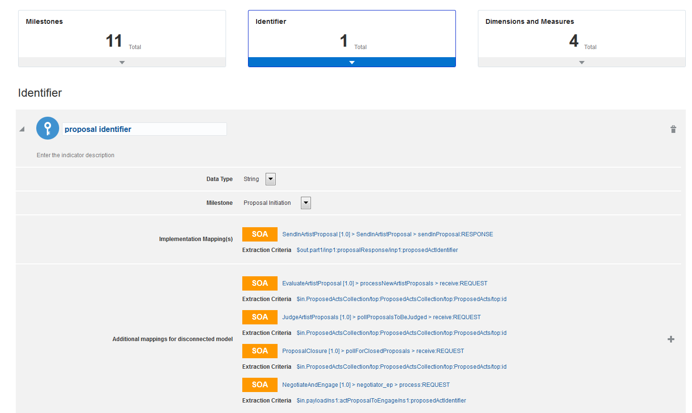

Slide 10
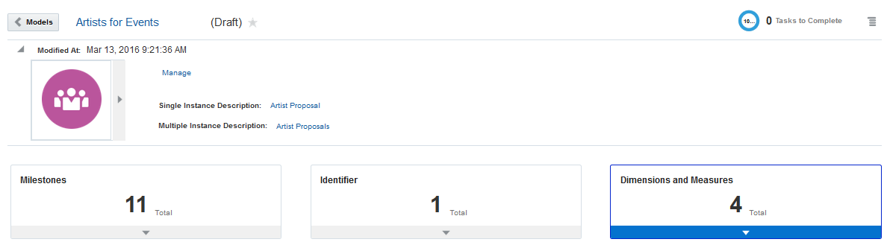
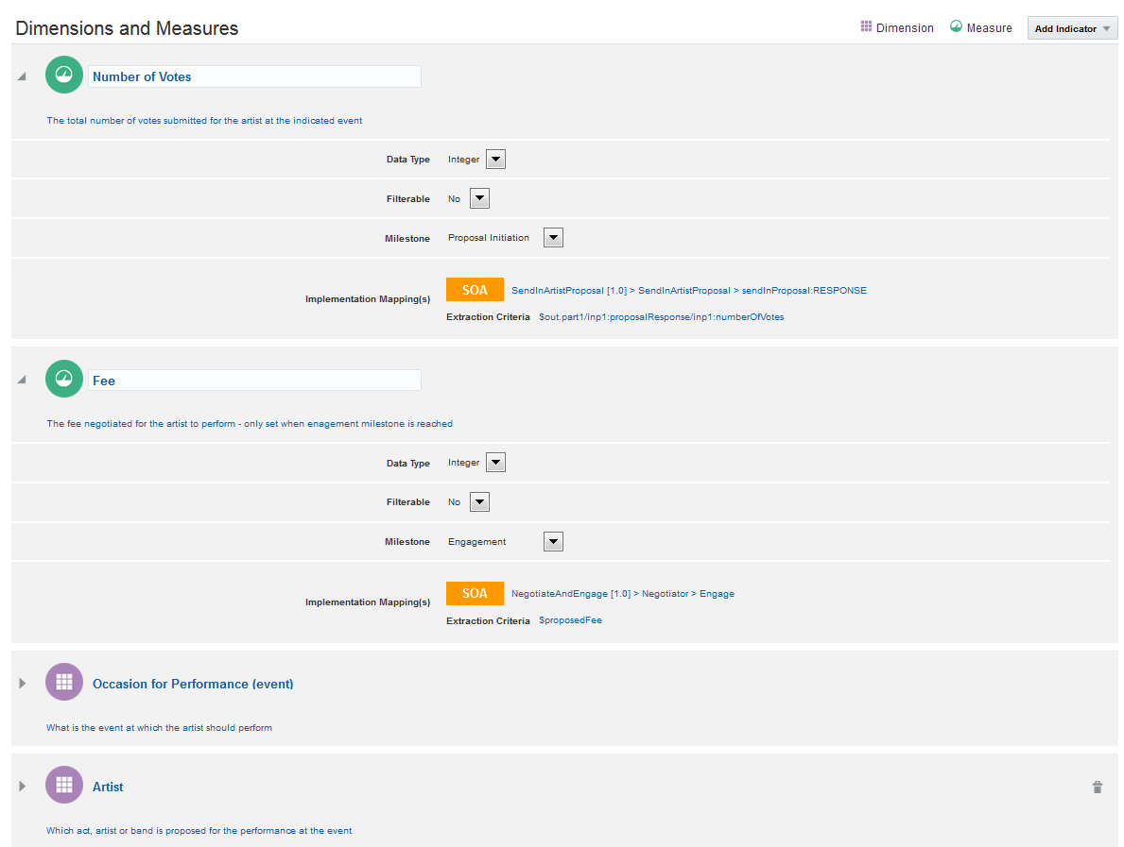

Slide 11
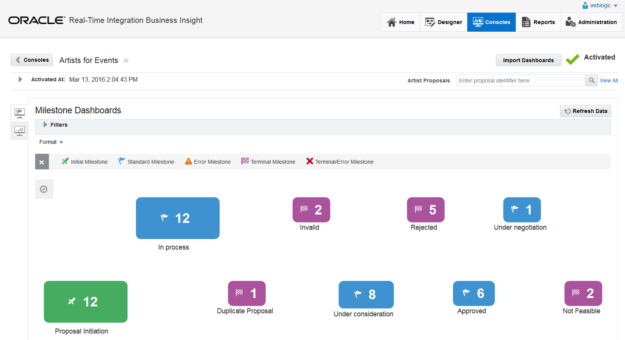

Slide 12
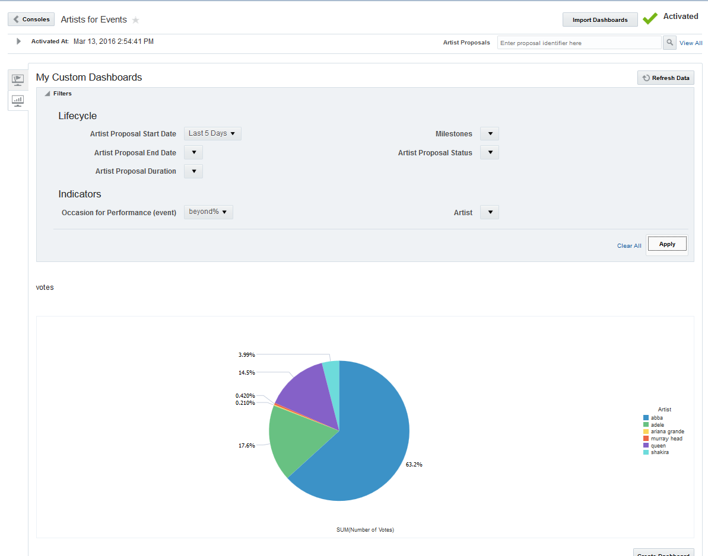

Slide 13
EvaluateArtistProposal
SOA Composite
SendInArtistProposal
SOAP
BR
B
SOA Composite
REST
M
SB
PS
SOA Composite
BS
PL
T
B
JudgeArtistProposal

Slide 14
Each call made for a specific identifier heralds a new milestone for an instance tracked by Insight
SOA Composite
BPEL
For each id in set
call DB procedure (to update a row)

