Slide 1
EvaluateArtistProposal
SOA Composite
SendInArtistProposal
SOAP
BR
B
SOA Composite
M
SOA Composite
T
B
JudgeArtistProposal

Slide 2
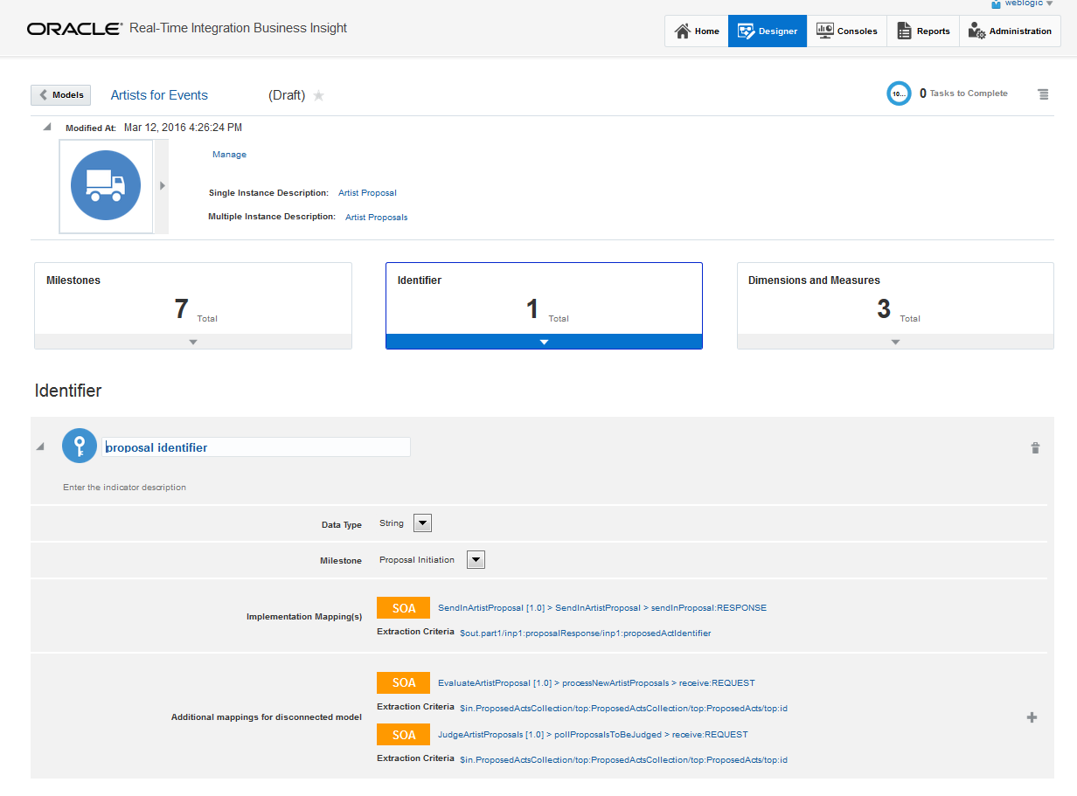

Slide 3
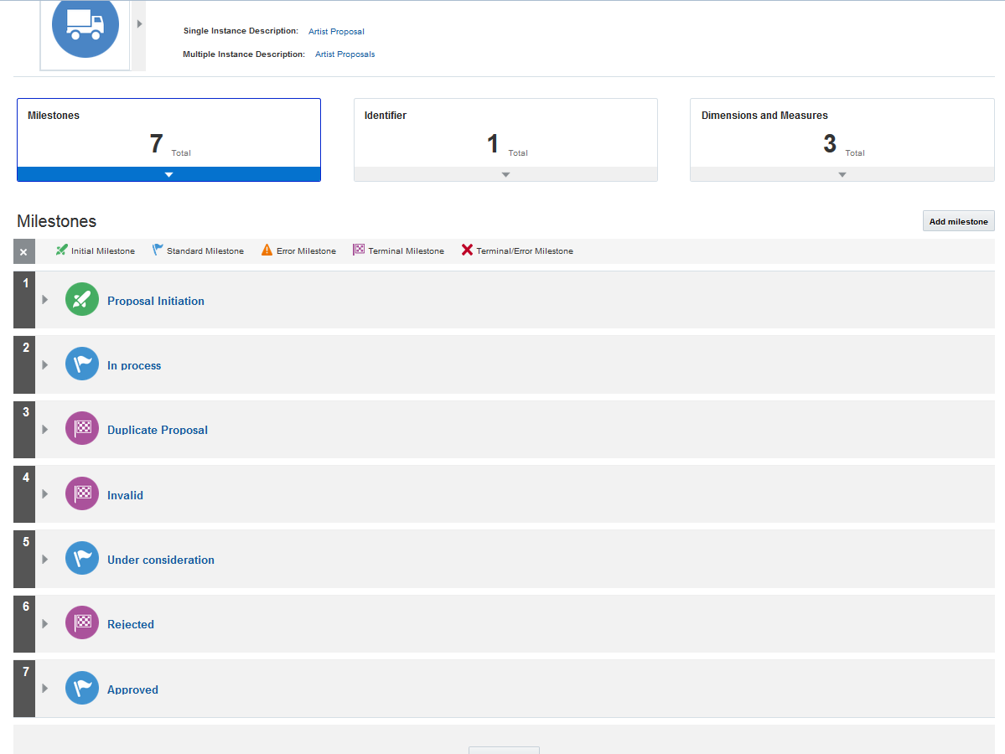

Slide 4
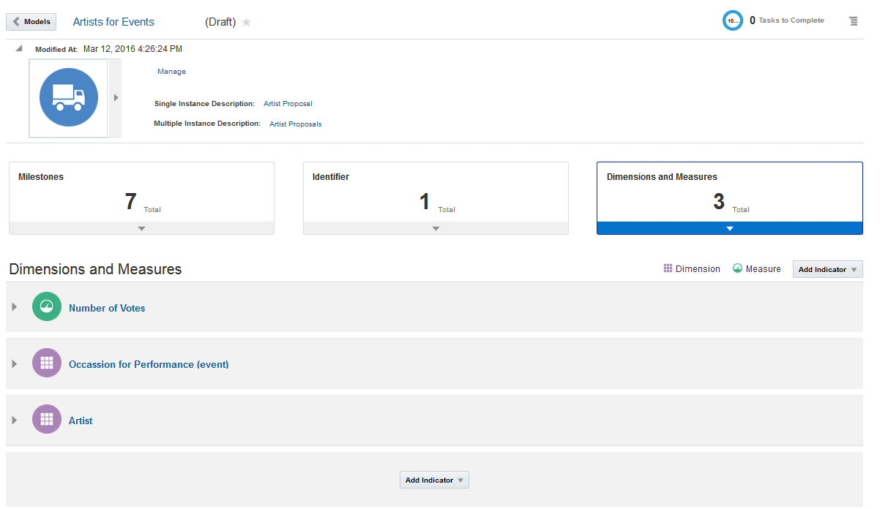

Slide 5
EvaluateArtistProposal
SOA Composite
SendInArtistProposal
SOAP
BR
B
SOA Composite
REST
M
SB
PS
SOA Composite
BS
PL
T
B
JudgeArtistProposal

