Slide 1

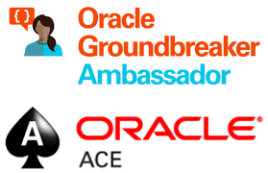

Triple C - Centralize, Cloudify and Consolidate Dozens of Oracle Databases
SPOUG 2021 – Madrid, Spain, November 3rd, 2021
Lucas Jellema, Architect & CTO AMIS | Conclusion
Notes:
Session Code: SP21AUD006
Name: Lucas Jellema
Email: lucas.jellema@amis.nl
Position: Architect
Twitter: https://twitter.com/lucasjellema
Linkedin: https://www.linkedin.com/in/lucas-jellema/
Bio: Lucas Jellema is solution architect and CTO at AMIS and member of the Conclusion Architecture Board, The Netherlands. The running theme through most of his activities is transfer of knowledge and enthusiasm (and live demos). Lucas is JavaOne 2015 Rockstar, Oracle Groundbreaker Ambassador and ACE Director and a frequent speaker at conferences such as Oracle Code, Oracle OpenWorld, CodeOne (JavaOne), Devoxx and on Groundbreaker tours. He publishes techy stuff at Github, Medium, Slideshare, DZone, OTN, and the AMIS Technology Blog (https://technology.amis.nl). He is the author of two books with O’Reilly Press.
Session Title: Triple C - Centralize, Cloudify and Consolidate Dozens of Oracle Databases
Area of Interest: Database, Security & Cloud Infrastructure
Date & Time (in CET Time) Scheduled: 03-11-2021 15:30
Location Scheduled: OnSite Madrid: Auditorium of Casa del Lector
Session Description: Dozens of Oracle Databases - each health center location has one on its local server with the same data model and the same set of applications. These databases have to be centralized and cloudified and also be consolidated into one or as few databases as possible. To lower costs, ease operations and enable innovation. Each location can access only its own data, applications do not have to be changed and different locations can run different versions of applications and database objects. This is the story of a critical migration. About the cloud ready analysis, the Proofs of Concept with Oracle Database features VPD and Edition Based Redefinition, the scalability investigation, the redesign of change management, rollout and operational management processes and the careful modernization of a 25 year old platform on the latest database release and a shiny new, fully automated cloud platform. This is the story of an organization that had state of the art systems in the mid-90s. And they have these same systems today - no longer state of the art. They can keep the systems alive, but barely, and at increasing cost. In the Fall of 2020, we started an investigation into the feasibility of bringing the 100s of databases from each of the locations together, in a central location, in the cloud and finally: consolidated into one or at least as few database instances as possible. Using Oracle Database Virtual Private Database and Edition Based Redefinition, a smart database connection configuration in each site and a limited reimplementation of non-cloud/non-consolidated mechanisms (interaction with local file system for example) we have designed and proven a working new design and migration approach.

Slide 2



Lucas Jellema CTO for AMIS | Conclusion Cloud Solution Architect
lucas.jellema@amis.nl | technology.amis.nl | @lucasjellema | lucas-jellema

Slide 3
Triple Play - Centralize, Cloudify and Consolidate
C3
SOLL
C2
C1
IST

Slide 4
Starting Point
120+ sites
Local Setup – the same for all sites (except for data)
Server, 4CPU with Hyperthreading, 32GB or 64GB; 4 VMs
Oracle Database 12c R1 Enterprise Edition
12-15 GB data (60% site specific)
30-100K transactions per day
Java-based Integration platform
100s background jobs & daemons
Shell script, Perl, C++ (binary), PL/SQL, SQL
UI platform (Oracle Forms & modern low code, Java based)
Database dates back to late ‘90s
Business relevance
site
site
Site
integration platform
Mobile equipment
UI Application
Oracle Database 12.1
Apps (jobs & daemons)
Printer

Slide 5
Desire to Consolidate Databases
Reduce operational effort, technical maintenance and Oracle license & support fees
Constraints
Each site only access to their own data (like a private database)
Minimal impact on existing application code
Target platform: Azure Cloud
Performance on par
Migration must be low risk to business operations
Network upgrade for all sites may be assumed
site
site
Site
integration platform
Mobile equipment
UI Application
Oracle Database 12.1
Apps (jobs & daemons)
Printer
Centralized, Cloudified, Consolidated
site
site
Site
integration platform
Mobile equipment
Oracle Database 19c
UI Application
Oracle Database 19c & VPD
Apps (jobs & daemons)
Printer

Slide 6
Virtual Private Database “access database as if each site is the only one”
Every table has a column SITE_ID
Every SQL statement has a WHERE condition for each table accessed:
WHERE SITE_ID = <current site’s identifier>
select * from X
Site 23
select *
from X
where SITE_ID = <>
COL A | COL B | SITE_ID
AB | 21 | 23
GH | 121223 | 23
Table X
COL A | COL B | SITE_ID
AB | 21 | 23
CD | 18645 | 36
EF | 651 | 11
GH | 121223 | 23
IJ | 5633 | 36
select * from X
COL A | COL B | SITE_ID
CD | 18645 | 36
IJ | 5633 | 36
Site 36

Slide 7
Oracle Database Enterprise Edition - Virtual Private Database Fine Grained Access or Row Level Security Access Policy
Policy is applied to a Table or View
It specifies a function to invoke to return a filter condition to be added to SQL statements (SELECT & DML)
always return the string “WHERE SITE_ID = SYS_CONTEXT(‘MY_CTX’,’CURRENT_SITE_ID’)”
add RLS policy for all types of SQL statements – invoke policy function
SQL
Table X
Site Filter Policy Function
COL A | COL B | SITE_ID
AB | 21 | 23
CD | 18645 | 36
EF | 651 | 11
GH | 121223 | 23
IJ | 5633 | 36
memory cache with session wide parameters
Application Context MY_CTX
CURRENT_SITE_ID

Slide 8
Proof of Concept
Prove
that and how consolidation (centralized and cloudified) can work
Solution Design of End State (SOLL)
how will it be
sizing
cost (OPEX)
Roadmap for migrating to end state
how do we get there
how much effort will it be
what do we need (time, budget, skills, specific people, tools, ...)
Impact
Risk
Benefits

Slide 9
PoC ++
In addition to C3 for Site Databases
with all database clients running locally, on site
Now also apply C3 to
local background applications, jobs & daemons
local UI Applications
local integrations & integration platform
Centralized, Cloudified, Consolidated
site
site
Site
integration platform
Mobile equipment
SOLL
Oracle Database 19c
UI Application
Oracle Database 19c & VPD
Apps (jobs & daemons)
Printer
Centralized, Cloudified, Consolidated
site
site
Site
SOLL++
Mobile equipment
integration platform
Oracle Database 19c & VPD
UI Applications
Oracle Database 19c & VPD
A few Apps (jobs & daemons)
Printer
Apps (jobs & daemons)

Slide 10

Triggers, Drivers, Objectives, Bonus Benefits
Costs: Hardware, Software licenses & support fees
Operational effort (and risk)
Business & Technology agility & innovation
Increasing feature release frequency
Data freshness on site & in central
Mobile Apps – used on site and running against central systems can use real time site data
Reduction in vulnerability
Scalability – short term peaks & long-term growth (or decline)
Accelerating provisioning (& decommissioning) of sites
Focus scarce IT staff on business value (away from IaaS)
Implementing the Cloud Strategy and moving forward on architecture roadmap
Reduce Oracle footprint

Slide 11
PoC Setup
Oracle Database 19c EE Multitenant Architecture on Azure VM
Create PDB - a centralized clone of a local site database
to test 19c upgrade and cloudification
Create PDB as the consolidated database
Import into consolidated PDB an export from a site database – schemas and database objects only
excluding schemas for UI App and Integration platforms
Prepare VPD in PDB
extend tables with column SITE_ID, create application context, create package, create and apply VPD policy function
Create PDB as the staging database to load individual site exports into
Import site export into staging database
Transfer data from staging data to application tables in consolidated database
and set value for SITE_ID column
Centralized Site Database
Site 1 Database
Site 2 Database
Consolidated Site Database
testing 123
Site 3 Database
Staging Site Database

Slide 12
VPD Set Up in Consolidated Database: How to set or derive Site Context?
Define VPD Policy with a Function to return Query Filter
Apply VPD policy on all application tables
Create Package to set site_id in application context
When to call this package? – with minimal impact on existing application code!
For jobs, daemons and other stateful database sessions
Each site uses a site-specific database service name (tnsnames.ora) (or proxy user)
all service names end up in the same database instance
On Logon trigger intercepts database session initialization, inspects the database service name (using sys_context & USERENV), determines site_id and calls sited procedure to set app context
UI App
Site Filter Policy Function
ON LOGON trigger
Application Context my_ctx
Daemons & Jobs
Package
Connect through site specific database service
current_site_id

Slide 13
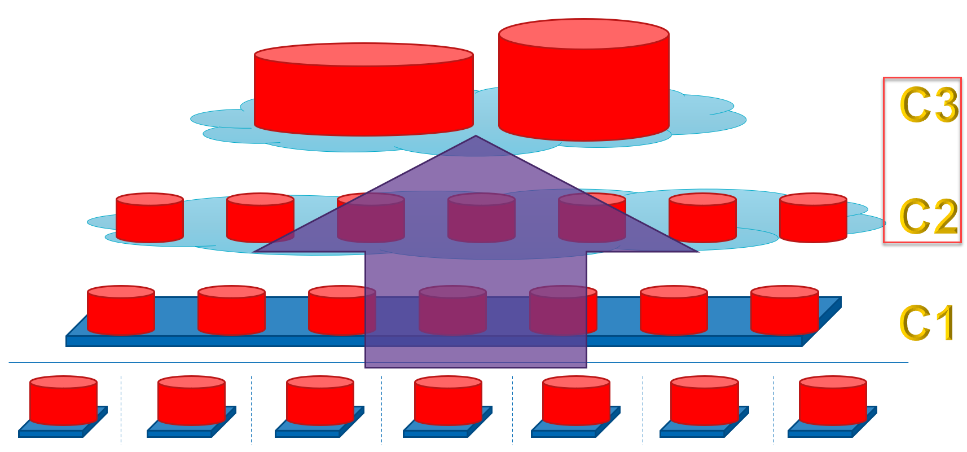
Cloudify & Consolidate
Site is no longer the only inhabitant of the database
Shared objects or unique names: pipe, alert, Table Lock, DDL operations
Unique & Primary (and therefore Foreign) Keys extended
Indexes extended with column SITE_ID
New Table Indexes with only SITE_ID => Table Partitioning
partition (at least large, heavily accessed) tables by Site
Proxy User per site – site specific credentials
used in ON LOGON trigger to set Site Identifier in Application Context
Sequences set to highest value in any of the imported databases
Single Record Table (max_trans = 2)
In Cloud no access allowed from database to environment
abandon utl_file, DIRECTORY, utl_tcp, utl_http, External Table

Slide 14

Example: Process Status Table
Local: Single Record Table to indicate actual status of core process
every step in single, sequential process updates the record
Consolidated: 20-50 record table (that all fit in one or a few data blocks)
how many transactions can concurrently take place on this table?
INIT_TRANS and MAX_TRANS settings govern the number of transactions that can concurrently have locks on a data block
default = 2
Job - update process status every few seconds
Job
In local SITE database, this table has a single record and fits into a single database block
Table Process_Status

Slide 15
Alternative Implementation
View uses Table Function to retrieve all process status records
select * from table(process_status_handler.get_statuses)
Session 1 / site 15
View
Process_Status
Session 2 / site 27
DML statements are intercepted and turned into PL/SQL calls to process_status_handler to manipulate application context
Instead Of (DML) Trigger
Session 3 / site 39
Session 4 / site 41
PL/SQL package
Proces_Status_Handler
Job – every X seconds – writes current Application context to table
Job
Archive in case the database goes down. Global Application Context is recovered during database startup
In memory cache – global across the database instance – that holds the current process status for each site
Global Application Context
status 15
status 41
Table Process_Status_backup
status 27
status 39
status 52
Notes:
Alternative implementation:
Process Status held in memory – global application context
Table replaced with View
query against table function that retrieves data from app context
I/O trigger on View to intercept DML and write to app context
No locks, no transaction, global memory
when database dies, status information dies with it
optional: background job every 5 seconds to write contents of app context to background table

Slide 16

Exploring & Demonstrating Consolidated Database Performance
Will the consolidated database(s) be able to provide performance on par with today’s local on-site behavior?
How many consolidated, central database instances will be required
and what will the sizing be of VMs and Databases?
Strategies
Scale Up - vertical
Scale Out – horizontal
Tune, Redesign, Refactor, leverage “performance enhancing features” (for example materialized views, in memory database, move read only workload to standby database)
We require flexibility in scale (aka elasticity)
Uncertainty regarding performance after migration
Variable load (daily, seasonal, incidents)
Future growth (organic & through acquisitions)

Slide 17

Elasticity – Scale Up and Down
Increase VM Shape
CPU, Memory, #IOPS, I/O Throughput, Storage Size & Speed, Network Connections & Bandwidth
Scale Up Application Server and Database
No impact on application code or configuration
Substantial impact on price
VM cost
Software License cost
Limited by the VM shapes on (affordable) offer
there are boundaries
All eggs in one basket?

Slide 18

Elasticity – Scale Out and In
Add VM instances
with additional Database and App Server instances
Move data to new database instance
Move jobs to different app servers, move UI apps to different UI app servers
Reconfigure Job definitions – for different sets of sites
Update routing rules – site go to different app server
Impact
spread the workload
distribute risk (impact of any database failing)
increase license and cloud resource fees ?
increase DBA/Ops effort ?
Scaling from one to two is hard, beyond that it is quite straightforward
Reverse Proxy
UI App A
UI App A
UI App B

Slide 19
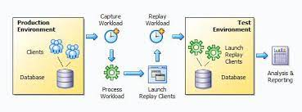
Load Test with Realistic Workload
How to put a realistic load on the consolidated database?
the same combination of SQL statements and PL/SQL activities as locally on site
scaling the load to a multifold of the single site load – 10-30 times the local load
Oracle Real Application Testing
Capture workload in live database (filtering out specific users)
Replay workload on any target database
stretch in and out (elastic time)
scale up the replayed workload (run multiple workloads in parallel)
Analyze the actual performance of the replay
resource usage, errors, bottlenecks, query timings, AWR, ASH reports

Slide 20
How to run workloads for dozens of sites (from only three RAT captures and three data sets)
A special Consolidated Performance Test Database has been set up
Based on data sets from three sites, data has been created for X sites
RAT recordings have been made on three production sites: 1516, 3036 and 5805 – from July 29th, 16:00 hours until July 30th, 16:00
RAT Recordings are replayed through a site-specific database service against the consolidated database and executed in the VPD for the site derived from the database service
RAT is used to replay each of the workloads multiple times. All replays take place through different site specific database service names
RAT was used to capture 24h workload in three Site DBs
Site DB
TEST DB
Data was loaded from three sites. All records have been duplicated several times for different site: SITE_ID is changed in each copy
RAT
Site DB
Logon Trigger
Tables
SIte DB
Logon trigger sets SITE_ID in Application Context based on database service name used by RAT. All RAT sessions run in different VPDs

Slide 21
Challenges in Achieving Proper RAT Results
VM and Database configuration for running RAT
disk size, flashback area, file system interaction
overhead caused by RAT tooling itself
Running tests takes a long time (to prepare and process)
EMCC 13c (Enterprise Manager Cloud Control)
Determining meaningful results is not trivial
from RAT reports
from ASH, AWR, SQL Tuning Set
Additional option: while the RAT workload is replayed – run a simple periodic load test with some indicative queries (using JMeter for example) and measure the execution times (that ran in the context of representative workload)
Database Workload not suited for concurrent execution (refactoring required)
Missing indexes on foreign keys
Lock Table
Create and Drop Table
Update Single Data Block table
Use of isolated objects in non-isolated environment: pipe & alert
Write logging through UTL_FILE

Slide 22
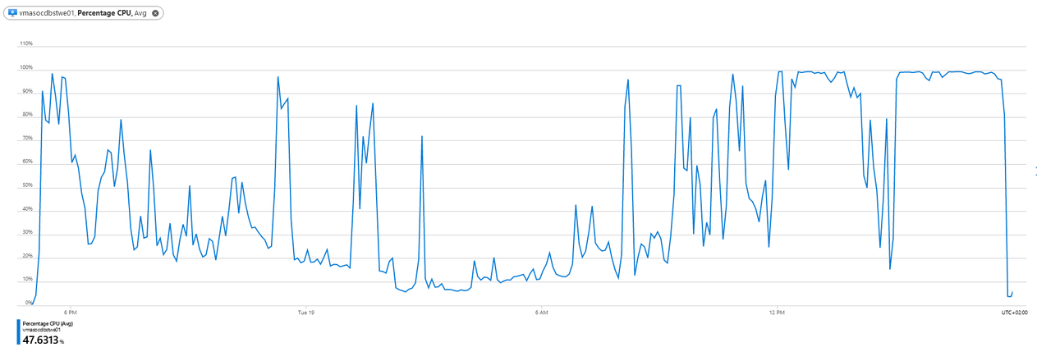
RAT Approach
Run multiple tests to mutually compare
Run workloads for an increasing number of sites
Run workloads on a number of VM shapes
CPU, Memory, IOPS and throughput/bandwidth, disk size and mapped Database configuration settings (SGA, PGA, UGA, #processes, parallel_max_servers)
Run workloads with various database design and code refactorings and workarounds
Disable dbms_alert, apply Table Partitioning, comment out utl_file calls
Determine performance for each workload from
database resource usage metrics (cpu, disk io, IO wait time)
query & transaction performance (execution time and throughput)
Our aim: determine the number of sites that we can support in a single VM / Database instance (with reasonable shape)
and calculate the total number of instances required for 120 (now) and 200 (later) sites
show a (linear) relationship between the number of sites and the performance and between the VM shape and the performance for a fixed number of sites
determine the bottleneck factor(s) at play

Slide 23
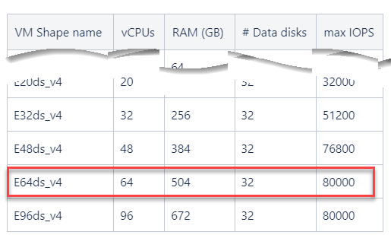
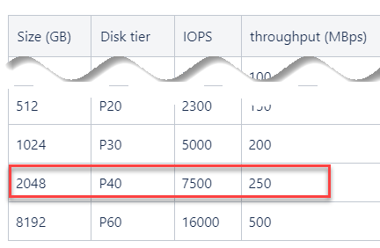
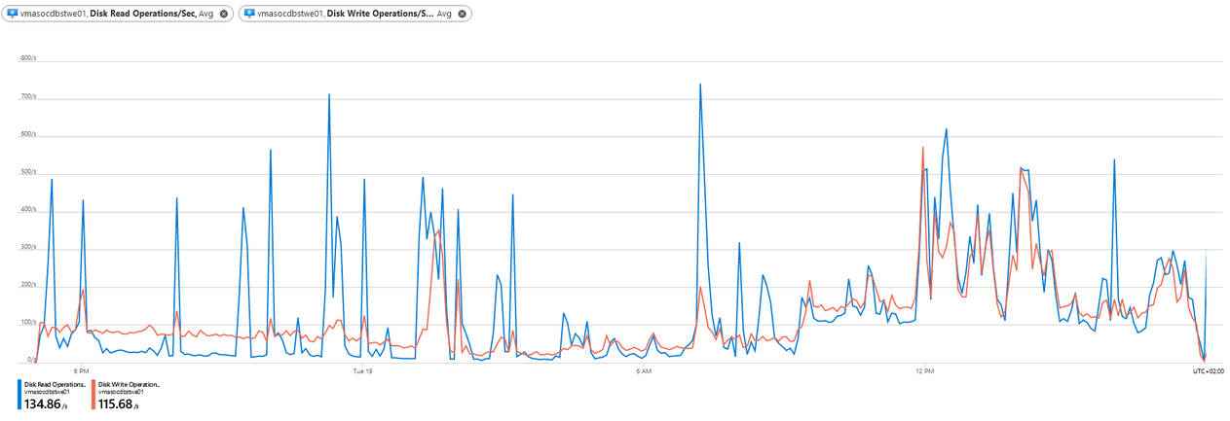
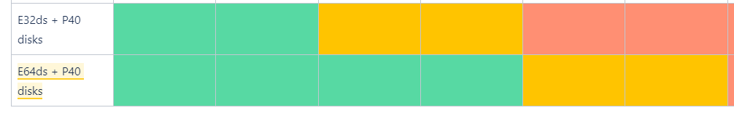
RAT Findings
Findings
without any refactoring and code improvements
20-30 sites in a single Database instance
VM shape: E64ds (64 vCPU, 504 GB) + P40 disks
2.3 (?) Azure vCore per site
Bottlenecks
CPU
IOPS
disk size (from logging written through utl_file)
20 sites
30 sites
40 sites

Slide 24
Lots of Opportunities for Improvement – to host more sites in a single database instance
optimizations without application impact
partitioning of tables
index design (add, refine, remove indexes, partitioning of indexes - auto index design)
execution plan optimizations for bottleneck actions
Materialized Views (for heavily queried datasets)
in memory database option (for heavily queried datasets)
resource plans (and consumer groups) to assign resources to high priority jobs
explicitly work with generic data - remove data records shared across site
clean up redundant/discarded data
scale up of VM shape & DB configuration (IOPS, memory, CPU, SGA, parallelization, # processes..)
optimizations with some application impact
purge redundant data and/or archive cold data in external storage (NoSQL, Azure Blob)
spread jobs differently over the day (to reduce peaks)
using standby databases in read only mode – to reduce the load on the primary database, achieve higher overall performance and even allow us a smaller VM shape for all databases (license consequences)
remove unused objects
rewriting SQL query (of poorly performing queries)
code optimization (remove usage of shared resources - alerts, pipes, DDL, table locks)
BO App job consolidation across multiple sites (make jobs process multiple sites at once)

Slide 25

Consolidate Daemons and Jobs
Existing Daemons and Jobs run for a single site
After centralizing, site specific Daemons & Jobs run in parallel/sequentially
hitting the database all at once (?)
note: they need to have unique names
No benefit of Set Level Processing in Database
Scaling can be achieved by consolidating daemons and jobs:
make them run for multiple sites (instead of just one)
fewer daemons and jobs
SQL set query and DML (instead of single record)

Slide 26
Application Server Scripts, Daemons & Jobs
Local Setup – specific to one site
(only) desired version of each of 50+ applications installed (shell, binary compiled from C++, Perl, SQL, PL/SQL)
Hard coded directories & credentials in code
Configuration Files
Data Directories
Daemons & scheduled Jobs – process all
Central App Server with all sites consolidated
all [in use] versions of all applications are installed
no hard coded location/configuration references anywhere– refer to environment variables
database connection based on Oracle Wallet and TNS_ADMIN environment variable
site specific data directories – referred to through environment variables
run daemons and jobs per site (or better yet: consolidate across all sites)
unique name
site specific settings for environment variables (application version directories, TNS_ADMIN, data directories)

Slide 27

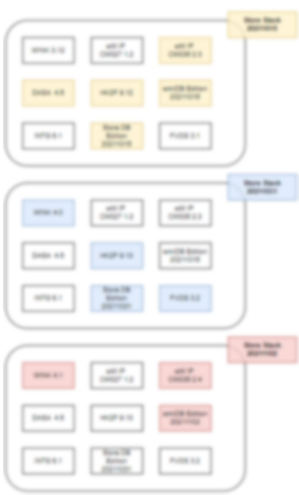
Change Management
Design principles for change management process: low risk, fine grained control, high flexibility, high degree of automation, minimal downtime and efficient usage of cloud resources
A new release (bundle of application versions at a certain cut-off date) should not be rolled out at once, big bang to all sites
controlled multi-stage rollout – with one or some, several and many (or all) sites adopting a new release at different moments
Roll out of a release should have minimal impact and cause minimal downtime
discern between the installation & configuration of new versions and the activation of new versions for sites
A roll out can easily be undone
sites can be moved between versions quickly and easily

Slide 28
Multiple application versions co-exist
Not all sites are on the same application version
Multiple versions of each application coexist on app server
Not all sites use the same versions of database objects (canary site, early adopter, laggard)
different versions of Packages, Types and Views
requiring evolved definitions of Tables
How can we support multiple “database releases” to coexist within the same multi-site consolidated database?
so we do not have to move sites between databases?

Slide 29
Introducing Oracle Database Edition Based Redefinition (EBR)
Edition Based Redefinition EBR – introduced in Oracle Database 11gR2 (2012) (created to support zero down-time roll out of new releases of Oracle eBusiness Suite)
free feature in all flavors of Oracle Database
Editions add a “release” dimension to the database – orthogonal to schemas
an edition is a collection of database objects ( object_name, object_type and schema)
in an editioned database, the full coordinates of a database object become ( object_name, object_type, schema, edition)
two editions can contain different versions of a database object (package, view, type, synonym, function)
each session runs in a specific edition – this current edition determines which version of each database object is used (during name resolution as part of statement parsing)

Slide 30
Oracle Database Name Resolution
When a Statement is Parsed or Evaluated – Name Resolution determines which database objects to access
For example:
begin X(42); end;
Oracle Database has to decide what exactly X is (name resolution)
PL/SQL unit in current user’s schema (or the schema of the schema set with alter session set current schema)
private synonym (in current schema) and the associated object it refers to – which can be a PL/SQL unit or synonym
public synonym and the associated object it refers to – which can be a PL/SQL unit or another synonym
alter session set current_schema C
begin x(42); end;
alter session set current_schema B
begin x(42); end;
alter session set current_schema D
begin x(42); end;
Schema C
Schema A
Procedure X
Procedure X
Schema B
Schema D
Public Synonym X
Synonym X

Slide 31
Oracle Database Name Resolution
Name Resolution in editioned database uses Current Edition to determine the Object Version
For example:
begin X(42); end;
Oracle Database has to decide what exactly X is (name resolution)
PL/SQL unit in current user’s schema (or the schema of the schema set with alter session set current schema)
private synonym (in current schema) and the associated object it refers to – which can be a PL/SQL unit or synonym
public synonym and the associated object it refers to – which can be a PL/SQL unit or another synonym
in an editioned database, name resolution also needs to check which version of the object lives in the current edition
alter session set current_schema C
alter session set edition = R3
begin x(42); end;
alter session set current_schema B alter session set edition = R2
begin x(42); end;
alter session set current_schema D
begin x(42); end;
Schema C
Schema A
Schema B
Procedure X
Edition R2
Procedure X
(1.1)
Schema D
Synonym X
Edition R2
Procedure X (1.2)
Public Synonym X (2.0)
Edition R3
Edition R3
Public Synonym X (3.0)

Slide 32
Oracle Database Name Resolution
Database object versions in a “site release” are in a database edition
a database edition inherits all object versions from its predecessor – then overwrites this inheritance with its own specific changes
Tables are outside editions - there is only one version of a table
table changes must be backward compatible
Advanced: There can be multiple versions of data records (domain values, configuration data, …)
add an “edition from” and an “edition until” column to each table that contains versioned data
define a VPD policy on the table with a filter that checks the current edition vs these edition columns
Edition R1
Procedure X
(1.0)
View Y
(1.0)
Package Z
(1.0)
Type Q
(1.0)
Edition R2
Procedure X
(1.1)
Edition R3
Procedure X (1.2)
Package Z
(1.1)
Type Q
(1.0)
Table B
Sequence K
Table A

Slide 33
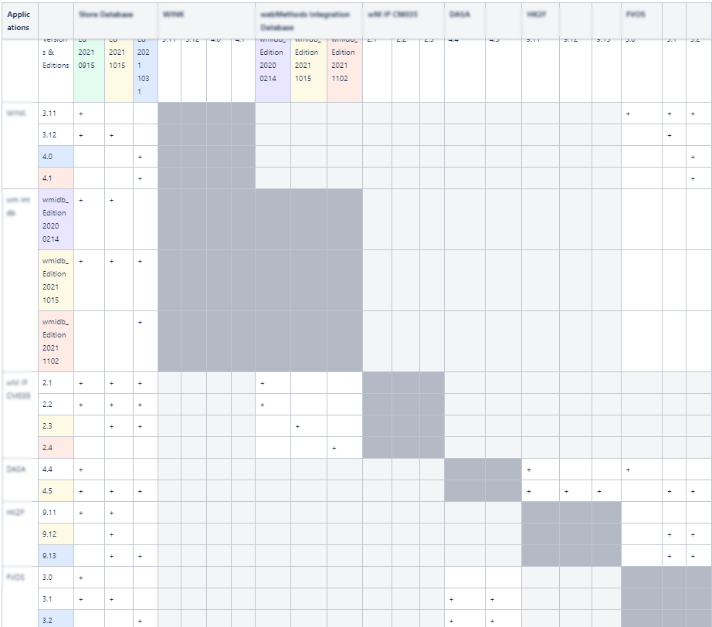
Working with Database Editions to Support Multiple Releases from a Single Database
Site 44
Each site is associated with one specific database edition
all database actions performed for that site are done in the context of that edition
Each site uses one specific version of each application
the application versions used by the site must be compatible with the site’s database edition and with each other
The application version & database compatibility matrix (“what can go together”) is crucial in managing the mutual compatibilities
APP R- 3.0
APP P - 1.3
APP S - 1.0
Edition R2
APP Q - 1.2
APP P - 1.3
APP Q - 1.1
APP R – 2.0
APP S - 1.0
APP P - 1.3
APP R- 3.0
APP P - 1.3
APP Q - 1.2
APP R – 3.1
APP P - 1.3
APP S - 1.1
Edition R1
Edition R2
Edition R3
Table A
Table B
Application version compatibility matrix

Slide 34
UI Application: each UI App version can work with one (or more) database editions
Site 1
Site 38
Site 44
Site 101
Site 66
Site 110
local
central
UI App A 1.2
UI App Server
UI App A 1.3
UI App A
UI App B
UI App A 1.4
Ed 3
Ed 4
Ed 5
sites 1-30, 104
sites 52-88, 104-115
sites 31-51, 100-103

Slide 35
UI Application – Routing, Versions and Editions
Site 1
Site 38
Site 44
Site 101
Site 66
Site 110
Site specific URLs for the UI App
local
Reverse Proxy
central
routing
rules
UI App Server
UI App Server
UI App Server
UI App Server
Stored procedure call to DB to pass Site Identifier for VPD
UI App A
1.2
UI App A
1.2
UI App A
1.3
UI App A
1.4
Ed 3
Ed 3
Database Connection associated with Database Edition
Ed 5
Ed 4
Ed 4
Ed 3
Ed 5
Ed 5
sites 1-30, 104
Ed 4
sites 52-88, 104-115
sites 31-51, 100-103

Slide 36

Not All Sites are Created Equal Using Feature Toggles to Cater for “Same Software, Different Behavior”
The desired behavior of software can differ across sites
location, type of site …
participation in a business pilot – trying out new services, devices, products, ways of working (for a short or longer period of time)
All types of sites run the same software
the desired difference in behavior is achieved through feature toggles in the software
A feature toggle consists of the combination of conditional behavior in the code and the check on the condition (toggle on or off?)
if < feature toggle X enabled> then < do this > else < do that or do nothing>
Whether or not a toggle is enabled at a given moment in time can depend on
location or type of site
site participation in a pilot
current time/date
…?

Slide 37
Change Management Process
Release
Initial Rollout
Next Rollout
Test/Accept
Prepare/Install
Smoke Test/Use
R4.6
APP R- 3.0
Edition R2
APP P - 1.3
APP S - 1.0
APP Q - 1.2
Prior to Release
designate application & database object versions to ship
establish mutual compatibility between all versions in the release
and backwards compatibility from earlier releases still supported for sites (the new stuff should not break any existing still in use)
note: all database table changes are backwards compatible
Prepare release on Production environment
Build up a new UI App Server with the new UI App version
Install new background application versions on App Server – next to existing
Create new Database Edition and create new versions of database objects
note: no one is using any of the new things
Initial roll out – for a test or dummy site or a real site canary release
Generate Reverse Proxy routing rules that will route users on site to new UI App version
Generate App Server symbolic links and environment variables for site to use new App versions & DB edition
Update site to database edition mapping records – to associate site with new DB edition
Once success is confirmed, repeat for additional sites
In case of failure, reverse the steps to roll site back to original release

Slide 38
Summary & Conclusions
[20 years of accumulated] Technical Debt catches up with us
hard coded values, lack of automated regression tests, old technology (and no more skills), lack of documentation (how, what, why), limited application portfolio/life cycle management (which applications & features are still in use; dependencies between applications)
Many refactor opportunities
to reduce complexity and increase maintainability, improve performance, reduce operational effort, reduce cloud resource usage
Know the out-of-the-box (or easily purchasable) mechanisms of the Oracle Database

Slide 39
Applied Oracle Database features
Feature | Since | License / Cost | Purpose
Virtual Private Database | 8i | every edition, no cost option | Fine grained (row level) access control
Database Link | ? (< 7) | every edition, no cost option | SQL against other Oracle Databases
Instead Of Trigger | 8.0 | every edition, no cost option | Handle DML statements against Views
Table Function | 9iR1 | every edition, no cost option | Create View on top of PL/SQL Function i/o table or view
Proxy User | 9iR2 | every edition, no cost option | Light-weight, schema-less database user
Application Context (session or global) | 8i | every edition, no cost option | In memory data cache
Logon Trigger | 8i | every edition, no cost option | Programmatic intercept Database Session initialization
Real Application Testing | 11gR1 | separate license | Capture and Replay actual database workload
Sharding | 12cR2 | EE up to 3 shards; >3: Active Data Guard, RAC or Golden Gate | Physically partition Oracle Database in shards – allowing cross shard operations as if on a single logical database
Table Partitioning | 8.0, 9i | Partitioning Option | Physically partition table data – improve query & DML
Multitenant (PDBs) | 12cR1 | every, no cost up to 3PDBs | Consolidated DBA across PDBs – including clone DB
Edition Based Redefinition | 11gR2 | every edition, no cost option | Zero down time application upgrades [by supporting multiple parallel releases of database objects]

Slide 40
Summary & Conclusions
[20 years of accumulated] Technical Debt catches up with us
hard coded values, lack of automated regression tests, old technology (and no more skills), lack of documentation (how, what, why), limited application portfolio/life cycle management (which applications & features are still in use; dependencies between applications)
Many refactor opportunities
to reduce complexity and increase maintainability, improve performance, reduce operational effort, reduce cloud resource usage
Know the out-of-the-box (or easily purchasable) mechanisms of the Oracle Database
Decoupling – between sites, applications, application & database, application & environment
to allow (independent) scaling, fine grained release rollout, implementation changes
Steppingstone for short term gains and longer term innovation & improvement
paid for from cost reduction in hardware & software (and reduced OPS effort)
Controlled Migration: add sites, move jobs, migrate UI apps
Network is pivotal (capacity & stability)
some application offline capabilities maybe required

Slide 41
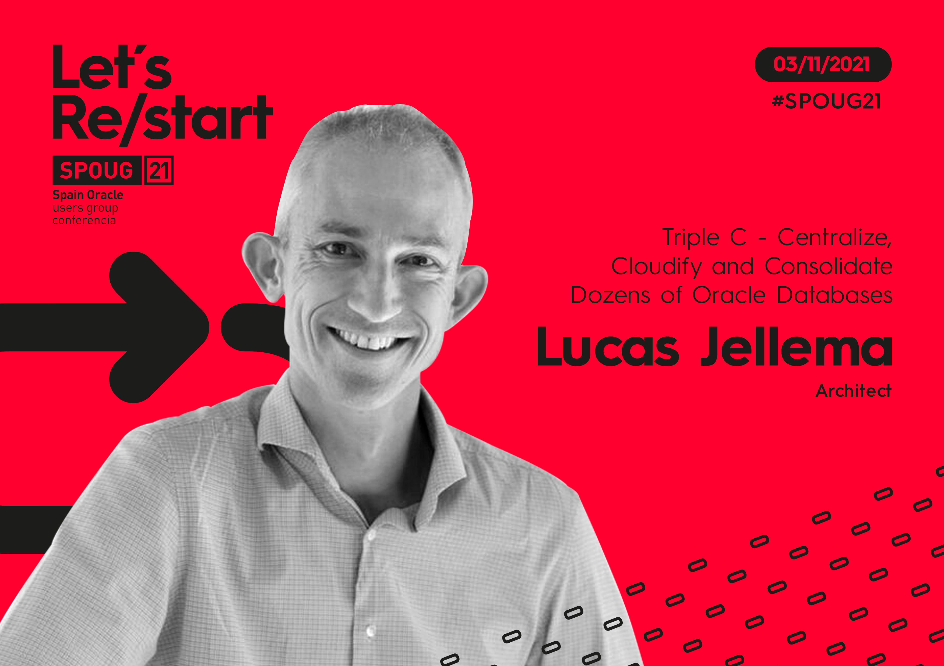
Muchas Gracias
lucas.jellema@amis.nl | technology.amis.nl | @lucasjellema | lucas-jellema

