Slide 1




Six Virtual Developer Meetups
Wednesday June 17th – Functions
http://bit.ly/real-oci
Cloud Native Application Development on Oracle Cloud Platform
Rolando Carrasco
Lucas Jellema
Project Fn | Polyglot Functions | Functions on OCI | API Gateway |

Slide 2
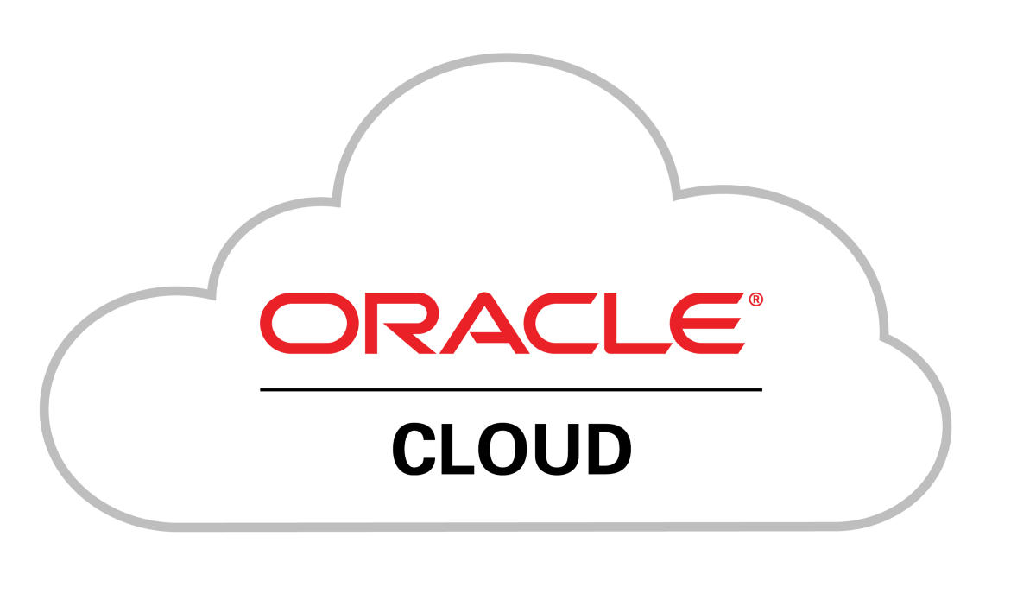

See
Hear
Native Application Development
Do

Slide 3
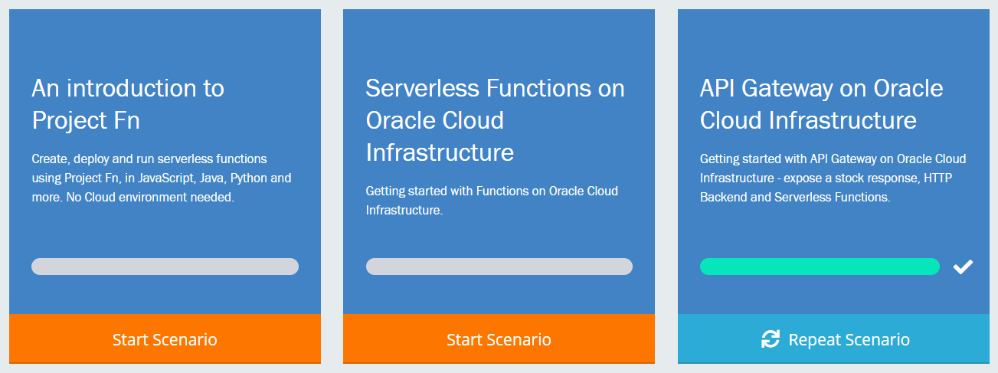

Touring Oracle Cloud services for cloud native application development
Introduction
Demonstration
Guided Handson Labs
Q&A
All sessions are recorded and will be available for replay

Slide 4

http://bit.ly/real-oci

Slide 5
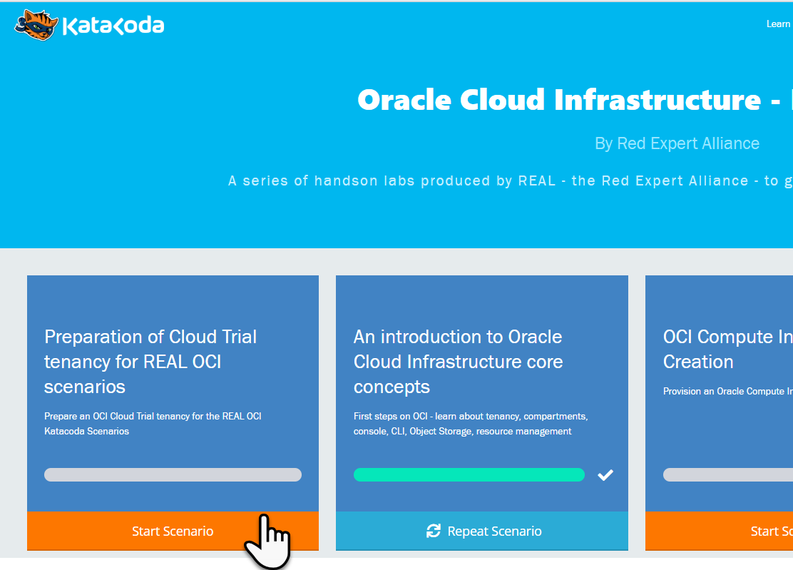
Preparation for the Katacoda Hands-On Labs
Arrange access to Oracle Cloud Infrastructure Tenancy
Existing or new OCI Cloud Trial
Existing OCI tenancy
Go to http://bit.ly/real-oci home of the REAL Katacoda scenarios for OCI
Run First Scenario to prepare the OCI tenancy for REAL Katacoda OCI Scenarios
Provision an OCI compartment and some resources
Prepare auth token, key pair and config file for using the OCI CLI in other scenarios
Go http://bit.ly/real-oci

Slide 6

Cloud Trial as Registered Webinar Attendee
cloud.oracle.com/tryit
Signup for Cloud Trial with same email address as used for webinar registration
Use a company email address (not gmail or hotmail); do not use an address already used for an Oracle Cloud Trial
Do not use credit card – because email is whitelisted (as of tomorrow, June 11th)
You will get
$500 credits on (discounted) Oacle cloud services
Access to always Free Tier

Slide 7
The Prepared Tenancy
Security
Group
VCN
vcn-lab
Tag Namespace
lab-tags
IGW
Public Subnet-vcn-lab
Private Subnet-vcn-lab
policies
API Gateway
lab-apigw
Dynamic Group
lab-apigw-dynamic-group
Stream
lab-stream
Compartment – lab-compartment

Slide 8

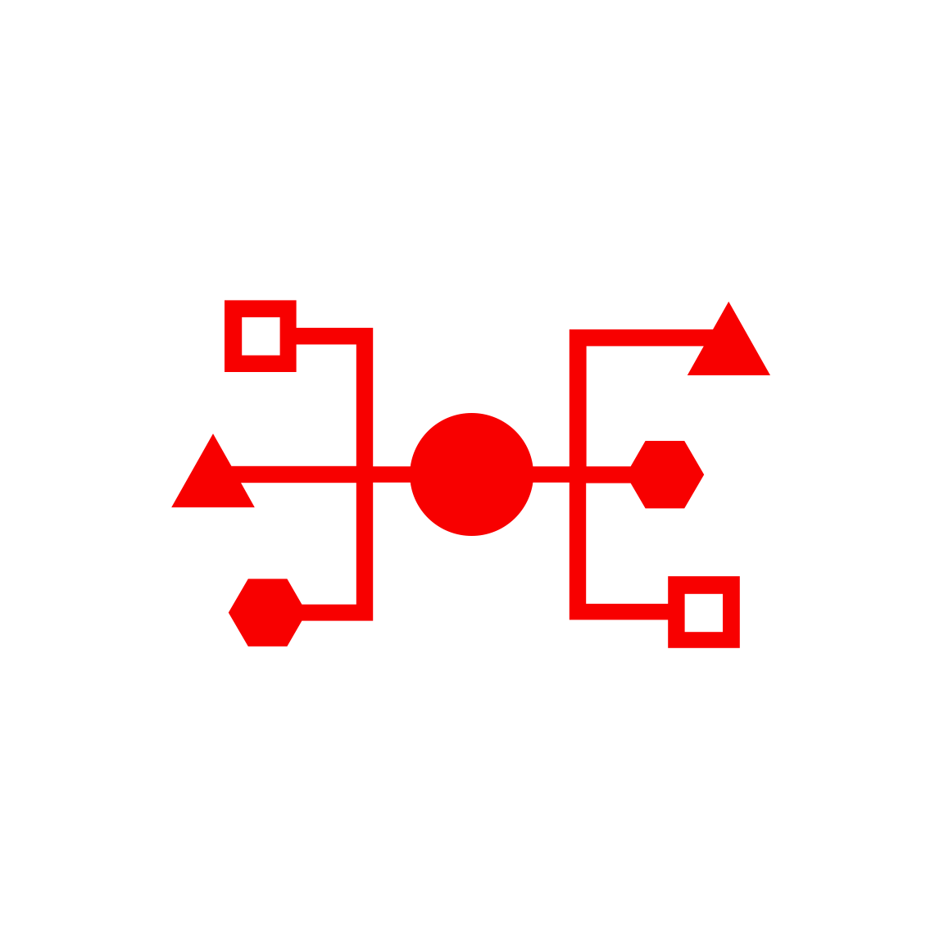


Health Check
Monitoring
Logging
Alarms
Notifi-cations
OCI Services for Cloud Native Application Development
API Gateway
Functions
Streaming
Digital Assistant
NoSQL Database
Object Storage
OKE – Managed Kubernetes
Container
Container
OCIR
ID & Access
Management
Tagging
Compartments
API/Service
Events
Resource
Manager
Search
Compute

Slide 9

Serverless Functions
Project Fn
Open Source
Docker based
Runs anywhere – including (but not only) cloud based
Development done with a CLI and a local Server
Out of the box support for various runtimes
Java, JavaScript, Python, Go, Ruby
Support for any Docker Image
Every Function is built upon deployment into a Docker Container Image
Function instances are running containers based on such images
Triggered by HTTP requests
Cluster functions in applications
Support Configuration Settings on Functions and Applications
Provided to function as environment variable

Slide 10

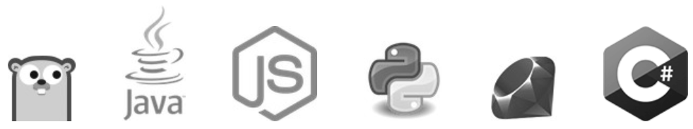

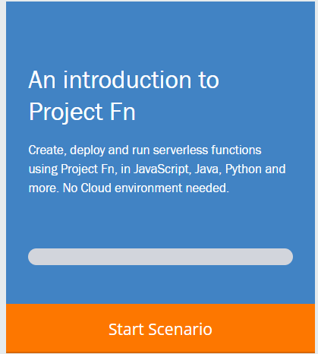
Why and What a Katacoda Scenario for Project Fn?
The Container Native Serverless Framework
Project Fn is an open source FaaS platform that you can run anywhere -- any cloud or on-premise.
It implements serverless Functions through Docker containers
Out of the box support for many runtimes
Also support for custom Docker Container
Project Fn is the foundation for Serverless Functions on OCI
Get your environment ready: Fn CLI, Fn Server (no OCI CLI)
Create a function and an application
Deploy a function and run a function
Function implemented with Custom Docker Container
Function based on GraalVM powered Java native image

Slide 11

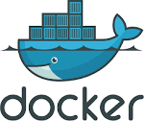
Fn Functions – request handling
With method, headers, query parameters, url path, body
Function
FDK
HTTP Request
Function Implementation (Node, Java, Go, Python, custom Docker, …)
input – derived from body
ctx – raw HTTP request components

Slide 12
Demo

Slide 13
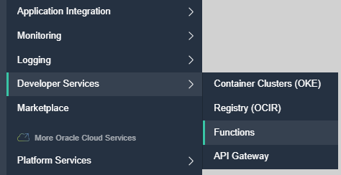
Oracle Functions
Functions on OCI – based on Fn
Oracle is one of the Fn providers
Function Container Images are stored in OCI Container Registry
Triggers can be:
HTTP Requests
OCI Events
API Gateway calls
OCI gathers logs (on OCI Object Storage) and metrics
A function instance will be removed after 5-10 minutes of inactivity
Note: an instance can handle multiple requests

Slide 14
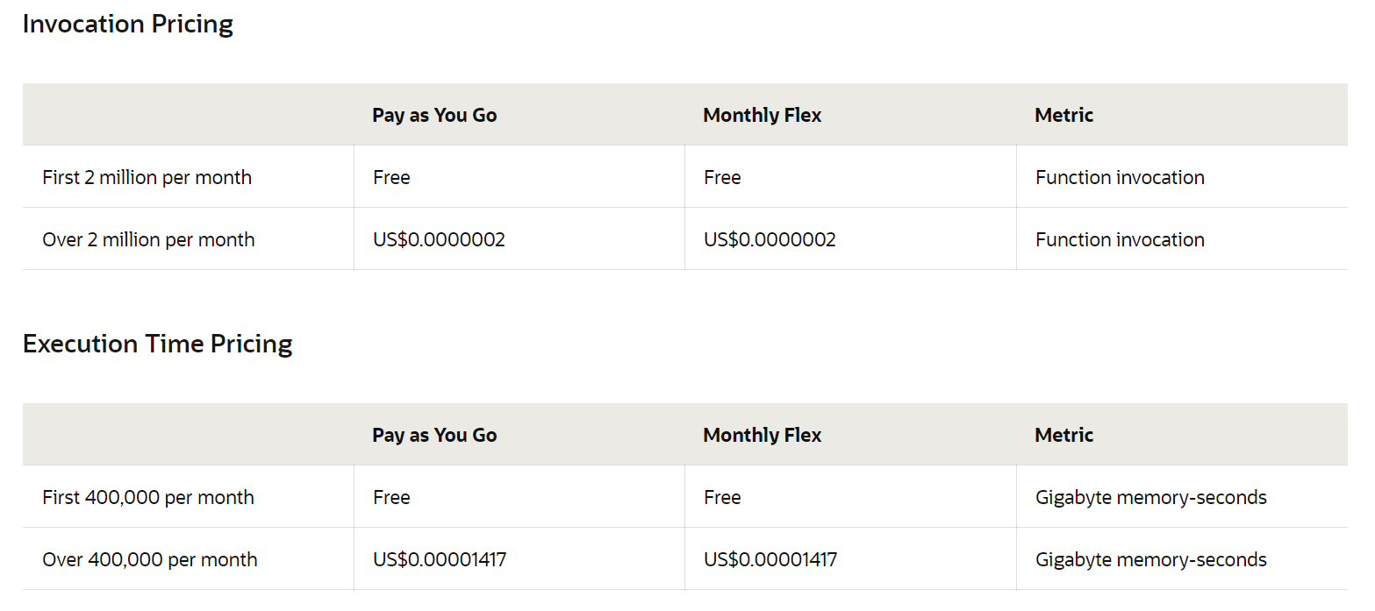
OCI Functions - Pricing

Slide 15
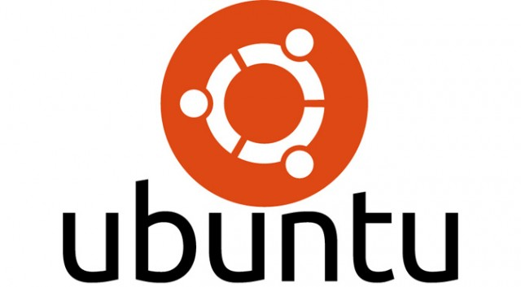
Oracle Cloud Infrastructure
invoke
Application
invoke
Function
OCIR
Project Fn
Container Image for Function
oci fn function invoke …
oci raw-request …
deploy
OCI Config
Docker Container with Function & Runtime
OCI CLI
Docker
Ubuntu 19.04 Guest (on Katacoda)

Slide 16
Why and What a Katacoda Scenario for Oracle Functions?
Very suitable for katacoda, since both the OCI CLI and FN CLI covers pretty much everything you need to work with it
FaaS is a relevant topic in Cloud Native Development
It is a very powerfull platform. Attractive in both technical and pricing
If you already have OCI, this is a Good way to start exploring functions.
If you are looking for a Serverless FaaS platform, this is a good option for you
Get your environment ready
Create a function
Deploy a function
Monitor a function
Set environment variables for your functions

Slide 17
API Gateway
Expose private endpoints publicly
Stable (public) endpoints
Routing (verb & wildcard based)
Parameter and Header mapping
Request Policies
Rate limiting (per client & general)
CORS (for direct web client access)
Metrics Monitoring & Logging
Authentication & Validation
Handle HTTP calls:
Authorize
Route
Map
Monitor/ Audit
GA was Mid December 2019
Function
Any Service Invoker
API Gateway
Stock
Any 3rd party HTTP endpoint
VM
Any HTTP Endpoint on OCI
OKE
OIC
…
Oracle Cloud Infrastructure

Slide 18
API Gateway Authorizer Function
Authorizer Function can be configured on Route or on API Deployment
Any backend – HTTP destination, Oracle Function, Stock Response – can be subject to an authorizer function
Invoke API, provide token in header
JSON returned by Authorizer Function is embedded in request to backend
Any Service Invoker
API deployment
/path
Any backend
API Gateway
Authorizer Function
Authorizer Function that allows or denies access based on Header [Token]
Oracle Cloud Infrastructure

Slide 19
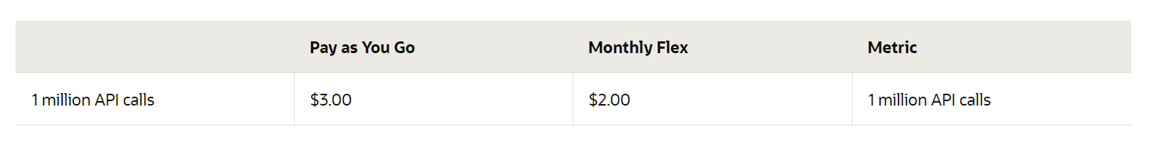
OCI API Gateway - Pricing

Slide 20
Why and What a Katacoda Scenario for OCI API Gateway?
OCI API Gateway is the consolidated and decoupled entry point to services running on OCI or on other back ends
API Gateway integrates very well with OCI Functions
Expose HTTP Access to Functions through API Gateway
API Gateway was released on December 2019
An API Gateway is a key component in a Cloud Native implementation
API Gateway provides some lean policies on Request and Response: header authorization, rate limiting, parameter mapping, monitoring, logging, CORS
Lab Environment already contains API Gateway lab_apigw
Add deployment with stock and regular HTTP backend
Integrate an Oracle Function with OCI API Gateway
Test your services
Configure the API Deployment and inspect the logging

Slide 21

Q&A and Live Handson
Ask your questions in the Zoom Q&A Window
Get your Cloud Trial:
We will stay online for the next hour to help you out with handson challenges
cloud.oracle.com/tryit
http://bit.ly/real-oci

