Slide 1
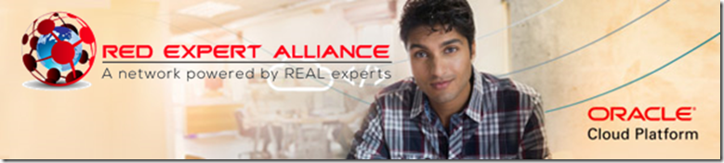



Six Virtual Developer Meetups
Wednesday June 24th – Advanced Functions
http://bit.ly/real-oci
Cloud Native Application Development on Oracle Cloud Platform
Rolando Carrasco
Lucas Jellema
Functions on OCI | API Gateway | Streaming | NoSQL Database | Object Storage

Slide 2
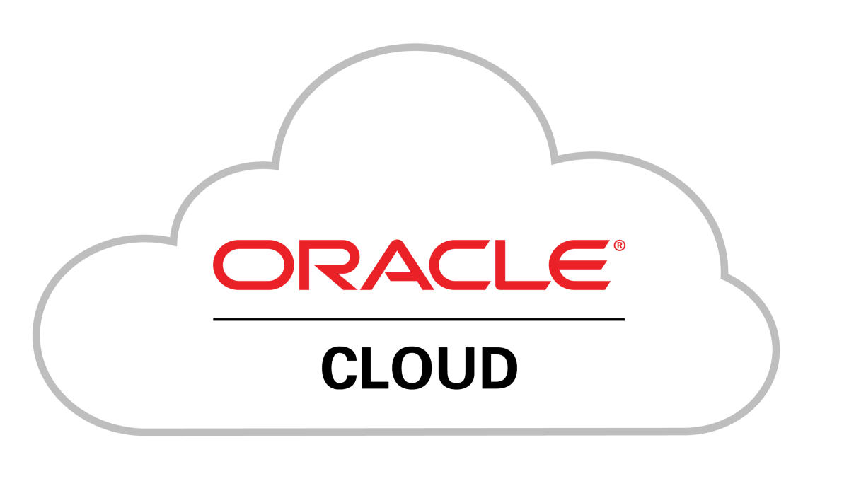

See
Hear
Native Application Development
Do

Slide 3
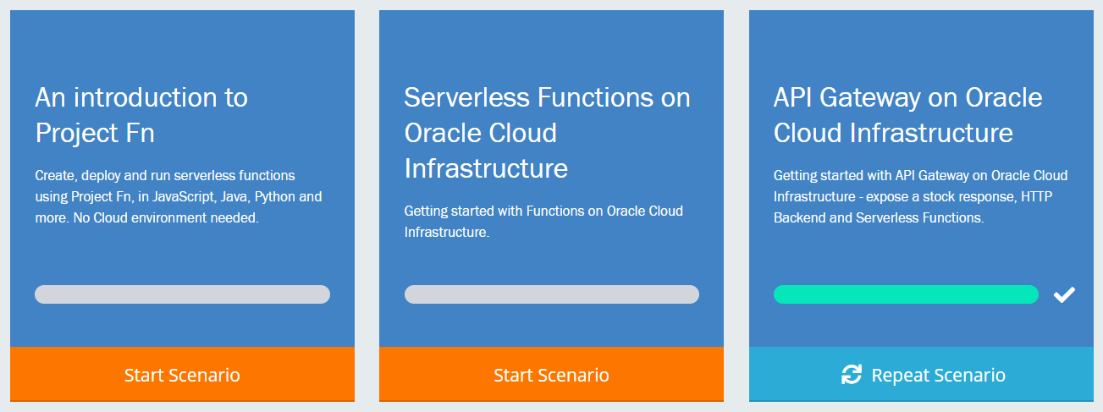

Touring Oracle Cloud services for cloud native application development
Introduction
Demonstration
Guided Handson Labs
Q&A
All sessions are recorded and will be available for replay

Slide 4

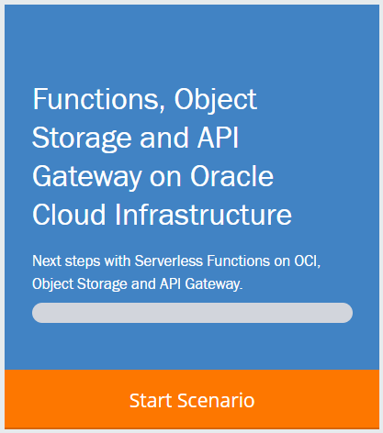
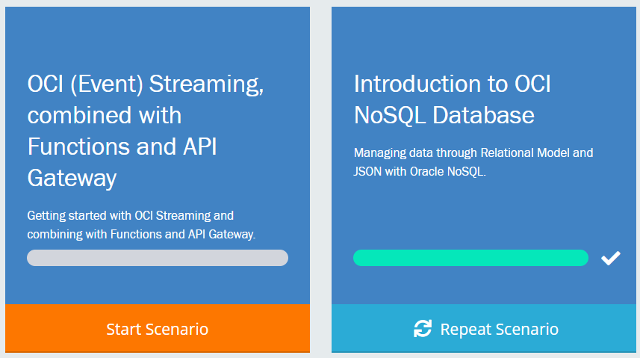
http://bit.ly/real-oci

Slide 5
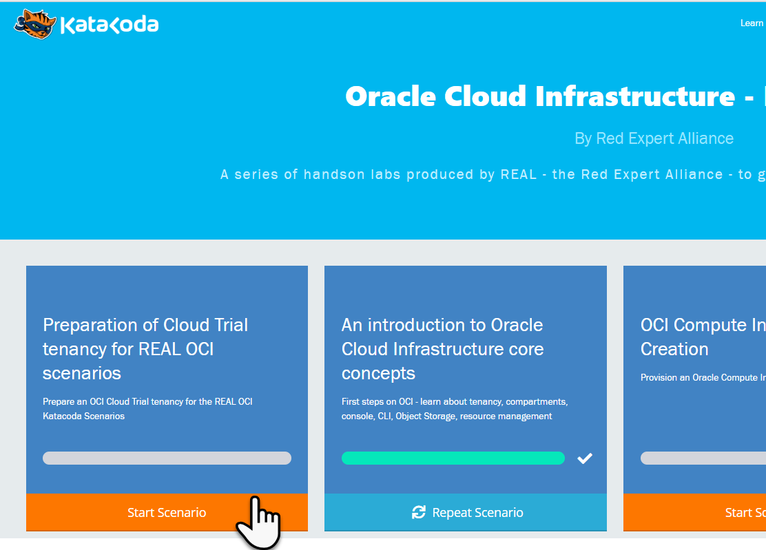
Preparation for the Katacoda Hands-On Labs
Arrange access to Oracle Cloud Infrastructure Tenancy
Existing or new OCI Cloud Trial
Existing OCI tenancy
Go to http://bit.ly/real-oci home of the REAL Katacoda scenarios for OCI
Run First Scenario to prepare the OCI tenancy for REAL Katacoda OCI Scenarios
Provision an OCI compartment and some resources
Prepare auth token, key pair and config file for using the OCI CLI in other scenarios
Go http://bit.ly/real-oci

Slide 6
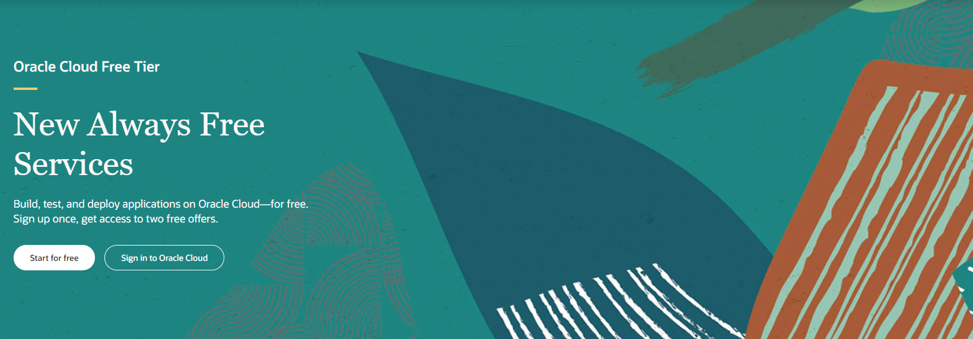
Cloud Trial as Registered Webinar Attendee
cloud.oracle.com/tryit
Signup for Cloud Trial with same email address as used for webinar registration
Use a company email address (not gmail or hotmail); do not use an address already used for an Oracle Cloud Trial
Do not use credit card – because email is whitelisted (as of tomorrow, June 11th)
You will get
$500 credits on (discounted) Oacle cloud services
Access to always Free Tier

Slide 7
The Prepared Tenancy
Security
Group
VCN
vcn-lab
Tag Namespace
lab-tags
IGW
Public Subnet-vcn-lab
Private Subnet-vcn-lab
policies
API Gateway
lab-apigw
Dynamic Group
lab-apigw-dynamic-group
Stream
lab-stream
Compartment – lab-compartment

Slide 8

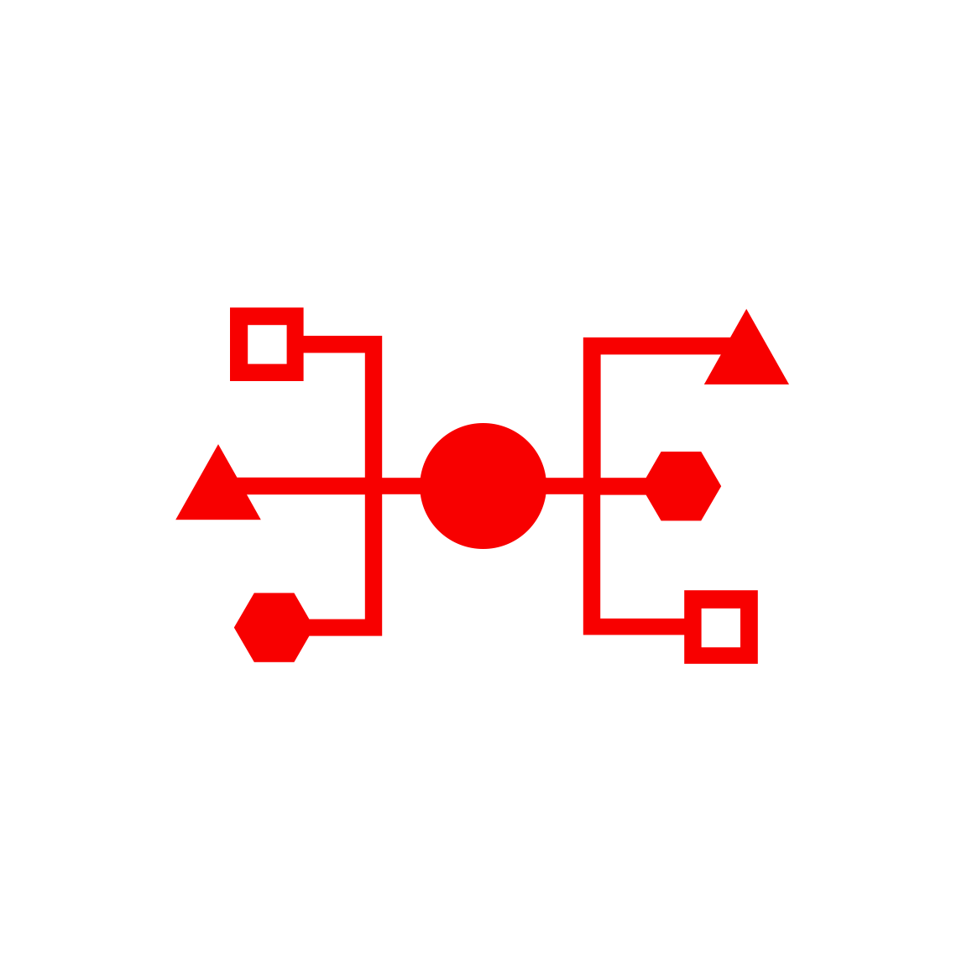


Health Check
Monitoring
Logging
Alarms
Notifi-cations
OCI Services for Cloud Native Application Development
API Gateway
Functions
Streaming
Digital Assistant
NoSQL Database
Object Storage
OKE – Managed Kubernetes
Container
Container
OCIR
ID & Access
Management
Tagging
Compartments
API/Service
Events
Resource
Manager
Search
Compute

Slide 9
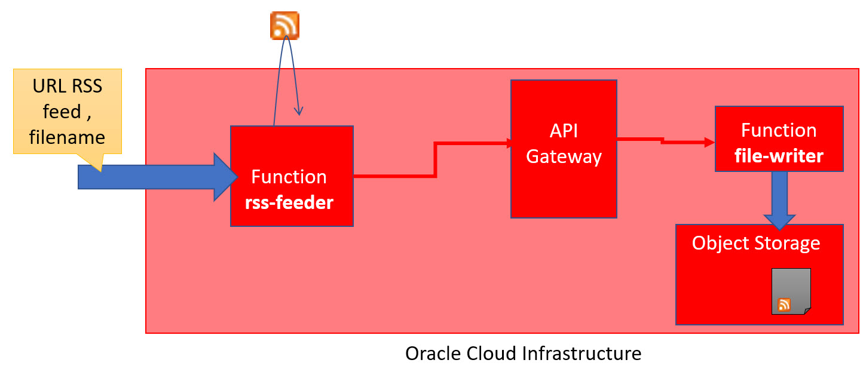
Scenario on Functions + API Gateway + Object Storage

Slide 10


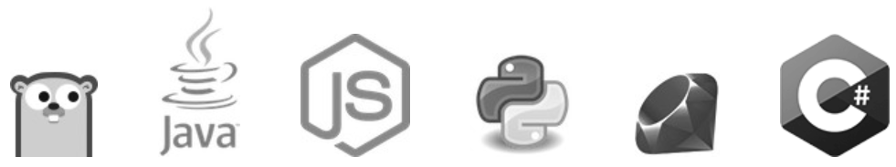
Why and What a Katacoda Scenario for Functions + API Gateway + Object Storage?
Have an integrated scenario (Functions, Node, Gateway, Storage)
Keep testing the CLI for different scenarios
Differentiate calling a function directly and via the OCI API Gateway
Show the integration between Node.JS and Object Storage
Continue using the elements of previous scenarios (API GTWY)
Automate all tasks via OCI CLI
Test Functions via CLI
Test APIs via CLI
Validate contents within the Object Storage

Slide 11
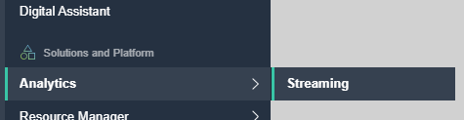
OCI Streaming Service
Kafka Like – Event Queue
Support for partitions and consumer groups
Events are Published and Consumed through REST API calls
Java SDK available
No Push to Consumer!
Oracle Cloud Infrastructure
OCI Streaming
Stream
Listener
Publisher
Listener
Listener
On prem
3rd Party Cloud

Slide 12
OCI Streaming Service
Message retrieval is done through a Cursor
Similar to a (long running) query
Cursor indicates where to read from Stream
Earliest, latest, at offset, from offset, from time
No Filter to apply upon reading
Message Retention: 7 days
Max throughput: 1 MB/s
Max message size: 1 MB
Oracle Cloud Infrastructure
cursor
OCI Streaming
Stream
Listener
Publisher
Listener
Listener
On prem
3rd Party Cloud

Slide 13
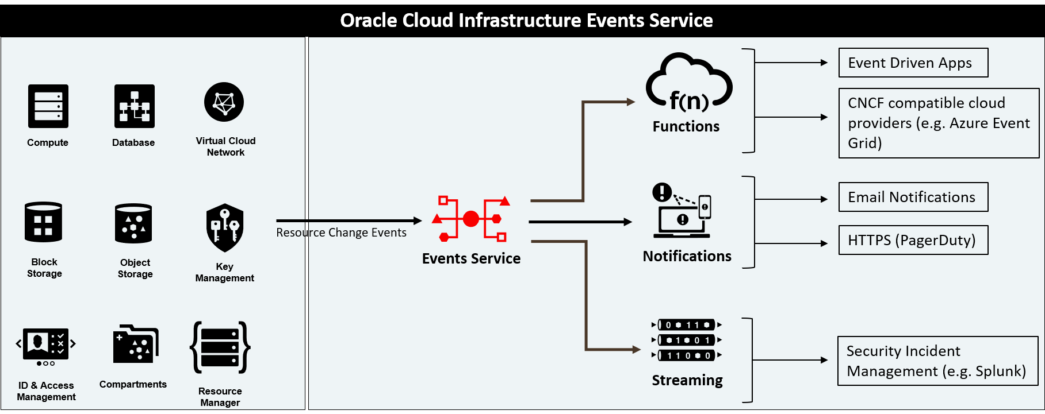
EVENTS and STREAMING SERVICES

Slide 14

OCI Streaming Service – DIY Push
Integration Cloud
Function
Function
OCI Streaming
Stream
Function Message Listener
push
API Gateway
Function
OCI Monitoring Healthcheck
Trigger Listener
Function
App
Oracle Cloud Infrastructure

Slide 15
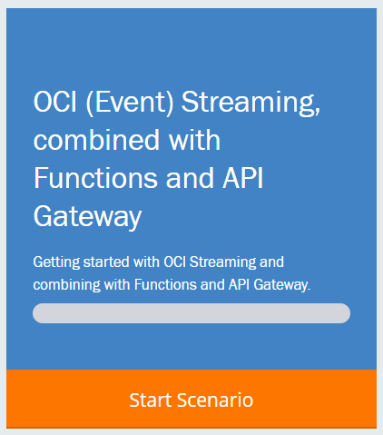
Why and What a Katacoda Scenario for OCI Streaming?
Introduce the OCI streaming service
High volume publish/subscribe messaging platform
Compatible with Apache Kafka & Kafka Connect
Integration with other OCI services – Events, Functions
Get started Streaming through OCI CLI
Create an OCI Stream
Create a Function Listener
Use OCI Monitor to check what is hapenning
Expose functions via OCI API Gateway

Slide 16
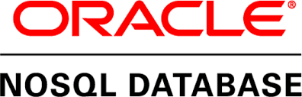
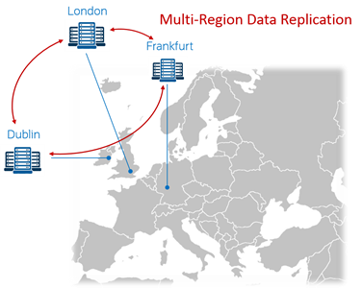
NoSQL Database Cloud Service
Launched in February 2020 – a fully managed cloud service
Based on Oracle NoSQL Database
Which itself is based on Berkeley DB as storage engine
Schemaless JSON and SQL enabled on relational data
ACID, consistent, relational, structured, joins
Partial JSON Updates
Server-side updates to JSON documents
Time-To-Live – auto-expire on records
Built-in Data Redundancy
Multi-region architecture
read-anywhere/write-anywhere in “WAN” cluster
REST APIs, OCI CLI and SDKs in Java, Python, Node and Go

Slide 17
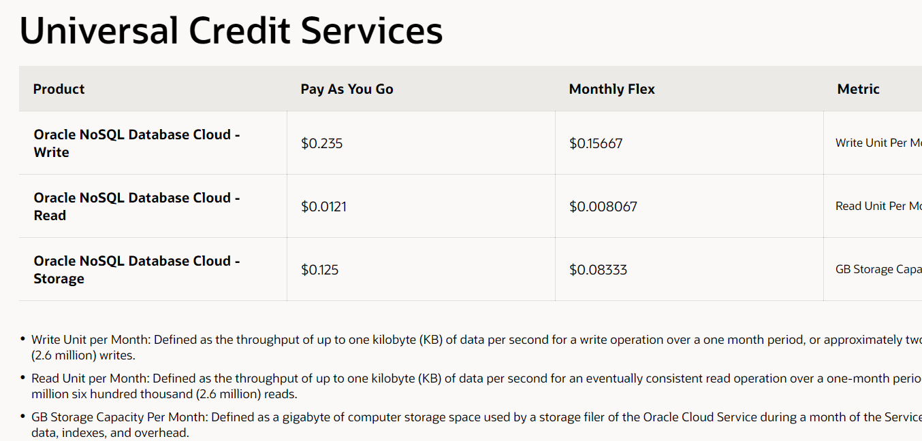

Slide 18
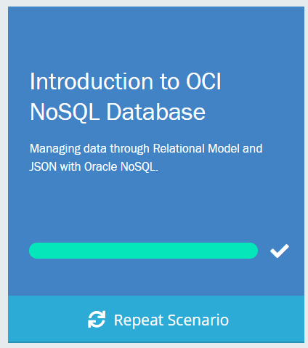
Why and What a Katacoda Scenario for NoSQL Database?
Introduce the fully managed NoSQL Database Cloud service
NoSQL Database is start small and cheap persistence solution in cloud native application architectures
NoSQL Database is global, multi-model, ACID or BASE
Introduce the OCI CLI for making a flying start with NoSQL Database service
Create Tables
Insert and Query relational records (OCI CLI & Console)
Insert and Query JSON documents
(partially) Update JSON documents
Drop tables

Slide 19

Q&A and Live Handson
Ask your questions in the Zoom Q&A Window
Get your Cloud Trial:
We will stay online for the next hour to help you out with handson challenges
cloud.oracle.com/tryit
http://bit.ly/real-oci

